Slide 1
Power Plant Engineering

Slide 2
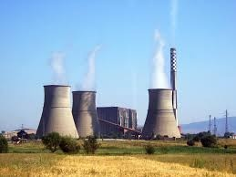
Steam Power Plant

Slide 3
Introduction
A generating station which converts heat energy of coal combustion into electrical energy is known as a steam power station.
Works on Rankine Cycle
Steam produced in boiler (usually by burning coal) is expanded in the prime mover (i.e. steam turbine)
Condensed steam is fed back to boiler again
The steam turbine drives the alternator produces electricity

Slide 4
Rankine Cycle

Slide 5
Rankine Cycle

Slide 6
Advantages and Disadvantages
Advantages
(i) The fuel (i.e., coal) used is quite cheap.
(ii) Less initial cost as compared to other generating stations.
(iii) It can be installed at any place irrespective of the existence of coal. The coal can be transported to the site of the plant by rail or road.
(iv) It requires less space as compared to the hydroelectric power station.
(v) The cost of generation is lesser than that of the diesel power station.
Disadvantages
(i) It pollutes the atmosphere due to the production of large amount of smoke and fumes.
(ii) It is costlier in running cost as compared to hydroelectric plant.

Slide 7
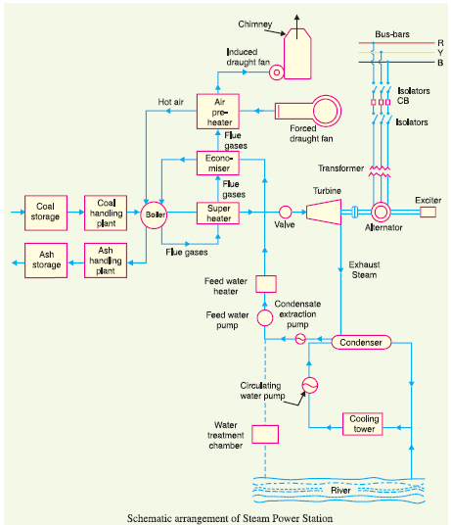
Layout of Steam Power Plant

Slide 8
Layout of Steam Power Plant
The schematic arrangement of a modern steam power station can be divided into the following stages:
Coal and ash handling plant
Steam generating plant
Steam turbine
Alternator
Feed water
Cooling arrangement

Slide 9
Coal and Ash handling plant
Coal is transported to power station by rail or road and stored in coal storage plant and then pulverized
Pulverized coal is fed to the boiler by belt conveyers
Coal gets burned in the boiler and ash produced is removed to the ash handling plant and then delivered to ash storage plant for disposal
A 100MW station operating at 50% LF may burn about 20000tons of coal per month and produce 3000 tons of ash

Slide 10
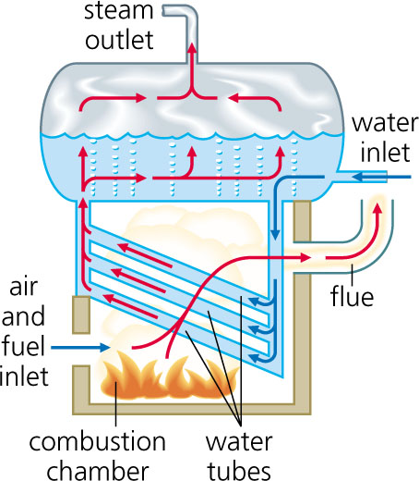
Steam Generating Plant
The steam generating plant consists of a boiler for the production of steam and other auxiliary equipment for the utilization of flue gases
1. Boiler: The heat of combustion in the boiler is utilized to convert water into steam at high temperature and pressure.

Slide 11
Steam Generating Plant
2. Superheater
The steam produced in the boiler is wet and is passed through a superheater where it is dried and superheated (i.e., steam temperature increased above that of boiling point of water) by the flue gases on their way to chimney.
Benefits:
Firstly, the overall efficiency is increased.
Secondly, too much condensation in the last stages of turbine (which would cause blade corrosion) is avoided.

Slide 12
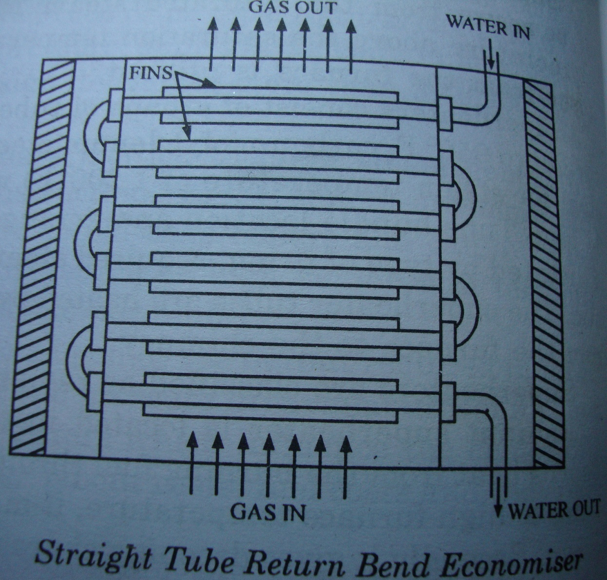
Steam Generating Plant
3. Economiser
An economiser is essentially a feed water heater and derives heat from the flue gases for this purpose.
The feed water is fed to the economiser before supplying to the boiler.
The economiser extracts a part of heat of flue gases to increase the feed water temperature.

Slide 13
Steam Generating Plant
4. Air Preheater
An air preheater increases the temperature of the air supplied for coal burning by deriving heat from flue gases.
Air is drawn from the atmosphere by a forced draught fan and is passed through air preheater before supplying to the boiler furnace.
The air preheater extracts heat from flue gases and increases the temperature of air used for coal combustion.
Benefit:
increased thermal efficiency and increased steam capacity per square meter of boiler surface.

Slide 14
Steam Turbine
Dry and superheated steam from superheater is fed to the steam turbine.
The heat energy of steam when passing over the blades of turbine is converted into mechanical energy.
After giving energy to the turbine, the steam is exhausted to the condenser which condenses the exhausted steam by means of cold water circulation

Slide 15
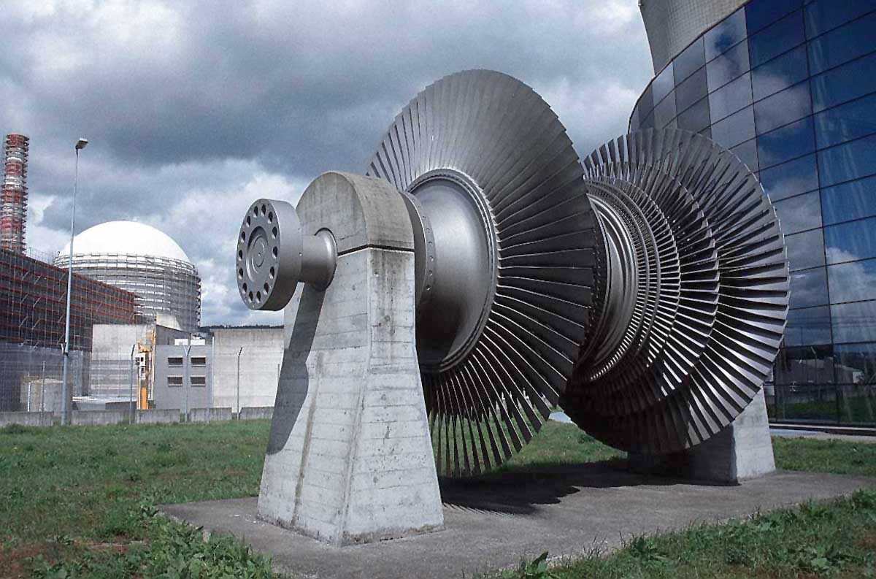
Turbine – Full View

Slide 16
Alternator
Steam turbine is coupled to an alternator which converts the mechanical energy to electrical energy
The electrical output of the alternator is delivered to the bus bars through transformer, circuit breakers and isolators.

Slide 17
Feed Water
The condensate from the condenser is used as feed water to the boiler.
The water that may be lost in the cycle is made up from the external source
The feed water on its way to boiler gets heated up by water heaters and economizer.
This helps to improve the overall efficiency of the plant

Slide 18
Cooling Arrangement
Condenser condenses the steam exhausted from the turbine
Water is drawn from natural sources like river, lake, canals…
Circulating water takes up the heat and itself gets heated up
This hot water can be discharged away or used again by using a cooling tower

Slide 19
Choice of Site for Steam Power Stations
Supply of fuel.
Availability of water.
Transportation facilities.
Cost and type of land.
Nearness to load centers.
Distance from populated area.

Slide 20
Equipment of Steam Power Station
Steam generating equipment
Condenser
Prime mover
Water treatment plant
Electrical equipment.

Slide 21
Steam Generating Equipment
Boiler
boiler furnace
Superheater
Economizer
air pre-heater

Slide 22
Boiler
A boiler is closed vessel in which water is converted into steam by utilizing the heat of coal combustion. Steam boilers are broadly classified into the following two types :
Water tube boilers: water flows through the tubes and the hot gases of combustion flow over these tubes.
Fire tube boilers: in a fire tube boiler, the hot products of combustion pass through the tubes surrounded by water.
Water tube boilers have a number of advantages over fire tube boilers
require less space
smaller size of tubes and drum
high working pressure due to small drum,

Slide 23
Fire Tube Boiler vs Water Tube Boiler

Slide 24
Superheater
. Superheaters are mainly classified into two types according to the system of heat transfer from flue gases to steam viz.
(a) Radiant superheater
(b) Convection superheater
A radiant superheater is placed directly in the combustion chamber. Simply we can say that radiant superheater can see the flames from burner.
A convection superheater is located in the path of the hot gases. That means convection superheater can’t see the flames from the burner.

Slide 25
A radiant superheater is placed directly in the combustion chamber. Simply we can say that radiant superheater can see the flames from burner.
A convection superheater is located in the path of the hot gases. That means convection superheater can’t see the flames from the burner.

Slide 26
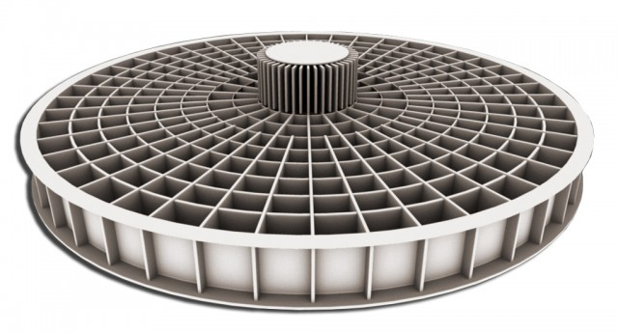
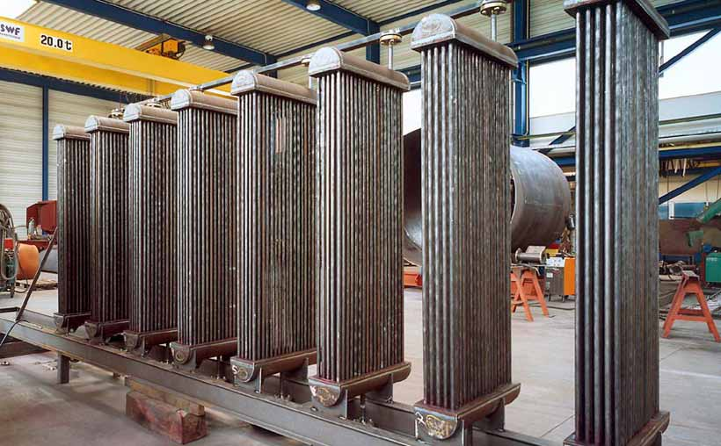

Slide 27
Condenser
A condenser is a device which condenses the steam at the exhaust of turbine. It serves two important functions.
Firstly, it creates a very low pressure at the exhaust of turbine, thus permitting expansion of the steam in the prime mover to a very low pressure. This helps in converting heat energy of steam into mechanical energy in the prime mover.
Secondly, the condensed steam can be used as feed water to the boiler.
There are two types of condensers, namely :
Jet condenser
Surface condenser

Slide 28
Condenser
Jet Condenser: In a jet condenser, cooling water and exhausted steam are mixed together. Therefore, the temperature of cooling water and condensate is the same when leaving the condenser.
Advantages :
low initial cost
less floor area required
less cooling water required and
low maintenance charges.
Disadvantages :
condensate is wasted and
high power is required for pumping water.

Slide 29
Condenser
Surface Condenser: In a surface condenser, there is no direct contact between cooling water and exhausted steam. It consists of a bank of horizontal tubes enclosed in a cast iron shell. The cooling water flows through the tubes and exhausted steam over the surface of the tubes. The steam gives up its heat to water and is itself condensed.
Advantages:
condensate can be used as feed water
less pumping power required and
creation of better vacuum at the turbine exhaust.
Disadvantages:
high initial cost
requires large floor area and
high maintenance charges.

Slide 31
Prime Mover
The prime mover converts steam energy into mechanical energy. There are two types of steam prime movers:
steam engines and
steam turbines
A steam turbine has several advantages over a steam engine as a prime mover:
high efficiency
simple construction
Higher speed
less floor area requirement and
low maintenance cost.

Slide 32
Steam Turbine
Steam turbines are generally classified into two types according to the action of steam on moving blades viz.
Impulse turbines: the steam expands completely in the stationary nozzles (or fixed blades),the pressure over the eastationary nozzles, the remaining expansion takes place during its flow over the moving blades. The result is that the momentum of the steam causes a reaction force on the moving blades which sets the rotor in motion.
Reactions turbines: the steam is partially expanded in the stationary nozzles, the remaining expansion takes place during its flow over the moving blades. The result is that the momentum of the steam causes a reaction force on the moving blades which sets the rotor in motion.

Slide 33
Steam Turbine

Slide 34
Water Treatment Plant
Boilers require clean and soft water for longer life and better efficiency. However, the source of boiler feed water is generally a river or lake which may contain suspended and dissolved impurities, dissolved gases etc. Therefore, it is very important that water is first purified and softened by chemical treatment and then delivered to the boiler.
The water from the source of supply is stored in storage tanks. The suspended impurities are removed through sedimentation, coagulation and filtration. Dissolved gases are removed by aeration and degasification. The water is then ‘softened’ by removing temporary and permanent hardness through different chemical processes. The pure and soft water thus available is fed to the boiler for steam generation.

Slide 35
Electrical Equipment
(i) Alternators: Each alternator is coupled to a steam turbine and converts mechanical energy of the turbine into electrical energy. The alternator may be hydrogen or air cooled. The necessary excitation is provided by means of main and pilot exciters directly coupled to the alternator shaft.
(ii) Transformers: A generating station has different types of transformers, viz.,
(a) main step-up transformers which step-up the generation voltage for transmission of power.
(b) station transformers which are used for general service (e.g., lighting) in the power station.
(c) auxiliary transformers which supply to individual unit-auxiliaries.
(iii) Switchgear. It houses such equipment which locates the fault on the system and isolate the faulty part from the healthy section. It contains circuit breakers, relays, switches and other control devices

Slide 36
Efficiency of Steam Power Station
(i) Thermal efficiency
The thermal efficiency of a modern steam power station is about 30%.
(ii) Overall efficiency
The overall efficiency of a steam power station is about 29%. It may be seen that overall efficiency is less than the thermal efficiency. This is expected since some losses (about 1%) occur in the alternator. The following relation exists among the various efficiencies.
Overall efficiency = Thermal efficiency X Electrical efficiency

Slide 37
Example 2.1. A steam power station has an overall efficiency of 20% and 0·6 kg of coal is burnt per kWh of electrical energy generated. Calculate the calorific value of fuel.

Slide 38
Example 2.2. A thermal station has the following data : Max. demand = 20,000 kW ; Load factor = 40% Boiler efficiency = 85% ; Turbine efficiency = 90% Coal consumption = 0·9 kg/kWh ; Cost of 1 ton of coal = Rs. 300 Determine (i) thermal efficiency and (ii) coal bill per annum.

Slide 39
Example 2.3. A steam power station spends Rs. 30 lakhs per annum for coal used in the station. The coal has a calorific value of 5000 kcal/kg and costs Rs. 300 per ton. If the station has thermal efficiency of 33% and electrical efficiency of 90%, find the average load on the station.

Slide 40
Example 2.5. A 100 MW steam station uses coal of calorific value 6400 kcal/kg. Thermal efficiency of the station is 30% and electrical efficiency is 92%. Calculate the coal consumption per hour when the station is delivering its full rated output.

