Slide 1
Join Operation in Database
Saif Mahmud parvez
Lecturer, CSE
DIU, PC

Slide 2
What is Join Operation??
Join operations take two relations and return another relation as the result.
Each of the variants of the join operations in SQL consists of a join type and a join condition. The join condition defines which tuples in the two relations match and what attributes are present in the result of the join.

Slide 3
Difference between inner and outer join
LEFT OUTER JOIN returns all the rows from the first table, even if there are no matches in the second table. RIGHT OUTER JOIN returns all the rows from the second table, even if there are no matches in the first table. INNER JOIN requires there is at least a match in comparing the two tables

Slide 4
Join Types
INNER JOIN: Returns all rows when there is at least one match in BOTH tables
LEFT JOIN: Return all rows from the left table, and the matched rows from the right table
RIGHT JOIN: Return all rows from the right table, and the matched rows from the left table
FULL JOIN: Return all rows when there is a match in ONE of the tables

Slide 5
Loan and Borrower Relation

Slide 6
SQL syntax for inner join
loan inner join borrower on loan.loan-number = borrower .loan-number

Slide 7
SQL syntax for left outer join
loan left outer join borrower on loan.loan-number = borrower.loan-number

Slide 8
SQL syntax for natural inner join
loan natural inner join borrower

Slide 9
SQL syntax for natural right outer join
loan natural right outer join borrower

Slide 10
SQL syntax for fullouter join
loan full outer join borrower using (loan-number)

Slide 11
Customers and Orders Relation

Slide 12
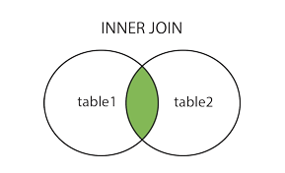
SQL INNER JOIN Syntax
SELECT column_name(s) FROM table1 INNER JOIN table2 ON table1.column_name=table2.column_name;

Slide 13
SQL INNER JOIN Example
SELECT Customers.CustomerName, Orders.OrderID FROM Customers INNER JOIN Orders ON Customers.CustomerID=Orders.CustomerID ORDER BY Customers.CustomerName;

Slide 14
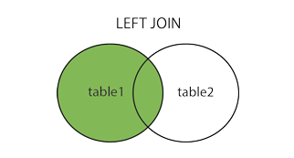
SQL LEFT JOIN Keyword
SELECT column_name(s) FROM table1 LEFT OUTER JOIN table2 ON table1.column_name=table2.column_name;

Slide 15
SQL LEFT JOIN Example
SELECT Customers.CustomerName, Orders.OrderID FROM Customers LEFT JOIN Orders ON Customers.CustomerID=Orders.CustomerID ORDER BY Customers.CustomerName;

Slide 16
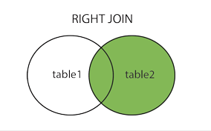
SQL RIGHT JOIN Keyword
SELECT column_name(s) FROM table1 RIGHT OUTER JOIN table2 ON table1.column_name=table2.column_name;

Slide 17
SQL RIGHT JOIN Example
SELECT Orders.OrderID, Employees.FirstName FROM Orders RIGHT JOIN Employees ON Orders.EmployeeID=Employees.EmployeeID ORDER BY Orders.OrderID;

Slide 18
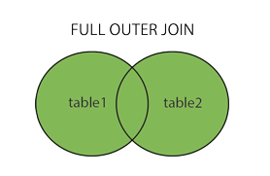
SQL FULL OUTER JOIN Syntax
SELECT column_name(s) FROM table1 FULL OUTER JOIN table2 ON table1.column_name=table2.column_name;

Slide 19
SQL FULL OUTER JOIN Example
SELECT Customers.CustomerName, Orders.OrderID FROM Customers FULL OUTER JOIN Orders ON Customers.CustomerID=Orders.CustomerID ORDER BY Customers.CustomerName;

Slide 20
Domain Types in SQL
char(n): A fixed-length character string with user-specified length n. The full form, character, can be used instead.
varchar(n): A variable-length character string with user-specified maximum length n. The full form, character varying, is equivalent.
int: An integer (a finite subset of the integers that is machine dependent). The full form, integer, is equivalent.
smallint: A small integer (a machine-dependent subset of the integer domain type).
real, double precision: Floating-point and double-precision floating-point numbers with machine-dependent precision.
float(n): A floating-point number, with precision of at least n digits.

Slide 21
Domain Types in SQL
date: A calendar date containing a (four-digit) year, month, and day of the month.
time: The time of day, in hours, minutes, and seconds. A variant, time(p), can be used to specify the number of fractional digits for seconds (the default being 0). It is also possible to store time zone information along with the time.
timestamp: A combination of date and time. A variant, timestamp(p), can be used to specify the number of fractional digits for seconds (the default here being 6).
Date and time values can be specified like this:
date ’2001-04-25’
time ’09:30:00’
timestamp ’2001-04-25 10:29:01.45’

Slide 22
Thanks to All

