Slide 1
Global Marketing Management A European Perspective
Global Competition and Strategy
Warren J. Keegan
Bodo B. Schlegelmilch

Slide 2
The competitive advantages
Big store with 100% display
Assembled or ready to assembled
Ready to take home
Technological support and expert consolation
Low cost food (rock bottom price)
Child care facility
Assembly help
Lowest possible price with highest quality and functional design
Space saving design

Slide 3
IKEA the opening case example

Slide 4
Cost Focused

Slide 5
Open floor, assembled or ready to be self assembled

Slide 6
A place for relaxed shopping

Slide 7
The food court

Slide 8
The menu

Slide 9
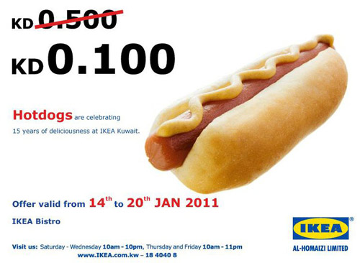
The rock bottom price

Slide 10
IKEA Child care

Slide 11
Store decorated as if you home

Slide 12
Overview
Dimensions of Global Competition
National Competitive Advantages
Industry Analysis: Five Forces Model
Analysis of Industry Groups
Competitive Advantages of Individual Companies
Summary

Slide 13
Learning Objectives
Understanding the importance of corporate strategies of a company
Appreciating the determinants for selecting, creating and pursuing a particular strategy
Knowing the levels of examining corporate strategy and the competitive position of a firm
Knowing why different companies pursue different strategies

Slide 14
Global Competition and Strategy: Important Concepts
The National Diamond
Five Forces Model
Generic Strategies
Playing the Spread
Strategic Groups
Hypercompetition

Slide 15
Dimension of Global Competition
A company`s success in global markets is determined by its ability to establish competitive advantages
Forces influencing competition in an industry need to be examined
Analysis of a firm`s position within an industry is important

Slide 16
Micheal Porter

Slide 17
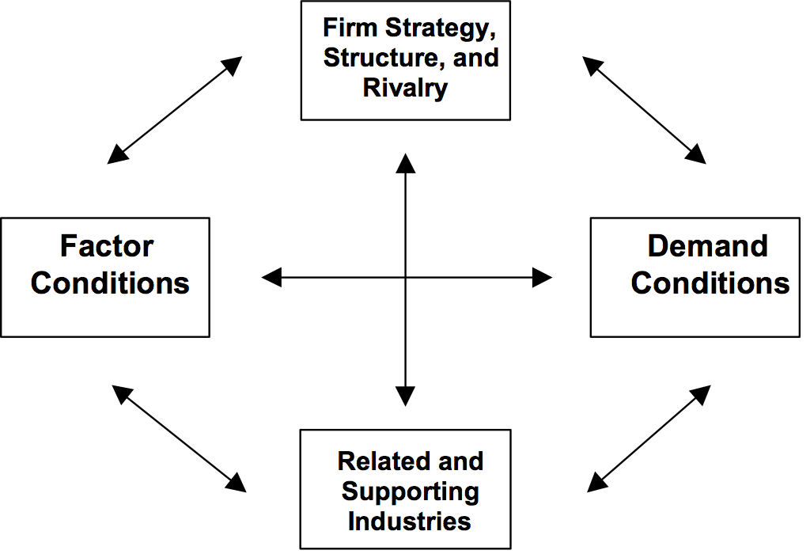
National Competitive Advantage: Determinants of National Advantage

Slide 18
National Competitive Advantage: Factor Conditions
Human Resources
Physical Resources
Knowledge Resources
Capital Resources
Infrastructure Resources
Alternative Categorisation of Factors

Slide 19
Demand Conditions, Related and Supporting Industries
Home-market demand conditions are important
Composition of home demand
The size and pattern of growth of home demand
Internationally competitive suppliers provide inputs to downstream industries
Contact and coordination give access to foreign markets

Slide 20
Firm Strategy, Structure, and Rivalry
Differences in management styles, organisational skills and strategic perspectives create advantages and disadvantages for firms
Domestic rivalry has a powerful influence on competitive advantage, because it keeps an industry dynamic and creates pressure to improve and innovate
Intensity of competition and quality of competitors are important

Slide 21
Other Forces Acting on the Diamond
Chance
Occurrences that are beyond the control of firms
Government
Buyer of products and services
Policy maker of policies on labour, capital formation and product standards
Other Non-market factors
Interest groups, activists and the public

Slide 22
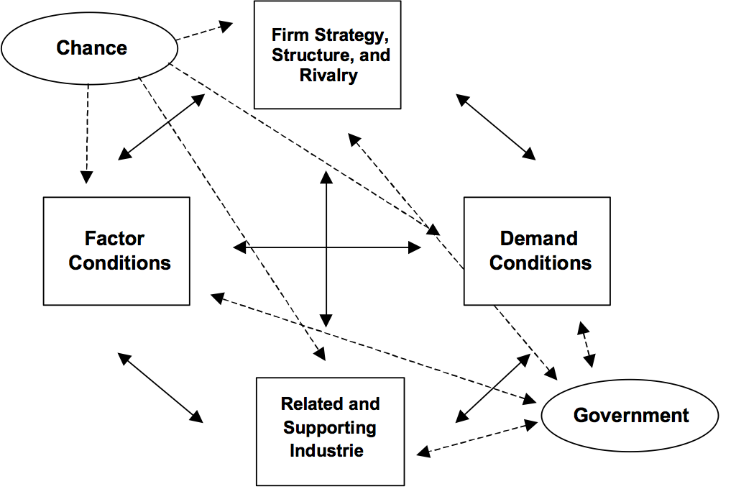
Dimension of Global Competition

Slide 23
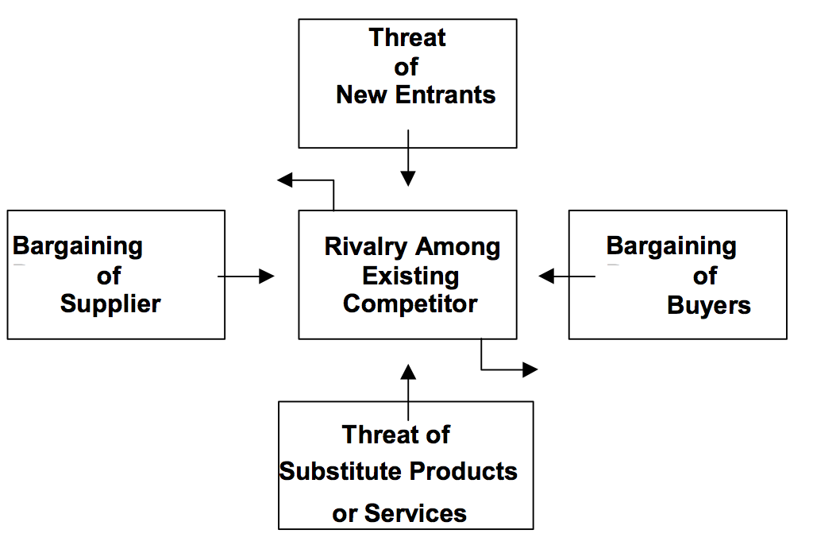
Industry Analysis
Five Forces Model

Slide 24
Industry Analysis
Threat of new entrants
Threat of substitute products
Bargaining power of suppliers
Bargaining power of buyers
Rivalry among competitors

Slide 25
Threat of new entrants

Slide 26
Threat of substitute products

Slide 27
Service industries

Slide 28
Bargaining power of suppliers

Slide 29
Bargaining power of buyers

Slide 30
Rivalry among competitors

Slide 31
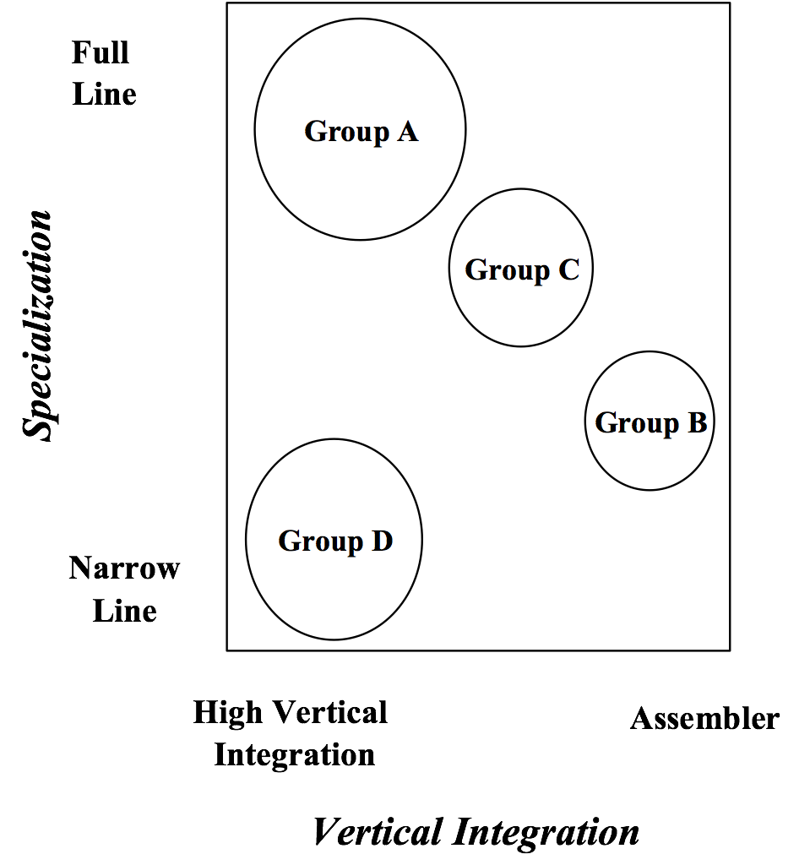
Analysis of Industry Groups
Map of Strategic Groups in a Hypothetical Industry

Slide 32
Characteristics of Strategic Groups
Mobility Barriers
Limit access to specific industry and switch between strategy groups
Varying level of bargaining power with consumer and supplier
Threat of Substitutes
Companies serving special needs are less vulnerable

Slide 33
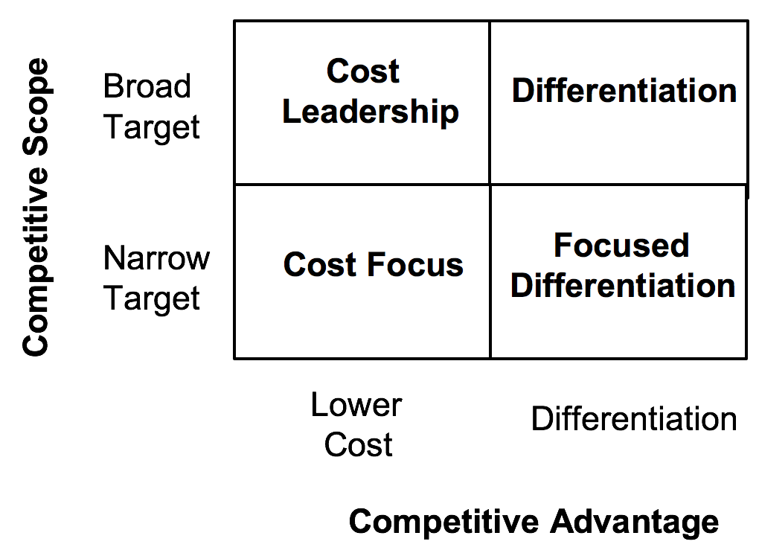
Competitive Advantage of Individual Companies (1)
Generic strategies for creating competitive advantages

Slide 34
Competitive Advantage of Individual Companies (2)
Broad Market Strategies
Cost-Leadership Advantage
Differentiation
Narrow Target Strategies
Focused Differentiation
Cost Focus
Playing the Spread

Slide 35
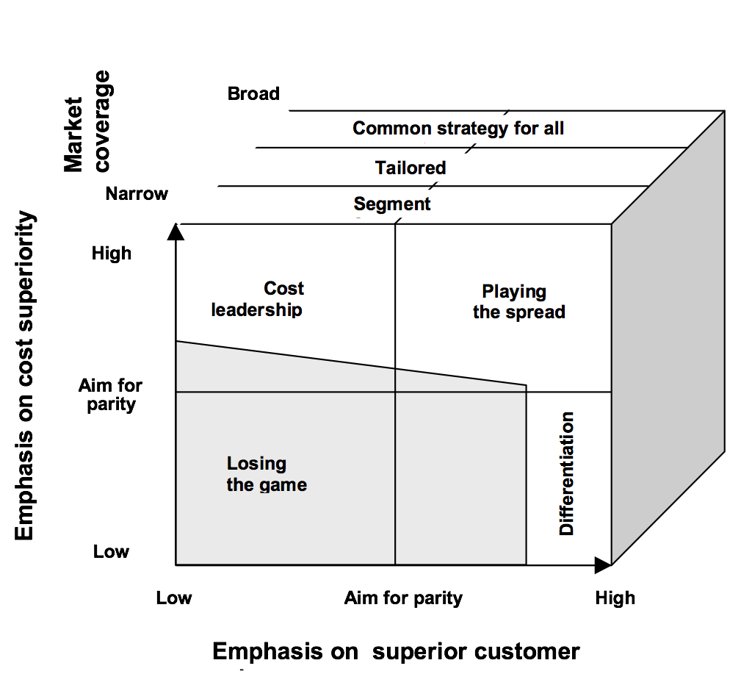
Competitive Advantage of Individual Companies (3)

Slide 36
Strategic Perspectives
Layers of Advantage
Less risks if wide portfolio of advantages exist
“Loose Bricks” left in the defensive walls of competitors who are focused on a market area
Changing the Rules
Refuse to play by the rules set by industry leaders
Collaborating
Using know-how developed by other companies

Slide 37
Hypercompetition
Porter`s models only provide snapshots of competition
“Hypercompetition” describes a dynamic, competitive world, in which no action or advantages can be sustained for long
The only advantage of a companies is to manage dynamic strategic interactions: Cost-quality, timing and know-how, entry barriers and deep pockets
Companies must seek unsustainable advantages

Slide 38
Summary
Various Factors are helping industries and countries to achieve competitive advantage
Porter`s five Forces Model
Groups of companies may follow similar strategic dimensions
Focusing on the individual strategy of a company, an understanding of the unique source of the firm`s competitive advantages is of great importance

