Slide 1
Conditionals
Note: Call Joseph’s mom
Fatema Akter
Lecturer
Daffodil International University

Slide 2
Clause
A clause is a group of words containing a subject as well as a finite verb.
1. He is honest.
2. In spite of being ill, he attended the class.
3. I shall go to market for buying some books.

Slide 3
What is Conditional?
Conditional sentences are statements discussing known factors or hypothetical situations and their consequences.
Complete conditional sentences contain a conditional clause (often referred to as the if-clause) and the consequence.

Slide 4
Zero conditional
General statement about general habits.
If+ present simple + present simple.
For instance: If you add two and two, you get four.

Slide 5
If / When ... simple present ..., ... simple present ...]
[... simple present ... if / when ... simple present ]

Slide 6
The present real conditional (also called conditional 0) is used to talk about what you normally do in real-life situations
If I go to a friend's house for dinner, I usually take a bottle of wine or some flowers.
When I have a day off from work, I often go to the beach.
If the weather is nice, she walks to work.

Slide 7
IMPORTANT If / When
Both "if" and "when" are used in the present real conditional. Using "if" suggests that something happens less frequently. Using "when" suggests that something happens regularly.
Examples:
When I have a day off from work, I usually go to the beach.[I regularly have days off from work.]
If I have a day off from work, I usually go to the beach. [I rarely have days off from work.]

Slide 8
First Conditonal
First conditional sentences are used to express situations in which the outcome is likely (but not guaranteed) to happen in the future.
Structure: If + Subject + Present tense followed by subject + Object, Subject + shall/will/can/may + Present form of verb + Object

Slide 9
Lisa has lost her watch, She tells Suzy:
Lisa: I’ve lost my watch. Have you seen it anywhere?
Suzy : No, But if I find it, I’ll tell you.

Slide 10
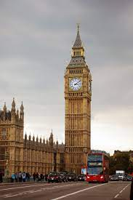
If I go to the London, I will see the Big Ben.

Slide 11
If I go to my friend's house for dinner tonight,
I will take a bottle of wine or some flowers.
[I am still not sure if I will go to his house or not.]
When I have a day off from work, I will go to the beach.
[I have to wait until I have a day off.]

Slide 12
Second Conditional
2nd conditional sentences are useful for expressing outcomes that are completely unrealistic or never happened.
Structure: If + Subject + Past form of Verb + Object, Subject + would/could/might + Present form of verb + Object

Slide 13
If the sun were shining, I would go to the beach.
If I were in Hawaii, I would be lying on the beach.

Slide 14
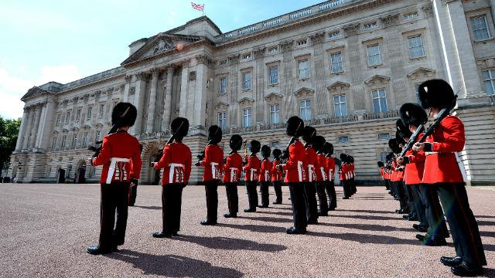
If I went to the Buckingham Palace, ___________

Slide 15
If I went to the Buckingham Palace, I would take photo of the Royal Guard.

Slide 16
Third Conditional
Third conditional sentences are used to explain that present circumstances would be different if something different had happened in the past.
Structure: If + Subject + had + Past participle form of Verb + Object, Subject + would/could/might + have + Past participle form of verb + Object

Slide 17
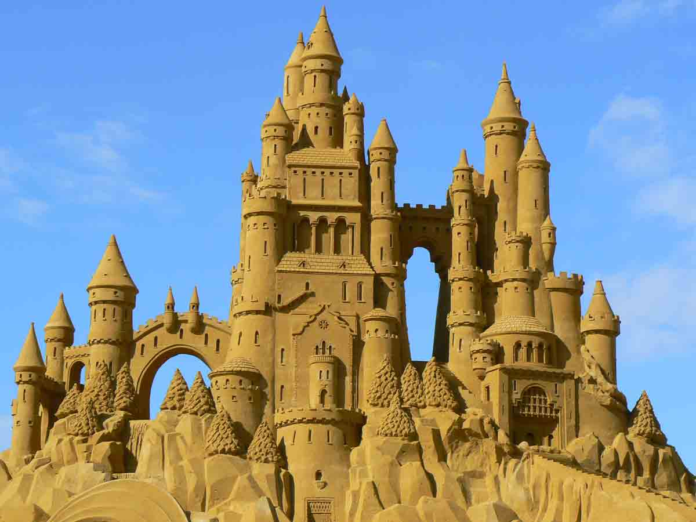
If I had gone to the beach, I would have made sand castle.

Slide 18
What would you have done if you had won the lottery last week?
I would have bought a house.

