Slide 1
Lecture-8: Rational Z-Transform
A ratio of two polynomials.
Has two terms: Poles and Zeros.
Zeros: The zeros of a z-transform X(z) are the values of z for which X(z)= 0
Poles: The poles of a z-transform X(z) are the values of z for which X(z)=
Example: x(z) =
Here,
zeros 1, at z = 1
poles 1, at z = 2

Slide 2
Problems
Determine pole zero plot for the signals,
(a)
(b)
(c)
Example-3.3.1: x(n)= u(n) a > 0

Slide 3
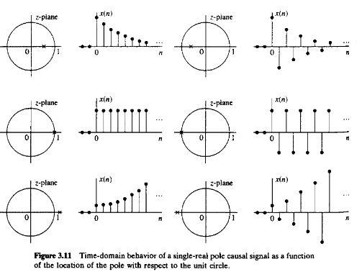
Pole Location and Time-Domain Behavior for Causal Signals
The characteristic behavior of causal signals depends on whether the poles of the transform are contained in the region |z| < 1, or in the region |z| > 1, or on the circle |z| = 1. Since the circle |z| = 1 has a radius of 1, it is called the unit circle.
x(n) = u(n)

Slide 4
Relation between discrete signal and Z-Transform
x₁(n)= 0 1 -1
x₂(n)= -1 0 1
After folding,
0 1 -1 0 1 -1 0 1 -1 0 1 -1 0 1 -1
1 0 -1 1 0 1 0 -1 -1
C(0)= 0+0+1= 1 C(1)= 1 C(2)= -1 C(-1)= -1 C(-2)= 0
so, the output sequence: 0 -1 1 1 -1

Slide 5
Now,
x₁(z) = 0. z¹ + 1. z⁰ + (-1) z⁻¹
= (1- z⁻¹)
x₂(z)= (-1) z¹+ 0.z⁰+1.z⁻¹
= (-z+z⁻¹)
x₁(z) .x₂(z)= (1- z⁻¹). (-z+z⁻¹)
= -z + z⁻¹ + z. z⁻¹ -z⁻¹. z⁻¹
= -z+1+z⁻¹-z⁻²
The coefficients: 0 -1 1 1 -1

Slide 6
The system function of a linear time-invariant system
The output of a (relaxed) linear time-invariant system to an input sequence x(n) can be obtained by computing the convolution of x(n) with the unit sample response of the system. The convolution property allows to express this relationship in the z-domain as
Y(z)= H(z) X(z)
so, y(n)= h(n) * x(n)
Then,

Slide 7
Problems
Example- 3.3.4: Determine the system function and the unit sample response of the system described by the difference equation
y(n)= ½ y(n-1) + 2 x(n)
Example- 3.4.2
Example- 3.4.4
Example- 3.4.5
Example- 3.4.6

Slide 8
Problems
Example- 3.6.2: Determine the transient and steady-state responses of the system characterized by the difference equation,
y(n)= 0.5 y(n-1)+ x(n)
Example-3.6.4:
y(n)= 2.5 y(n-1) - y(n-2) + x(n)-5 x(n-1)+ 6 x(n-2)
Example-3.6.5: Determine the response of the system
y(n)= 5/6 y(n-1)-1/6 y(n-2)+ x(n)
To the input signal,

