Slide 1
Structure and functions of liver

Slide 2
Functions of liver
Digestion
The liver plays an active role in the process of digestion through the production of bile. The emulsification of fats by bile turns the large clumps of fat into smaller pieces that have more surface area and are therefore easier for the body to digest.
Metabolism
The liver metabolizes carbohydrate, lipids, and proteins into biologically useful materials.
Hepatocytes absorb much of the glucose and store it as glycogen.
Fatty acids are absorbed by hepatocytes and metabolized to produce energy in the form of ATP. Glycerol is converted into glucose by hepatocytes through the process of gluconeogenesis. Hepatocytes can also produce lipids like cholesterol, phospholipids, and lipoproteins that are used by other cells throughout the body.
Amino acids entering the liver require metabolic processing before they can be used as an energy source. Hepatocytes first remove the amine groups of the amino acids and convert them into ammonia and eventually urea. Urea is less toxic than ammonia and can be excreted in urine as a waste product of digestion. The remaining parts of the amino acids can be broken down into ATP or converted into new glucose molecules through the process of gluconeogenesis.
Detoxification
The hepatocytes of the liver remove many potentially toxic substances. Enzymes in hepatocytes metabolize many of these toxins such as alcohol and drugs into their inactive metabolites.

Slide 3
Functions of liver
Storage
Glucose is transported into hepatocytes under the influence of the hormone insulin and stored as the polysaccharide glycogen. Hepatocytes also absorb and store fatty acids from digested triglycerides. The storage of these nutrients allows the liver to maintain the homeostasis of blood glucose. Our liver also stores vitamins and minerals - such as vitamins A, D, E, K, and B12, and the minerals iron and copper - in order to provide a constant supply of these essential substances to the tissues of the body.
Production
The liver is responsible for the production of several vital protein components of blood plasma: prothrombin, fibrinogen, and albumins. Prothrombin and fibrinogen proteins are coagulation factors involved in the formation of blood clots.
Immunity
The liver functions as an organ of the immune system through the function of the Kupffer cells. Kupffer cells (are specialized macrophages located in the liver, ) play an important role by capturing and digesting bacteria, fungi, parasites, worn-out blood cells, and cellular debris.

Slide 4
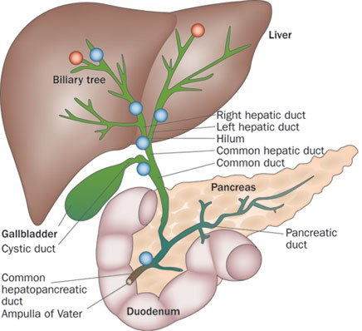
Pathway of bile secretion
Biliary tree is the arboreal branches of the bile ducts.
The bile produced in the liver is collected in bile canaliculi, which merge to form bile ducts.
Within the liver, these ducts are called intra hepatic (within the liver) bile ducts, and once they exit the liver they are considered extra hepatic (outside the liver).
The intra hepatic ducts eventually drain into the right and left hepatic ducts, which merge to form the common hepatic duct.
The cystic duct from the gallbladder joins with the common hepatic duct to form the common bile duct.
Bile either drains directly into the duodenum via the common bile duct, or is temporarily stored in the gallbladder via the cystic duct. The common bile duct and the pancreatic duct enter the second part of the duodenum together at the ampulla of Vater. (Hepato pancreatic ampulla).

Slide 5
Bile acids
Cholic acid
Deoxycholic acid
Cheno-deoxycholic acid
Lethocholic acid
Enolic acid
Bile pigments
Bilirubin
Biliverdin
Bile salts
Na tauro-cholate, K tauro – cholate
Na glycholate, K glycolate

Slide 6
Functions of bile salts
The bile salts have two important actions in the intestinal tract:
First, they have a detergent action on the fat particles in the food. This decreases the surface tension of the particles and allows agitation in the intestinal tract to break the fat globules into minute sizes. This is called the emulsifying or detergent function of bile salts.
Second, bile salts help in the absorption of (1) fatty acids, (2) monoglycerides, (3) cholesterol, and (4) other lipids from the intestinal tract.
formation of small physical complexes with these lipids; the complexes are called micelles, and they are semisoluble in the chyme because of the electrical charges of the bile salts. The intestinal lipids are “ferried” in this form to the intestinal mucosa, where they are then absorbed into the blood.

Slide 7
Important topics
Differences between hydrolytic and ecbolic type of secretion.
Functions of pancreatic proteases.
Why different digestive juices are necessary for digestion of food?
Functions of Gallbladder
Absorption of fat and protein
Aptylism, Hyposalivation

