Slide 1
Static Electricity Formation
Chapter 05

Slide 2
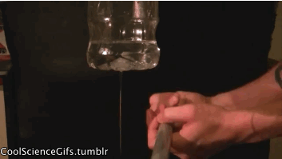
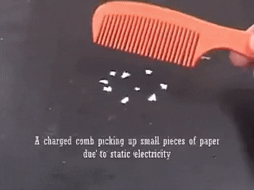
Static Electricity
When two surfaces come in close contact to each other, then due to friction static charge is developed.
This produced charge remains enclosed between those surfaces and can not move from one place to another.
This type of charge is only exchanged between the surfaces and is known as static electricity.

Slide 3
Static Electricity
The nature and amount of static charge formation will be different based on different fibres.
Usually, in case of manmade fibres this charge generation will be higher if is compared to natural fibres.

Slide 4
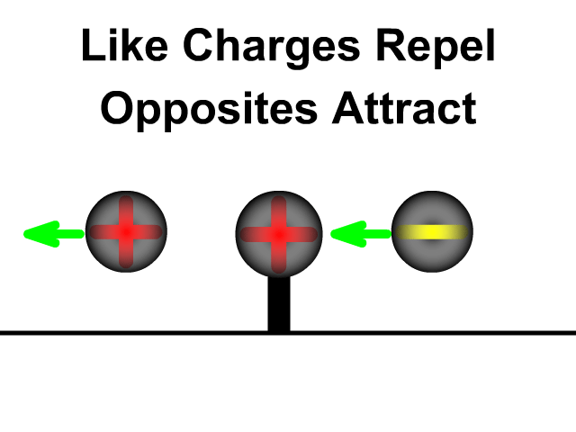
Effects of Static Electricity formation in Textile Industry
Similar charges repel each other.
Unlike charges attract each other.
Attraction between a charged textile material and another charged particle.

Slide 5
01. Similar charges repel each other:
Charged filaments in a beam will be blown out away from one another.
Cloth will not be folded down properly.
Difficulties in fabric spreading of cutting section at garments industry.
Ballooning of slivers occurs in drawing frame.

Slide 6
02. Unlike charges attract each other:
Difficulties in parachute opening.
Different parts of a garment may be sticked together.
Difficulties in materials handling.

Slide 7
03. Attraction between a charged textile material and another charged particle:
Dusts, dirts etc may be attached with the textile material and make it dirty.
During processing, fibres can be lapped around drafting rollers.
Fibres may be sticked with different parts of a machine.

Slide 8
Methods of static electricity minimization
By controlling relative humidity% in spinning and weaving industry it is possible to reduce static charge formation.
By applying conductive liquid such as oil, emulsion etc on textile materials, static charge generation may be reduced.
By blending conductive material with non-conductive material static charge formation can be reduced.

Slide 9
Methods of static electricity minimization
By using anti-static finishes to the textile materials it is possible to reduce the charge formation.
By earthling different parts of a textile machine produced charge can be neutralized or removed.

Slide 10
Thank You

