Slide 1
The Political History of Bangladesh : Development Trend (Ancient to Modern)
Md. Fouad Hossain Sarker
Assistant Professor
Department of Natural Sciences
Daffodil International University

Slide 2
Objectives of this Class
Understand the historical and political development of Bengal.
Realize the political dynamics of Bengal in accordance with historical ground.
Know the ruling structure of Bengal as well as peoples rebellion against the oppressor.
Explore and examine the outcomes of the dynastic rule.

Slide 3
Pre Ancient History of Bengal
Stone Age: 7000 – 3000 BC (Austro-Asiatic, Mongoloid & Dravidian)
The stone age is a broad Prehistoric which means the spans of time before recorded history or the invention of writing systems. It also refers ‘beginning of the universe’ / ‘life appeared on earth’ / ‘since human like beings appeared. This age lasted 3.4 million years, and ended 4500 BC and 2000 BC with the advent of metalworking.
Bronze Age: 3000-1300 BC (Indo-Aryan Era)
Iron Age: 1200-26 BC (Indo-Aryan & Maurya Era)
Magadha Empire: Western Bangladesh, as part of Magadha, became part of the Indo-Aryan civilization by the 700 BC.
Mahasthangarh: In 700 BC Urban civilization emerges at Mahasthangarh, Now at Bogra district.

Slide 4
Stone Age covers
Paleolithic : It is the period of human history distinguished by the development of the most primitive stone tools; human groups together in small societies such as bands, and existed by gathering plants and fishing, hunting wild animals.
Mesolithic : It is an archaeological concept used to refer to specific groups of archaeological cultures/ refer to different time spans in different parts of Eurasia/ late developments of hunter-gather traditions.
Neolithic : New Stone age, was a period in the development of human technology/ some parts of the Middle East, and later in other parts of the world/ cultivated crop and mark the invention of the technology of farming/ singe houses.

Slide 5
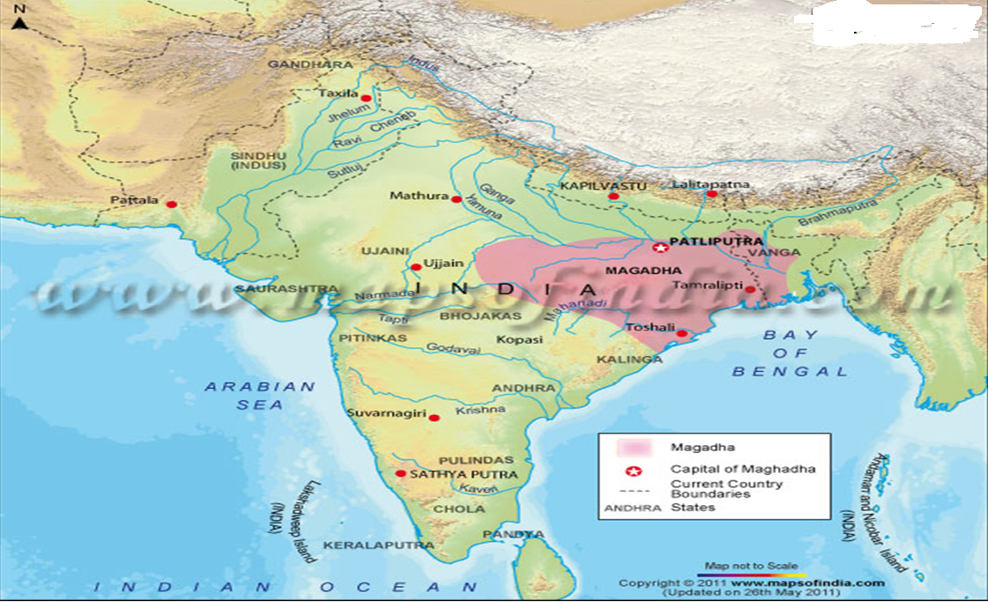
Magadha Empire

Slide 6
Ancient History of Bengal: Development Trend Time Frame: 400 BC to 1204 AD
Maurya Dynasty (321 BC–185 BC)
Foremost Rulers: Chandragupta Maurya, Ashoka Vardhana
Gupta Empire (240 AD–550 AD )
Foremost Rulers: Sri-Gupta, Chandra Gupta-1, Samudra Gupta
Gauda /Gaur Kingdom (590 AD–637 AD)
Foremost Ruler: Shashanka
Pala Empire (756 AD-1161 AD)
Foremost Rulers: Gopala, Dharmapala, Devapala, Mahipala-1, Rampala
Sena Dynasty: (1070 AD-1229 AD)
Foremost Ruler: Hemantasen, Vijayasen, Ballalsen, Lakshmansen

Slide 7
Ancient History of Bengal: The Independent Kingdom of South –East Bengal
The Kharga Dynasty (Second half of 7th century)
Area: Bara kamta or Karmanta Vasaka, Triura and Noakhali
Foremost Rulers: Khargauddam, Deva Kharga
The Deva Dynasty (Beginning of 8th Century)
Area: Bara kamta or Karmanta Vasaka, Tripura and Noakhali
Foremost Rulers: Sri-Shanti, Sri- Ananda & Sri- Bhava
The Kanti Deva Dynasty ( 9th Century)
Area: Harikela, Sylhet , Foremost Ruler: Kanti Deva
The Chandra Dynasty (End of the 9th Century -1045 AD)
Foremost Rulers: Troilakya, Sri-Chandra, Kalyan chandra, Area: Banga and Samatata
The Varmaraja Dynasty: (At the end of 11th Century –in the middle of 12th Century)
Foremost Ruler: Jatavarma, Harivarma , Area: Banga, Samatata and Nagabhumi

Slide 8
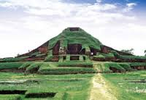
Ancient History of Bengal: Political Dynamics
Shashanka was the first Independent ruler in Bengal.
Pala dynasty was the first independent Buddhist dynasty of Bengal. Gopala was the first ruler. He came to power in 750 in Gaur by a democratic election.
The Buddhist Pala dynasty lasted for four centuries (750-1159 AD)
The Palas were followed by the Sena dynasty who brought Bengal under one ruler during the 12th century.
Ballal Sena introduced caste system in Bengal and made Nabadwip the capital.
Reference:
1. Rahim et al. (2001). Bangladesher Itihash. Nawroze Kitabistan. Dhaka.

Slide 9
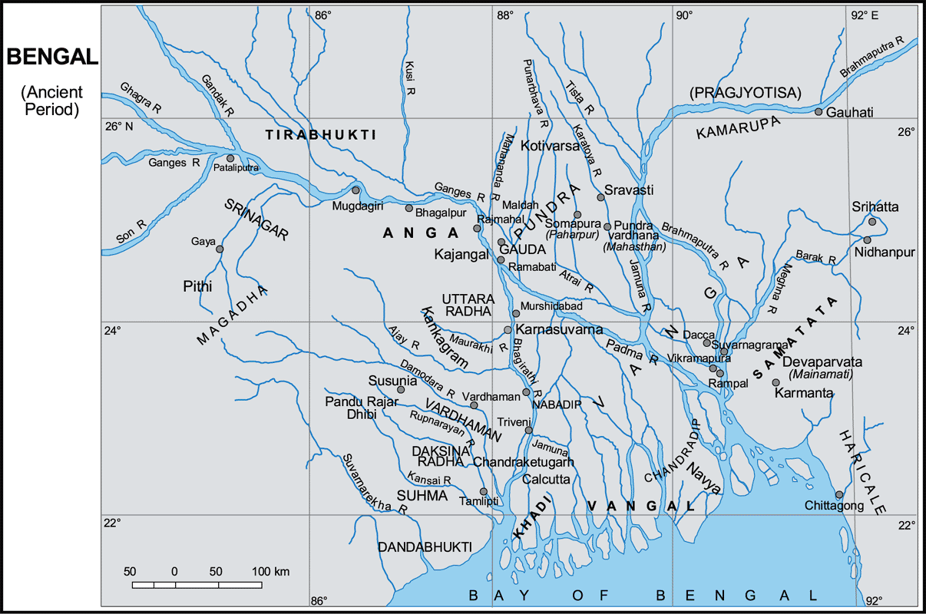

Slide 10
Mediaeval History of Bengal: Development Trend Time Frame: 1204-l757 AD
Khilji dynasty: (1204-1227)
Foremost Ruler: Muhammad bin Bakhtiyar Khilji
Mamluk Sultanate: (1227–1281)
Foremost Ruler: Nasiruddin Mahmud
Tugluk Sultanate: Independent Sultans of Bengal (1338-1352)
Foremost Rulers: Fakhruddin Mubarak Shah, Ilyas Shah
Ilyas Shahi dynasty: (1352-1414)
Foremost Rulers: Shamsuddin Ilyas Shah, Ghiyasuddin Azam Shah
Ganesha dynasty: Began with Raja Ganesha in 1414.
Hussain Shahi dynasty: (1494-1538)
Foremost Rulers: Alauddin Hussain Shah
Mughal Subahdars: (1565–1717)
Foremost Rulers: Islam Khan, Munim Khan, Mir Jumla, Shaista Khan, Murshid Quli Khan
Nawabs of Bengal: (1717-1830)
Foremost Rulers: Murshid Quli Khan, Siraj-Ud Daulah, Mansur Ali Khan (1830)

Slide 11
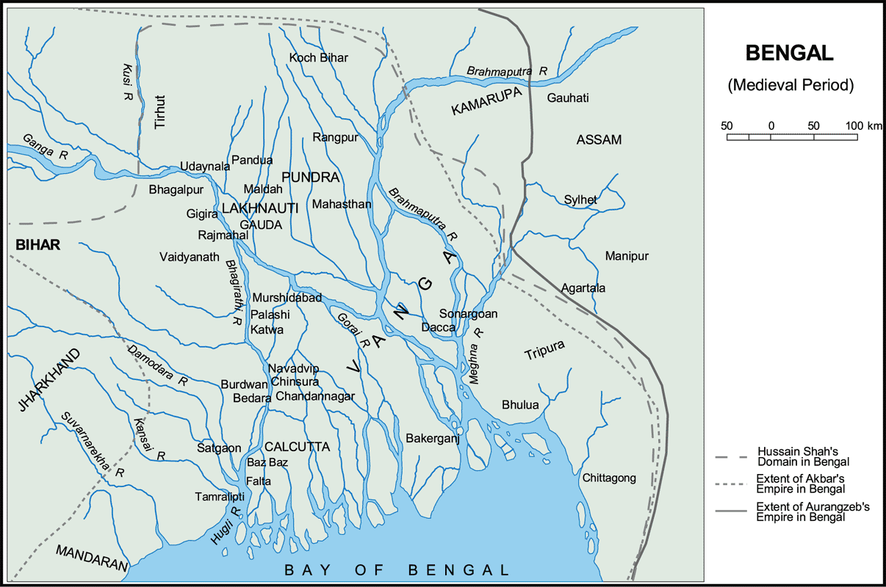
Mediaeval History of Bengal: Political Dynamics

Slide 12
Mediaeval History of Bengal: Political Dynamics
The Middle age in Bengal coincided with the Muslim rule.
About 550 years of Muslim rule, Bengal was effectively ruled by Delhi-based all India empires for only about two hundred years. For about 350 years Bengal remained virtually independent.
The Muslim rule in Bengal is usually divided into three phases.
- The first phase which lasted from 1204 to 1342 witnessed the consolidation of Muslim rule in Bengal. It was characterized by extreme political instability.
- The second phase which extended the period 1342 to 1575 saw the emergence of independent local dynasties such as the Ilyas Shahi dynasty, dynasty of King Ganesha and Husain Shahi dynasty.
- The third phase which lasted from 1575 to 1757 witnessed the emergence of a centralized administration in Bengal within the framework of the Mughal empire.
References: 1. Karim, Dr. Abdul. Banglar Itihas. Dhaka
2. Rahim et al. (2001). Bangladesher Itihash. Nawroze Kitabistan. Dhaka.

Slide 13
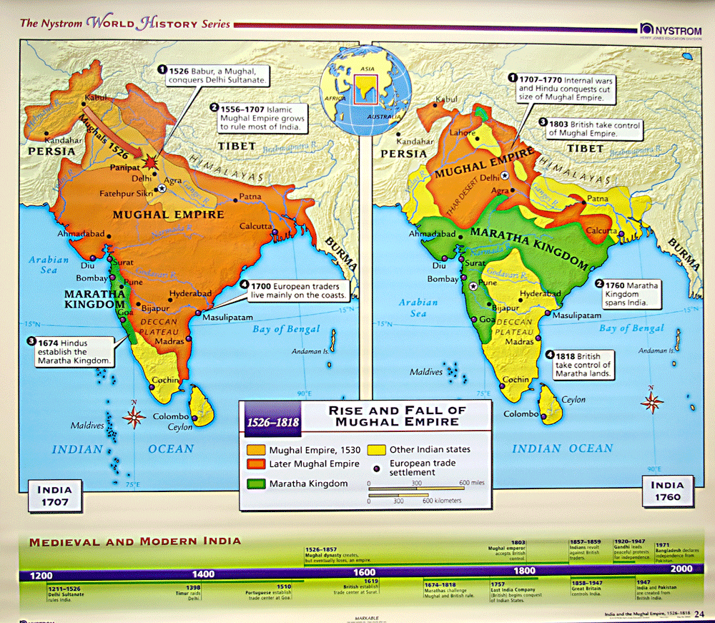
Rise and Fall of Mughal Empire

Slide 14
Battle Of Palashi
The Conspiracy Against Nawab Siraj-Ud-Daula:
Tri-parties conspiracy: Family persons, High officials of Nawab’s , East India company
23rd April’ 1757 Calcatta Parishad decided to throw out Nawab.
The Battle:
June 5, 1757: An agreement between Watts and Mir Jafar. On 22 June the British army under Lord Clive set out for Palashi. In the meantime the nawab had started from Murshidabad and encamped at Palashi to oppose the enemy.
The war started at about 8 in the morning on 23 June 1757.
Nawab's army under Mir Mardan, Mohanlal, Khwaja Abdul Hadi gave a brave fight while Mir Jafar, Yar Latif and Ray Durlabh merely stood by.
After Mir Mardan's death, Sirajuddaula called Mir Jafar and implored him to save his life. Mir Jafar advised the nawab to suspend action for the day.
With the nawab's commanders turning back, the British made a onslaught and The battle was over by 5 in the afternoon and victorious Clive immediately proceeded towards Murshidabad. Finally The English won the victory at Palashi.

Slide 15
Modern History: British Colonial Rule Time Frame: 1757-1947
From June 23, 1757 the East India Company of England became the virtual ruler of Bengal and From 1757 they installed their own Nawab.
The Indian Rebellion of 1857 replaced rule by the Company with the direct control of Bengal by the British Crown.
Revolt against British Rule
Fakir Sannyasi Movement: (1760-1800)
Leadership: Fakir Majnu Shah, Vabani Pathak, Pargal Shah
Rangpur Farmers Movement: 1783, Leadership: Nur Uddin
Balaki Shah Revolt: 1791-1792 in Bakerganj
Faraiji Movement: 1820- 1862, It was widely received in the districts of Dhaka, Faridpur, Barisal, Mymensingh and Comilla
Leadership: Haji Shariatullah, Dudu Miyan
Titumir’s Rebellion in west Bengal in 1831

Slide 16
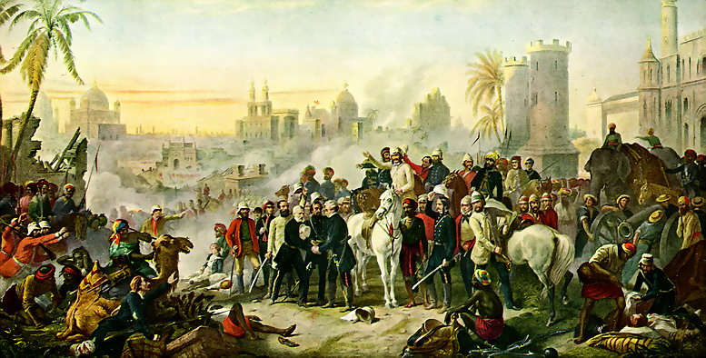
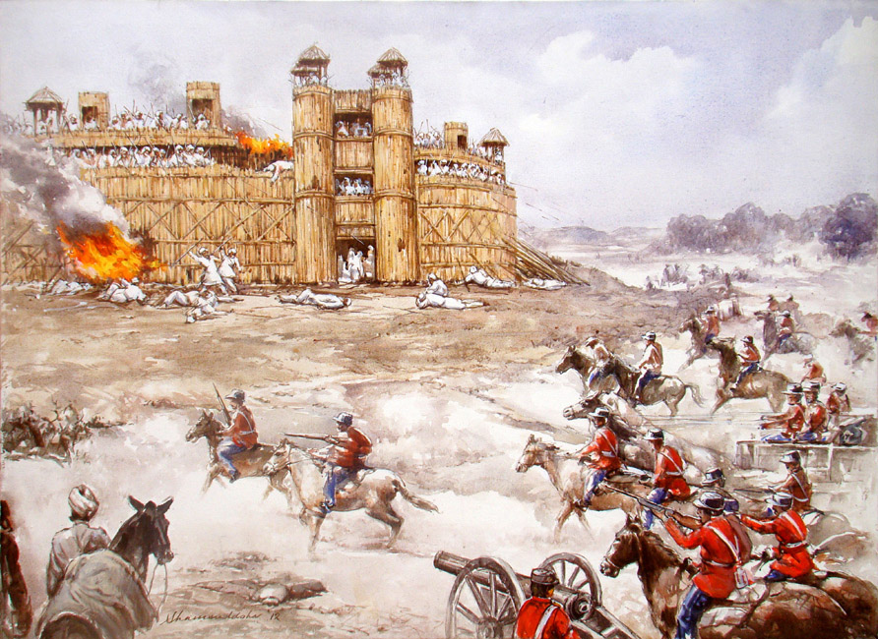
The rebellion of 1857
Revolt against British Rule ﴾Continued)
The rebellion of 1857: A large-scale rebellion in northern and central India. It began as a mutiny of sepoys of the East India Company's army.
Leadership: Bahadur Shah Zafar, Bakht Khan, Mangal Pandey, Nana Sahib
Indigo revolt : 1859-1860
The Indigo revolt (or Nilbidroha) was a peasant movement and subsequent uprising of indigo farmers against the indigo planters that arose in Bengal.
Titumir’s Rebellion

Slide 17
British Colonial Rule: ﴾Continued)
Reformation Movement
Role of Raja Ram Mohan Rai: Indian Renaissance, Religious Reformation
Role of Nawab Abdul Latif: Emphasize on education and Established the Mohammedan Literary Society of Calcutta.
Role of Syed Ameer Ali: Muslim Renaissance
Syed Ahmad Khan: Literary movement at The Aligarh Muslim University
Partition of Bengal: 16 October 1905
It separated the largely Muslim eastern areas from the largely Hindu western areas. Due to political protests, the two parts of Bengal were reunited in 1911.
Formation of Muslim League: 1906
The All-India Muslim League formed in December 1906 in Dhaka, attended by 3,000 delegates. Its strong advocacy was for the establishment of separate Muslim-majority nation-states.

Slide 18
British Colonial Rule: ﴾Continued)
Movements against British Rule
Swadeshi Movement : 1905 to 1917
Began with and because of the partition of Bengal in 1905.
The Khilafat movement: (1919-1924)
A pan-Islamic political protest campaign by Muslims in British.
Leadership: Maulana Abul Kalam Azad, Maulana Muhammad Ali
Non-cooperation movement: 1920
After the Jallianwala Bagh incident, Gandhi started the non-cooperation movement. It was supported by the Indian National Congress also.
The Quit India Movement: 1942
It was a civil disobedience movement by Gandhi.
References: 1. Ram Gopal, Indian Muslims: A political Study
2. Khan Raisuddin K M, Bangladesh: Itihash Porikroma (2009), Dhaka.

Slide 19
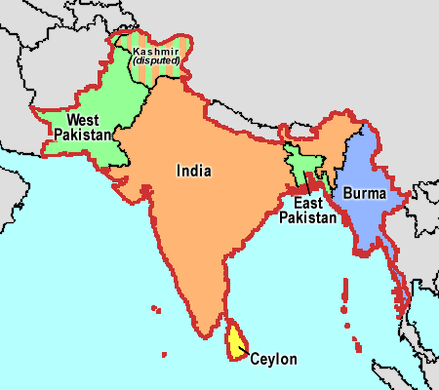
Modern History: Pakistan Period Time Frame: 1947-1971
The Lahore Resolution of 1940 demanded that Muslims are numerically in a majority should be grouped to constitute "Independent States“.
The power transferred to Pakistan and India on 14–15 August 1947 according to "3 June Plan“.
Pakistan, was in fact "a double country", the two wings were not only separated from each other, they were also culturally, economically and socially different.
State Language Movement in 1952: foundation of Bengali Nationalism.
Six Point Program in 1966: It is compared to Magnacarta.
On 26 March 1971, Bangladesh stared journey as a independent country.
Reference: 1. Khan Raisuddin K M, Bangladesh: Itihash Porikroma, Dhaka.

Slide 20
The Birth of Bangladesh
Military crackdown by the Pakistan army began during the early hours of March 26, 1971.
On 26 March 1971, Bangabandhu Sheikh Mujibur Rahman declared that,
‘Today Bangladesh is a sovereign and independent country. On Thursday night West Pakistani armed forces suddenly attacked the police barracks at Razarbagh and the EPR Headquarters at Pilkhana in Dhaka…….... May Allah aid us in our fight for freedom. Joy Bangla.’
On 27 March 1971, Ziaur Rahman declared that,
‘I, Major Ziaur Rahman, on behalf of our great leader Bangabandhu Sheikh Mujibur Rahman, do hereby declare that the independent Peoples Republic of Bangladesh has been established.…… Victory is ours by the Grace of Allah. Joy Bangla.
On 16 December 1971, Our long cherished victory has acquired.
Reference: 1. Maniruzzaman, Talukdar , `The Bangladesh Revolution and its Aftermath’, (UPL). Dhaka

Slide 21
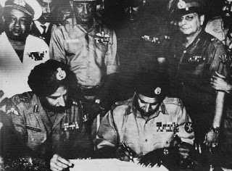
Surrender Of Pakistan Army

Slide 22
Political Regime: 1971 to Till
1971 to 1974 : Democratic Regime
1975 to 1975 : One Party Rule
1975 to 1990 : Military Regime
1991 to 2006 : Democratic Regime
2006 to 2008 : Non Democratic Regime
2009 to 2013 : Democratic Regime
2014 to till : Democratic Regime

Slide 23
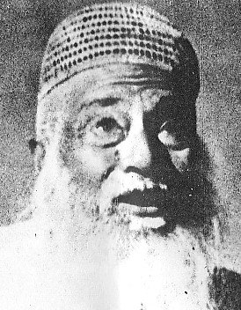
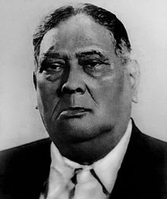
Key Political Person of Bangladesh
Abdul Hamid Khan Bhashani was born in Sirajganj in 1880 . On 31 January 1952 he formed the "All Party Language movement Committee“. The United Front was formed under his leadership. He was the founder President of the Awami Muslim League. He participated in the Khilafat Movement as well.
He gained popularity among peasants and the higher status emerging leadership of Bengali Muslims.
He Played role in 1947 Sylhet Referendum, through which Sylhet chose to become part of the Pakistan. During Kagmaree Conference Bhashani said "good bye“ to the West Pakistan. He played role in the 1969 movement. In January 1972, he first demanded the immediate withdrawal of Indian troops. In May 1976 he led a Long March demanding demolition of the Farakka Barrage.
12 December 1880
17 November 1976
Abul Kasem Fazlul Huq popular with the title Sher-e-Bangla Bengal, was the first elected Prime Minister of Bengal under British rule. He served as General Secretary of the Indian National Congress; and was a working committee member of the All India Muslim League.
In 1929, he founded the Krishak Praja Party (KPP). He became Chief Minister of Bengal in 1952.
He presented Lahore Resolution in 1940 that established homeland for Muslims; that ultimately resulted the nation of Pakistan as well as Bangladesh.
26 October 1873
27 April 1962

Slide 24
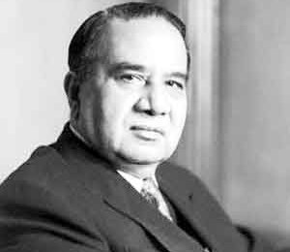
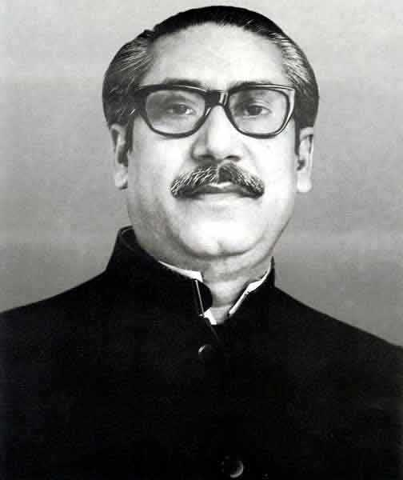
Key Political Person of Bangladesh ﴾Continued)
Huseyn Shaheed Suhrawardy was born in Midnapore, West Bengal. He served as the Prime Minister of Bengal in British India. He joined the Swaraj Party of Chittaranjan Das in 1921. As a member of the All-India Muslim League, he assumed the premiership of Bengal in the mid-1940s. In 1952, he joined the Awami League.
Along with A. K. Fazlul Huq and Maulana Bhashani, he led the United Front alliance in the 1954 East Bengal elections.
In 1956, Suhrawardy won the slot of Prime minister and was hastily appointed as fifth Prime Minister by President Iskander Mirza. He died in 1963 in Beirut, Lebanon after suffering a massive heart attack.
8 September 1892
5 December 1963
Sheikh Mujibur Rahman was the first President of Bangladesh during the Bangladesh Liberation War, and later became Prime Minister. In the formation of the Awami Muslim League, he was elected joint secretary. Following Suhrawardy's death in 1963, Mujib came to head of the Awami League.
With charismatic and forceful oratory, He inspired millions across East Pakistan to engage in the struggle for self-determination and independence.
In 1966, He proclaimed a 6-point plan titled Charter of Survival.
On 15 August 1975, a group of army officers killed Sheikh Mujib and his family.
17 March 1920
15 August 1975

Slide 25
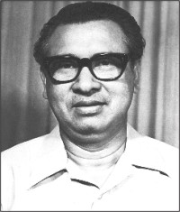
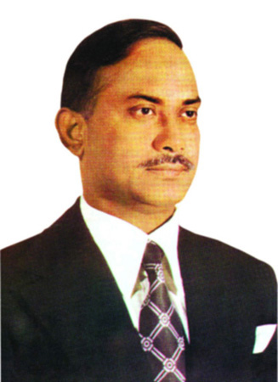
Key Political Person of Bangladesh ﴾Continued)
Tajuddin Ahmad served as the first Prime Minister of Bangladesh. Along with Bengali political and military leaders, he formed the first Government of Bangladesh in Meherpur in April 1971.
He organized protests and other activities during the Language Movement of 1952 also. He was arrested by police and imprisoned for several months.
He became the general secretary of the Awami League in the late 1960s and early 1970s. He coordinated the League’s election campaign in 1970, in which the League gained a historic parliamentary majority to form government.
Along with four other top League leaders, he was executed by members of the military in Dhaka Central Jail on 4 November 1975.
July 23, 1925
November 3, 1975
Ziaur Rahman was a military officer who served as the 7th President of Bangladesh. He was the commander of the Sector 11, during the war of independence. On 30 June 1971 he was appointed the commander of the Z Force.
On 7 November 1975, a mutiny staged by the Jatiyo Samajtantrik Dal with a group of army persons freed by Ziaur Rahman and appointed him as army chief.
He formed Bangladesh Nationalist Party in 1978, Re-introduced multi-party politics And announced a "19-point programme" of economic emancipation.
Zia began reorienting Bangladesh's foreign policy with United States, Western Europe, Africa, Middle East, Saudi Arabia and China.
19 January 1936
30 May 1981

Slide 26
References
Unfinished Memories, Sheikh Mujibur Rahman, UPL, 2012.
Bangladesh Revised: A Comprehensive Study of an Asian Nation, Muhamad Ruhul Amin, OSDER Publications, 2010.
Banglapeadia, National Encyclopedia of Bangladesh. Volume-1 to 10, Asiatic Society of Bangladesh, 2003.
History of Bangladesh (1704-1947), Edited by Sirajul Islam, Asiatic Society of Bangladesh, 1992.
Bangladesh: Emergence of a Nation, Muhith, A.M.A. Bangladesh Books International, 1978.
Bangladesher Itihash, Dr. M. Abdur Rahim, Dr. Abdul Momin Chowdhury, Dr. A.B.M. Mahmood and Dr. Sirajul Islam, Nawroze Kitabistan, Dhaka-1000.
History of Bengal, Majumdar, R, C. (1943), Dhaka.
The Bangladesh Revolution and its Aftermath, Maniruzzaman, Talukdar, (UPL), Dhaka.
Bangladesh: Itihash Porikroma, Khan Raisuddin K.M, (2009), Dhaka.

Slide 27
Chapter Related Questions
Write short note on ‘pre-ancient history’ of Bengal.
Discuss the development trend of mediaeval history f Bengal.
What were the revolt against British colonial rule? Discuss a brief.
Write a short brief on Independent kingdoms of south east Bengal in ancient period.
Write down the political dynamics of Mediaeval history f Bengal.
Describe the development trend of ancient history of Bengal.
Write a short brief on key political persons of Bangladesh.

Slide 28
Open discussion/ Feedback Session
What do you learn from today’s class?
Think , What will be the role of you?
Mention couple of problems that you unable to understand.
How can you assess today’s class environment?
How can we make it more active and impressive?
Thank You All.

