Slide 1
Digital Modulation
& Digital Receiver Design
Ref. Book: Communication Systems (Analog and Digital) is a reference book written by Sanjay Sharma
Chp-14 Digital Modulation Techniques

Slide 2
Fig. Digital Data Transmission System

Slide 3
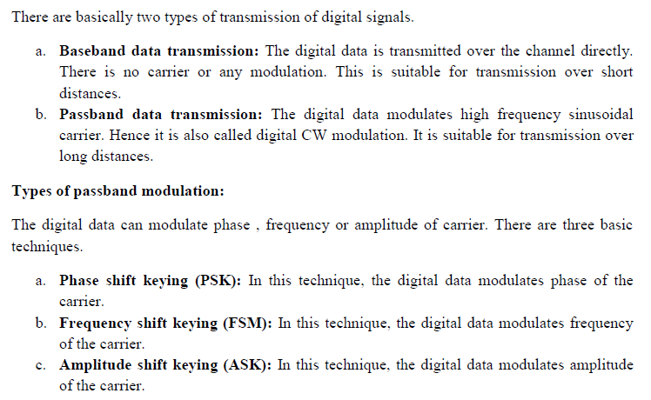

Slide 4
V(t)= A sin(2$π$fct+θ)
There are three types of Digital Modulation:
1.Amplitude Shift Keying(ASK) 2.Frequency Shift Keying(FSK) 3.Phase Shift Keying(PSK)
4. QAM (Quadrature Amplitude Modulation)
ASK
FSK
PSK

Slide 5
For amplitude shift keying: Vask =[1+Vm(t)] [A/2 cos 2$π$fct] when, Vm(t)=+1 Vask =[1+1]× A/2 cos2$π$fct Vask=A cos 2$π$fct when, Vm(t)=-1 Vask=0
Binary Data
Pulse
Representation
1 0 1 1 0 0 1 .........
t
Career
Signal
t
ASK Signal Of Frequency
t

Slide 6
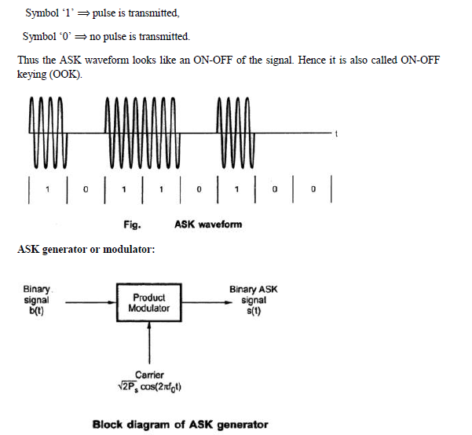

Slide 7
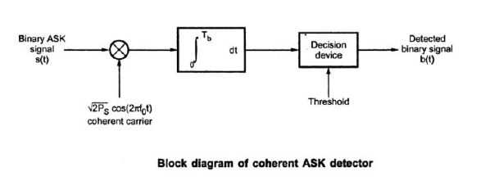
ASK Receiver

Slide 8
Frequency shift keying: if Vm(t)=+1 Vc(t)=A sin(2$π$f1t+θ) if Vm(t)=-1 Vc(t)= A sin(2$π$f2t+θ) where, F1>F2
Binary Data
Pulse
Representation
1 0 1 1 0 0 1 .........
t
Career
Signal
t
FSK Signal Of Frequency
t

Slide 9
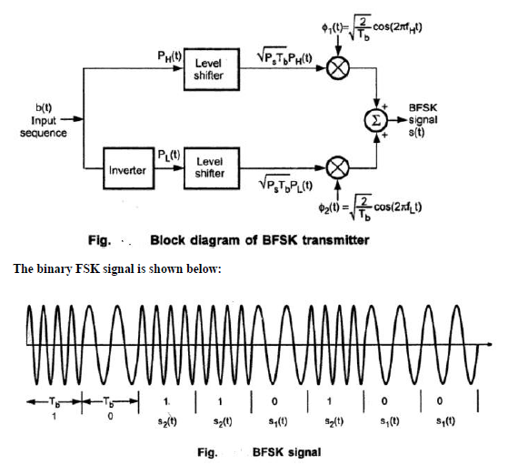

Slide 10
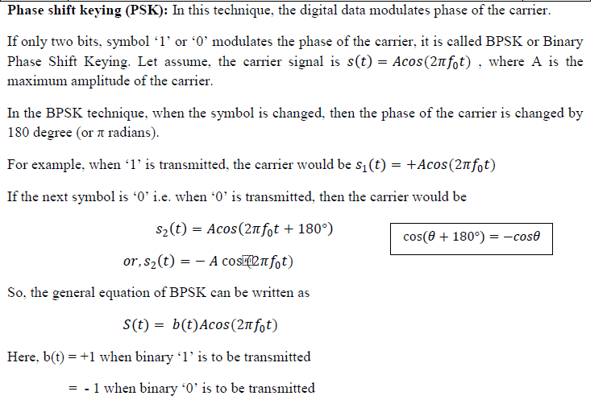
Phase Shifting Keying

Slide 11
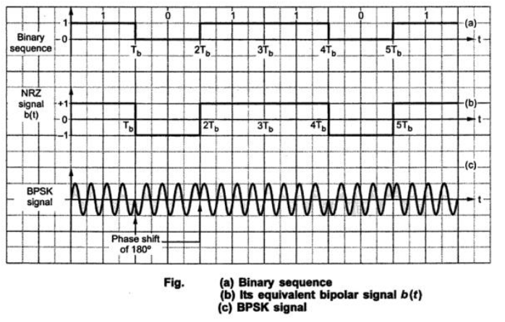

Slide 12
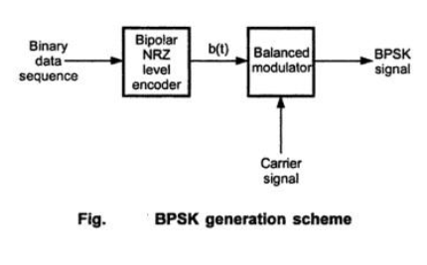
Generation of BPSK signal:

Slide 13
Phase Shifting Keying: if Vm(t)= +1, then θ=0° Vc(t)= A sin(2$π$f1+ θ) if Vm(t)= -1,Then θ=180° Vc(t)= A sin(2$π$f1+ θ)
Binary Data
Pulse
Representation
1 0 1 1 0 0 1 .........
t
Career
Signal
t
PSK Signal Of Frequency
t

Slide 14
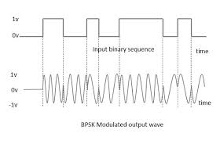

Slide 15
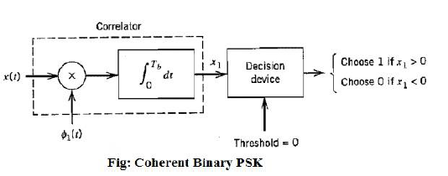
PSK Receiver

Slide 16
Quadrature Phase Shift Keying (QPSK)
If two or more bits are combined in some symbols, then the signaling rate is reduced. Therefore, the frequency of the carrier required is also reduced. This reduces the transmission channel bandwidth. Thus because of grouping of bits in symbols, the transmission channel bandwidth is reduced. In Quadrature phase shift keying, two successive bits in the data sequence are grouped together. This reduces the bit rate of signaling rate and hence reduces the bandwidth of the channel.
In BPSK, we know that when symbol changes the level, the phase of the carrier is changed by 180°. Since there were only two symbols in BPSK, the phase shift occurs in two levels only.
In QPSK , two successive bits are combined. This combination of two bits forms four distinct symbols. When the symbol is changed to next symbol, the phase of the carrier is changed by 45°(𝜋4 𝑟𝑎𝑑𝑖𝑎𝑛𝑠). Table shows these symbols and their phase shifts.

Slide 17
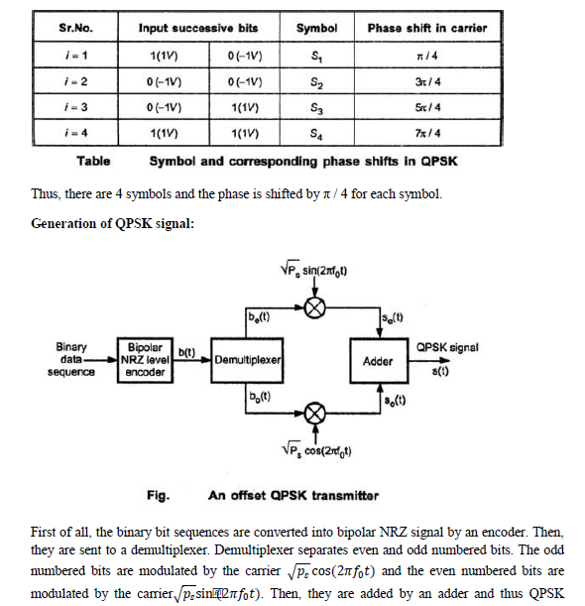

Slide 19
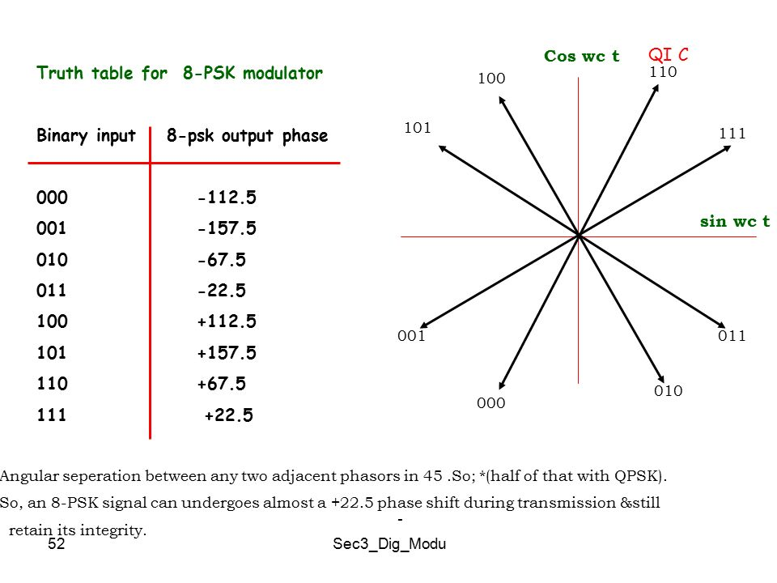

Slide 20
8PSK modulation and demodulation block diagram

Slide 21
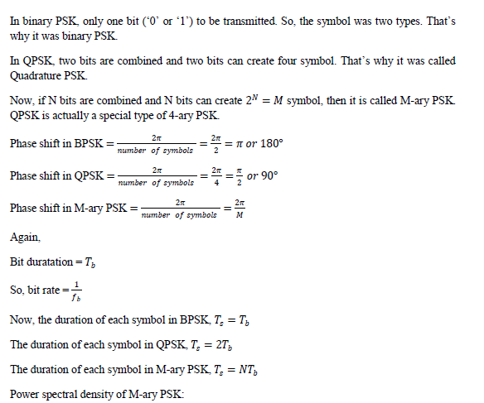
M-ary PSK.

Slide 22
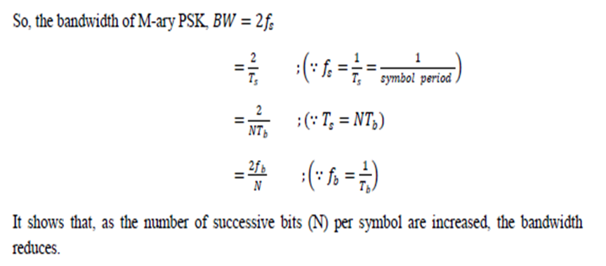

Slide 23
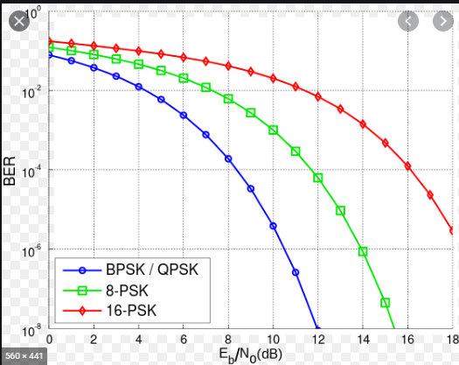

Slide 24
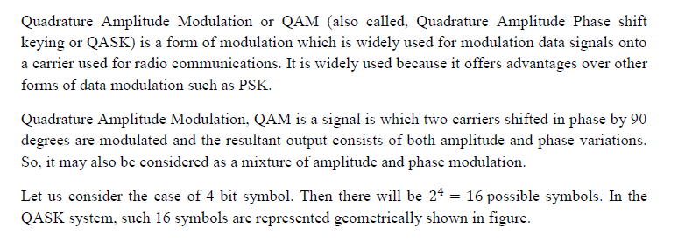
QAM (Quadrature Amplitude Modulation)

Slide 26
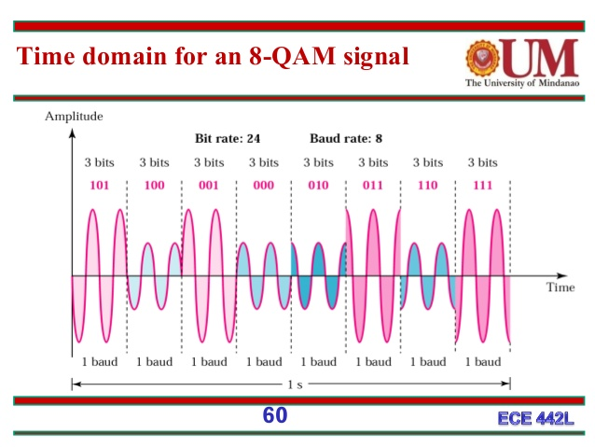

Slide 27
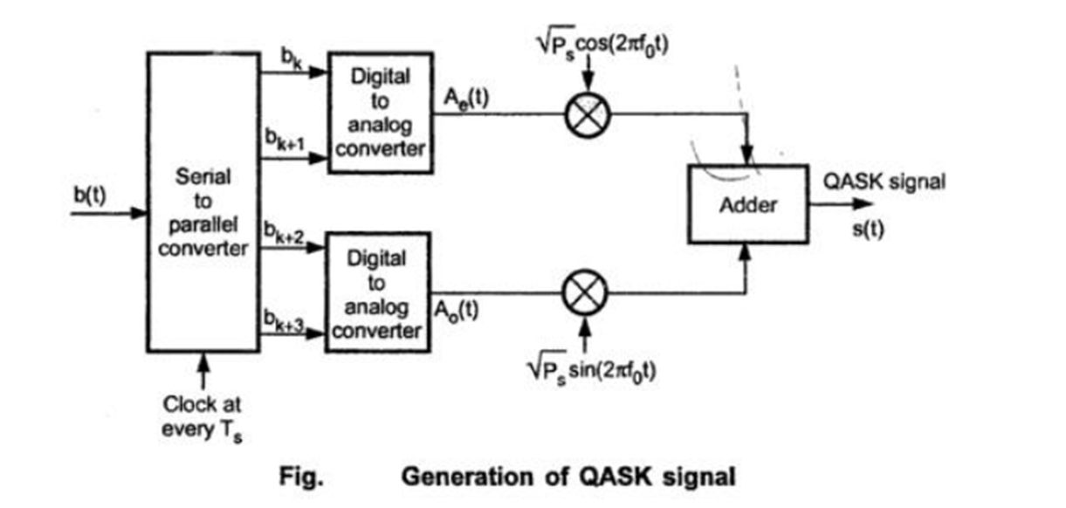

Slide 28
Fig: Digital transmitter
Antenna
Modula
tor
A/D
Pre-coder
BPF
Clock
Buffer
Analog Carrier

Slide 29
What is interchannel interference and intersymbol interference?
Interchannel interference: In a given transmission channel, the interference resulting from signals in one or more other channels is called interchannel interference. Example of interchannel interference: crosstalk in telephony; cross-view and other color in television.
Intersymbol interference: In telecommunication, Intersymbol Interference (ISI) is a form of distortion of a signal in which one symbol interferes with subsequent symbols. This is an unwanted phenomenon as the previous symbol have similar effect as noise, thus making the communication less reliable.

