Slide 1
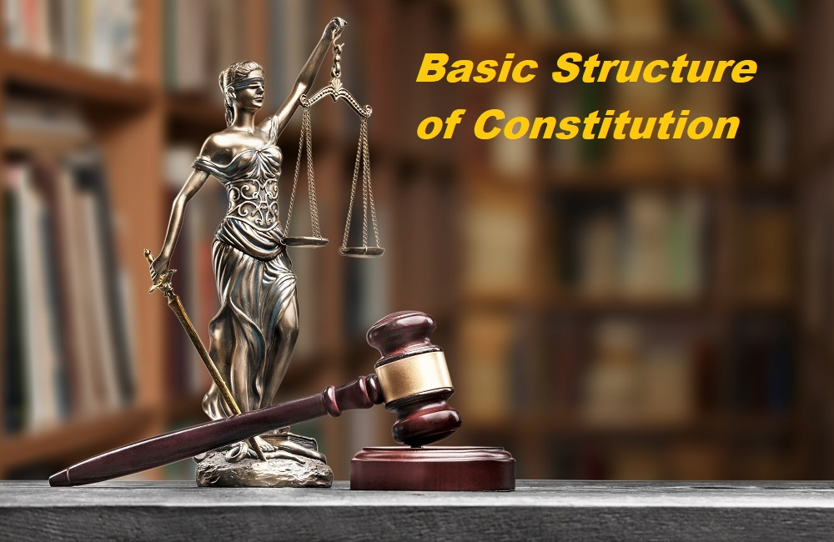

Slide 2
INTRODUCTION:
Firstly, we have to know that, what the basic structure of the constitution is. This doctrine is not a settled principle of constitutional law. It is a growing principle of Constitutional Jurisprudence. The basic structure doctrine is the judge made doctrine whereby certain features of a constitution are beyond the limit of the powers of amendment of a parliament. This doctrine also applies only to the constitutionality of amendments and not to the ordinary Acts of the parliament which must confirm to the entirety of the constitution.
.

Slide 3
Bangladesh Constitution and Basic Structure Doctrine
The Constitution of Bangladesh is the highest ruling of Bangladesh. It represents Bangladesh as a democratic republic nation where all the power is in the hands of Bangladeshi people and characterizes basic political principles of the state and stands for the fundamental rights of citizens. It was approved by the Assembly of Bangladesh on November 4, 1972; it was exercised from December 16, 1972.
The constitution stands as the most powerful evidence to state Bangladesh as a unitary, independent and Republic, founded on a struggle for national liberation, and that is how we achieve the People's Republic of Bangladesh. It lays a strong foundation of
Nationalism,
Secularity,
Democracy and
Socialism
as the essential ethics that stands for the Republic and declares the quest of a society that gives its citizens- the rule of law, fundamental civil rights and independence as well as fairness and evenhandedness, political, economic and social

Slide 4
The origin of the concept of "Basic Structures" of the constitution:
The concept of the basic structure of the constitution can be found in the sub-continent in the case of Pakistan Supreme Court in -FAZLIL QUDER CHOWDHURY Vs. ABDUL HAQUE. It was held that Franchise and form of government are fundamental features of a constitution. The power conferred upon the presidency by the constitution of Pakistan to remove difficulties does not extend to making an allegation in a fundamental feature of the constitution.
Kesavananda Bharati case (1973)
This was a landmark case in defining the concept of the basic structure doctrine in India.
The SC held that although no part of the Constitution, including Fundamental Rights, was beyond the Parliament’s amending power, the “Basic structure of the Constitution could not be abrogated even by a constitutional amendment.”

Slide 5
The Basic structure of the constitution of Bangladesh:
The constitution shall be the supreme law of the land for all times. Nothing can be done which is brings about a violation of the constitution and its basic features. That means the constitution of Bangladesh beings the embodiment of the WILL of the republic of Bangladesh which mentioned in Article 7 of the Bangladesh constitution. In the case of ANWAR HOSSAIN Vs. Bangladesh,
This case is also known as the eighth amendment case. Here Article 7 was prevailed. This is the first case whereby the Supreme Court of Bangladesh as striking down an amendment to the constitution made by the parliament. By two writ petition the amended article 100 and the notification of the chief justice were challenged. A division bench of the High Court Division (HCD) dismissed the petition summarily. Leave was granted by the Appellate Division (AD) by a majority of 3 to 1 striking down the 8th amendment.

Slide 6
The principle argument of the judgment is that-the constitution stands on certain fundamental principles which are the structural pillars. These basic features are:
1) Supremacy of the constitution which states in article 7 of the constitution.
2) Democracy which states in the preamble.
3) Republican government which states in the article 1 of the constitution.
4) Independence of judiciary which states in article 22 of the constitution.
5) Unitary state which is mentioned in article 1 of the constitution.
6) Separation of powers which is mentioned in article 22 of the constitution.
7) Fundamental rights which is mentioned in from Article 26 to 47A of the constitution.

Slide 7
These structural pillars of the constitution stand beyond any change by amendatory process. If these principles are curtailed more than one permanent seat of the Supreme Court by exercising the amending power, then it destroying the unitary character of the judiciary.
The amended article 100 is Ultra vires because it has destroyed the essential limb of the judiciary by setting up rival courts to the HCD in the name of permanent Benches conferring full jurisdiction, power and function of the HCD. The amended article 100 is inconsistent with article 44, 94, 101, and 102. It also reduced article108 to article 111 of the Bangladesh Constitution. It directly violated article 114, this amended is illegal because there is no provision of transfer which is essential requisite for dispensation of justice.

Slide 8
Conclusion
It is seen from the above abstract, that a few Amendments ended at one time under certain forceful situation were consequently detached by another Amendment, and also that numerous of these had a nationwide harmony. But a only some of the Amendments were endorsed without appropriate arguments and thorough discussions concerning all the pledge holders including people adhering to diverse, sometime differing, ideological or opinionated views. Amendments that were the consequence of unsophisticated thought, lack of esteem for democratic practices or suitability have clearly come under severe disapprovals, sometimes for suitable motives and sometimes for sectarian political ideas.

