Slide 1
Data Communication and Computer Networks EEE 485
Course Teacher: Md. Zakir Hasan(MZH)

Slide 2
Text Books
Behrouz A. Forouzan, “Data Communications and Networking”, 5th Edition McGraw Hill, 2012.
Bernard Sklar, “Digital Communications: Fundamentals and Applications”, 2nd Edition, Prentice Hall.

Slide 3
Course Objectives
To understand the general terminologies and trends in Data Communication and Computer Network.
To analyse the data transmission, interfacing, and line coding.
To explore the field of computer networking and communication, emphasizing network topologies and interference issues.
To get familiar with various network layers.
To analyse in-depth techniques for Computer Protocols and IP addressing.
To provide a brief knowledge about wireless communication.

Slide 4
Course Contents
Familiarization with the course, Basics of Data Communication
Transmission Impairments, Information on data capacity theorem, Shannon’s Capacity theorem, Nyquist theorem
PCM, Sampling, Quantization, Encoding, Quantization Error, Reduction of quantization error
DPCM, Delta Modulation, Error of Delta Modulation, Reducing Error
Digital to Digital Conversion-Source Coding, Line Coding
Block coding
Digital to Analog Conversion: ASK,FSK,PSK, BPSK
Error detection and correction. CRC and other methods. RS232 (or EIA 232D) V.24 interface standard
Classification of networks according to topology and size, Relation between LAN, MAN and WAN.
Network Layer: overview of TCP/IP protocol suite and OSI model
Internet applications, e-mail and file transfer SMTP and FTP, HTTP Wireless LAN, IEEE 802.11 and Bluetooth.

Slide 5
Course Contents
Multiple access- CSMA/CD, CSMA/CA, CDMA
Circuit and packet Switching: Space division and time division
switching, single node networks, Packet switching, Circuit switching and hybrid switching, Virtual circuit and data-grams
IP address and subnetting
Local Area Networks- traditional Ethernet, Fast Ethernet and Gigabit Ethernet, connecting devices, repeater, hub, bridge and switch
Transmission medium: guided and unguided
Review of lectures delivered so far and discussion with the students.

Slide 6
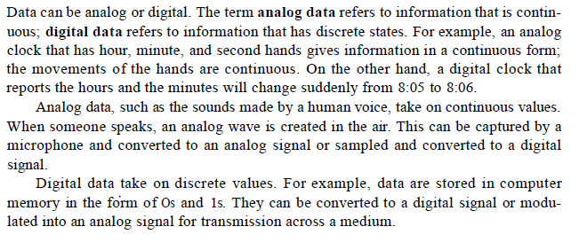
Data Communication(Analog and digital)

Slide 7
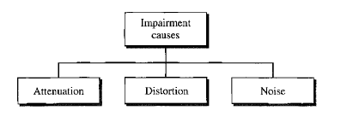
Transmission Impairments

Slide 8
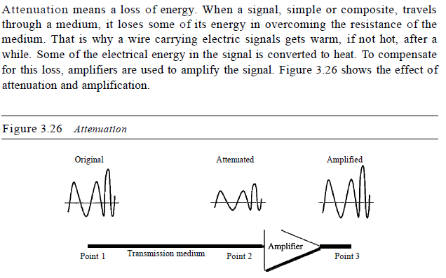
Attenuation

Slide 9
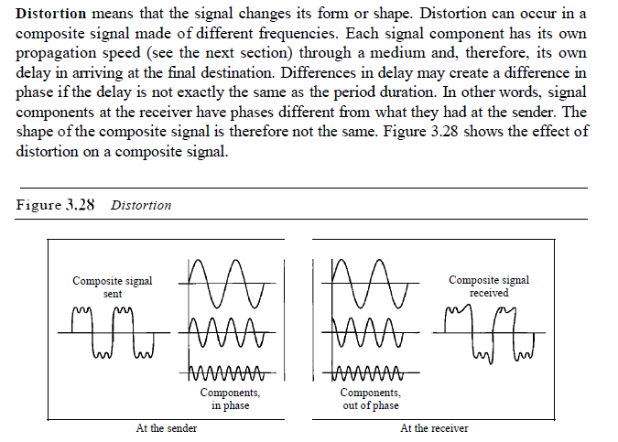
Distortion

Slide 10
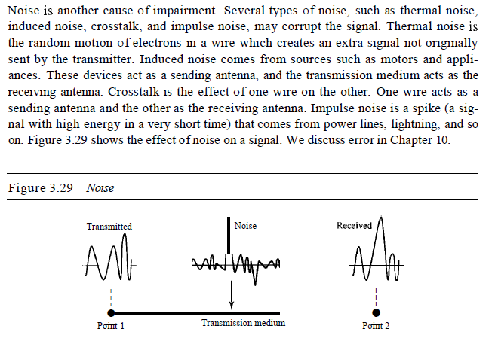
Noise

Slide 11
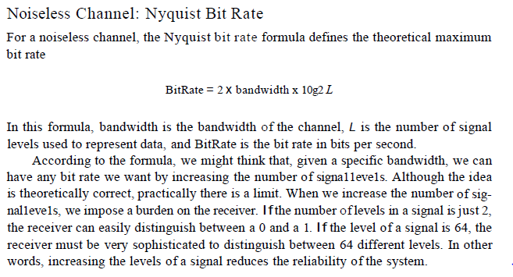

Slide 12
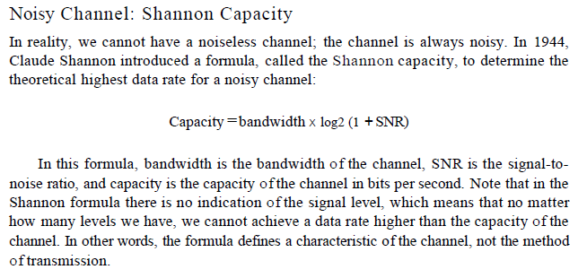

Slide 13
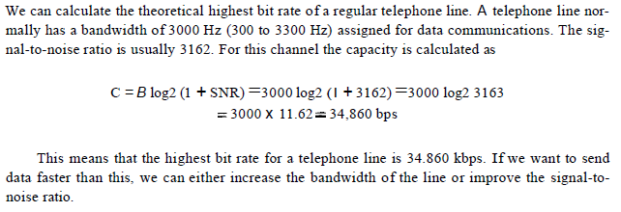
Maths

Slide 14
Test yourself

Slide 15
SNR(db to value)
23.92Mbps
SNRdb=10*log10(SNR)
265=2*20*log2L
6.625=log2L
2^6.625=L
L=98.4=>128
36/10=log(SNR)
10^3.6=SNR
C=2M*log2(1+3981)

Slide 16
L=2^n
L=2,4,8,16,32,64,128,256,512,1024
Bitrate=2*bandwidth*n
n= bit number
L=signal level
n=2(0,1)
L=2^2=4
1,2,3,4

