Slide 1
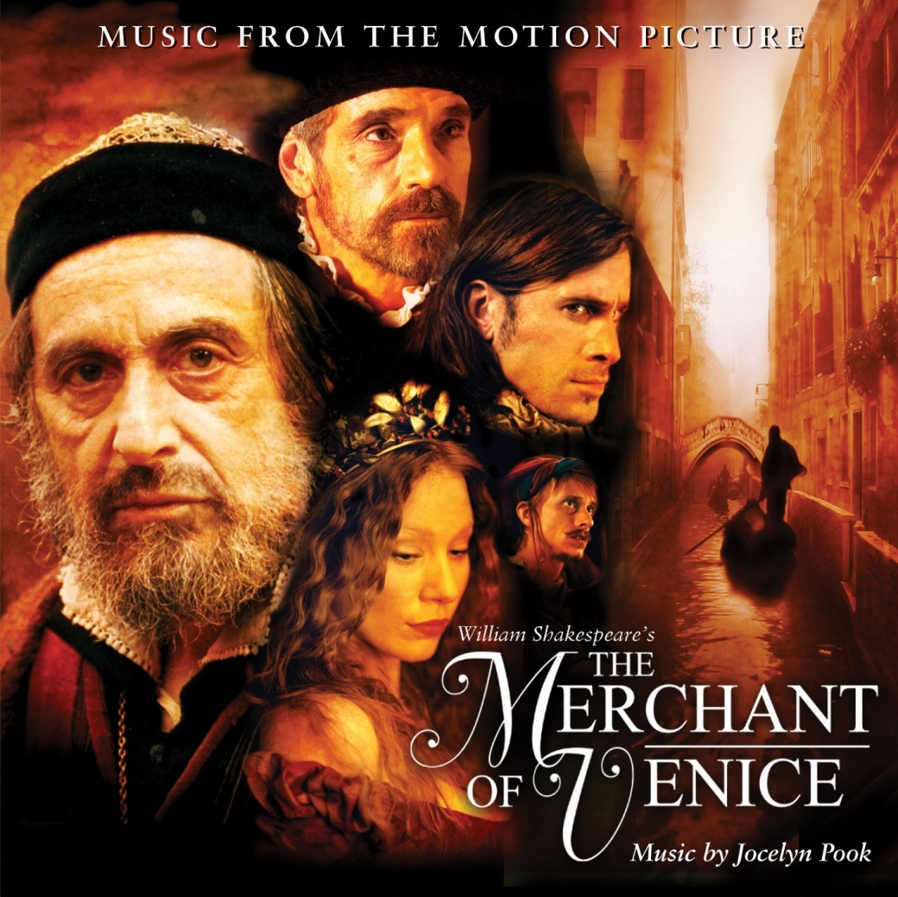
The Merchant of Venice
William Shakespeare

Slide 2
Key Facts
written in either 1596 or 1597
parts of the play are found in a number of contemporary Italian story collections
earliest performance record - held at the court of King James in the spring of 1605

Slide 3
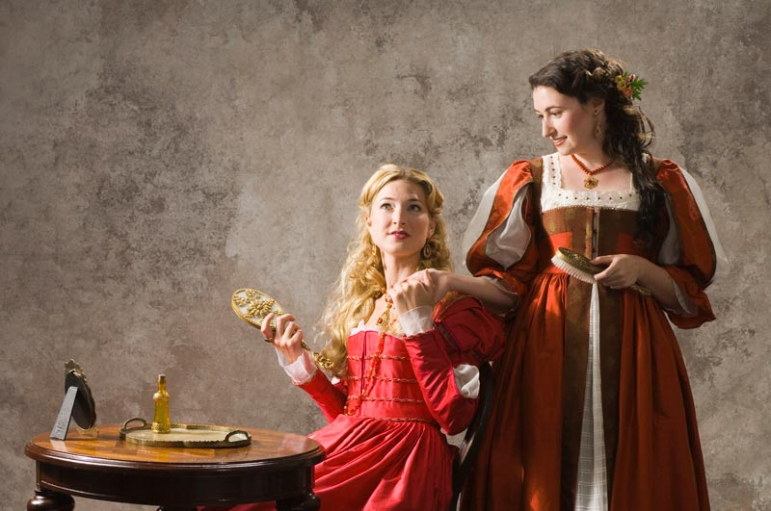
Portia & Nerissa

Slide 4
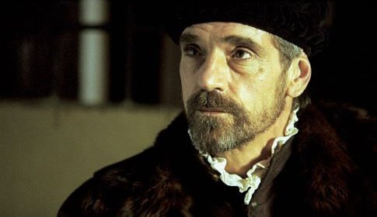
Antonio – The Title Character

Slide 5
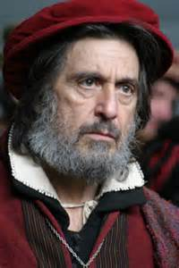
Shylock
On the Elizabethan stage, Jews
were often presented in a
caricature, with hooked noses and
bright red wigs, and were
depicted as avaricious usurers.
Many modern readers and
Theatre goers have read the play as
a plea for tolerance pointing out
Shylock's painful status in Venetian
society

Slide 6
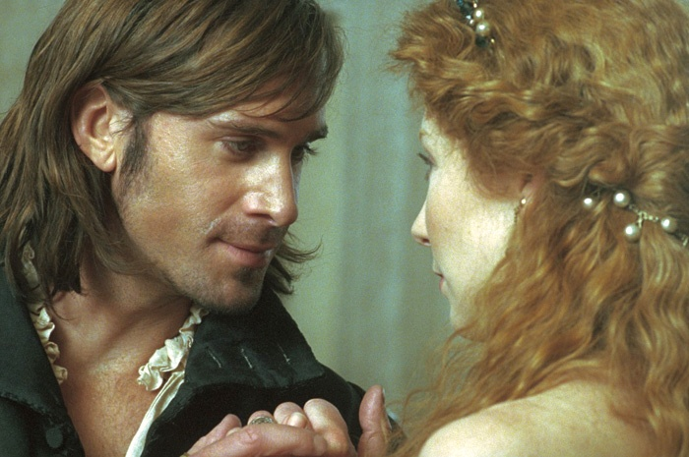
Bassanio & Portia

Slide 7
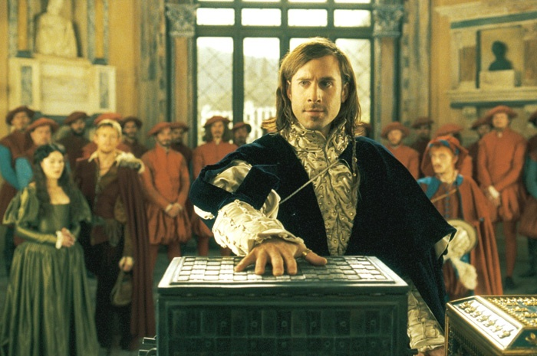
The Casket Scene

Slide 8
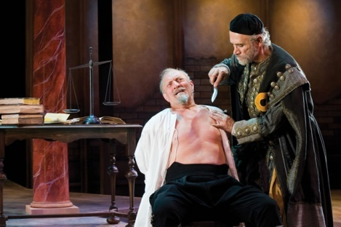
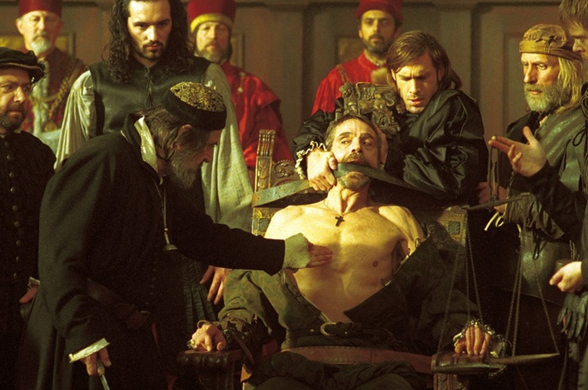
The Trial Scene

Slide 9
Themes
Antisemitism
Love
Mercy
Cycle of feelings of hatred
Filial Piety

