Slide 1
Role of NGOs in Microfinance:
The Case of Bangladesh
Mohammad Faisal Akber
Department of Development Studies
Daffodil International University

Slide 2
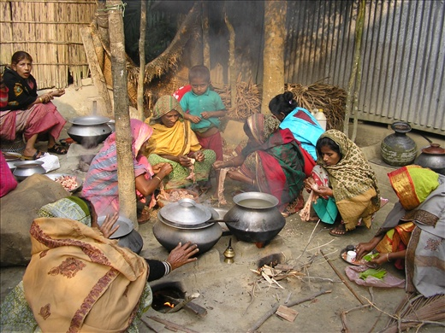
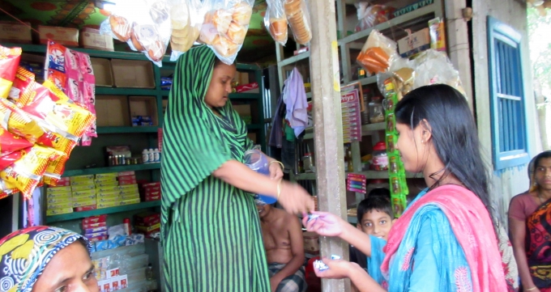

Slide 3
Microfinance and Microcredit
Microfinance
Microfinance is the provision of financial services such as loans, savings, insurance, and training to people living in poverty. (Opportunity International)
The provision of financial services to low-income clients or unique lending groups including Clients and the self-employed, who have lack access to banking and related services. (Wikipedia)
Microfinance is which low-income households have access to a affordable financial services offered by retail providers to finance income-producing activities, build assets, protect against risks.
Microcredit
Microcredit is the extension of very small loans (microloans) to the unemployed, to poor entrepreneurs and to others living in poverty who are not considered bankable.

Slide 4
Key Takeaways of Microfinance
Microfinance is a banking service provided to unemployed or low-income individuals or groups who otherwise would have no access to financial services.
Microfinance allows people to take on reasonable small business loans safely, and in a manner that is consistent with ethical lending practices.
The majority of micro financing operations occur in developing nations, such as Uganda, Indonesia, Serbia, and Honduras.
Like conventional lenders, micro financiers charge interest on loans and institute specific repayment plans.
The World Bank estimates that more than 500 million people have benefited from microfinance-related operations.

Slide 5
Micro-Credit
The word credit’ comes from Latin word ‘credo’ meaning ‘I believe or to trust’.
Hence “credit” entails someone, the lender, to believe or trust someone, the borrower with funds to be used by the borrower for his /her purposes, to be repaid to the lender with interest at a later stage on agreed terms and conditions.
In the doctrines of development, micro-credit is viewed as extension of small loans to women for income-generating projects.
Micro-credit has been portrayed as a magic bullet for poverty alleviation.
However, according to Professor Yunus, the Grameen Bank model of micro-credit is not solely a matter of the extension of credit; it has a unique set of social objectives that it aims to implement through micro-credit policies.

Slide 6
Key Takeaways of Microcredit
Microcredit is a method of lending very small sums to individuals to start or expand a small business.
Microcredit borrowers tend to be low-income individuals living in parts of the developing world; the practice originated in its modern form in Bangladesh.
Most microcredit schemes rely on a group borrowing model, originally developed by Nobel Prize winner Muhammad Yunus and his Grameen Bank.

Slide 7
Difference: Microfinance and Microcredit
Meaning
Microfinance indicates a number of financial services provided to the small entrepreneurs and enterprises who do not get finance from the banks or any other institutions.
Microcredit is a small loan facility provided to the people to those who have less earning and encourage to become self-employed.
Component
Microfinance is a whole concept.
A microcredit is an aspect or we can say a component of the microfinance. Microcredit is an extended service of the microfinance.
Services included
Microfinance includes a variety of services like savings, deposits, insurance, loan, pension, and credit. In short, it includes both credit and non-credit activities.
Microcredit includes loans and credit. It means only credit activities.

Slide 8
Features of Microfinance
Borrowers are from the low-income group
Loans are of the small amount called as microloans
Short duration loans
Loans are offered without Security
High frequency of repayment
Loans are generally taken for income generation purpose

Slide 9
Advantages and Disadvantages of Microfinance
Advantages
Collateral-free loans.
Disburse quick loan under urgency.
Help people to meet their financial needs.
Provide an extensive portfolio of loans.
Promote self-sufficiency and entrepreneurship.
Harsh repayment criteria.
Small Loan amount.
High-interest rate.
Disadvantages
Harsh repayment criteria.
Small Loan amount.
High-interest rate.

Slide 10
Aims of Microfinance
Poverty Reduction
(the original aim) through financial inclusion
Protection against income volatility (insurance)
Raising domestic savings in lowest income countries
Sustainable finance for new enterprises
Gender Empowerment
Microfinance has long been used in developing countries to help poor entrepreneurs who cannot access mainstream finance

Slide 11
Evolution & Trends
Microfinance existed in this country in one form or another for a long time.
Prof. Muhammad Yunus made the breakthrough with his action research in Jobra village of Chittagong in 1976 and then in Tangail in 1979.
Established Grameen Bank in 1983
“Grameen credit” is collateral-free, pro-women credit system
Today Grameen Bank is predominantly (90%) owned by the rural poor whom it serves with 2,565 branches (July, 2011)
Yunus & Grameen Bank received Nobel peace prize in 2006.
Mohammad Yunus, Bangladeshi Social Entrepreneur, Banker, Economist who was awarded Noble Peace Prize for founding the Grameen Bank and pioneering the concept of Microfinance.

Slide 12
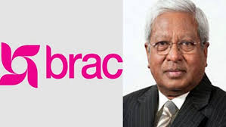
Evolution & Trends (Cont.)
Sir Fazle Hasan Abed established BRAC in 1972 for relief & rehabilitation operations following liberation war. It began community development in 1973 & microfinance in 1974. BRAC has many “credit-plus” programs on health, education, legal services.
ASA was founded by Md. Shafiqual Haque Choudhury in 1978 & was registered in 1979. ASA is the most efficient in operation.
All these 3 MFIs perform international operations and occupy three-fourth of the industry. Some other large MFIs are Proshika, BURO, TMSS, SSS, Shakti, Uddipan, PMUK, JCF.

Slide 13
Evolution & Trends (Cont.)
Specialized institutions, Government & commercial banks also retails microcredit. Major players in the field:
Palli Karma-Sahayak Foundation (PKSF) was established in 1990. It implements its programs through its 250 member institutions with wholesale microfinance & training.
Microcredit Regulatory Authority (MRA) was established in 2006 for licensing & monitoring microfinance institutions. It has given licenses to about 550 MFIs so far.
Institute of Microfinance (InM) was also established in 2006 as an independent research & training organization. It does not have a microfinance program.

Slide 14
Who are the Suppliers of Microcredit
The principal microcredit service providers in Bangladesh are usually categorized into four major groups:
NGOs
Specialized Institutions
Commercial Banks with microcredit programs
Administrative ministries or divisions
Although there are thousands of NGOs throughout the country offering micro credits, many of them are very small in loan portfolio or number of borrowers, and the majority of micro credit clients are being served by four huge Microcredit institutions, namely Grameen Bank, BRAC, ASA and Govt. agencies & BRDB. The World Bank estimates that in 2005 the four institutions combined account for 86% of all active borrowers and over 90% of all outstanding loans in the Bangladesh Microcredit sector.

Slide 15
Who are the clients of microcredit?
Typical microcredit clients are poor and low-income people that do not have access to other formal financial institutions.
Microcredit clients are often self-employed, household-based entrepreneurs.
Their diverse “microenterprises” include small retail shops, street vending, artisanal manufacture, and service provision.
In rural areas, micro entrepreneurs often have small income-generating activities such as food processing and trade; some but far from all are farmers.
Most clients below the poverty line are in the upper half of the poor. It is clear, however, that some MFIs can serve clients at the higher end of the bottom half.
Women often comprise the majority of clients.

Slide 16
Role of Microfinance NGOs
Direct Lender: The NGOs provide loans to low income people and those living in remote rural areas. They employ methods that allow it to cover all of their costs with earned income when they reach adequate economies of scale. The NGOs may borrow from the financial markets to increase the size of their revolving loan fund.
Matchmaker: The NGOs link borrowers and savers to the banks. They take on the tasks of organizing, training, assessing, monitoring and collecting from the clients. The NGOs receive income for the services they provide, either as a fee from the bank or by borrowing from the bank and re-lending the money to their clients at a higher rate.
Packager: The NGOs provide production, marketing, management, and accounting assistance and training to rural enterprises to help them develop to the point where they can access financial services from a bank.

Slide 17
Role of Microfinance NGOs
Product Developer: The NGOs experiment with innovative methods for providing financial services in rural areas. They develop credit and savings products that banks can implement profitably. NGOs then teach the banks how to use these products.
Trainer of Financial Institutions: The NGOs provide training to the staff and management of a bank, helping them to understand and implement successful methodologies for rural financial intermediation.
Trainer of NGOs: The NGOs provide training to other NGOs, helping them to acquire the expertise and financial disciplines needed to implement financial service programs. The NGOs playing this role, often serves as an apex institution, coordinating training and evaluations of several NGOs working in rural finance.

Slide 18
Impact of Microfinance
The World Bank's 2008 Poverty Assessment has two findings in this context-
First, Microfinance has expanded more in areas that were poorer, presumably because the better-off geographical areas were covered in the previous decade.
Second, the reduction in poverty in rural Bangladesh has been much more in upazilas where microfinance membership increased more rapidly.
Microfinance has positive impact on Women Empowerment, Consumption Smoothing, and to some extent, in Building Assets.

Slide 19
Impact of Microfinance
Socio-economic impact of microfinance
Access to finance & breaking Mahajans’ circles
Helps mitigating seasonal hunger & shocks
Promotes employment & productivity
Facilitates savings & builds up asset
Empowers women
Fertility transition & contraceptive use
Self-employment, favorable agricultural contract
Migration
Rural power structure

Slide 20
Broad Category |  | Indicators |  | Cause of Change
Economic Impact |  | Income |  | Self employment activities
 |  |  |  | Greater access to cultivable land through the rental market
 |  | Food Security
 |  | Wage (land poor)
 |  |  |  | Transport and other non-agri activities support by microcredit
 |  | Employment (land poor) |  |  | Better access to the land rental market wage employment in non-agri sector
 |  | Assets (land poor) |  |  | Poultry livestock, bi-cycles, rickshaw/van
Social and development impacts |  | Fertility and contraceptive use |  |  | program participation female methods dominate
 |  | Health and Nutrition |  |  | program placement effect
 |  | Sanitation and drinking water |  |  | program participation
 |  | Literacy and school enrollment of children |  |  | program participation
 |  | Social mobility |  |  | do not vary significantly

Slide 21
Impact of Microfinance over poverty
Through the labour market
Through the capital market
Through the markets for goods consumed by poor people
Through production linkages

Slide 22
Impact of Microfinance in Women Empowerment
Rural women at a glance
Loan facilities
Saving facilities
Sources of finance available
Official system
Unofficial system
Agriculture organization
Training of and information for rural women
Women's Role in Economy
Women and micro finance
Women’s participation in Microfinancing activities

Slide 23
Women in Social Structure
Men
Social Structure
The Difference
Women

Slide 24
Microcredit and Rural Women Empowerment
Microcredit
Independent Income
Greater Control on household economy
Economic Empowerment

Slide 25
Microcredit Strengthens Women’s Decision Making Power within the Household
Participation in Decision Making Process
Gaining More Resources
Becoming Empowered

Slide 26
Impact of Microcredit on Health and Nutrition Status
Women achieve economic power through microcredit
Women also possess the responsibility of family hygiene in rural areas
Becoming empowered, women can take care of the sanitation system and family hygiene
Thus better health and nutrition status can be achieved
Achieving Better Health

Slide 27
Financial & Physical Capital Effects of Micro-credit
Borrowers change their previous jobs (wood cutting, destroying forests etc.)
Micro-credit enables borrowers to focus on present consumption instead of future consumption

Slide 28
Increased Income & Ownership
Micro-credit enables borrowers to -
Have a developed sense of ownership over environmental resources which they would have destroyed mercilessly in the past.

Slide 29
Income Diversification
Micro-credit encourages the borrowers for income diversification
Microcredit Decreases Overgrazing and Deforestation
The Borrowers of Micro-credit invest their income into various activities which in turn reduces pressure on environment

Slide 30
What Does Micro-Credit Do?
It promotes credit as a human right.
It is aimed towards the poor, particularly poor women.
It is based on ‘trust’, not on legal procedures and system.
It is offered to create self-employment, income-generating activities and housing for the poor, as opposed to consumption.
It was initiated as a challenge to conventional banking which rejected the poor by classifying them as ‘not creditworthy’.
It provides service on the door-step of the poor based on the principle that the people should not go to the bank, the bank should go to the people.
It gives high priority to building social capital.

Slide 31
The Micro-credit Program in BRAC
Microfinance is one of the oldest programs in BRAC.
Since it launched in 1974, it has covered all 64 districts.
It provides four stages as a ladder to help the vast majority of the population get out of the poverty trap.
The Micro-credit Program in BRAC: Four Step Ladder
First is to provide asset grants and soft loans from the targeting the Ultra Poor program
Second is to borrow microloans from the Dabi scheme
Third is to borrow microloans from the Progoti scheme
Fourth is to borrow SME (Small and medium enterprises) loans from mainstream banks

Slide 32
Adverse effect of microfinance
Works mainly on moderate poor, no long run impact. But Sustainable savings more important in long run.
Some borrowers benefitted but a lot struggling, over-indebtedness and asset loss.
Sub-prime style lending, charged high rates of interest
Coercive collection practices by some lenders
Micro-finance cannot compensate for inadequate healthcare, education or infrastructure

Slide 33
References
Alamgir, D. (2010). State of Microfinance in Bangladesh. Dhaka: Institute of Microfinance.
CDF. (1996-2006). Bangladesh Microfinance Statistics. Dhaka: Credit & Development Forum.
Faruqee, R., & Badruddoza, S. (2011). Microfinance in Bangladesh: Past, Present and Future . Dhaka: Institute of Microfinance.
Hasan, T. (2011). Governance of MFIs in Bangladesh. Dhaka: Institute of Microfinance.

