Slide 1
Designing and Managing Integrated Marketing Communications
17
Marketing Management, 13th ed

Slide 2
Chapter Questions*
*This questions are important for final exam.
What is the role of marketing communications?
How do marketing communications work?
What are the major steps in developing effective communications?
What is the communications mix and how should it be set?
What is an integrated marketing communications program?
Copyright © 2009 Pearson Education, Inc. Publishing as Prentice Hall 17-2

Slide 3
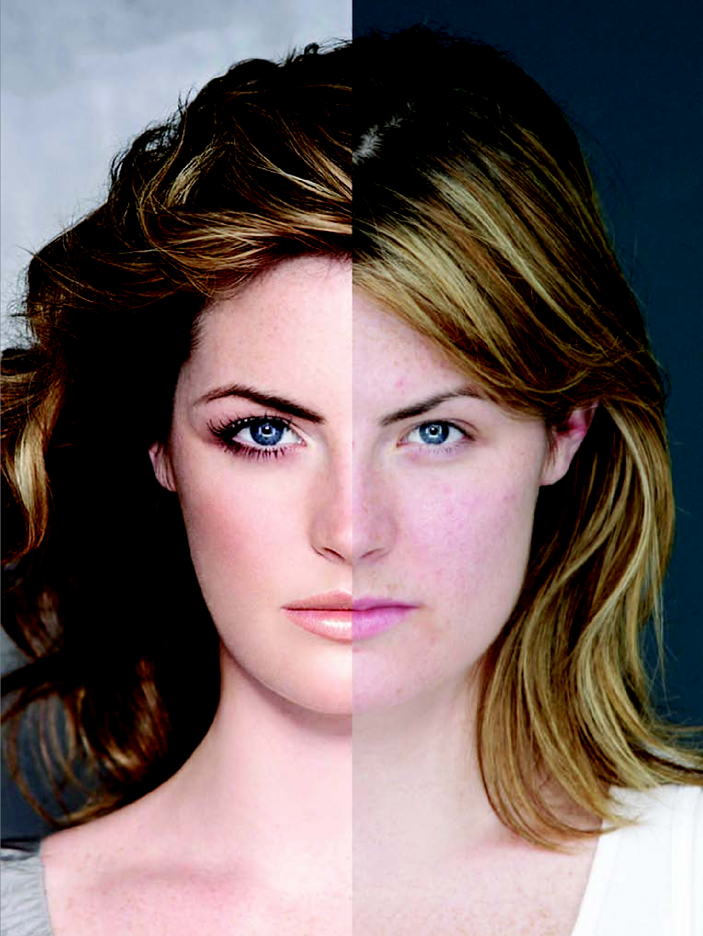
Dove’s Campaign for Real Beauty
Copyright © 2009 Pearson Education, Inc. Publishing as Prentice Hall 17-3

Slide 4
What are Marketing Communications?
Marketing communications are the means by which firms attempt to inform, persuade, and remind consumers, directly or indirectly, about the products and brands they sell.
Copyright © 2009 Pearson Education, Inc. Publishing as Prentice Hall 17-4

Slide 5
Modes of Marketing Communications
Advertising
Sales promotion
Events and experiences
Public relations and publicity
Direct marketing
Interactive marketing
Word-of-mouth marketing
Personal selling
Copyright © 2009 Pearson Education, Inc. Publishing as Prentice Hall 17-5

Slide 6
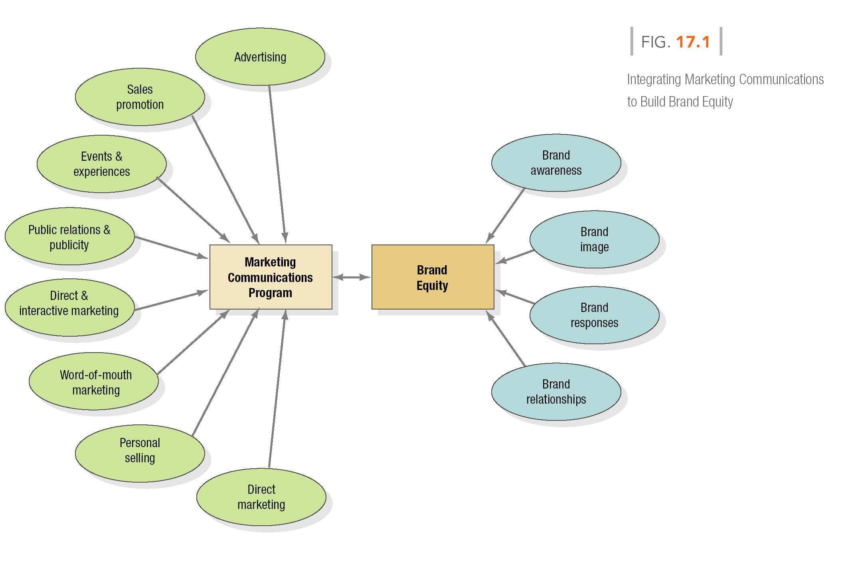
Figure 17.1 IMC Builds Brands
Copyright © 2009 Pearson Education, Inc. Publishing as Prentice Hall 17-6

Slide 7
Table 17.1 Communication Platforms
Advertising
Print and broadcast ads
Packaging inserts
Motion pictures
Brochures and booklets
Posters
Billboards
POP displays
Logos
Videotapes
Sales Promotion
Contests, games, sweepstakes
Premiums
Sampling
Trade shows, exhibits
Coupons
Rebates
Entertainment
Continuity programs
Copyright © 2009 Pearson Education, Inc. Publishing as Prentice Hall 17-7

Slide 8
Table 17.1 Communication Platforms
Events/ Experiences
Sports
Entertainment
Festivals
Arts
Causes
Factory tours
Company museums
Street activities
Public Relations
Press kits
Speeches
Seminars
Annual reports
Charitable donations
Publications
Community relations
Lobbying
Identity media
Company magazine
Copyright © 2009 Pearson Education, Inc. Publishing as Prentice Hall 17-8

Slide 9
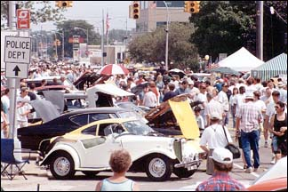
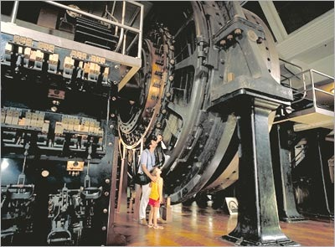
Visitors to the Woodward Dream Cruise Often Tour Ford’s Factory Museum
Copyright © 2009 Pearson Education, Inc. Publishing as Prentice Hall 17-9

Slide 10
Table 17.1 Communication Platforms
Personal Selling
Sales presentations
Sales meetings
Incentive programs
Samples
Fairs and trade shows
Direct Marketing
Catalogs
Mailings
Telemarketing
Electronic shopping
TV shopping
Fax mail
E-mail
Voice mail
Blogs
Websites
Copyright © 2009 Pearson Education, Inc. Publishing as Prentice Hall 17-10

Slide 11
Word-of-Mouth Marketing
Person-to-person
Chat rooms
Blogs
Copyright © 2009 Pearson Education, Inc. Publishing as Prentice Hall 17-11

Slide 12
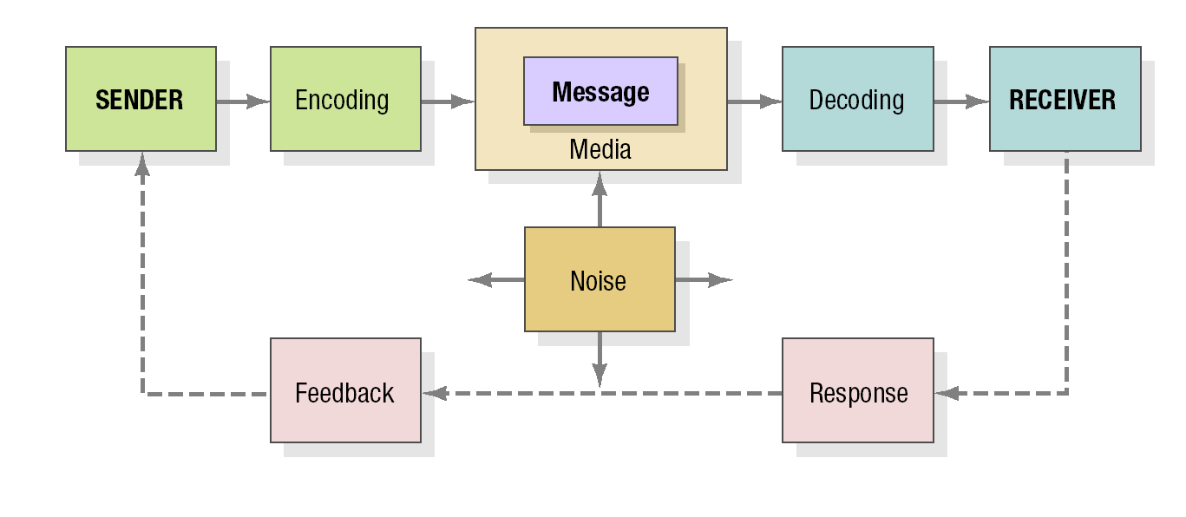
Figure17.2 Elements in the Communications Process*
*This question is VVI for final exam
Copyright © 2009 Pearson Education, Inc. Publishing as Prentice Hall 17-12

Slide 13
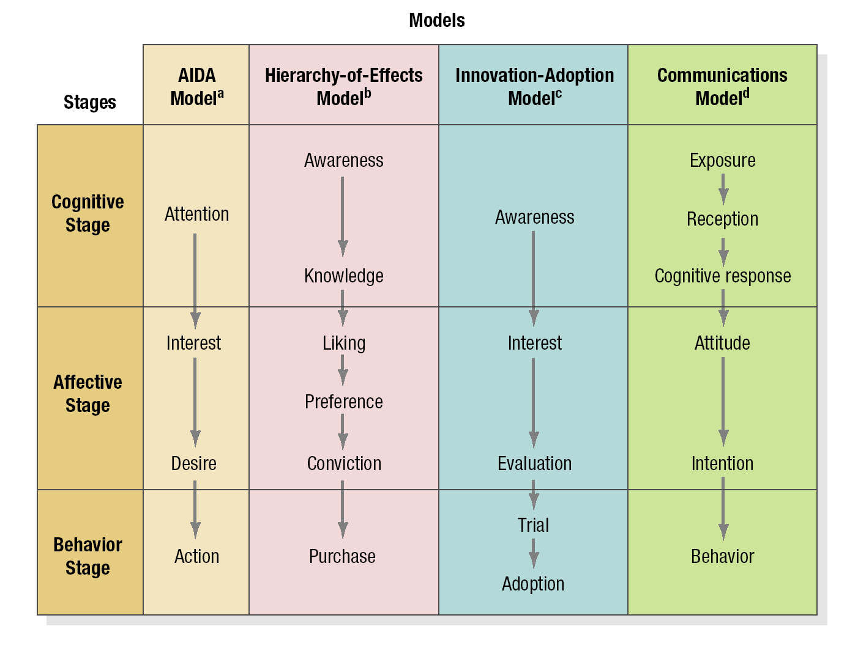
Figure 17.3 Response Hierarchy Models
Copyright © 2009 Pearson Education, Inc. Publishing as Prentice Hall 17-15

Slide 14
An Ideal Ad Campaign
The right consumer is exposed to the message at the right time and place
The ad causes consumer to pay attention
The ad reflects consumer’s level of understanding and behaviors with product
The ad correctly positions brand in terms of points-of-difference and points-of-parity
The ad motivates consumers to consider purchase of the brand
The ad creates strong brand associations
Copyright © 2009 Pearson Education, Inc. Publishing as Prentice Hall 17-16

Slide 15
Figure 17.4 Steps in Developing Effective Communications
Identify target audience
Determine objectives
Design communications
Select channels
Establish budget
Decide on media mix
Measure results/ manage IMC
Copyright © 2009 Pearson Education, Inc. Publishing as Prentice Hall 17-17

Slide 16
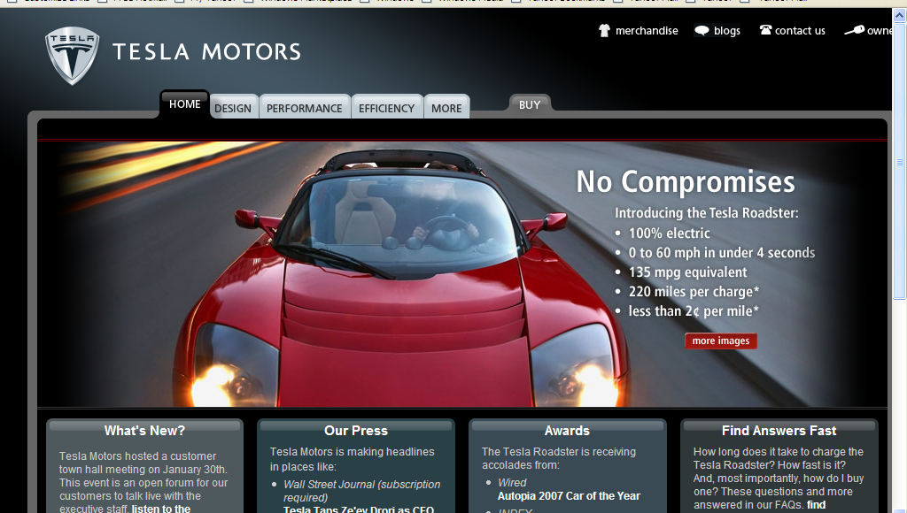
Communications Objectives
Category Need
Brand Awareness
Brand Attitude
Purchase Intention
Copyright © 2009 Pearson Education, Inc. Publishing as Prentice Hall 17-18

Slide 17
Designing the Communications
Message strategy
Creative strategy
Message source
Global adaptation
Copyright © 2009 Pearson Education, Inc. Publishing as Prentice Hall 17-19
Notes:
Video icon links to American Express video on how it changed message strategies with the use of celebrity endorser, Jerry Seinfeld, and the use of webisodes online.

Slide 18
Issues Facing Global Adaptations
Is the product restricted in some countries?
Are there restrictions on advertising the product to a specific target market?
Can comparative ads be used?
Can the same advertising be used in all country markets?
Copyright © 2009 Pearson Education, Inc. Publishing as Prentice Hall 17-22

Slide 19
Select Communication Channels
Personal channels
Nonpersonal channels
Integration of channels
Copyright © 2009 Pearson Education, Inc. Publishing as Prentice Hall 17-23

Slide 20
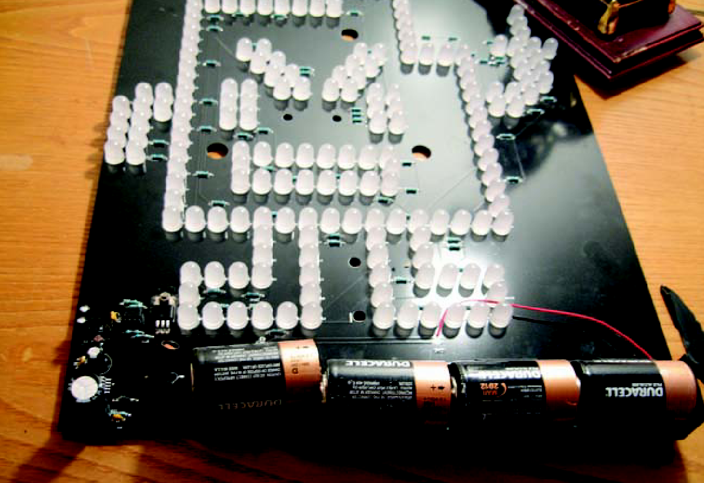
Nonpersonal Communication Channels
Media
Sales Promotion
Events and Experiences
Public Relations
Copyright © 2009 Pearson Education, Inc. Publishing as Prentice Hall 17-26

Slide 21
Establish the Budget
Affordable
Percentage-of-Sales
Competitive Parity
Objective-and-Task
Copyright © 2009 Pearson Education, Inc. Publishing as Prentice Hall 17-27

Slide 22
Objective-and-Task Method
Establish the market share goal
Determine the percentage that should be reached
Determine the percentage of aware prospects that should be persuaded to try the brand
Determine the number of advertising impressions per 1% trial rate
Determine the number of gross rating points that would have to be purchased
Determine the necessary advertising budget on the basis of the average cost of buying a GRP
Copyright © 2009 Pearson Education, Inc. Publishing as Prentice Hall 17-28

Slide 23
Characteristics of The Marketing Communications Mix
Advertising
Pervasiveness
Amplified expressiveness
Impersonality
Sales Promotion
Communication
Incentive
Invitation
Copyright © 2009 Pearson Education, Inc. Publishing as Prentice Hall 17-29

Slide 24
Characteristics of the Marketing Communications Mix
Public Relations and Publicity
High credibility
Ability to catch buyers off guard
Dramatization
Events and Experiences
Relevant
Involving
Implicit
Copyright © 2009 Pearson Education, Inc. Publishing as Prentice Hall 17-30

Slide 25
Characteristics of the Marketing Communications Mix
Direct Marketing
Customized
Up-to-date
Interactive
Personal Selling
Personal interaction
Cultivation
Response
Word-of-Mouth Marketing
Credible
Personal
Timely
Copyright © 2009 Pearson Education, Inc. Publishing as Prentice Hall 17-31

Slide 26
Factors in Setting Communications Mix
Type of product market
Buyer readiness stage
Product life cycle stage
Copyright © 2009 Pearson Education, Inc. Publishing as Prentice Hall 17-32

Slide 27
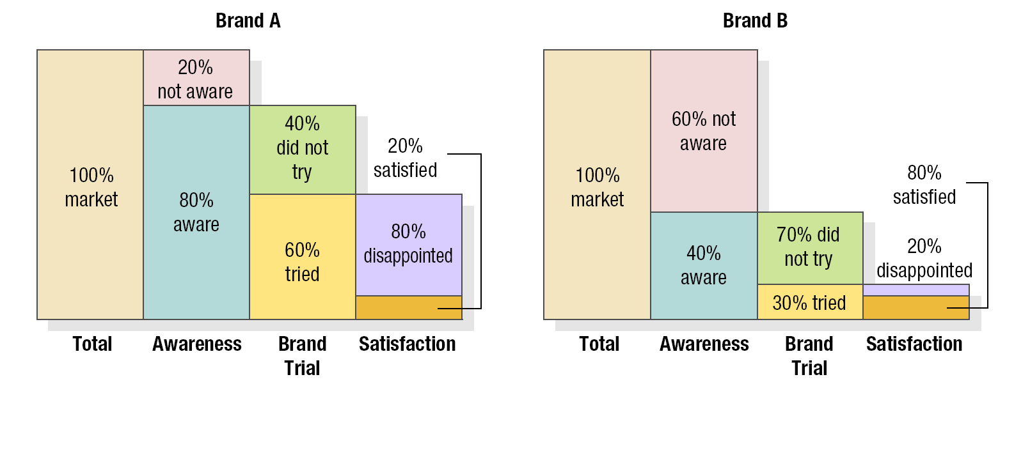
Figure 17.6 Current Consumer States for Two Brands
Copyright © 2009 Pearson Education, Inc. Publishing as Prentice Hall 17-34

Slide 28
Marketing Debate
Has TV advertising lost power?
Take a position:
TV advertising has faded in importance.
or
2. TV advertising is still the most powerful
advertising medium.
Copyright © 2009 Pearson Education, Inc. Publishing as Prentice Hall 17-36

Slide 29
Marketing Discussion*
*This topic is important for Final Exam
Pick a brand and go to the Website.
Locate as many forms of
communication as you can find.
Conduct an informal communications
audit. What do you notice? How
consistent are the different
communications?
Copyright © 2009 Pearson Education, Inc. Publishing as Prentice Hall 17-37

