Slide 1
INTRODUCTION TO INTERNATIONAL FINANCIAL MANAGEMENT

Slide 2
LEARNING OBJECTIVES
What is International Financial Management and why do we need to study it?
What are the goals of International Financial Management?
What are the key trends in the world economy?
What is a multinational corporation and what are the basic types?
How does International financial management differ from domestic financial management?

Slide 3
Contents of IFM
Foreign
Exchange
Markets
Sourcing
Capital in
Global Markets
International
Financial
Management
Synthesis
Managing
FOREX
Exposure
Foreign
Investment
Decisions

Slide 4
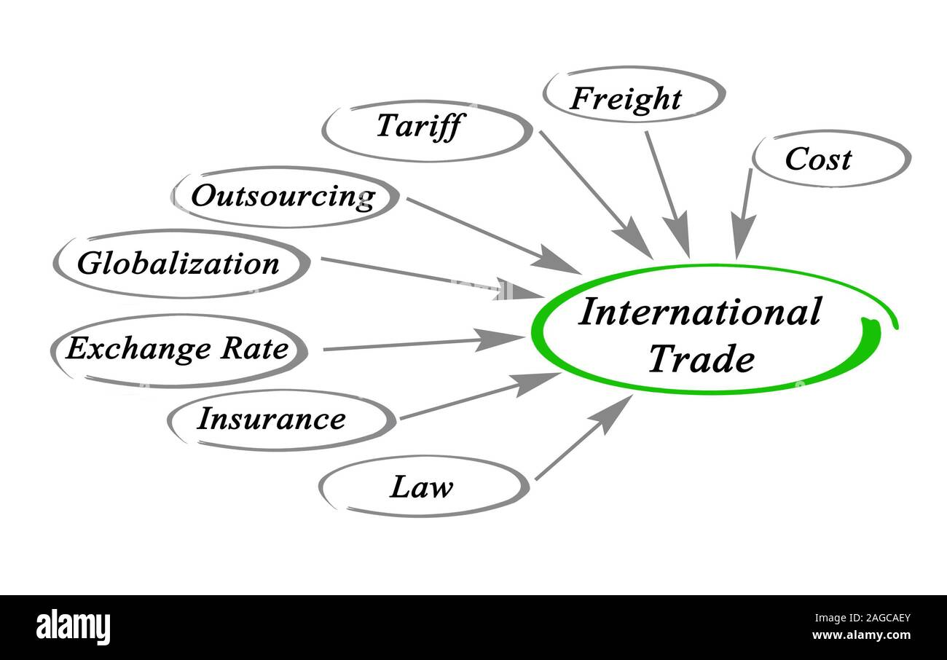

Slide 5
What are the Key Issues of International Financial Management?
Foreign exchange risk
IFM deals with exchange risk. Appreciation or devaluation of a currency may have an adverse effect on a company’s product pricing, input cost and financial state of affairs.
Political risk
An unexpected overturn of the government may jeopardize existing negotiated contract. On the other hand expropriation of assets by the host government could ruin company’s investment.
Market imperfections
Trade barriers and tax incentives may affect location of production.
Expanded opportunity sets
Could raise funds in global markets and may gain from economies of scale.

Slide 6
What is the Goal of Multinational Financial Management?
Corporate Goals
Shareholder Wealth Maximization
Corporate Wealth Maximization
Operational Goals
Maximizing consolidated profits after taxes
Minimizing the firm’s effective global tax burden
Correct positioning of the firm’s income, cash flows, and available funds

Slide 7
Conflict and Constraints with the MNC’s Goal
Agency problem
Environmental constraints
Regulatory constraints
Ethical constraints

Slide 8
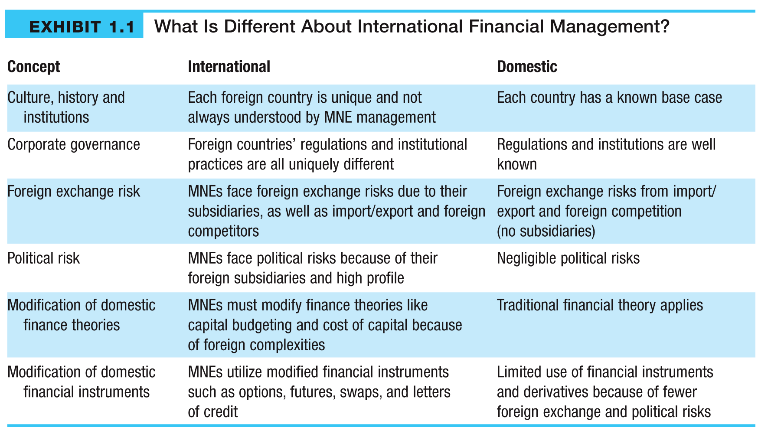
How International FM Differ from the Domestic One

Slide 9
The importance of international trade
International trade between different countries is an important factor in raising living standards, providing employment and enabling consumers to enjoy a greater variety of goods.
International trade has occurred since the earliest civilizations began trading, but in recent years international trade has become increasingly important with a larger share of GDP devoted to exports and imports.

Slide 10
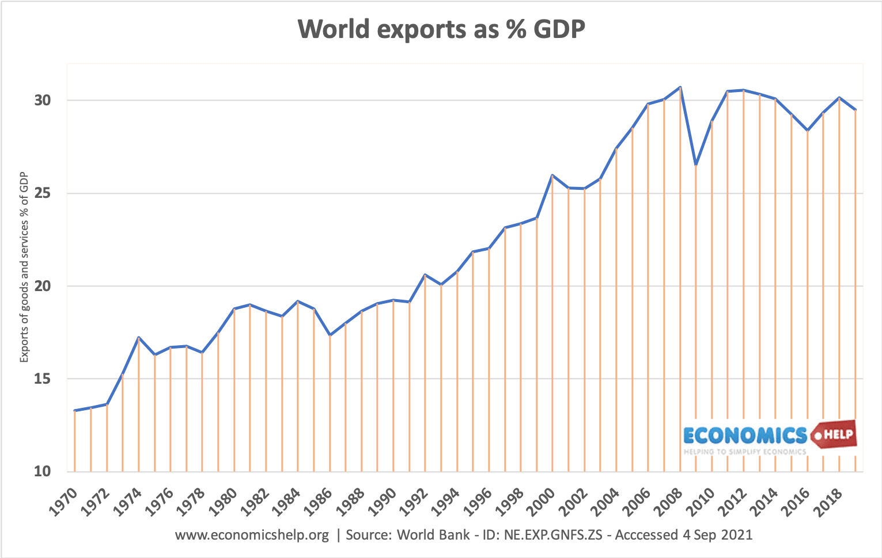

Slide 11
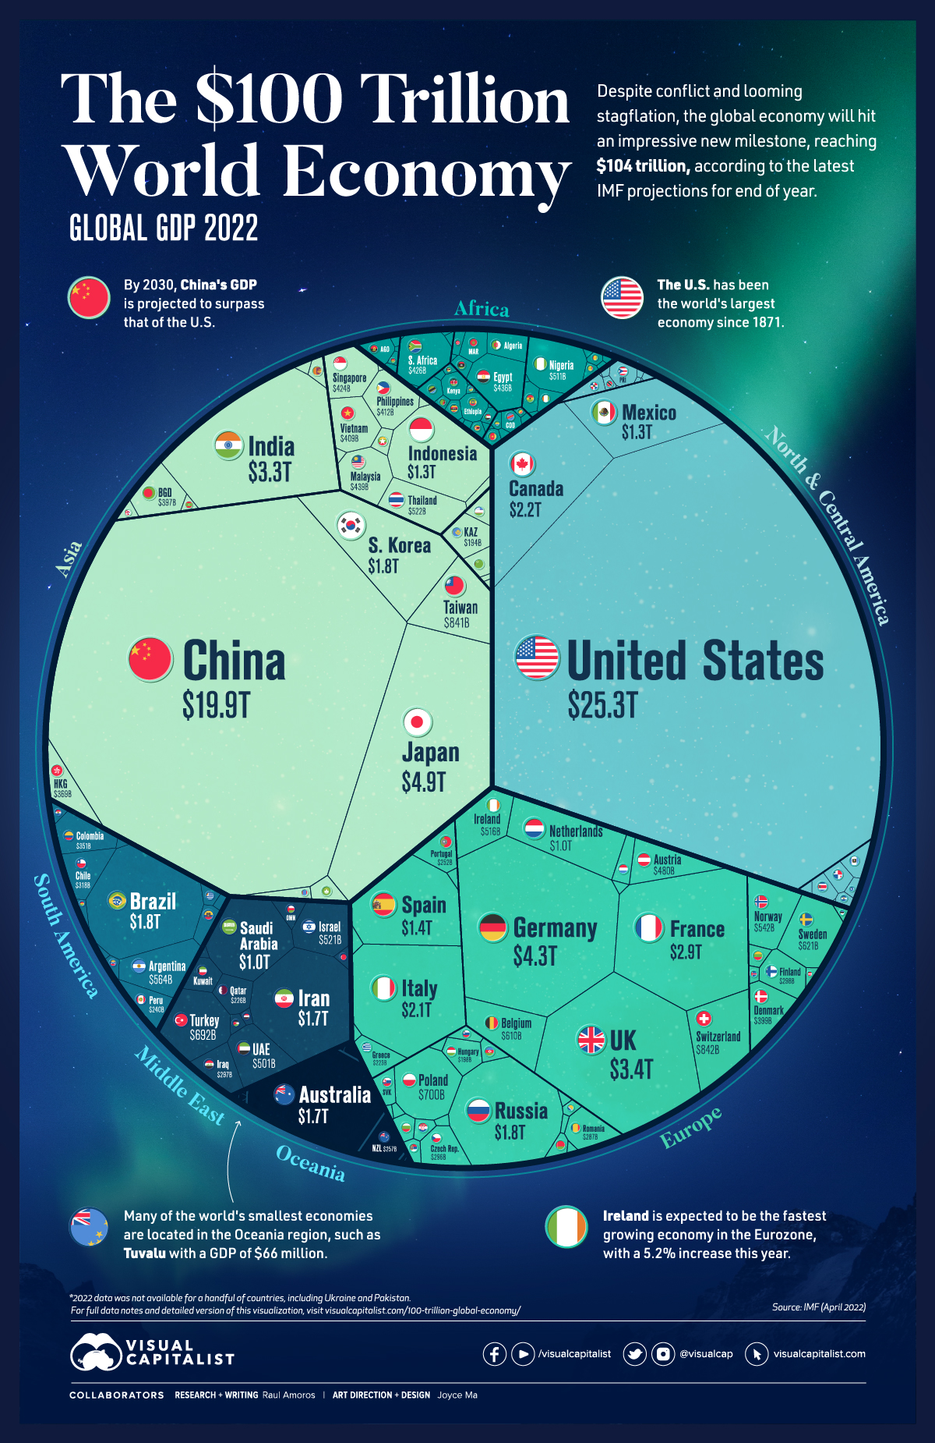

Slide 12
https://youtu.be/UYTzhkbc7IM

Slide 13
The importance of international trade
1. Make use of abundant raw materials
Some countries are naturally abundant in raw materials – oil (Qatar), metals, fish (Iceland), Congo (diamonds) Butter (New Zealand). Without trade, these countries would not benefit from the natural endowments of raw materials.
2. Comparative advantage
The theory of comparative advantage states that countries should specialize in those goods where they have a relatively lower opportunity cost. Even if one country can produce two goods at a lower absolute cost – doesn’t mean they should produce everything. India, with lower labor costs, may have a comparative advantage in labor-intensive production (e.g. call centers, clothing manufacture).
3. Greater choice for consumers
New trade theory places less emphasis on comparative advantage and relative input costs. New trade theory states that in the real world, a driving factor behind the trade is giving consumers greater choice of differentiated products. We import BMW cars from Germany, not because they are the cheapest but because of the quality and brand image.

Slide 14
The importance of international trade
4. Specialization and economies of scale – greater efficiency
Another aspect of new trade theory is that it doesn’t really matter what countries specialise in, the important thing is to pursue specialization and this enables companies to benefit from economies of scale which outweigh most other factors. Sometimes, countries may specialize in particular industries for no over-riding reason – it may just be a historical accident. But, that specialization enables improved efficiency.
5. Service sector trade
Trade tends to conjure images of physical goods import bananas, export cars. But, increasingly the service sector economy means more trade is of invisibles – services, such as insurance, IT services and banking. Even in making this website, I sometimes outsource IT services to developers in other countries
6. Global growth and economic development
International trade has been an important factor in promoting economic growth. This growth has led to a reduction in absolute poverty levels – especially in south east Asia which has seen high rates of growth since the 1980s.

Slide 15
Problems arising from free trade
Given the importance of free trade to an economy, it is unsurprising that people are concerned about the potential negative impacts.
Infant industry argument.
The fear is that ‘free trade’ can cause countries to specialise in primary products – goods which have volatile prices and low-income elasticity of demand. To develop, economies may need to restrict imports and diversify the economy. This isn’t an argument against trade per se, but an awareness trade may need to be ‘managed’ rather than just rely on free markets.
Trade can lead to cultural homogenization.
Some fear trade gives an advantage to multinational brands and this can negatively impact local produce and traditions. Supporters argue that if local products are good, they should be able to create a niche than global brands cannot.

Slide 16
Problems arising from free trade
Displacement effects. Free trade can cause uncompetitive domestic industries to close down, leading to structural unemployment. The problem with free trade is that there are many winners, but the losers do not gain any compensation. However, free-market economists may counter that some degree of creative destruction is inevitable in an economy and we can’t turn back to a static closed economy. On the upside, if the uncompetitive firms close down, ultimately new jobs will be created in different industries.
Environmental costs. The transportation of goods and services imposes environmental costs of pollution and carbon emissions, contributing to global warming

Slide 17
Pros and cons of international trade
International trade plays an important role in improving living standards and reducing poverty levels. But, there are also concerns about the unequal distribution effects and the environmental costs of trade.

Slide 18
Importance of IFM
Economic Interdependence
It means that in today’s world, no nation exists in economic isolation;
All aspects of a nation’s economy-its industry, service sectors, levels of income and employment, living standard are linked to the economics of its trading partners.
This linkage takes the form of international movements of goods and services, labor, business enterprise, investment funds, and technology.

Slide 19
Importance of IFM
International Competition
To withstand competition a corporation must lower its product cost through reducing cost of capital and sourcing inputs where those are cheaper.
Consequence of Increased Openness
Even the company that is not international in nature have to compete with corporations that could arrange capital at cheaper cost and produce goods where cost of production is lower.

Slide 20
Globalization of Economic Activities
It means that national economies rely on international trade in overall economic activity.
World trade expanded faster than world output in the last 50 years by a significant margin due to rapid technological change and continuing liberalization of trade and investment.
Technological innovation led to the increase of productivity, and the advances in transport technology brought people and enterprises closer together so that the boundary of tradable goods and services has been greatly extended.
These activities have led to more and more companies to globalize production structure through investment abroad.

Slide 21
Globalization of Economic Activities
World trade expanded faster than world output in the last 50 years by a significant margin due rapid technological change and continuing liberalization of trade and investment.
Technological innovation led to the increase of productivity, and the advances in transport technology brought people and enterprises closer together so that the boundary of tradable goods and services has been greatly extended.
These activities have led to more and more companies to globalize production structure through investment abroad.

Slide 22
What are the International Financial Management Decisions
Capital budgeting
What long-term international investments or projects should the business take on?
Capital structure
How should we pay for our assets?
Should we use local or foreign sourced debt or equity?
Working capital management
How do we manage the day-to-day finances of the firm? How could you manage foreign exchange risk?

Slide 23
International Financial Managers Need to have a Clear Understanding about Global Financial System
The Global Financial System
GOVERNMENT
TREASURIES
SUPERVISORY
AUTHORITIES
CENTRAL
BANKS
ACCOUNTING
STANDARD
BODIES
CURRENCIES
INTERNATIONAL
FINANCIAL
INSTITUTIONS
EXCHANGE
RATES
COMMERCIAL
BANKS
MULTINATIONAL
ENTERPRISES
(MCE)
FINANCIAL
MARKETS
INVESTMENT
BANKS
INSTITUTIONAL
INVESTORS
SOVEREIGN
FUNDS
RATING
AGENCIES

Slide 24
Multinational Enterprises
A multinational enterprise (MNE) is defined as one that has operating subsidiaries, branches or affiliates located in foreign countries.
While international finance focuses on MNEs, purely domestic firms can also face significant international exposures:
Import & export of products, components and services
Licensing of foreign firms to conduct their foreign business
Exposure to foreign competition in the domestic market
Indirect exposure to international risks through relationships with customers and suppliers

Slide 25
Types of Multinational Enterprises
Raw Material Seekers
First type of MNEs
Exploit raw materials found overseas
Trading, mining and oil companies
Market Seekers
Post-WWII MNEs
Expand production and sales into foreign markets
Big name companies – IBM, McDonalds etc.
Cost Minimisers
More recent MNEs
Seek out lowest production cost countries
Manufacturing and service companies

