Slide 1
AM(DSB+C) Modulation & Demodulation

Slide 2
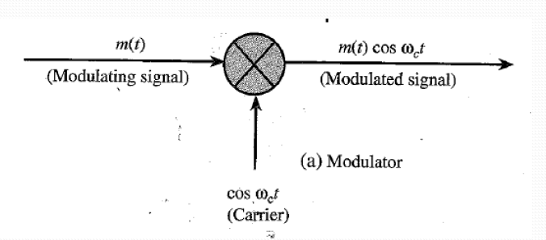
Modulation
Modulation is a process that causes a shift in the range of frequencies in a signal.
The original signal that generated from input transducer which actually we want to sent through transmitter is called Message Signal or modulating Signal or Baseband Signal.
The High Frequency Sinusoidal Signal Which is used to shift the frequency of message signal is called carrier signal.

Slide 3
Fourier Transform of Modulated Signal

Slide 4
Fig. Baseband Message Signal
Fig. Modulated Signal

Slide 5
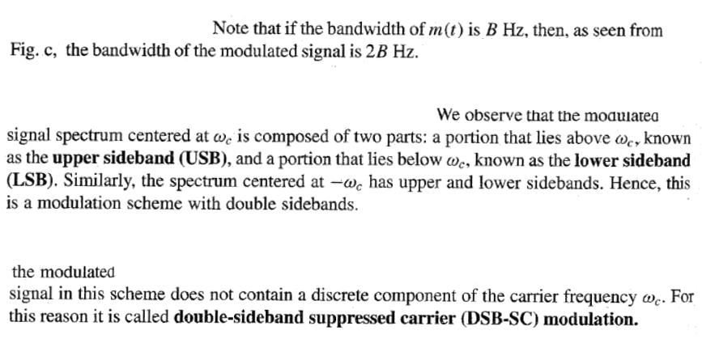

Slide 6
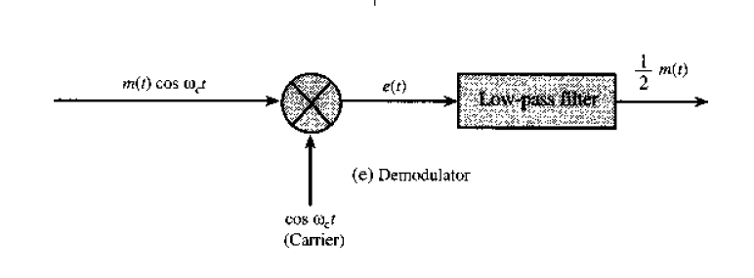
Demodulation
The process of recovering the baseband message signal from the modulated signal is referred to as demodulation or detection.
Or Retranslating the spectrum to its original position

Slide 7
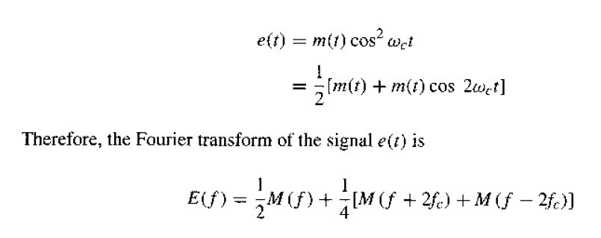
Fourier Transform of Demodulated Signal
Fig. Demodulated Signal Spectrum

Slide 8
Fig. Message Signal
Fig. Modulated Signal
Fig. Demodulated Signal

Slide 9
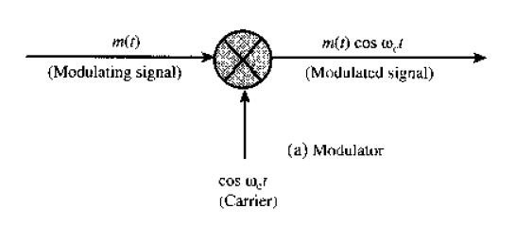
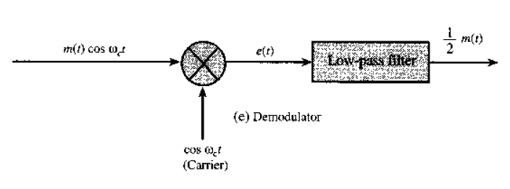
DSB Modulator & Demodulator
Transmitter
Receiver

Slide 10
Amplitude Modulation (AM)
Problem with DSB-SC Modulation :
Alternative of DSB-SC :

Slide 11
AM (DSB+C)
Alternative of DSB-SC = AM
Alternative of DSB-SC = AM

Slide 12
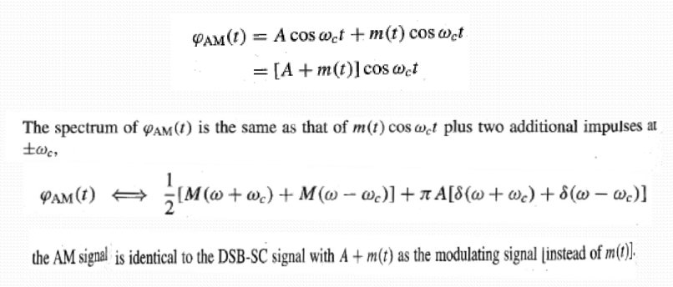
Amplitude Modulation (AM)

Slide 13
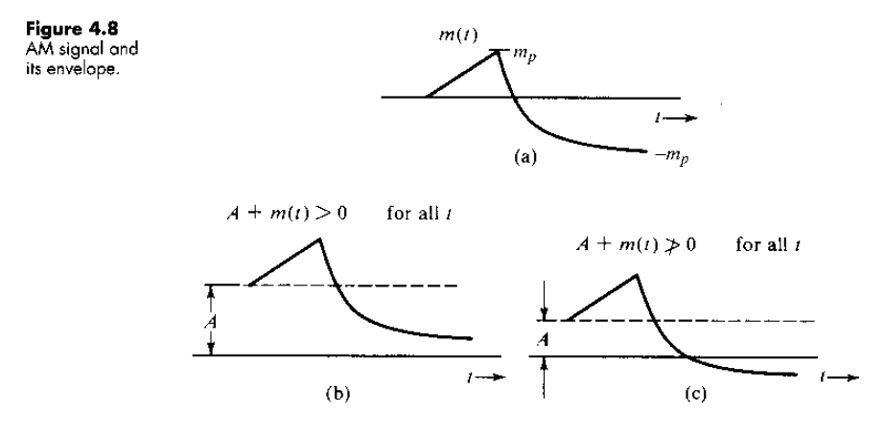

Slide 14
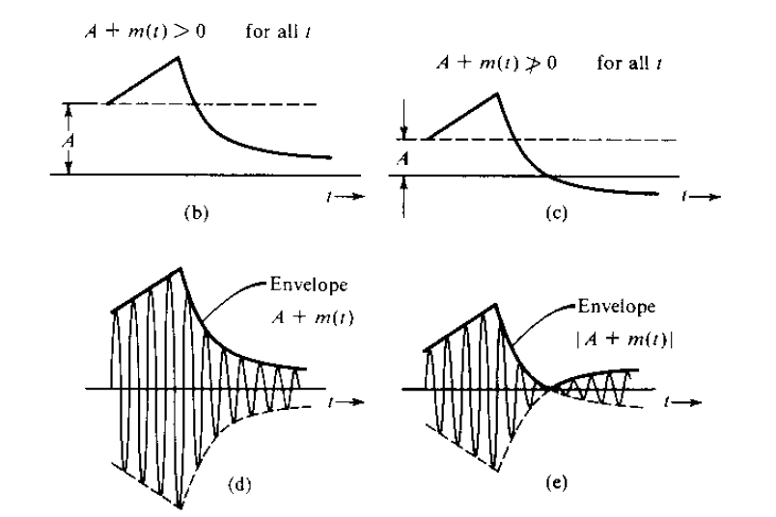

Slide 15
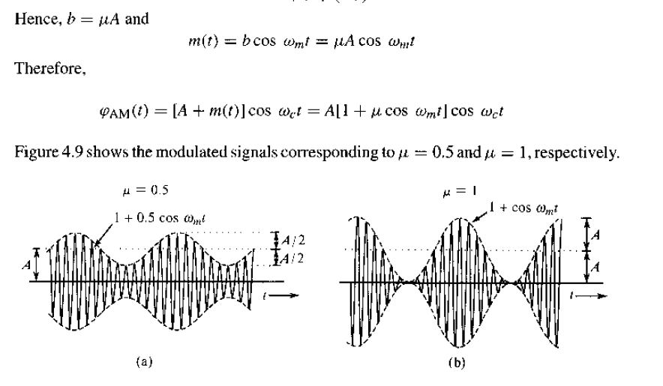
Tone Modulation

Slide 16
Derive the modulated signal for a single tone message signal and also derive the power equations.
Let
And, Carrier Signal,𝑐(𝑡) =𝐴𝑐cos⁡(2𝜋𝑓𝑐𝑡)
Message Signal,𝑚(𝑡) =𝐴𝑚cos⁡(2𝜋𝑓𝑚𝑡)
= µ𝐴𝑐cos⁡(2𝜋𝑓𝑚𝑡)
Where,
Am=Message Signal Amplitude
Ac=Carrier Signal Amplitude
Modulation Index, µ=$\frac{\text{Am}}{\text{Ac}}$

Slide 17
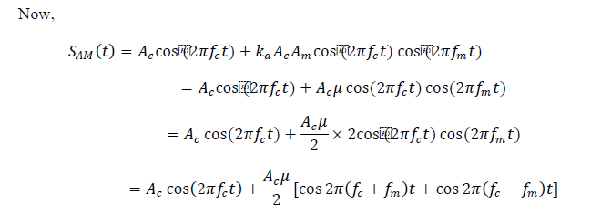
𝑚( 𝑡) =𝐴𝑚cos⁡(2𝜋𝑓𝑚𝑡)
And, 𝑐 (𝑡) =𝐴𝑐cos⁡(2𝜋𝑓𝑐𝑡)

Slide 18
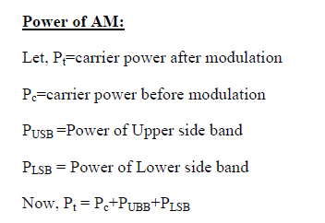

Slide 19
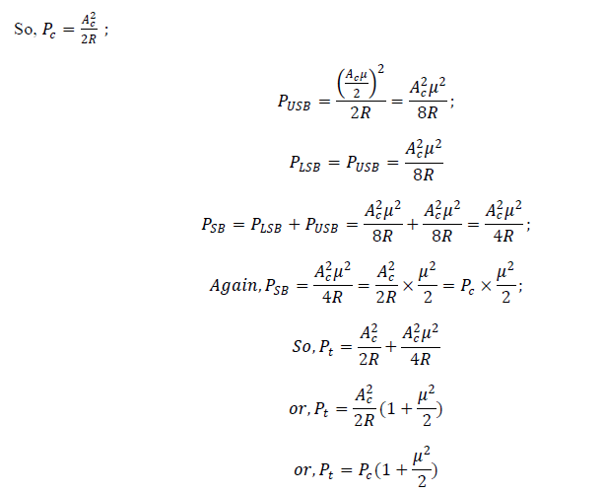

Slide 20
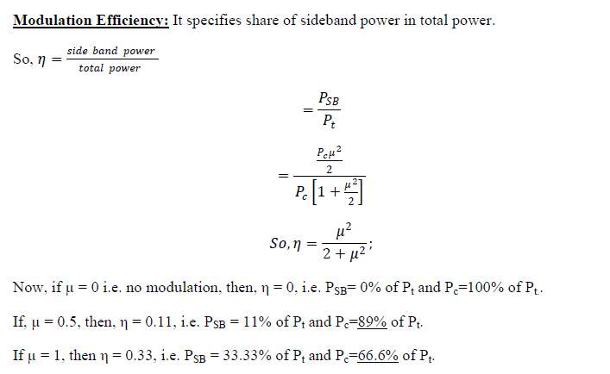

Slide 21
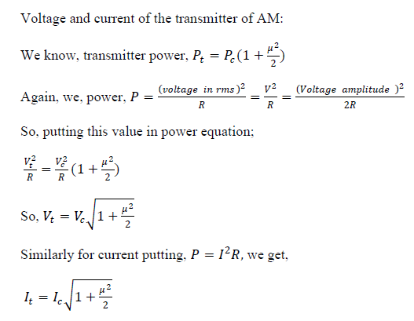

Slide 22
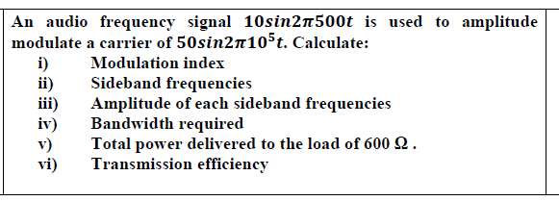
H.W

