Slide 1
Data Communication and Computer Networks

Slide 2
Digital to Analog Conversion
Digital-to-analog conversion is the process of changing one of the characteristics of an analog signal based on the information in digital data. Figure shows the relationship between the digital information, the digital-to-analog modulating process, and the resultant analog signal.

Slide 3
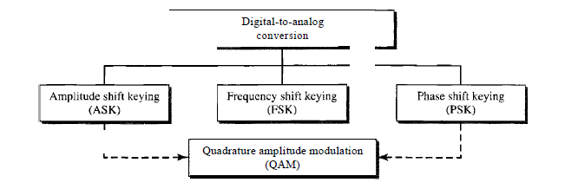
Types of Digital to Analog Conversion

Slide 4
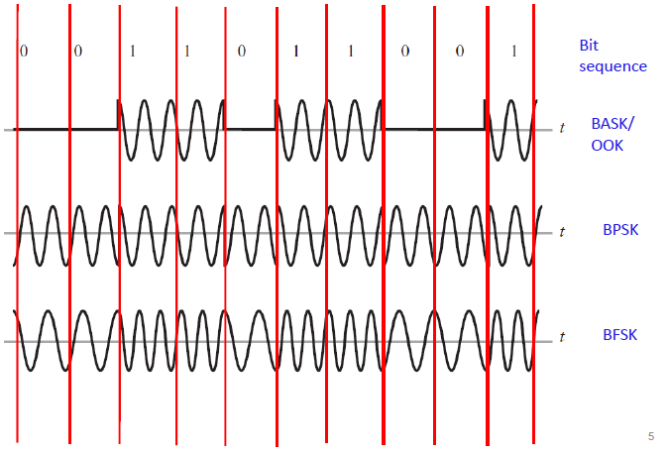

Slide 5
Carrier Signal
In analog transmission, the sending device produces a high-frequency signal that acts as a base for the information signal. This base signal is called the carrier signal or carrier frequency. The receiving device is tuned to the frequency of the carrier signal that it expects from the sender. Digital information then changes the carrier signal by modifying one or more of its characteristics (amplitude, frequency, or phase). This kind of modification is called modulation (shift keying).
Amplitude Shift Keying
In amplitude shift keying, the amplitude of the carrier signal is varied to create signal elements. Both frequency and phase remain constant while the amplitude changes.

Slide 6
BASK
Although we can have several levels (kinds) of signal elements, each with a different amplitude, ASK is normally implemented using only two levels. This is referred to as binary amplitude shift keying or on-off keying (OOK). The peak amplitude of one signal level is 0; the other is the same as the amplitude of the carrier frequency. Figure gives a conceptual view of binary ASK.

Slide 7
Implementation of BASK

Slide 8
BASK
Generation:
Advantage: Simplicity
Disadvantage: ASK is very susceptible to noise interference

Slide 9
Analog(transmitter)=>(analog>digital)=>(channel(digital)=>(digital>analog)=>Reciver(analog)

