Slide 1
Nutrition & Health
Introduction to Public Health
BakiBillah
Department of Public Health
Daffodil International University (DIU)

Slide 2
Learning Objectives
Nutrition
5 keys to healthy diet
Malnutrition
What are the consequences of malnutrition
Double burden of malnutrition
Maternal Nutrition and Breastfeeding

Slide 3
Nutrition
Nutrition is a critical part of health and development.
Better nutrition is related to improved infant, child and maternal health, stronger immune systems, safer pregnancy and childbirth, lower risk of non-communicable diseases (such as diabetes and cardiovascular disease), and longevity. (WHO)

Slide 4
5 keys to a healthy diet
1. Breastfeed babies and young children
From birth to 6 months of age, feed babies exclusively with breast milk (i.e. give them no other food or drink), and feed them "on demand" (i.e. often as they want, day and night)
At 6 months of age, introduce a variety of safe and nutritious foods to complement breastfeeding, and continue to breastfeed until babies are 2 years of age or beyond.
Do not add salt or sugars to foods for babies and young children

Slide 5
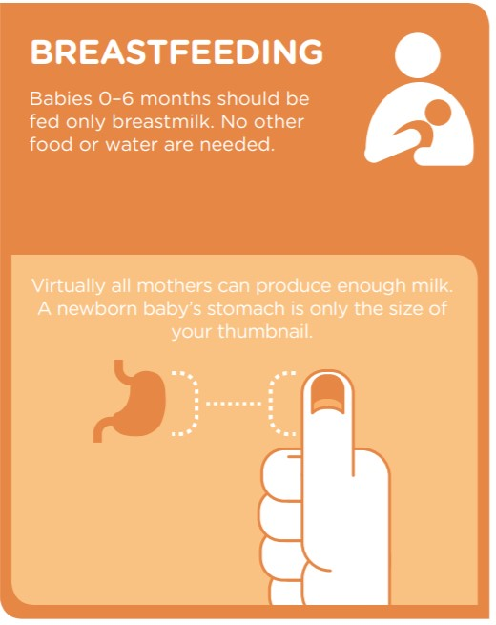

Slide 6
2. Eat a variety of foods
Eat a combination of different foods, including staple foods (e.g. cereals such as wheat, barley, rye, maize or rice, or starchy tubers or roots such as potato, yam, taro or cassava), legumes (e.g. lentils, beans), vegetables, fruit and foods from animals sources (e.g. meat, fish, eggs and milk)
Why? Eating a variety of whole (i.e. unprocessed) and fresh foods every day helps children and adults to obtain the right amounts of essential nutrients. It also helps them to avoid a diet that is high in sugars, fats and salt, which can lead to unhealthy weight gain (i.e. overweight and obesity) and noncommunicable diseases. Eating a healthy, balanced diet is especially important for young children's and development; it also helps older people to have healthier and more active lives.

Slide 7
3. Eat plenty of vegetables and fruit
Eat a wide variety of vegetables and fruit
For snacks, choose raw vegetables and fresh fruit, rather than foods that are high in sugars, fats or salt
Avoid overcooking vegetables and fruit as this can lead to the loss of important vitamins
When using canned or dried vegetables and fruit, choose varieties without added salt and sugars
Why? Vegetables and fruit are important sources of vitamins, minerals, dietary fibre, plant protein and antioxidants. People whose diets are rich in vegetables and fruit have a significantly lower risk of obesity, heart disease, stroke, diabetes and certain types of cancer

Slide 8
4. Eat moderate amounts of fats and oils
Use unsaturated vegetable oils (e.g. olive, soy, sunflower or corn oil) rather than animals fats or oils high in saturated fats (e.g. butter, ghee, lard, coconut and palm oil)
Choose white meat (e.g. poultry) and fish, which are generally low in fats, in preference to red meat
Eat only limited amounts of processed meats because these are high in fat and salt
Where possible, opt for low-fat or reduced'fat versions of milk and dairy products
Avoid processed, baked and fried foods that contain industrially produced trans-fat
Why? Fats and oils are concentrated sources of energy, and eating too much fat, particularly the wrong kinds of fat, can be harmful to health. For example, people who eat too much saturated fat and trans-fat are at higher risk of heart disease and stroke. Trans-fat may occur naturally in certain meat and milk products, but the industrially produced trans-fat (e.g. partially hydrogenated oils) present in various processed foods is the main source.

Slide 9
5. Eat less salt and sugars
When cooking and preparing foods, limit the amount of salt and high-sodium condiments (e.g. soy sauce and fish sauce)
Avoid foods (e.g. snacks), that are high in salt and sugars
Limit intake of soft drinks or soda and other drinks that are high in sugars (e.g. fruit juices, cordials and syrups, flavoured milks and yogurt drinks)
Choose fresh fruits instead of sweet snacks such as cookies, cakes and chocolate
Why? People whose diets are high in sodium (including salt) have a greater risk of high blood pressure, which can increase their risk of heart disease and stroke. Similarly, those whose diets are high in sugars have a greater risk of becoming overweight or obese, and an increased risk of tooth decay. People who reduce the amount of sugars in their diet may also reduce their risk of noncommunicable diseases such as heart disease and stroke.

Slide 10
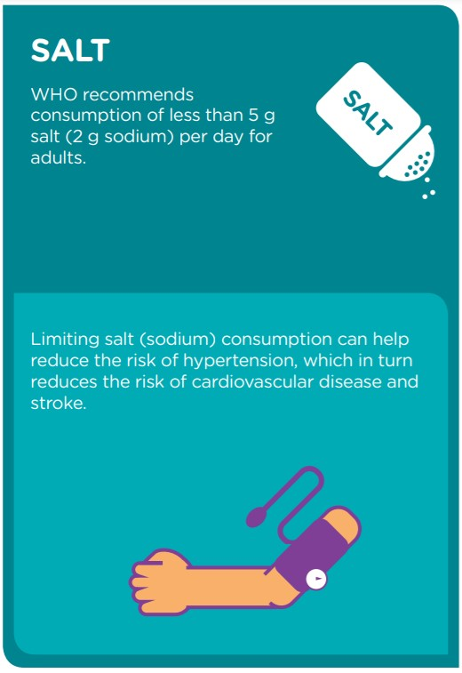
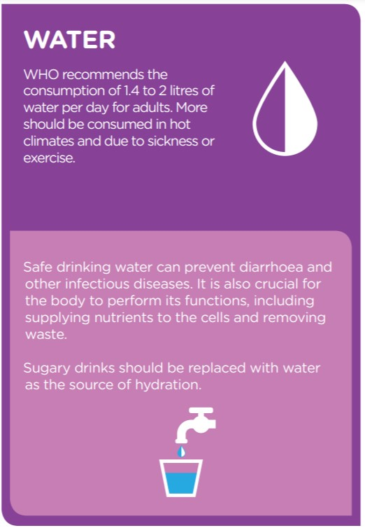

Slide 11
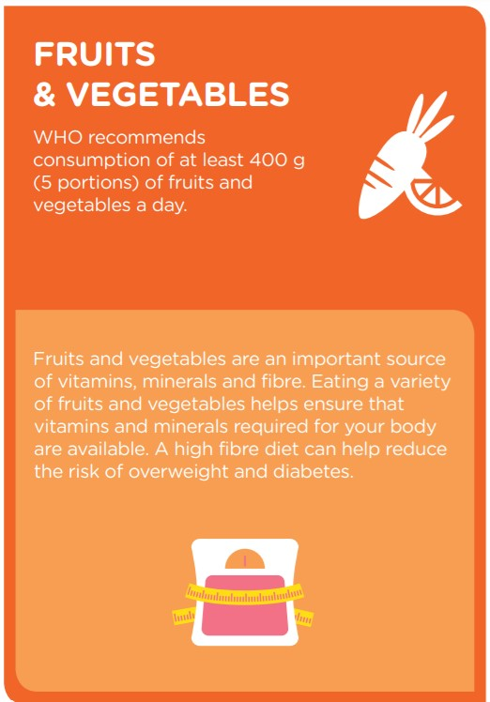
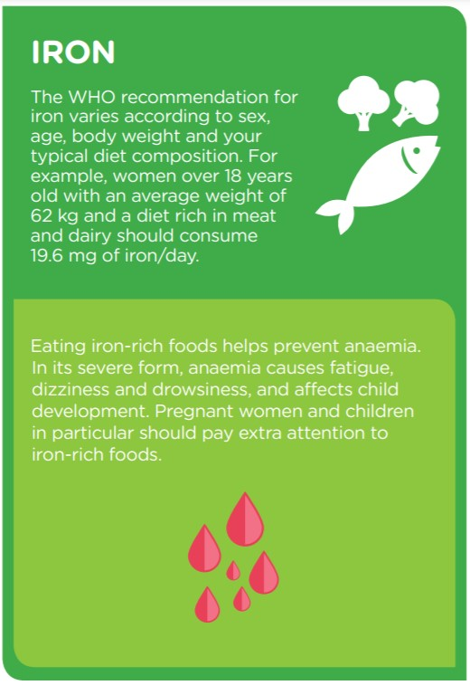

Slide 12
Malnutrition
Malnutrition refers to deficiencies, excesses or imbalances in a person’s intake of energy and/or nutrients. The term malnutrition covers 2 broad groups of conditions. One is ‘undernutrition’—which includes stunting (low height for age), wasting (low weight for height), underweight (low weight for age) and micronutrient deficiencies or insufficiencies (a lack of important vitamins and minerals). The other is overweight, obesity and diet-related noncommunicable diseases (such as heart disease, stroke, diabetes and cancer). (WHO)

Slide 15
What are the consequences of malnutrition?
Malnutrition affects people in every country. Around 1.9 billion adults worldwide are overweight, while 462 million are underweight. An estimated 41 million children under the age of 5 years are overweight or obese, while some 159 million are stunted and 50 million are wasted. Adding to this burden are the 528 million or 29% of women of reproductive age around the world affected by anaemia, for which approximately half would be amenable to iron supplementation.
Many families cannot afford or access enough nutritious foods like fresh fruit and vegetables, legumes, meat and milk, while foods and drinks high in fat, sugar and salt are cheaper and more readily available, leading to a rapid rise in the number of children and adults who are overweight and obese, in poor as well as rich countries. It is quite common to find undernutrition and overweight within the same community, household or even individual – it is possible to be both overweight and micronutrient deficient, for example.

Slide 16
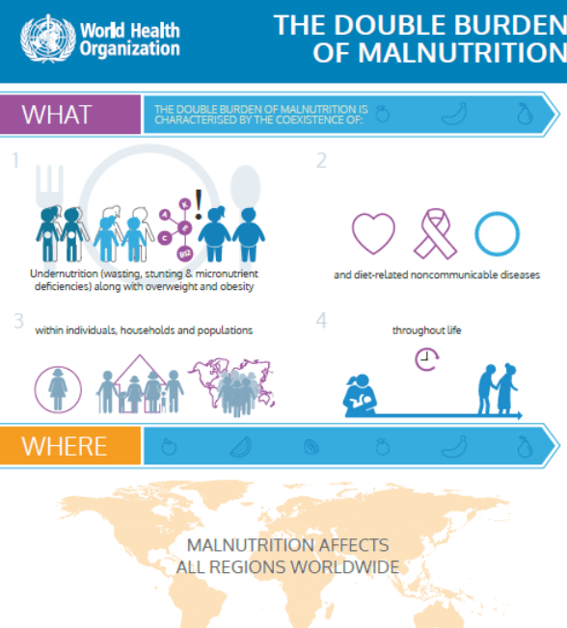
Double burden of malnutrition
The double burden of malnutrition is characterized by the coexistence of undernutrition along with overweight and obesity, or diet-related noncommunicable diseases, within individuals, households and populations, and across the life course.

Slide 18
What is Maternal Nutrition?
Malnutrition is a serious condition that occurs when an individual’s diet contains insufficient nutrients that do not meet the requirements of her body. It can cause damage to the vital organs and can adversely affect the functioning of the body.

Slide 19
Breastfeeding
Breastfeeding is one of the most effective ways to ensure child health and survival. However, nearly 2 out of 3 infants are not exclusively breastfed for the recommended 6 months—a rate that has not improved in 2 decades.
Breastmilk is the ideal food for infants. It is safe, clean and contains antibodies which help protect against many common childhood illnesses. Breastmilk provides all the energy and nutrients that the infant needs for the first months of life, and it continues to provide up to half or more of a child’s nutritional needs during the second half of the first year, and up to one third during the second year of life.
Breastfed children perform better on intelligence tests, are less likely to be overweight or obese and less prone to diabetes later in life. Women who breastfeed also have a reduced risk of breast and ovarian cancers.
Inappropriate marketing of breast-milk substitutes continues to undermine efforts to improve breastfeeding rates and duration worldwide.
Low rates of breastfeeding add more than $3 billion a year to medical costs for women and children in the United States. (CDC)

Slide 21
The primary maternal nutritional deficiencies found in deprived populations
a. Energy deficiency-
b. Iron-deficiency anaemia-coupled with folate deficiency
c. Vitamin A deficiency-
d. Iodine deficiency-leading to endemic goitre
e. Deficiency of other micro-nutrients, such as thiamine, niacin, and zinc, may still occur in certain geographic areas.

Slide 22
What Are The Causes Of Malnutrition?
1. Lack of a nutritious diet in low-income families.
2. Painful teeth or mouth conditions that may affect the ability to consume food.
3. Following an unhealthy diet due to lack of knowledge.
4. Loss of appetite due to other health conditions such as chronic infections, depression, etc.
5. Use of certain medications that may interfere with nutrient absorption.
6. Diarrhea, nausea, and vomiting may also cause malnutrition.
7. Inadequate intake of nutrients and calories that does not meet the increased demands of pregnancy.

Slide 23
N A T I O N A L N U T R I T I O N OV E R V I E W
Despite great progress over the last 20 years, poor nutrition is still hurting Bangladesh, its children and its future
Poor nutrition impacts on economic outcomes, on health, on education; improving nutrition can bring about positive change in the short and long term and is essential to Bangladesh's Vision 21
Bangladesh can own the problem and its solutions. Bangladesh can exercise control over its own budgets and policy priorities, and draw on international agendas
Existing nutrition strategies need to spend the budget allocated, and more needs to be spent across all of government
Substantive progress on nutrition policy can be made with strong leadership and coordination across government departments

Slide 24
N U T R I T I O N D U R I N G P R EG N A N C Y O V E R V I E W
From 2006-2015, Bangladesh witnessed a steep decline in maternal mortality
The new SDGs emphasize maternal and child health and nutrition
Under-nutrition even among the wealthy indicates that targeted nutrition interventions are now needed
Bangladesh has made remarkable progress in reducing maternal and infant mortality rates over the last several decades.
Maternal mortality rates in particular have seen the most dramatic improvements.

Slide 25
………..Continued
Between 2006 and 2015 Bangladesh experience a decline from 303 to 176per 100,000live births, a decline of 41.9percent.
This decline was faster than in regional neighbors India, Pakistan and Sri Lanka.
Substantial improvements have also been seen in infant mortality, with a decline of 35.4percent between 2006 and 201
Despite these laudable results, low birth rates, premature births, birth defects and still born births continue to be a cause of concern. The health of mothers and infants has significant implications. Low birth-weight babies can suffer life-long health risks as well as poor physical and cognitive development, leading to stunting and reduced incomes when they enter the labor market.

Slide 26
……….Continued
The persistence of mother and child under nutrition even among wealthy populations provides strong evidence that economic growth alone is not able to address the under nutrition issue in Bangladesh.
Targeted nutrition intervention activities are needed. Resolving under nutrition among pregnant women and infants will require the promotion of a host of different nutrition interventions.

Slide 27
Malnutrition and Global Fact
Malnutrition affects 2 billion people in the world.
45% of deaths of children underfiveyears of age are attributable to under-nutrition.
Malnutrition is an underlying cause of death of 2.6 million children each year – a third of child deaths globally.
Around 160 million children under five years of age worldwide are affected by stunting.
Vitamin A deficiencycauses157,000 child deaths a year, andzinc deficiency116,000 child deaths.

Slide 28
Malnutrition and Bangladesh
More than half the population suffers from malnutrition.
Severe acute malnutrition affects 450,000 children, while close to 2 million children have moderate acute malnutrition.
Anaemiaaffects 52% of children under five years of age.
41% of children underfive years of ageare stunted.

Slide 29
Malnutrition and Bangladesh
16% of children underfive years of ageare wasted.
36% of children under five years of ageare underweight.
A quarter of women are underweightand around 15% have short stature, which increases the risk of difficult childbirth and low-birth-weight infants.
Half of all women suffer from anaemia, mostly nutritional in origin.
Malnutrition is estimated to cost Bangladesh more than US$1bn every year in lost productivity.

Slide 31
UNDERLYING CAUSES OF MALNUTRITION

Slide 32
UNDERLYING CAUSES OF MALNUTRITION: POVERTY
One of the underlying causes of malnutrition is poverty and poverty is far from being eradicated. During the last two decades, the number of people effected by extreme poverty in Africa has nearly doubled, from 164 million in 1982 to some 313 million as of 2002. Poverty alone does not lead to malnutrition, but it seriously affects the availability of adequate amounts of nutritious food for the most vulnerable populations. Over 90 percent of malnourished people live in developing countries.

Slide 33
UNDERLYING CAUSES OF MALNUTRITION: LACK OF ACCESS TO FOOD
Most major food and nutrition crises do not occur because of a lack of food, but rather because people are too poor to obtain enough food. Non-availability of food in markets, difficult access to markets due to lack of transportation, and insufficient financial resources are all factors contributing to the food insecurity of the most vulnerable populations. People are increasingly dependent on international markets for all or part of their food supply, particularly between harvest periods. Many people are increasingly vulnerable due to fluctuations in the prices, as was recently illustrated during the global food crisis.

Slide 34
UNDERLYING CAUSES OF MALNUTRITION: DISEASE
Certain illnesses and infections, such as tuberculosis, measles, and diarrhea are directly linked to and one of the underlying causes of malnutrition acute malnutrition. A combination of disease and malnutrition weakens the metabolism creating a vicious cycle of infection and undernourishment, leading to vulnerability to illness. HIV and AIDS have become a leading cause of acute malnutrition in developing countries. A child infected with HIV is more vulnerable to acute malnutrition than a healthy child. Anti-retroviral drugs are more effective when combined with adequate, regular food intake. So ensuring a healthy diet is an important aspect of HIV control and treatment.

Slide 35
If the HIV-infected child becomes acutely malnourished, her/his diminished nutritional state will increase the likelihood of infections, and may lower the effectiveness of medications — either anti-retroviral treatment or for other illnesses and infections. When severely malnourished, an individual may not be able to tolerate medications at all. The combination of acute malnutrition and HIV and AIDS thus considerably increases the chances of morbidity, placing the child at a higher risk of death.

Slide 36
UNDERLYING CAUSES OF MALNUTRITION: CONFLICTS
Conflicts have a direct impact on food security, drastically compromising access to food. Often forced to flee as violence escalates, people uprooted by conflict lose access to their farms and businesses, or other means of local food production and markets. Abandoned fields and farms no longer provide food to broader distribution circuits. As a result, food supplies to distributors may be cut off, and the many populations dependent on them may be unable to obtain sufficient food.

Slide 37
UNDERLYING CAUSES OF MALNUTRITION: CLIMATE CHANGE
In 30 years, the number of natural disasters — droughts, cyclones, floods, etc. — linked to climate change has increased substantially. The effects of climate change are often dramatic, devastating areas which are already vulnerable. Infrastructure is damaged or destroyed; diseases spread quickly; people can no longer grow crops or raise livestock.
According to UN studies in over 40 developing countries, the decline in agricultural production caused either directly or indirectly by climate change could dramatically increase the number of people suffering from hunger in the coming years.

Slide 38
UNDERLYING CAUSES OF MALNUTRITION: LACK OF SAFE DRINKING WATER
Water is synonymous with life. Lack of potable water, poor sanitation, and dangerous hygiene practices increase vulnerability to infectious and water-borne diseases, which are direct causes of acute malnutrition.

Slide 39
Effects of Malnutrition

