Slide 1
Effective Team Communication Techniques and Tools for Software Development
Fahim Faisal
Lecturer, Dept. of CSE
Daffodil International University

Slide 2
Outline
Introduction to Team Communication
Overview of Effective Team Communication
Techniques for Effective Team Communication
Diagrams and Charts Used in Software Project Management
Noteworthy Management and Communication Tools

Slide 3
Introduction to Team Communication
Team communication is a two-way street with lanes according to member count. If not done right, misunderstanding can lead to major mishaps.
Behind every successful software deployment is an effective software development team. Developers and other key players have to collaborate for the accomplishment of project goals.
Effective communication plays a major role in any goal achievement. Without it, misinterpretation of instructions and other information can sometimes cause irreparable damages. Hence, businesses must take steps ahead to counter miscommunication.

Slide 4
Overview of Effective Team Communication
Improving a software development team’s communication process can be challenging. Team managers have to bridge the gap between differing personalities, values, and cultures. There may even be language nuances to consider. However, there are still ways to facilitate a good communication system.
Effective communication happens when two or more people exchange ideas, messages, and information. The sender of the message has to ensure that the receiver understands it. While the receiver is expected to ask questions or clarify things if the message is confusing. Whether it’s verbal or written communication, effective communication is essential for project success.
Bad team communication always leads to the disruption of information flow. It can also spark internal conflicts, which are hindrances to progress and team morale. And when all these happen, it’ll most likely waste time, money, and resources to undo mistakes and issues caused by miscommunication.

Slide 5
Techniques for Effective Team Communication
Well-Defined Project Guidelines
Keep it Short and Simple (KISS) Principle
Proper Questionnaire
Involving Developers from the Beginning
Use of Project Management Software
Knowledge Sharing Among Peers
Internal Conflict Resolution
Active Listening
Positive Work Environment

Slide 6
Well-Defined Project Guidelines
All the stakeholders should know the goals and requirements of the project. This sets proper expectations for what the result should look like. Developers who know their precise responsibilities tend to become more productive and deliver great results.
Guidelines should be properly documented alongside verbal communication. All documentation should be accessible to all the stakeholders at all time. Proper documentations ensure that every stakeholder knows how the final product should look like. Documentations work as bookmarks or blueprints. Everything goes smoothly when everyone understands how each task contributes to the accomplishment of goals.
Communication frequency and schedule must set beforehand. Whether teams will post updates after every hour or every week must be finalized before beginning development. Additionally, meeting time should be discussed within the group and set at a convenient time for everyone.

Slide 7
Keep it Short and Simple (KISS) Principle
Keeping every team communication short and simple goes a long way. Unnecessary words on important discussions may lead to confusion and misunderstanding. Specially, in case of remote communication, clear and concise instructions are absolutely crucial.
Developers also have different knowledge and expertise. The same terms and phrases may mean different things for different people. Hence, clarification of the meaning of terms must be ensured so that everyone is on the same page.

Slide 8
Proper Questionnaire
During a meeting or in written conversations, effective communication is a product of asking the right questions. It becomes even better with open-ended questions, since these kinds of queries encourage more details rather than the normal yes-or-no questions. In a way, it gauges the team’s understanding of the what, how, why, and when of your project specifications.
So instead asking an employee if a certain task or goal can be accomplished, it is always better to ask the methodology or action plan which the employee wants to utilize in order to accomplish the goal. This creates room for group discussions and innovative ideas to be generated.

Slide 9
Involving Developers from the Beginning
Doing it right from the start makes it easier to succeed. Hence, it is crucial to involve the developers in the planning stage. If developers get involved in the design and planning phase, it will become easier in the implementation phase. Most importantly, this reduces the probability of losing time and resources on unfeasible plans.

Slide 10
Project Management and Communication Tools
Modern-day software development must include the use of various management software to organize goals and transform them into tasks. Using these tools helps teams to collaborate smoothly.
Team members can track their tasks and deadlines easily. It also gives the leaders and project managers a bird’s-eye view of the project’s progress. Moreover, everyone can document issue resolutions within the tool for the team to use as a reference.
On the other hand, there are also tools for internal and external team communication. For instance, with remote working arrangements, most teams use Zoom, Slack, or Skype to communicate with each other. At full-scale, teams also use Google Workspace for collaboration and communication.

Slide 11
Knowledge Sharing Among Peers
Promoting knowledge sharing is a good way to build a versatile software development team. Knowledge sharing among peers not only expands the skills and expertise of every member but also encourages camaraderie among groups, which leads to better collaboration.
For example, informal monthly skill-sharing sessions can be arranged where developers can share their expertise so that others can get familiar with their work and learn new skills. This may lead to cross-functional teams without additional cost.

Slide 12
Internal Conflict Resolution
Unresolved internal conflicts can dampen team morale, which is not good for any project’s progress. Hence, both technical and interpersonal issues should be discussed by setting some time aside and resolved as soon as possible.
Personal biases and grudges should be kept at bay while resolving conflicts. Personal attacks and public humiliation of employees often result in disasters for companies.

Slide 13
Active Listening
Active listening means proactively listening to what another person says instead of just hearing it. It is absolutely crucial for effective communication among peers. Attentively listening to teammates and ignoring distractions are keys to a healthy team environment. Asking questions and being respectful are integral parts of efficient communication. Maintaining eye contact from time-to-time is also considered very important.
Even in case of disagreement, one must be polite and respectful to others. One may try to establish his/her opinion by providing logics and insights instead of arguing. Opinions must be presented in a civil, comprehensive and well-defined manner and criticisms must always be constructive.

Slide 14
Positive Work Environment
When a positive workplace culture exists, developers feel at ease while performing their tasks. As a result, everyone becomes more productive and efficient in delivering expected outcomes.
For materializing a positive work environment, respect and inclusivity from everyone must be appreciated and encouraged. Micromanaging the team should be avoided, the members must be held accountable for their actions.
Expressing gratitude and rewarding deserving candidates are crucial for creating a healthy work environment. Criticizing developers publicly is always a bad idea. Instead, one-on-one coaching and training sessions are much more effective.

Slide 15
Diagrams and Charts Used in Project Management
For managing software projects adequately and efficiently, we use various project management diagrams and charts. Some noteworthy diagrams and charts are listed below:
Gantt Chart
PERT Chart
Product/Work Breakdown Structure

Slide 16
Gantt Chart
Gantt Chart first developed by Henry Gantt in 1917. Gantt chart usually utilized in project management, and it is one of the most popular and helpful ways of showing activities displayed against time. Each activity represented by a bar.
Gantt chart is a useful tool when you want to see the entire landscape of either one or multiple projects. It helps you to view which tasks are dependent on one another and which event is coming up.

Slide 17
Gantt Chart Example

Slide 18
PERT Chart
PERT is an acronym of Program Evaluation Review Technique. In the 1950s, it is developed by the U.S. Navy to handle the Polaris submarine missile program.
In Project Management, PERT chart represented as a network diagram concerning the number of nodes, which represents events.
The direction of the lines indicates the sequence of the task. In the following example, tasks between "Task 1 to Task 9" must complete, and these are known as a dependent or serial task. Between Task 4 and 5, and Task 4 and 6, nodes are not depended and can undertake simultaneously. These are known as Parallel or concurrent tasks. Without resource or completion time, the task must complete in the sequence which is considered as event dependency, and these are known as Dummy activity and represented by dotted lines.

Slide 19
PERT Chart Example

Slide 20
Product/Work Breakdown Structure
Product Breakdown Structure (PBS) is a management tool and necessary a part of the project designing. It is a task-oriented system for subdividing a project into product parts. The product breakdown structure describes subtasks or work packages and represents the connection between work packages. Within the Product Breakdown Structure, the project work is diagrammatically pictured with various types of lists. The Product Breakdown Structure is exactly the same as Work Breakdown Structure (WBS). PBS/WBS can either follow top-down or bottom-up approach.

Slide 21
Product/Work Breakdown Structure Example

Slide 22
Noteworthy Management and Communication Tools
Some of the most popular and noteworthy management and team communications tools for software development are:
monday.com
Wrike
Smartsheet
GitHub
Confluence
Jira
Trello
Slack
Google Workspace
Wooboard

Slide 23
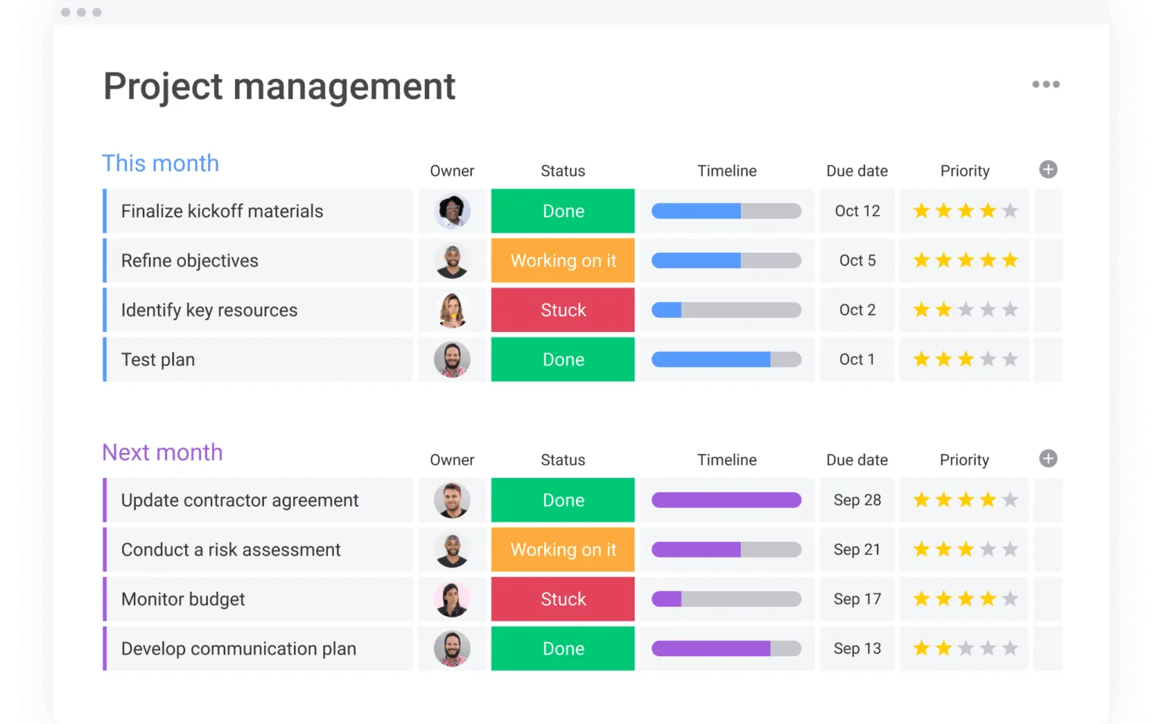
monday.com
monday.com is an open cloud-based platform where one can design, track, and customize one’s software projects. It is one of the most popular tools for task management and effective collaboration.

Slide 24
Wrike
Wrike is a powerful cloud software tool for project management, planning, and team collaboration.

Slide 25
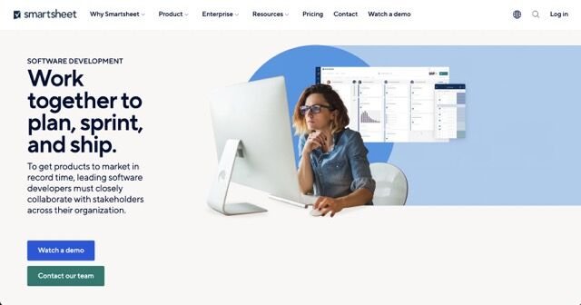
Smartsheet
As an online collaboration tool, Smartsheet facilitates developers to work on multiple applications that might be of use when communicating or operating with stakeholders, such as Google Drive, Google Docs, and Google Calendar.

Slide 26
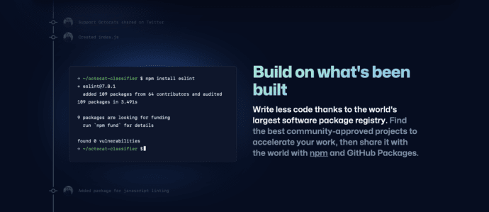
GitHub
GitHub is an open-source community that brings developers together to create an end-to-end product, share code snippets, and discover how millions of users contribute to software development.

Slide 27
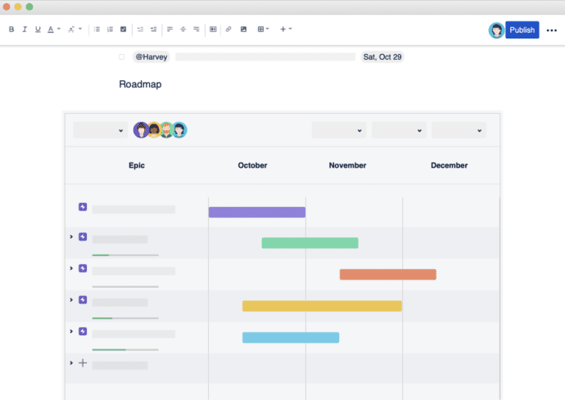
Confluence
Major organizations like LinkedIn, NASA, and the New York Times use Confluence for their teams. It is a great tool, especially for receiving feedback on completed work and offers more than 3,000 app integrations with Google Drive, DropBox, Office, and more.

Slide 28
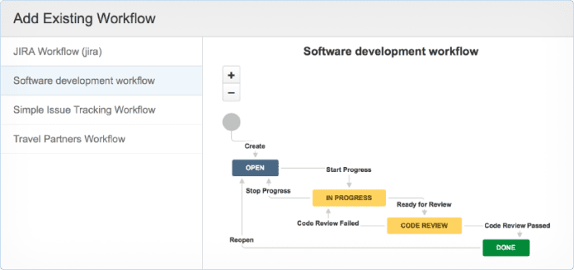
Jira
Jira is a proprietary product developed by Atlassian that allows bug tracking, issue tracking and agile project management.

Slide 29
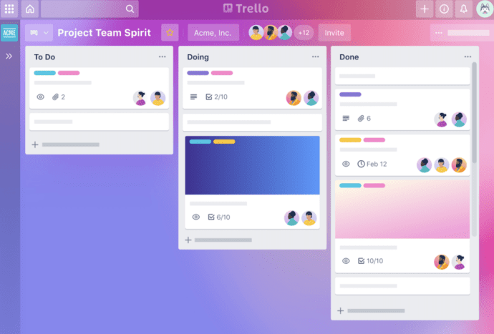
Trello
Trello is a project management tool for keeping track of tasks on a comprehensive dashboard and is very simplified and user-friendly yet perfectly functional. It also includes checklists, due dates, meeting notes, and attachments.

Slide 30
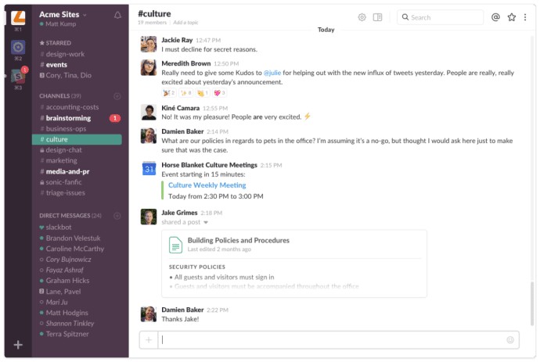
Slack
Slack is an amazing communication tool that makes group chats or calls, sending files, direct messaging, and third-party integrations seamless.

Slide 31
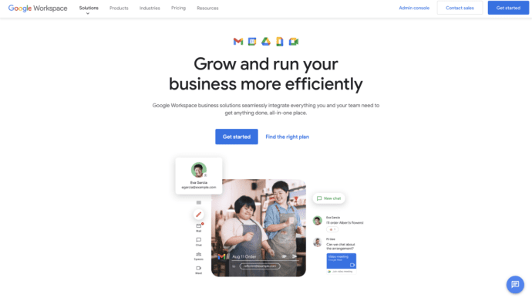
Google Workspace
Considering that Google dominates the collaborative workspace arena, it is a viable option for team collaboration owing to its feature-rich tools (which expand and improve with each update) and user-friendly UI.

Slide 32
WooBoard
Wooboard is a social gamification platform to engage and reward employees. Team members can gain points and cash in real-world rewards for Amazon, Starbucks, Spotify, FitBit, and more.

Slide 33
Questions?

Slide 34
Thank You

