Slide 1
Variable Load on Power Plants

Slide 2
Variable Load on Power Stations Important Terms and Factors
Variable Load on Power Station
The load on a power station varies from time to time due to uncertain demands of the consumers and is known as variable load on the station.
Load curve: The curve showing the variation of load on the power station with respect to time is known as a load curve.
The load on a power station is never constant; it varies from time to time. These load variations during the whole day are recorded half-hourly or hourly and are plotted against time on the graph. The curve thus obtained is known as daily load curve as it shows the variations of load w.r.t. time during the day.

Slide 3
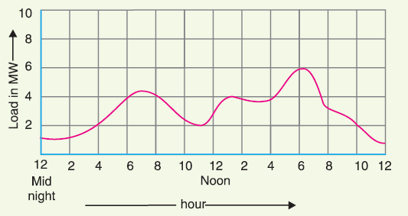
Important Terms and Factors
The monthly load curve can be obtained from the daily load curves of that month. For this purpose, average values of power over a month at different times of the day are calculated and then plotted on the graph. The monthly load curve is generally used to fix the rates of energy.
The yearly load curve is obtained by considering the monthly load curves of that particular year. The yearly load curve is generally used to determine the annual load factor
Daily load curve:
Draw daily load curve for Room 203-4

Slide 4
Important Terms and Factors
Importance of daily load curve
The daily load curves have attained a great importance in generation as they supply the following information readily:
The daily load curve shows the variations of load on the power station during different hours of the day.
The area under the daily load curve gives the number of units generated in the day.
The highest point on the daily load curve represents the maximum demand on the station on that day.
The area under the daily load curve divided by the total number of hours gives the average load on the station in the day.
Average load = Area (in kWh) under daily load curve/24 hours

Slide 5
Important Terms and Factors
Importance of daily load curve (cont.)
5. The ratio of the area under the load curve to the total area of rectangle in which it is contained gives the load factor.
Load Factor = Average load/Max. demand
= Average load x 24/Max. demand x 24
= Area (in kWh) under daily load curve/Total area of rectangle in which the load curve is contained
6. Load curve helps in selecting size and number of generating units.
7. Load curve helps in preparing the operation schedule of the station.

Slide 6
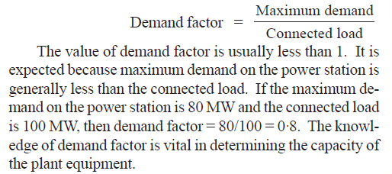
Important Terms and Factors
Connected load: It is the sum of continuous ratings of all the equipment connected to supply system.
Maximum demand: It is the greatest demand of load on the power station during a given period.
Demand factor: It is the ratio of maximum demand on the power station to its connected load i.e.,

Slide 7
Important Terms and Factors
Average load: The average of loads occurring on the power station in a given period (day or month or year) is known as average load or average demand.

Slide 8
Important Terms and Factors
Load factor: The ratio of average load to the maximum demand during a given period is known as load factor.

Slide 9
Important Terms and Factors
Diversity factor: The ratio of the sum of individual maximum demands to the maximum demand on power station is known as diversity factor
Plant capacity factor: It is the ratio of actual energy produced to the maximum possible energy that could have been produced during a given period

Slide 10
Important Terms and Factors
Plant use factor: It is the ratio of kWh generated to the product of plant capacity and the number of hours for which the plant was in operation

Slide 11
Important Terms and Factors
Units Generated per Annum: It is often required to find the kWh generated per annum from maximum demand and load factor. The procedure is as follows

Slide 12
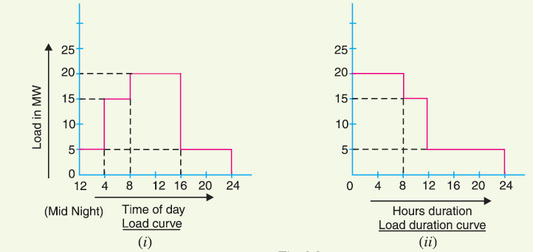
Important Terms and Factors
Load Duration Curve: When the load elements of a load curve are arranged in the order of descending magnitudes, the curve thus obtained is called a load duration curve.

Slide 13
Important Terms and Factors
Base Load and PEAK load power plants: The unvarying load which occurs almost the whole day on the station is known as base load and the various peak demands of load over and above the base load of the station is known as peak load.
Requirements for PEAK load plant:

Slide 14
Examples: Variable Load on Power Stations

Slide 15
Examples: Variable Load on Power Stations

Slide 16
Examples: Variable Load on Power Stations

Slide 17
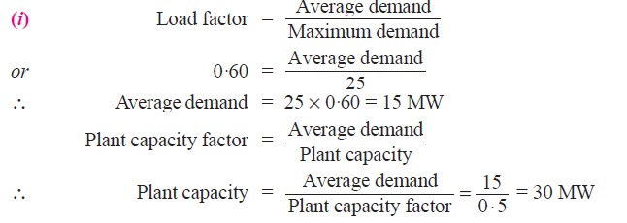
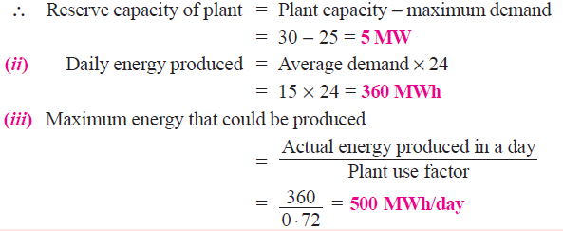
Examples: Variable Load on Power Stations

Slide 18
Examples: Variable Load on Power Stations

Slide 19
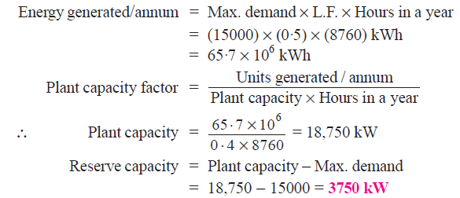
Examples: Variable Load on Power Stations

Slide 20
Examples: Variable Load on Power Stations

Slide 21
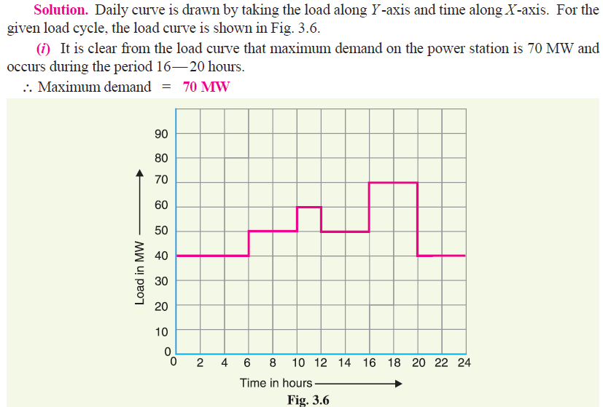
Examples: Variable Load on Power Stations

Slide 22
Examples: Variable Load on Power Stations

Slide 23
Examples: Variable Load on Power Stations

Slide 24
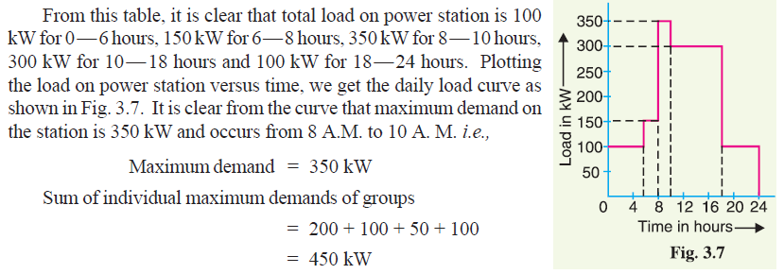
Examples: Variable Load on Power Stations

Slide 25
Examples: Variable Load on Power Stations

Slide 26
Thank You
Contact: dralam.eee@diu.edu.bd

