Slide 1
Topic 11
Index Number

Slide 2
Index Number
A number that expresses the relative change in price, quantity, or value compared to a base period.
If the index number is used to measure the relative change in just one variable, such as hourly wages in manufacturing, we refer to this as a simple index.
It is the ratio of two variables converted to a percentage.

Slide 5
Construction of Index Numbers

Slide 6
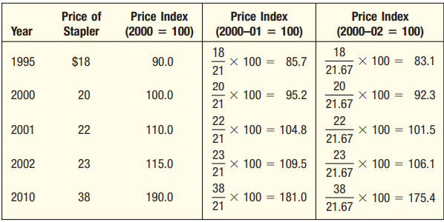
The base period need not be a single year. Note in Table that if we use 2000–01 100, the base price for the stapler would be $21 [found by determining the mean price of 2000 and 2001, ($20 $22)2 $21].
The prices $20, $22, and $23 are averaged if 2000–02 is selected as the base.
The mean price would be $21.67.
The indexes constructed using the three different base periods are presented in Table.
(Note that when 2000–02 100, the index numbers for 2000, 2001, and 2002 average 100.0, as we would expect.)
Logically, the index numbers for 2010 using the three different bases are not the same.

Slide 7
Unweighted Indexes

Slide 11
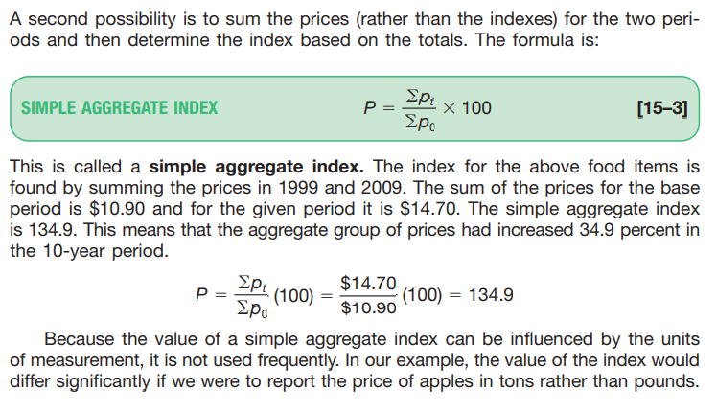
Simple Aggregate Index

Slide 12
Simple Aggregate Index

Slide 15
First we determine the total amount spent for the six items in the base period, 1999.
To find this value, we multiply the base period price for bread ($0.87) by the base period quantity of 50.
The result is $43.50. This indicates that a total of $43.50 was spent in the base period on bread.
We continue that for all items and total the results.
The base period total is $507.64.
The current period total is computed in a similar fashion.
For the first item, bread, we multiply the quantity in 1999 by the price of bread in 2009, that is, $1.28(50). The result is $64.00.
We make the same calculation for each item and total the result. The total is $695.72.

Slide 17
Paasche Price Index

Slide 20
Fisher’s Ideal Index

Slide 22
Thank You!

