Slide 1
Topics: Geographical Indication
Juwel Rana
Lecturer
Dept. of Nutrition & Food Engineering
Daffodil International University

Slide 2
Question???
Why do people choose ……………?
Ilish from Padma over meghna?
Chamcham from Tangail over Noakhali?
Kataribhog from Dinajpur Over mymensingh?
Darjeeling over “black” tea over Sylhet?

Slide 3
Geographical Indication
A geographical indication is a sign used on products that have a specific geographical origin and possess qualities or a reputation that are due to that origin.

Slide 4
Geographical indication
It is a sign used on products that have a specific geographical origin and possess qualities or a reputation that are due to that origin.
GI is a status accorded to a good which is unique to a particular region or area, and are originated from there.
It is used for agricultural products , food stuffs , wine and spirit drinks, handicrafts and industrial product

Slide 5
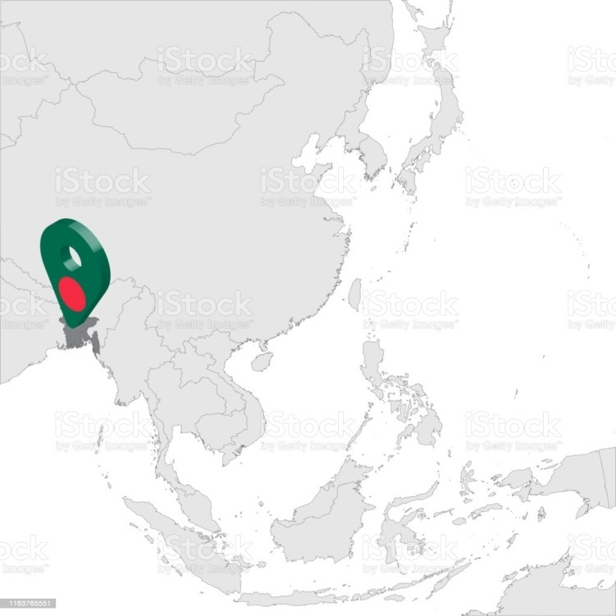
How many are registered as GI?

Slide 6
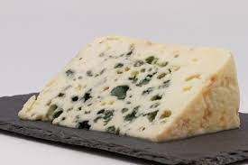
ROQUEFORT????
A product, a region Roquefort identifies a characteristic blue cheese made in a region in southwest France, around the municipality of Roquefort-sur-Soulzon.

Slide 7
A link between the product and the region
ROQUEFORT Cheese:
The characteristics of the milk obtained from indigenous breeds of sheep fed according to tradition, the characteristics of the caves in which the cheese is aged and the traditional know-how used in each step of the cheese making process give Roquefort its unique features and taste.

Slide 8
Can geographical indications only be used for agricultural products?

Slide 9
What is the difference between a geographical indication and a trademark?
Geographical indications and trademarks are distinctive signs used to distinguish goods or services in the marketplace.
Both convey information about the origin of a good or service, and enable consumers to associate a particular quality with a good or service.
Trademarks inform consumers about the source of a good or service. They identify a good or service as originating from a particular company. Trademarks help consumers associate a good or service with a specific quality or reputation, based on information about the company responsible for producing or offering it.
Geographical indications identify a good as originating from a particular place. Based on its place of origin, consumers may associate a good with a particular quality, characteristic or reputation.
A trademark can be assigned or licensed to anyone, anywhere in the world, because it is linked to a specific company and not to a particular place.
GI cannot be assigned or licensed to someone outside that place or not belonging to the group of authorized producers.

Slide 10
Difference between a geographical indication and a trademark
Geographical indication:
A geographical indication tells consumers that a product is produced in a certain place.
It may be used by all producers who make their products in the place designated by a geographical indication.
The name used as a geographical indication will usually be predetermined by the name of the place of production.
Trademark:
A trademark is a sign used by an enterprise to distinguish its goods and services from those of other enterprises.
A trademark will often consist of a fanciful or arbitrary name or device.
It gives its owner the right to exclude others from using the trademark.

Slide 11
Developing a geographical indication - why?
Geographical indications as a factor of rural development.
Geographical indications as a means to preserve traditional knowledge (TK) and traditional cultural expressions (TCEs).

Slide 12
Why use Geographical indication?
1.Respond to ever increasing consumer demand for guaranteed origin and production method.
2.Promote diversification and competitiveness.
3.Fair competition in global market.
4. Prevent de-localisation of production.

Slide 13
Importance of geographical indication
For Conservation of Traditional Products:
Geographical Indication is a name or sign used to protect certain products which are located in geographical specific or origin within the frame work of Intellectual property.
The aim of this study is to provide an overview and importance of geographical Indication on the traditional products.
Provide awareness among the people on the importance of it in social upliftment for rural development.

Slide 14
Types of GI- Home Work
PGI (Protected Geographical Indication) –In this agricultural foodstuff or product must have a reputation, characteristics or qualities as a result of its production, processing or preparation in a particular geographical area. For instance - the Cornish pastie - which can finally be baked outside Cornwall.
PDO (Protected Designation of Origin) – This has tighter requirements than the PGI: all three stages (production, processing and preparation) must take place in the designated area and the agricultural foodstuff or product must be made using distinct local knowledge - for instance Cornish Clotted Cream.
TSG (Traditional Speciality Guaranteed) – A product with traditional characteristics arising from its ingredients or production methods (eg, traditional Bramley apple pie filling). The product need not be linked to a geographical area and can be produced in any EU Member State.

Slide 15
Laws
THE GEOGRAPHICAL INDICATIONS ACT, 2013
An Act to provide for the protection and registration of geographical indications
To provide for the duration of protection of geographical indications
To provide for the appointment of a registrar
For remedies for infringement or prohibited use of geographical indications.

Slide 16
How geographical indications ARE protected
Special laws for the protection of geographical indications or appellations of origin
Trademark laws in the form of collective marks or certification marks
Laws against unfair competition
Consumer protection laws
specific laws or decrees that recognize individual geographical indications.

Slide 17
The Registration Process of GI
Step 1: Filing of application
Step 2 and 3 : Preliminary scrutiny and examination
Step 4: Show cause notice
Step 5: Publication in the geographical indication journal
Step 6: Opposition to Registration
Step 7: Registration
Step 8: Renewal
Step 9: Additional protection to notified goods
Step 10: Appeal

