Slide 1
CE 402: Industrial training Lecture: Outlines for industrial training report writing
Course teacher: Saurav Barua (SB)
Assistant Professor,
Dept. of Civil Engineering, DIU
Phone: +88-01715334075
Email: saurav.ce@diu.edu.bd

Slide 2
Instructions for Industrial training report writing
Only one final report to be submitted
Final report must be book-binding and pages within 30-40 pages
Each student has to prepare separate report and presentation (Must avoid plagiarism or it will deduce marks)

Slide 3
Outlines for Industrial training report writing
3. Outline for Industrial training report will as follows:
Cover page
Table of contents
Chapter 1: Description of the project site
-Must include google map of the site including GPS location

Slide 4
Observations
Chapter 2: Observations during site visit
-Must write the observations day-wise site visit in bullet point accompanied by evidence photos.
-Observations of design drawings and field visit in a same day must be separated by paragraphs.
-Observation must suffice to meet 3 W questions (What, Where, why.)

Slide 5
Learning outcomes and recommendations
Chapter 3: Learning outcomes and recommendations
-Must write learning outcomes and recommendations day-wise site visit.
-Learning outcomes and recommendations should be in bullets.

Slide 6
Conclusion
Chapter 4: Conclusion
- summarize project description,
- summarize observations,
- learning outcome and recommendations

Slide 7
Appendix
Appendix
- must include self assessment for Knowledge profile (K), Complex Engineering Problem (P) and Complex Engineering Activities (A) mapping with writing remarks of each point by 1-2 lines
- must include signed field log book
Marks distribution sheet for Industrial training report
Marks distribution sheet for Industrial training presentation
Copy of introductory/forwarding letter from the Head of Department and received signed by industrial training company
Copy of industrial training policy letter and received signed by industrial training company

Slide 8
Self assessment in the Appendix

Slide 9
Knowledge Profile (K)
K | Description | Mapping | Remarks
K1 | A systematic, theory-based understanding of the natural sciences applicable to the discipline | √
K2 | Conceptually based mathematics, numerical analysis, statistics and formal aspects of computer and information science to support analysis and modelling applicable to the discipline |  | ×
K3 | A systematic, theory-based formulation of engineering fundamentals required in the engineering discipline |  | ×
K4 | Engineering specialist knowledge that provides theoretical frameworks and bodies of knowledge for the accepted practice areas in the engineering discipline; much is at the forefront of the discipline | √
K5 | Knowledge that supports engineering design in a practice area | √
K6 | Knowledge of engineering practice (technology) in the practice areas in the engineering discipline | √
K7 | Comprehension of the role of engineering in society and of the identified issues in engineering practice in the discipline: ethics and the engineer’s professional responsibility to public safety; the impacts of engineering activity in economic, social, cultural, environmental and sustainability terms | √
K8 | Engagement with selected knowledge in the research literature of the discipline |  | ×

Slide 10
Complex Engineering Problem Solving (P)
P | Attributes | Description | Mapping | Remarks
P1 | Range of conflicting requirement | Involve wide-ranging or conflicting technical, engineering and other issues | √
P2 | Depth of analysis required | Have no obvious solution and require abstract thinking and originality in analysis to formulate suitable models |  | ×
P3 | Depth of knowledge required | Require research-based knowledge, much of which is at or informed by the forefront of the professional discipline, that allows a fundamental-based, first-principles analytical approach |  | ×
P4 | Familiarity of issues | Involve infrequently encountered issue | √
P5 | Extent of applicable codes | Are outside the problems encompassed by standards and codes of practice for professional engineering |  | ×
P6 | Extent of stakeholder involvement and level of conflicting requirements | Involve diverse groups of stakeholders with widely varying needs | √
P7 | Interdependence | Are high-level problems that include many component parts or sub-problems | √

Slide 11
Complex Engineering Activities (A)
A | Attributes | Description | Mapping | Remarks
A1 | Range of resources | Involve the use of diverse resources (for this purpose, resources include people, money, equipment, materials, information and technologies) | √
A2 | Level of interaction | Require the resolution of significant problems arising from interactions between wide- ranging or conflicting technical, engineering or other issue | √
A3 | Innovation | Involve the creative use of engineering principles and research-based knowledge in novel ways |  | ×
A4 | Consequences for society and the environment | Have significant consequences in a range of contexts, characterized by their difficulty of prediction and mitigation | √
A5 | Familiarity | Are outside the problems encompassed by standards and codes of practice for professional engineering |  | ×

Slide 12
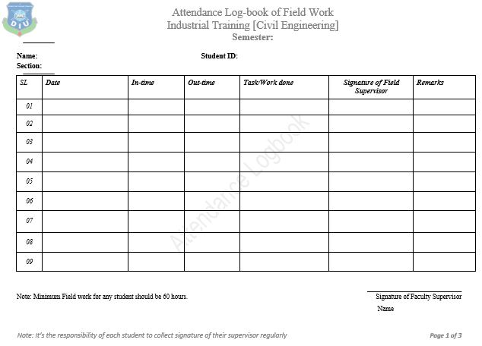
Field log book in the Appendix

Slide 13
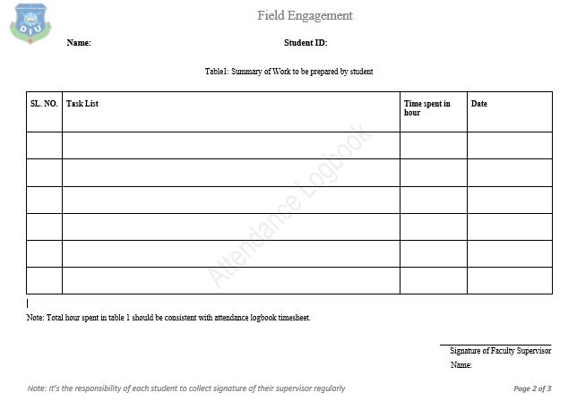
Field log book in the Appendix

Slide 14
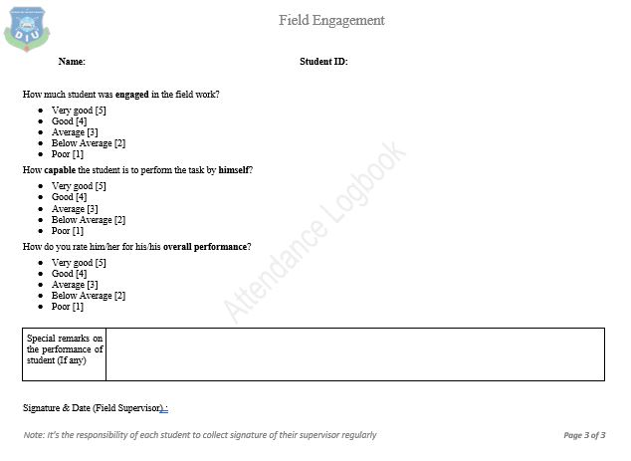
Field log book in the Appendix

Slide 15
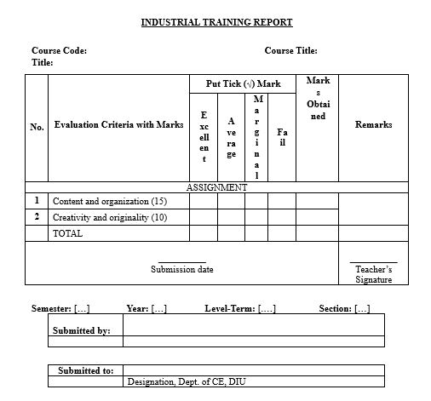
Marks distribution sheet for report

Slide 16
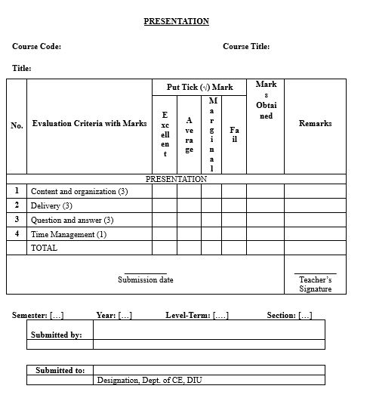
Marks distribution sheet for presentation

Slide 17
End of the Lecture

