Slide 1
Consumption
Definition: Quantity of raw materials required to produce a complete garment; Fabric and accessories required to produce per dozen garments.
Factors that affect Consumption
Measurement with technical specification: If measurement of the garments is bigger, consumption will be higher.
Style description: Consumption will be higher for complicated/design garments and will be less for plain/basic garments.
Fabrics description: Plain/Solid color fabric gives higher marker efficiency, Stripe, check and all over print (AOP) fabric consumption is comparatively higher.
Fabric width /weight: For woven fabric, higher the fabric width ensures lower consumption and for knit fabric, higher GSM of fabrics requires higher consumption for same style garments.
Washing shrinkage: Washing shrinkage is determined before finalizing the pattern. % of shrinkage is added with the pattern.

Slide 2
Methods of Calculating Consumption
Marking/Marker Planning: In this method, the parts of different size patterns are set on a marker, usually patterns of all size. It gives exact fabric consumption.
Mathematical process: In this method, consumption is calculated by using the measurement of different parts mentioned in the specification/measurement sheet.

Slide 3
Basic Formula for Consumption
Knit:
Length x Width x GSM
….……………………………….. : in Gram/Kg
10⁴ / 10⁷
Woven:
Length x Width
..….……………………………….. : in Yds
36 x Fabric Width

Slide 4
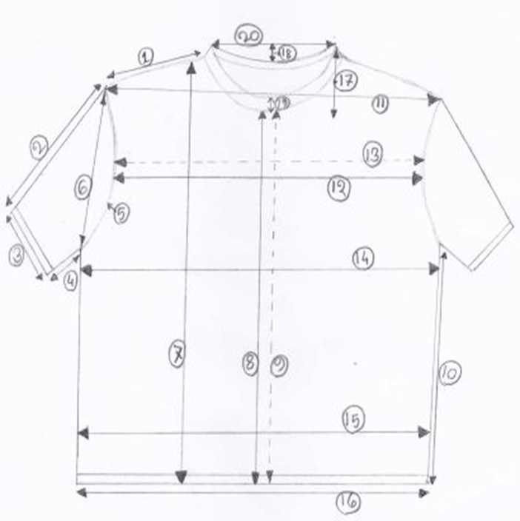
Sketch of a T shirt

Slide 5
Consumption for Knit (in Dozen)
Consumption formula:
L+SL+AL ½ C+AL GSM
--------------x-----------------x---------------x2x12+W%
100 100 1000
L = Length from HPS/CBL/back length (In the sketch, POM:7)
SL = Sleeve Length (In the sketch, POM:2)
½ C = half Chest (In the sketch, POM:14)
Al = Allowance (2 cm for each side)
W% = Wastage % of Marker = (100-marker efficiency)

Slide 6
Consumption for knit
L = HPS/CBL/BL
SL= Sleeve Length
AL=Allowance (2 cm for each side, each joining)
if, Body Length(7) = 62 cm
½ Chest(14) = 48 cm
Sleeve Length(2) = 12 cm
Neck width = 19 cm
Rib Height = 1.5 cm
GSM for body fabric = 180
GSM for Neck rib = 220
Marker efficiency = 88%

Slide 7
Consumption for knit
Body Fabric Consumption:
L+SL+AL ½ C+AL GSM
--------------x-----------------x---------------x2x12+W%
100 100 1000
( 62+ 12 + 10) ( 48+ 4) 180
=-------------------x-------------x------------x2x12+12%
100 100 1000
= (1.89 + 12% )kg/dz
= 1.89 + 1.89* 12/100
= 2.12 kg/dz

Slide 8
Consumption for knit
B. Neck Rib Consumption:
Width = Neck width x 2 + 2 cm (Round)
= 19X2+2 = 40 cm
Total Height = Rib Height X 2 + Allowance
= 1.5X2 +2=5 cm
( Length in cm X Width in cm X GSM X 12 )
Consumption (Kg/ dz) = ………………………………………………………….……….... + Wastage%
10⁷
= 40 X 5 X 220 /10000000 X 12+12% kg/dozen
= (.053 + 12% ) kg/ dz
= 0.059 kg/dz

Slide 9
Consumption for knit
Total consumption (A+B) = (body consumption + Neck rib consumption)
=(2.12+.059) Kg/dozen
= 2.18 kg/dz

Slide 10
Home work – Knitted T-shirt
1. Calculate fabric consumption for one dozen Knitted T-shirt by considering the followings:
Half Chest=55 cm, Length from HPS= 72 cm, Sleeve Length= 18 cm,
Armhole= 21 cm, Sleeve opening= 20 cm, Neck width= 18 cm, Arm hole = 26 cm, Neck Rib height= 1.5 cm; GSM of body fabric =140, GSM of Rib=220, Marker efficiency 86%.
2. Measure your own T-shirt and calculate its weight considering reasonable GSM (Range is 140-180), weight your T-shirt in a weighing scale and find out the differences of calculated weight and actual weight in gram.

Slide 12
Basic Shirt and its different parts
Collar+collar stand
Front-upper
Front-lower
Back
Yoke
Sleeve
Cuff
Pocket

Slide 13
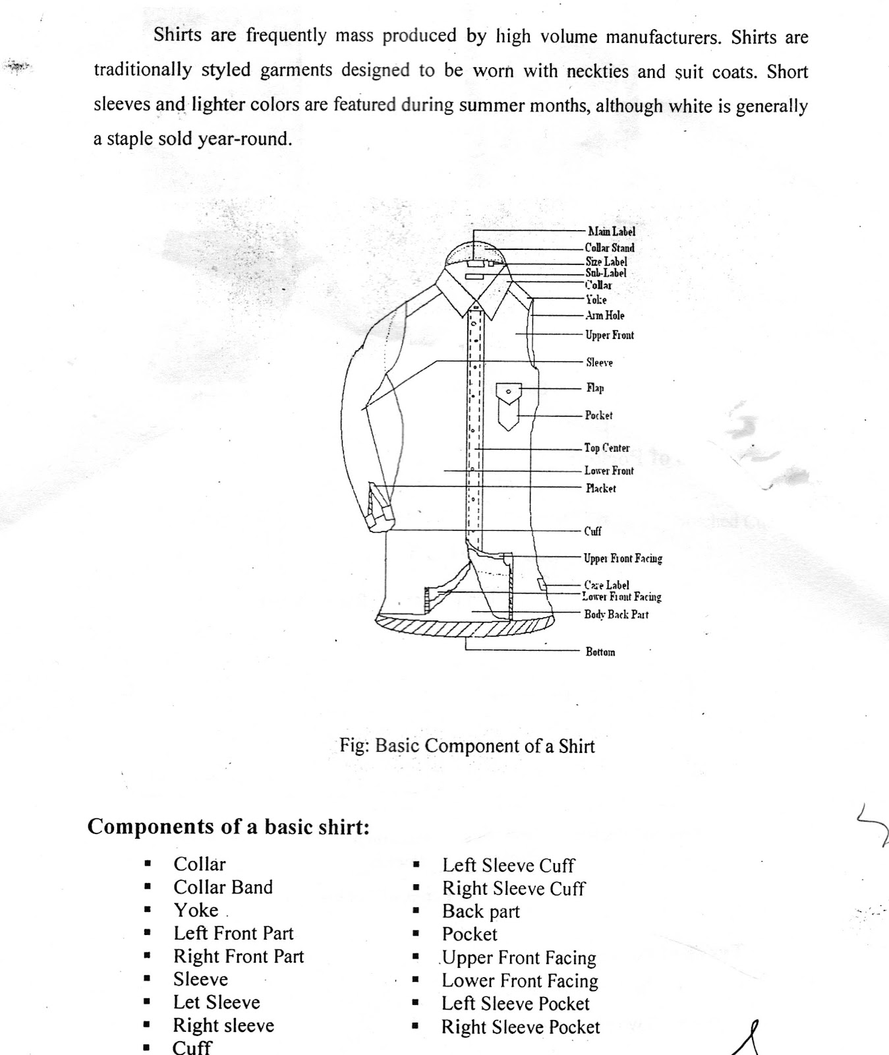

Slide 14
Sketch of an woven shirt

Slide 15
Consumption for Woven-Top
Length x Width
Formula=-------------------------------------
Fabric width x Fabric Unit

Slide 16
Consumption for Woven-Top
Body length (POM: 7) = Body length + Allowance (32+1=33’’)
Body Width (POM: 13) = 1/2xChest width + Allowance (24+1+3=28’’)
Long Sleeve length (POM: 2) = SL + Allowance (23+2.5+1.5=27’’)
Fabric width = 59’’
Marker Efficiency = 85%
{ (Length + Sleeve Length + Allowance) x (1/2Chest+Allowance }x2
Formula=-------------------------------------------------------------------------------------+Wastage%
36xFabric width
{(33+27)x28}x2
=------------------------------------------+15% Yards/piece
36x59
= 1.58+1.58x15/100 yards/piece
= 1.82 yards/piece
=21.84 yards/dozen

Slide 17
Home Work – woven shirt
1. Calculate the consumption of woven fabric per dozen of shirt considering
Length from HPS: 35 inch, Half Chest: 22 inch, Sleeve length: 26 inch, arm hole straight: 15 inch, fabric width: 60 inch, marker efficiency: 84%
2. Measure your woven shirt and calculate its fabric consumption considering fabric width 60 inch.

Slide 19
Sketch of a Pants

Slide 20
Consumption calculation for woven basic pants
Consumption per piece:
{½ waist cir. (A) X front rise (C)} x 2 + {½ thigh cir. (F) X inseam(J) x 4}
-------------------------------------------------------------------------------------------------- + wastage%
36 x 59x2.54x2.54
½ Waist Cir. = 46cm+8 cm (s) = 54 cm
Front Rise = 28 incl.WB+8cm =36 cm
½ Thigh Cir = 36 cm+4cm =40 cm
Inseam = 82 cm+4cm =86 cm
Fabric width: 59 inch
Marker Efficiency: 85%

Slide 21
Consumption calculation for woven basic pants
(54x36)x2+(40x86)x4
=---------------------------------+15%
36x59x2.54x2.54
3888+13760
=------------------------+15%
36x59x2.54x2.54
15
= 1.266+1.266 x ---------
100
= 1.456 yards/piece
= 1.456 x 12 yards/dozen
= 17.47 yards/dozen

Slide 22
Home Work – Woven bottom
1. Calculate fabric consumption for one dozen woven basic pants by considering the followings:
Half waist circumference = 45 cm, Front rise including waist band= 25 cm, Half thigh circumference = 35 cm, Inseam = 80 cm, Fabric width 60 inch, Marker efficiency: 85%

