Slide 1
Digital Communication
Digital Communication is that where the message or data is in digital form of
signal, then the digital message signal is modulated by using digital modulation techniques
Then transmitted by transmitter.
So
1.What is the basic Difference between Digital and Analog Communication System?
2.What is Analog Signal?
3.What is Digital Signal?
4.What is Digital Modulation ? And what are the techniques?
5.What are the Differences between Digital and Analog Modulation Techniques?
6.Actually message signals from input transducer (microphone ,camera or Keyboard are what types ?
Analog or Digital?
7.If Analog how can we convert this into digital in Digital communication?

Slide 2
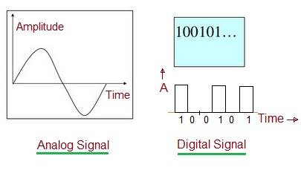
An analog signal signifies a continuous signal that keeps changes with a time period.
A digital signal signifies a discrete signal that carries binary data and has discrete values.
Analog signals are continuous sine waves. Digital signal is square waves.

Slide 3
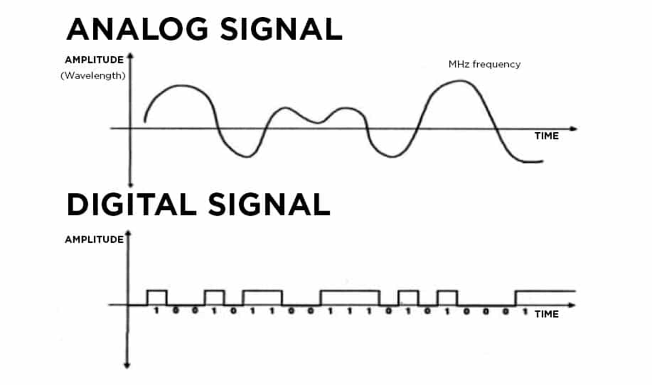

Slide 4
Basic Difference between Digital and Analog Communication System
Analog communication uses analog signal whose amplitude varies continuously with time from 0 to infinite. Digital communication uses digital signal whose amplitude is of two levels either Low i.e., 0 or either High i.e., 1.
Advantages of Digital Communication
Digital circuits are more reliable.
Digital circuits are easy to design and cheaper than analog circuits.
The configuring process of digital signals is easier than analog signals.
Digital signals can be saved and retrieved more conveniently than analog signals.

Slide 5
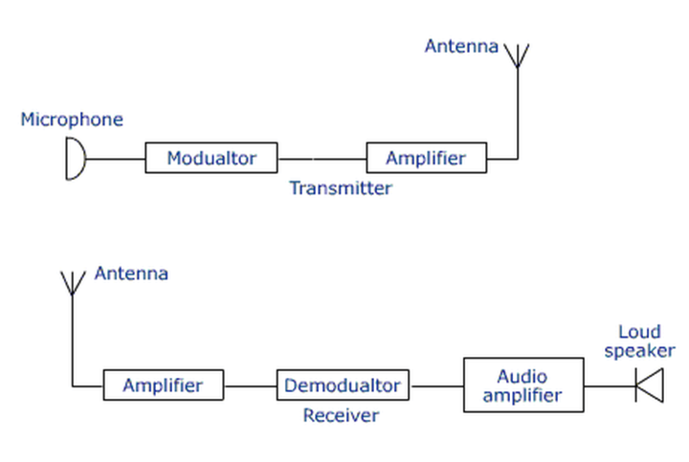
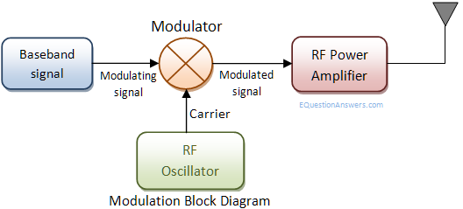

Slide 6
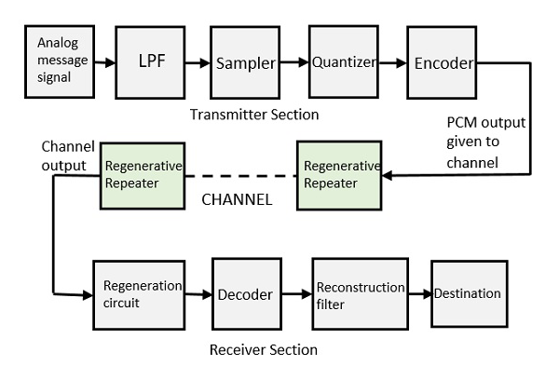

Slide 7
Digital Communication (Digital Transmitter)
Digital Bit
Digital signal pulse
[Input signal]
Analog or continuous signal
Digital Modulated
signal
A/D
Converter
Channel Encoder
Modulator
Digital Message signal
and
Carrier signal
A/D Converter: Analog To Digital Converter

Slide 8
Analog to Digital (A/D) Conversion:
PCM technic (pulse code modulation):-
Analogue Signal
Digital Signal
LPF
Sampler
Quantizer
Bit Encoder
c
c
c
Analogue Signal
Discreet Signal
Quantized Signal

Slide 9
A/D Conversion and Sampling Theorem

Slide 10
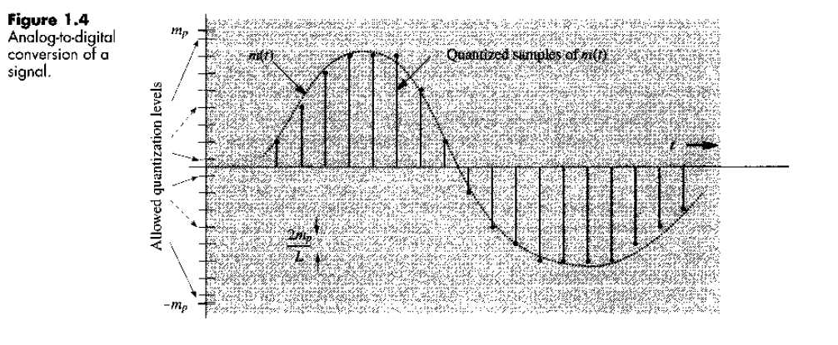

Slide 11
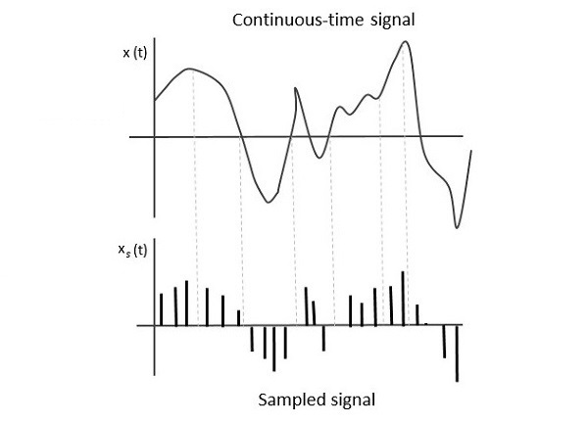
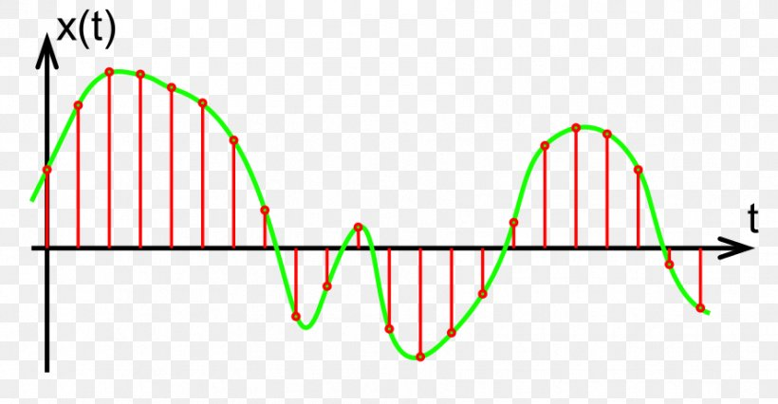

Slide 12
We know..
Δv=2m_{p}/L
Where,
L=Number of quantization level
Δv=Quantization interval
Here L=2^{n}
^{n} = Number of Bit to represent Each quantized Sample
Sample | Level | Digital
X(0) | 6 | 0110
X(1) | 8 | 1000
X(2) | 9 | 1001
X(3) | 10 | 1010
X(4) | 11 | 1011
X(5) | 10 | 1010
X(6) | 9 | 1001
X(7) | 8 | 1000
X(8) | 4 | 0100
X(9) | 3 | 0011
X(10) | 2 | 0010
X(11) | 3 | 0011
X(12) | 4 | 0100
11
10
9
8
7
6
5
4
3
2
1
o
Δv
m_{p}
8 9 10 11 12
1 Sec
0 1 2 3 4 5 6 7
6
Analogue Message Signal
m_{p}
Discreet Signal and Quantized Signal

Slide 13
Digital pulse of Binary Code:-
L | Binary Code | Digital pulse
0 | 0000
1 | 0001
2 | 0010
3 | 0011
4 | 0100
5 | 0101
6 | 0110
7 | 0111
8 | 1000
9 | 1001
1o | 1010
11 | 1011

Slide 14
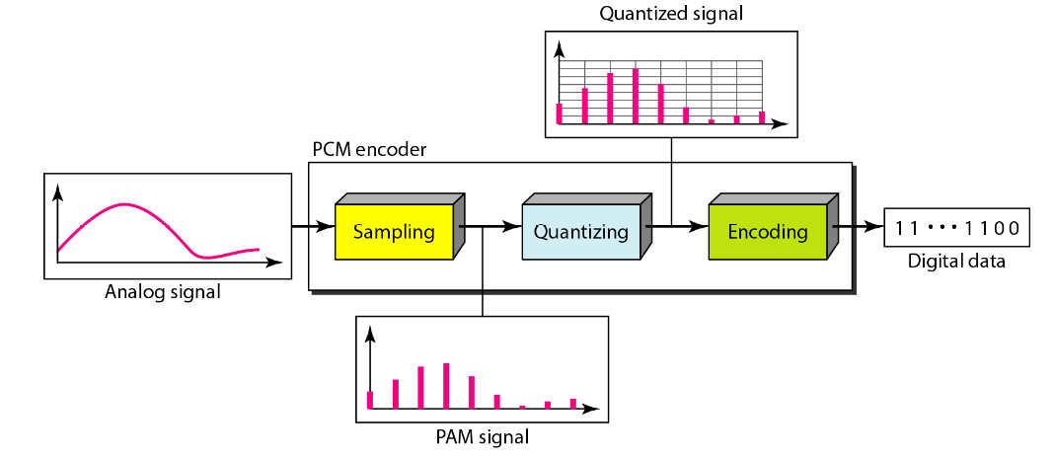

Slide 15
Sample | Level | Digital
X(0) | 6 | 0110
X(1) | 8 | 1000
X(2) | 9 | 1001
X(3) | 10 | 1010
X(4) | 11 | 1011
X(5) | 10 | 1010
X(6) | 9 | 1001
X(7) | 8 | 1000
X(8) | 4 | 0100
X(9) | 3 | 0011
X(10) | 2 | 0010
X(11) | 3 | 0011
X(12) | 4 | 0100
0110100010011010………………

Slide 16
A television signal has a bandwidth of 4.5MHz.This signal is sampled quantized and binary coded to obtain PCM signal. 1.Determine sampling rate if the signal is sampled at a rate 20% above the normal sampling rate. 2.Determine binary pulse rate in Kbps if the sample is quantized into 1024 level.
We know..
Δv=2m_{p}/L
Where,
L=Number of quantization level
Δv=Quantization interval
Here L=11≅2⁴

Slide 17
Solution:-
Ans:
1) Sampling rate = {(4.5x10⁶) x2} +2(4.5x10⁶) x0.2
=10.8x10⁶ sample/sec
2)Total bit = 10.8x10⁶x10
=10.8x10⁷ bps
=10.8x10⁴ Kbps
=108x10³ Kbps
=108 Mbps

Slide 18
Quantization Error and Quantization Noise
Ref. Book-Modern-Digital-And-Analog-Communication-Systems-4th-edition-by-Lathi
Chp.6 Quantization Error and Quantization Noise

Slide 19
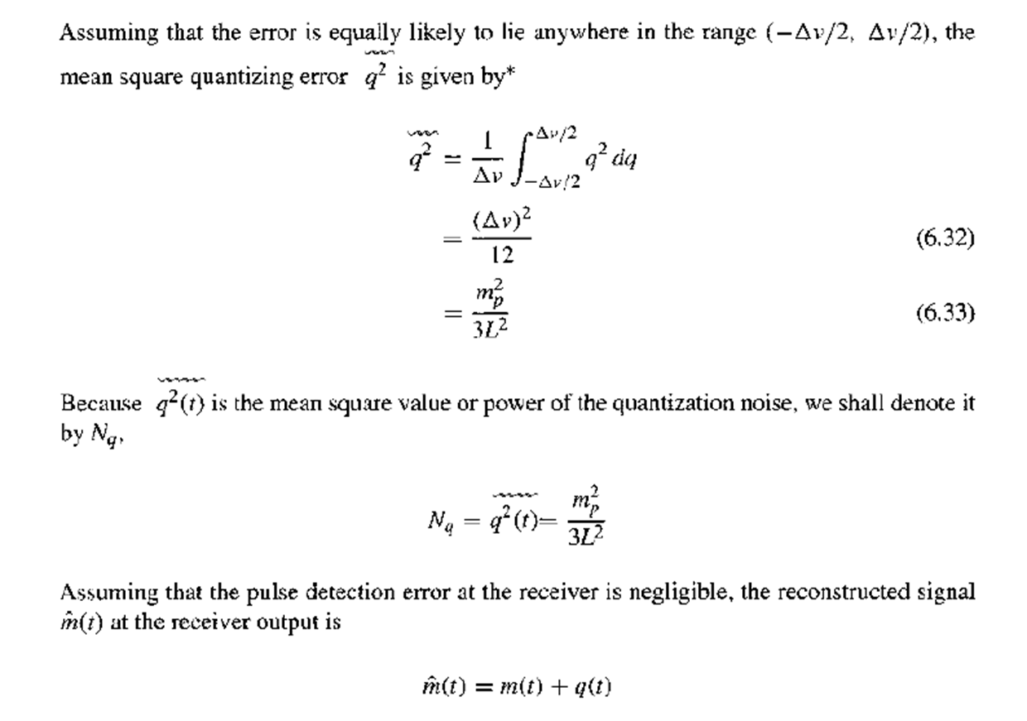

Slide 20
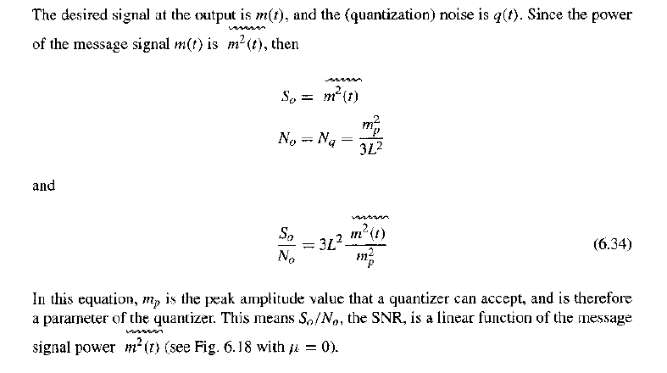

Slide 21
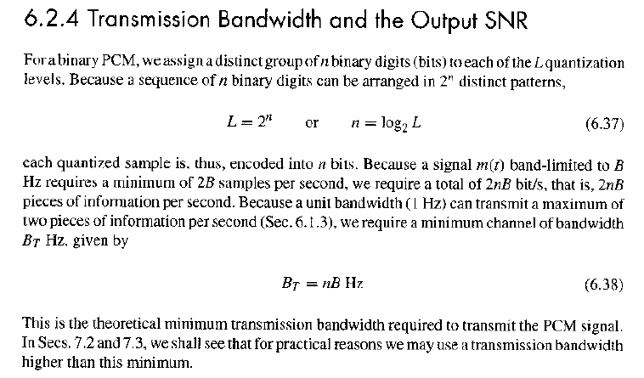

Slide 22
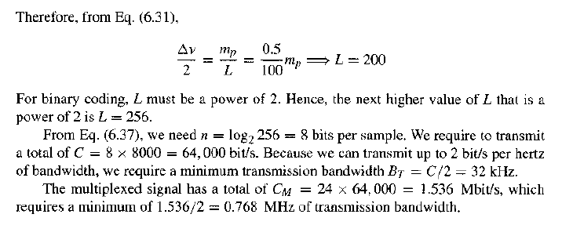

Slide 23
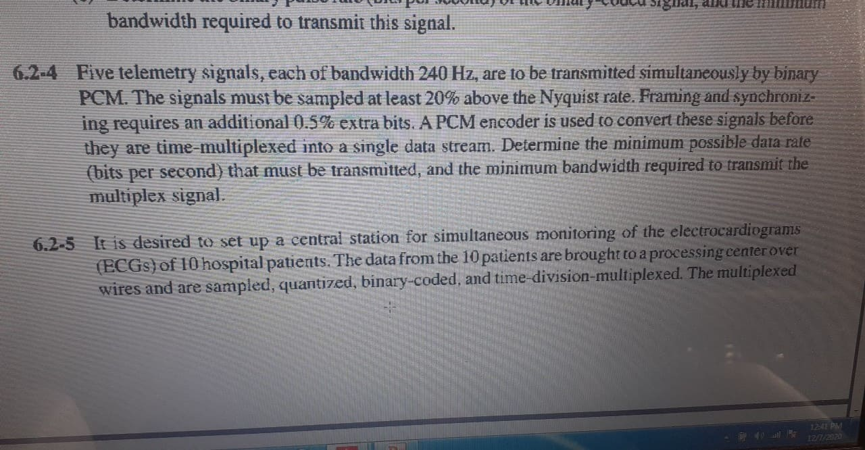

Slide 24
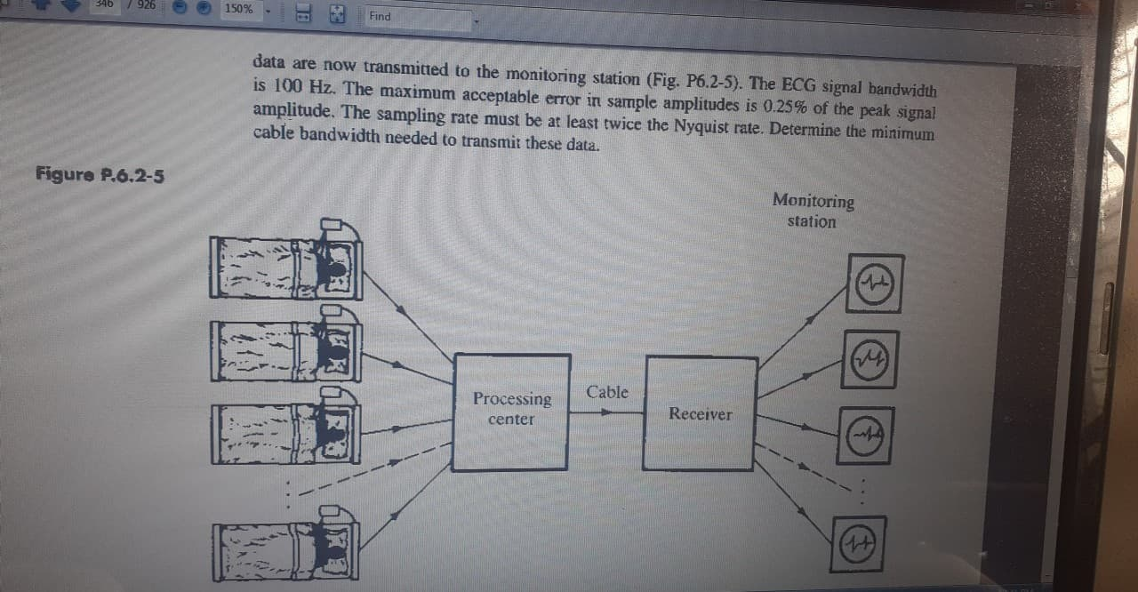

Slide 25
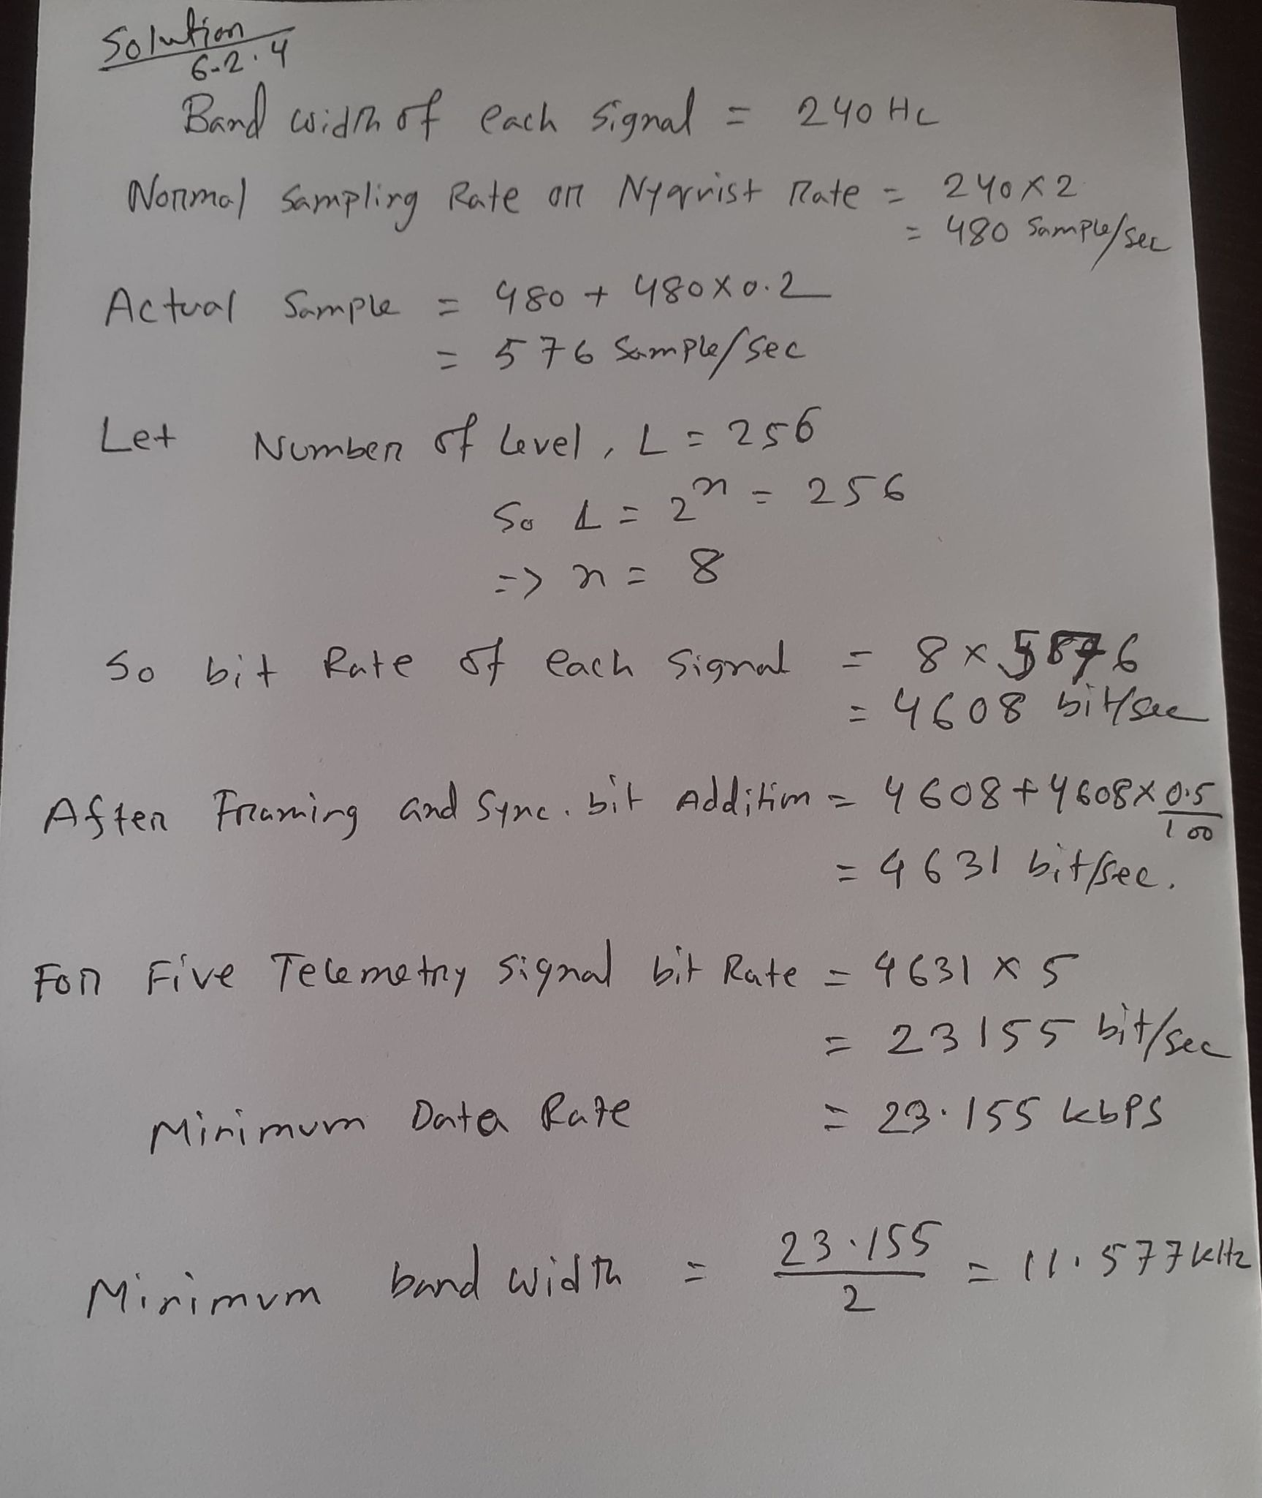

Slide 26
