Slide 1
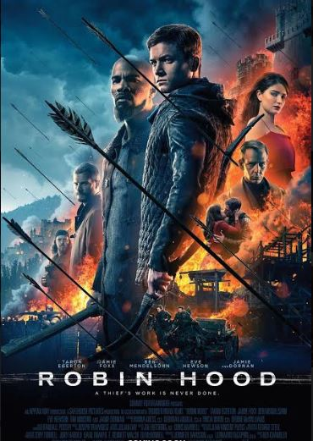
Robin hood (2018)
Name
ID
Subject

Slide 2
Trailer

Slide 3
Movie synopsis
A war-hardened Crusader and his Moorish commander mount an audacious revolt against the corrupt English crown in a thrilling action-adventure packed with gritty battlefield exploits, mind-blowing fight choreography, and a timeless romance.

Slide 4
story

Slide 5
characters

Slide 6
Directing

Slide 7
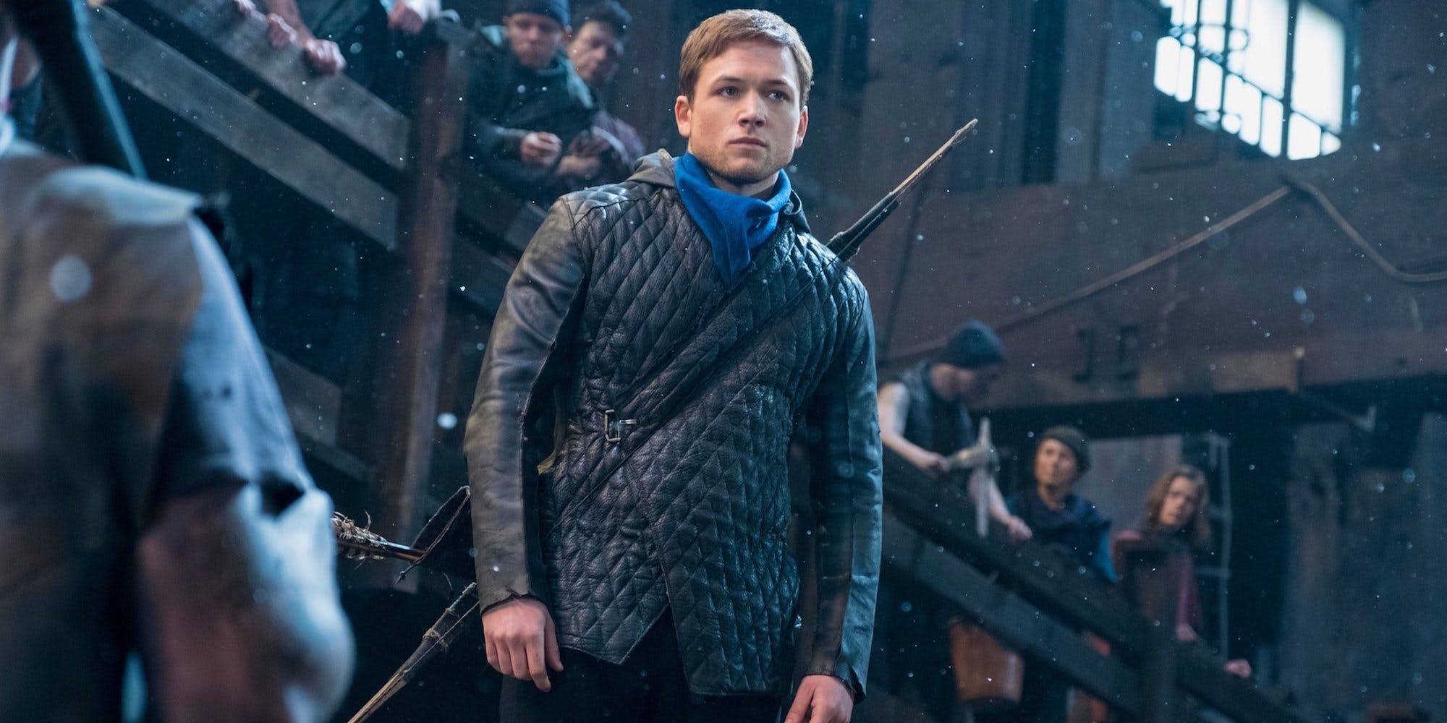
What I like about This movie
Cinematography
Editing style
Mise en scene
Colours

Slide 8
What I don’t like about This movie
Story
Characters
Directing

