Slide 1
Lecture-4: Discrete Time Signal & System
Functional Representation:
Sequence Representation:
1, for n=1,3
x(n)= 4, for n=2
0, elsewhere
x(n)= {1, 2, -1, 3, -2, 1}

Slide 2
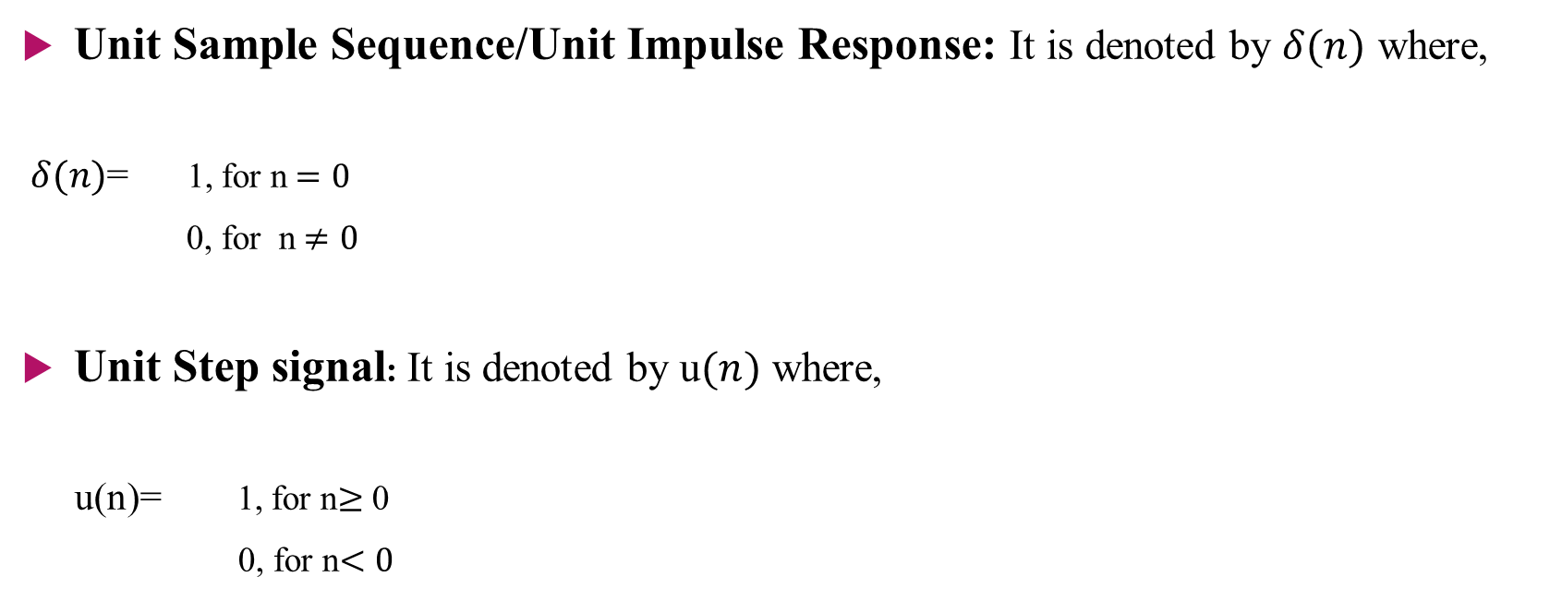
Some Elementary Discrete-time Signal
Unit Sample Sequence/Unit Impulse Response: It is denoted by $δ(n)$ where,
$δ(n)$= 1, for n$=0$
0, for n$≠0$
Unit Step signal: It is denoted by u$(n)$ where,
u(n)= 1, for n$≥$ 0
0, for n$<0$

Slide 3

Unit ramp signal: It is denoted by u_{r}(n) where,
u_{r}(n)= n, for n$≥0$
0, for n< 0
The exponential signal:
x(n) = a^{n}

Slide 4
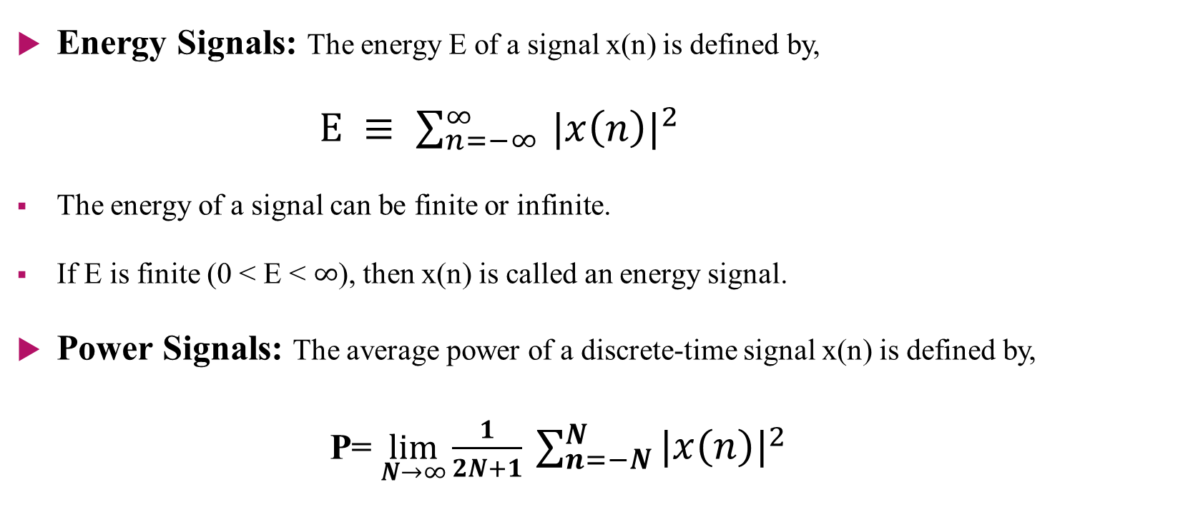
Classification of Discrete-time Signal
Energy Signals: The energy E of a signal x(n) is defined by,
$E ≡ \sum_{n=−∞ }^{∞}{|{x\left(n\right)|}^{2}}$
The energy of a signal can be finite or infinite.
If E is finite (0 < E < $∞$), then x(n) is called an energy signal.
Power Signals: The average power of a discrete-time signal x(n) is defined by,
P= $\lim_{N→∞}{\frac{1}{2N+1} }\sum_{n=−N}^{N}{|{x\left(n\right)|}^{2}}$

Slide 5

If we define the signal energy of x(n) over the finite interval -N$≤$n$≤$ $N$ as,
$$\text{E}\text{N}≡ \sum_{n=−N }^{N}{|{x\left(n\right)|}^{2}}$$
Then the signal energy E is,
E $≡$ $\lim_{N→∞}{ }\text{E}\text{N}$
and The average power of the signal x(n) is,
P= $\lim_{N→∞}{\frac{1}{2N+1} }\text{E}\text{N}$

Slide 6
Problems
Example-2.1.1: Determine the power and energy of the unit step signal.
Example-2.2.1: Determine the response of the following system to the input signal,
| n |, -3$≤n$
x(n) = 0, otherwise
y(n)= x(n)
y(n)= x(n-1)
y(n)= x(n+1)
y(n)= 1/3 [x(n+1)+ x(n)+x(n-1)]
y(n)= max{x(n+1), x(n), x(n-1)}
y(n)= $\sum_{k=−∞ }^{n}{x\left(k\right)=x\left(n\right)+x\left(n−1\right)+x\left(n−2\right)+…}$

