Slide 1
International Business
Chapter 6

Slide 2
What is International Business?
All commercial transactions—including sales, investments, and transportation—that take place between two or more countries.
“International Business”, define international business as, all commercial transactions- private and governmental between two or more countries.
The performance of business activates across the national boundaries.

Slide 3
Why Firms conduct International Business?
No nation in the world can produce all of the products that its people need and want.
Absolute Advantages- when a country can produce a product more efficiently than any other nation.
Comparative Advantages- when a country can produce one product more efficiently and at a lower cost than any other nations. It’s a comparison to other nations.

Slide 4
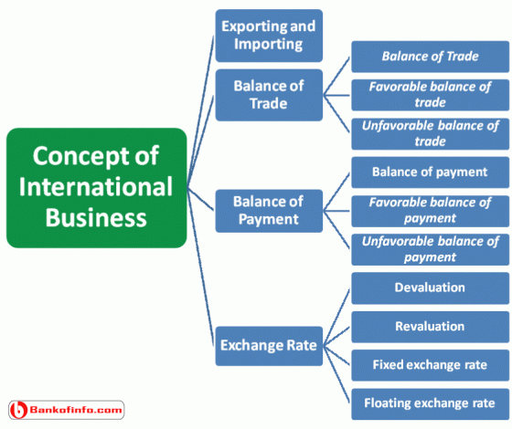
Basic Concepts of International Business

Slide 5
Basic Concepts of International Business
Exporting and Importing: Exporting is concerned with the selling of domestic goods in another country. Importing is concerned with purchasing goods made in another country.
Balance of Trade: The Balance of trade represents the difference between the visible export and import. It may be shown in the following way.
Balance of Trade= Visible export-Visible import.
Favorable balance of trade: Favorable balance of trade indicates that a country’s export is higher that its import.
Unfavorable balance of trade: When a country’s imports are higher than its exports, then it is called unfavorable balance of trade.

Slide 6
Basic Concepts of International Business
Balance of Payment: A Balance of payment represents the difference between visible plus invisible export and visible plus invisible import. It may be shown in the following equation.
Balance of payment = (Visible export + invisible export)-(Visible import +invisible import)
Favorable balance of payment: If more money is flowing in the country than flowing out of the country.
Unfavorable balance of payment: An unfavorable balance of payment exists when more money is flowing out of the country than flowing in.

Slide 7
Basic Concepts of International Business
Exchange Rate: It is the rate at which one country can exchange its currency with other country’s currency. Exchange rate is of four types:
Devaluation: Reducing the value of nation’s currency in relation to currencies of other nations.
Revaluation: revaluation increased the value of a country’s currency in relation to that of the other countries.
Fixed exchange rate: It is an unvarying exchange rate, which is set by the government.
Floating exchange rate: An exchange rate that fluctuates with market conditions

Slide 8
Barriers to International Trade
Cultural and social barriers
Political barriers
Tariffs and trade restrictions
Tariffs
Quotas
Embargoes
Boycotts
Exchange controls

Slide 9
Approaches to International Business
Approaches to International Business
Exporting
Licensing
Franchising
Joint Venture
Trading Companies
Countertrading
Direct Ownership
Multinational Corporations

Slide 10
Advantages of International Business
Earning valuable foreign currency
Optimum utilization of available resources
Increase in the standard of living of people
Benefits to consumers
Encouragement to industrialization
International peace and harmony
Cultural development

Slide 11
Disadvantages of International Business
Competition with developed countries
Rivalry among nations
Exploitation
Publicity of undesirable fashions
Language problems
Adverse effects on home industry

