Slide 1
Data Communication and Computer Networks

Slide 2
Digital To Digital Conversation
Digital data by using digital signals. The conversion involves three techniques: line coding, block coding, and scrambling. Line coding is always needed. block coding and scrambling mayor may not be needed.

Slide 3
Line Coding
Once a binary sequence of 1s and 0s is produced, the sequence is transformed into electrical pulses or waveforms for transmission over a channel and this is known as line coding.

Slide 4
Line Coding
Line coding is the process of converting digital data to digital signals. We assume that data, in the form of text, numbers, graphical images, audio, or video, are stored in computer memory as sequences of bits. Line coding converts a sequence of bits to a digital signal. At the sender, digital data are encoded into a digital signal; at the receiver, the digital data are recreated by decoding the digital signal. Figure shows the process.

Slide 5
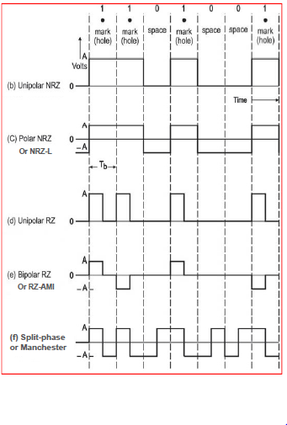
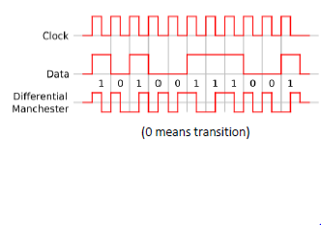
Various line coding (binary) methods:

Slide 6
Applications
Polar NRZ / NRZ-L: Digital logic circuits
RZ line codes: Base band transmission and magnetic recording (e.g., Bipolar RZ / RZ-AMI is used for telephone system)
Manchester Coding: Magnetic recording, optical communications and satellite telemetry.

Slide 7
Desired properties (i.e., design criteria) for line coding
Transmission bandwidth: should be as small as possible
Noise immunity: should be immune to noise
Power efficiency: for a given bandwidth and given error probability, transmission power requirement should be as small as possible
Error detection and correction capability: should be possible to detect and correct errors
Favorable power spectral density (PSD): should have zero PSD at zero (i.e., DC) frequency, otherwise the ac coupling and the transformers used in communication systems would block the DC component
Adequate timing information / self-clocking: should carry the timing or clock information which can be used for self-synchronization
Transparency: should be possible to transmit a digital signal correctly regardless of the patterns of 1’s and 0’s (by preventing long string of 0s and 1s)

