Slide 1
Sampling

Slide 2
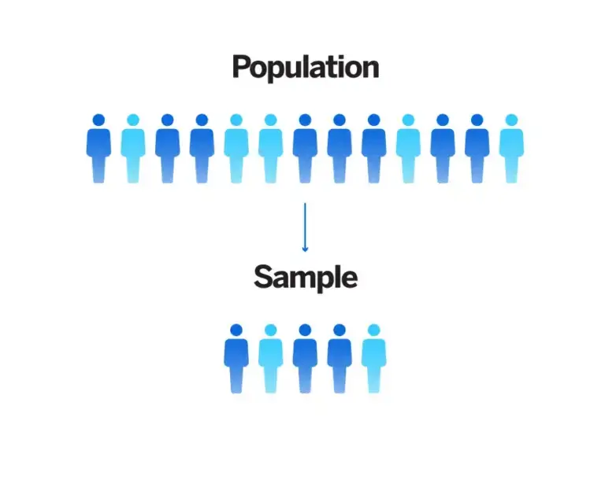
Introduction
In survey research, sampling is the process of using a subset of a population to represent the whole population.

Slide 3
Sampling definitions
Population: The total number of people or things you are interested in.
Sample: A smaller number within your population that will represent the whole.
Sampling: The process and method of selecting your sample.

Slide 4
Type of sampling
There are two major types of sampling methods: probability and non-probability sampling.
Probability sampling, also known as random sampling, is a kind of sample selection where randomization is used instead of deliberate choice. Each member of the population has a known, non-zero chance of being selected.
Non-probability sampling techniques are where the researcher deliberately picks items or individuals for the sample based on non-random factors such as convenience, geographic availability, or costs.

Slide 5
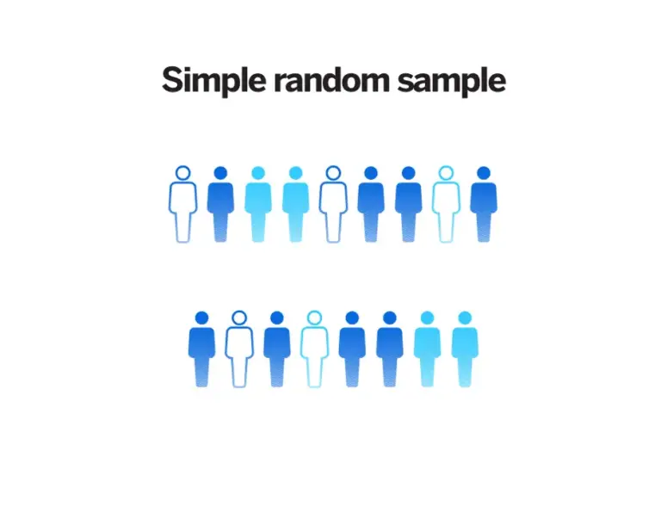
Probability sampling
Simple random sampling:
With simple random sampling, every element in the population has an equal chance of being selected as part of the sample. It’s something like picking a name out of a hat. Simple random sampling can be done by anonymizing the population – e.g. by assigning each item or person in the population a number and then picking numbers at random.

Slide 6
Probability sampling
2. Systematic sampling:
Systematic sampling is a type of probability sampling method in which sample members from a larger population are selected according to a random starting point but with a fixed, periodic interval.

Slide 7
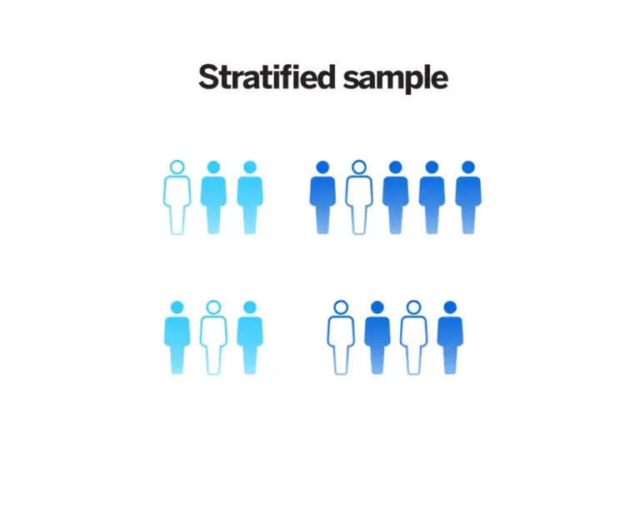
Probability sampling
3. Stratified sampling
Stratified sampling involves random selection within predefined groups. It’s a useful method for researchers wanting to determine what aspects of a sample are highly correlated with what’s being measured. They can then decide how to subdivide (stratify) it in a way that makes sense for the research.

Slide 8
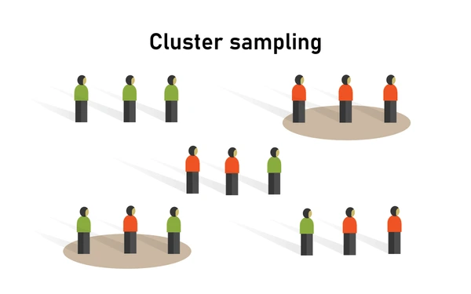
Probability sampling
4. Cluster sampling
With cluster sampling, groups rather than individual units of the target population are selected at random for the sample. These might be pre-existing groups, such as people in certain zip codes or students belonging to an academic year.

Slide 9
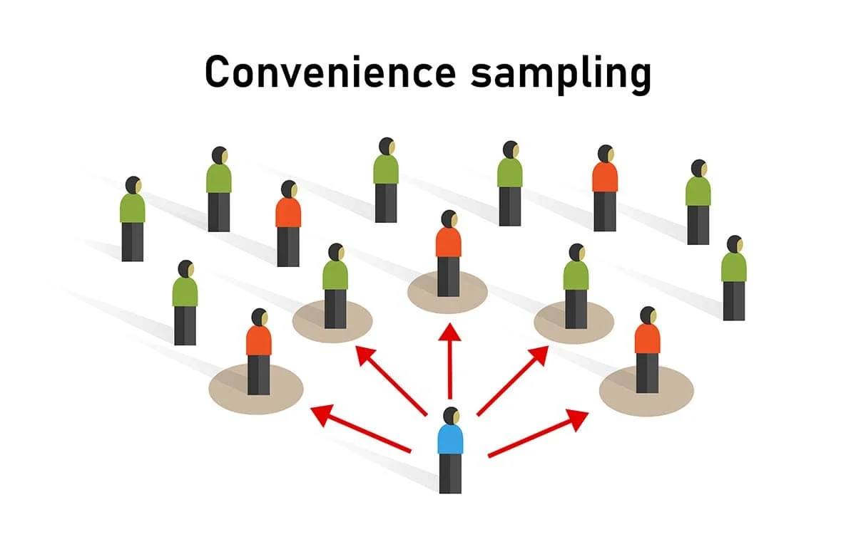
Non-probability sampling methods
Convenience sampling:
Convenience sampling is a non-probability sampling method where units are selected for inclusion in the sample because they are the easiest for the researcher to access.

Slide 10
Non-probability sampling methods
2. Quota sampling:
Quota sampling is a non-probability sampling method that relies on the non-random selection of a predetermined number or proportion of units.

Slide 11
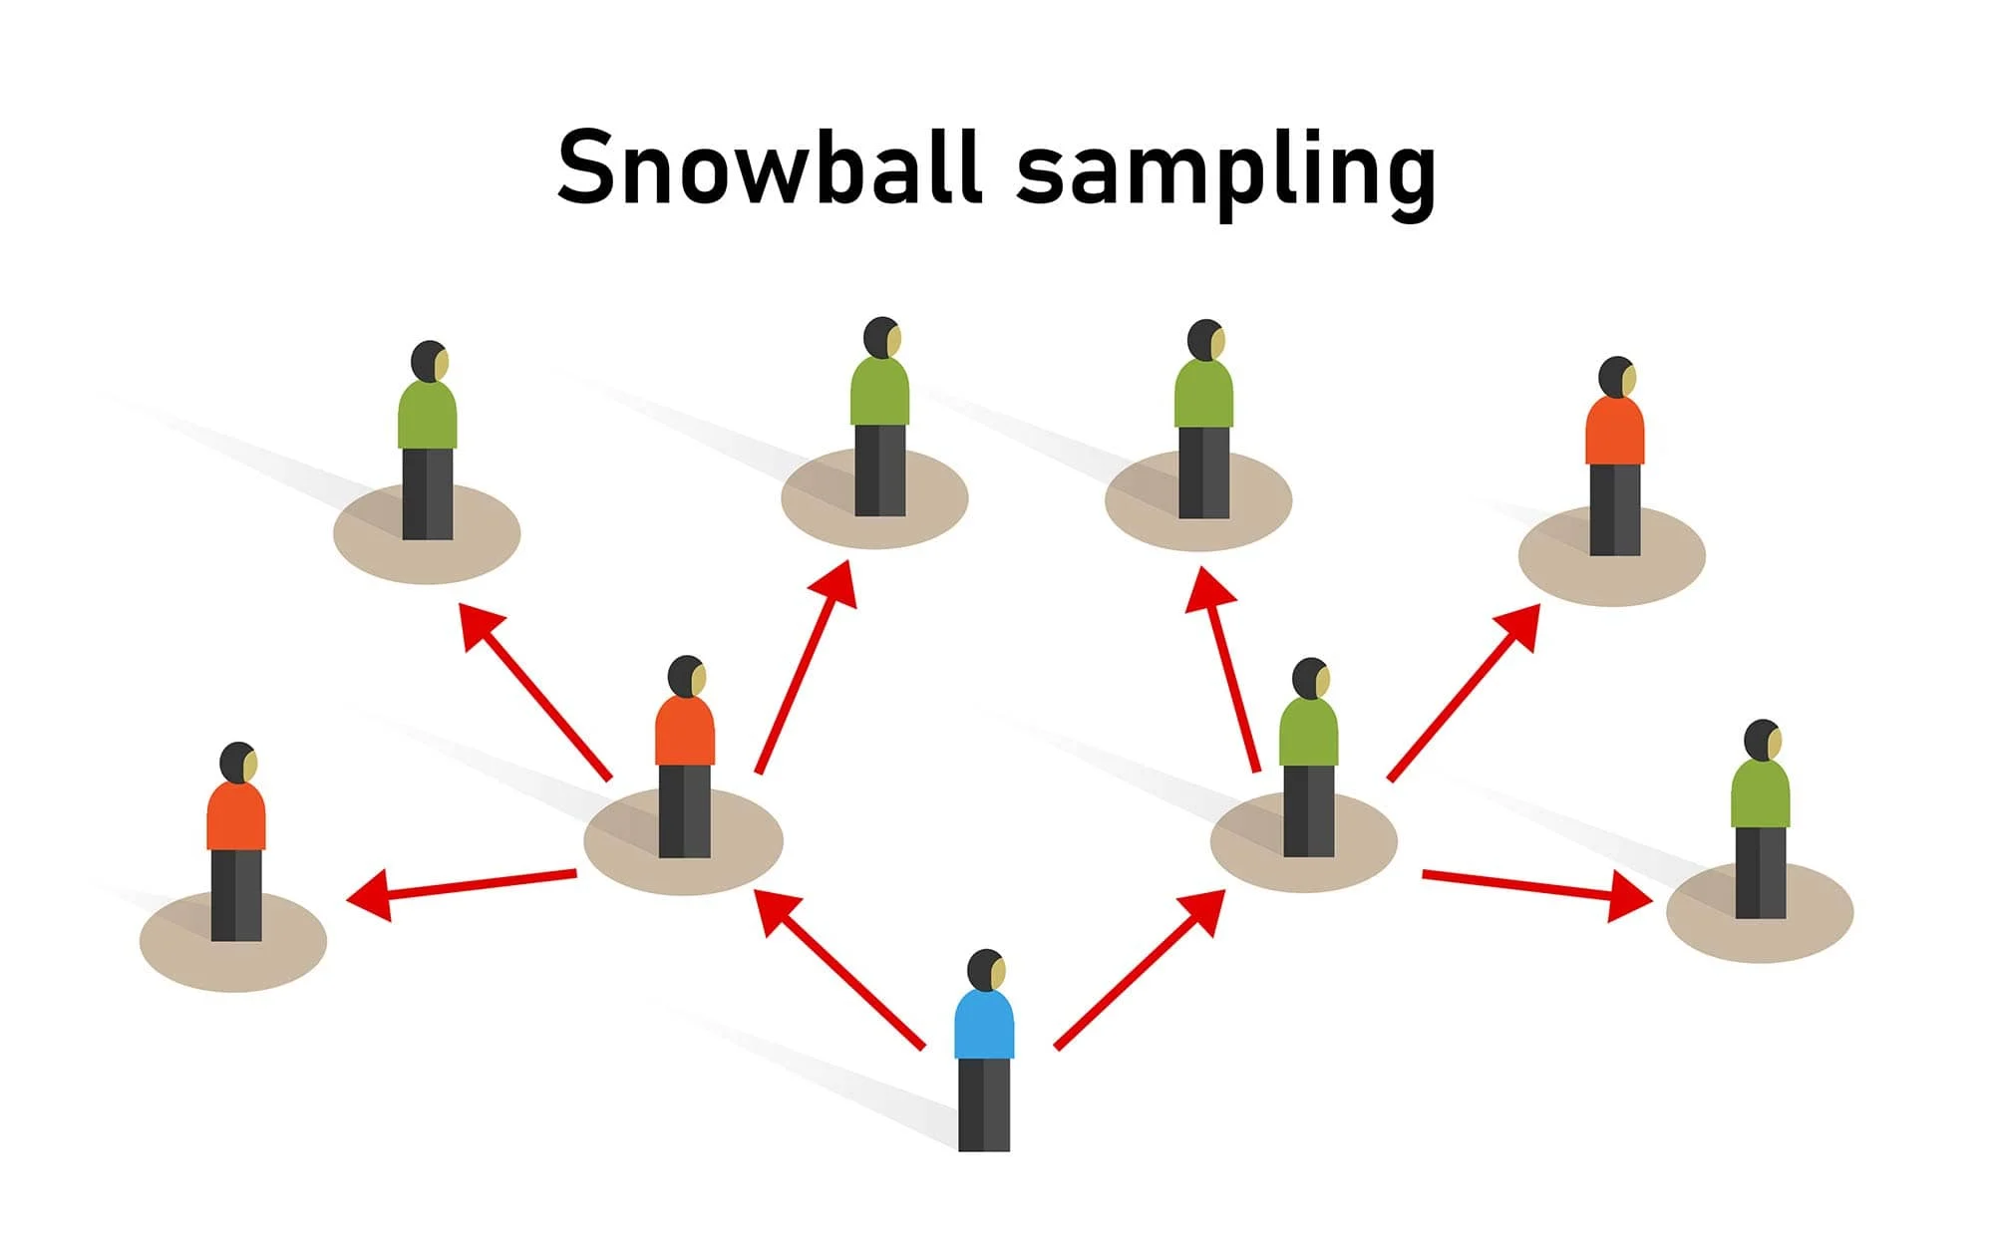
3. Snowball or referral sampling:
Snowball sampling is a recruitment technique in which research participants are asked to assist researchers in identifying other potential subjects.

Slide 12
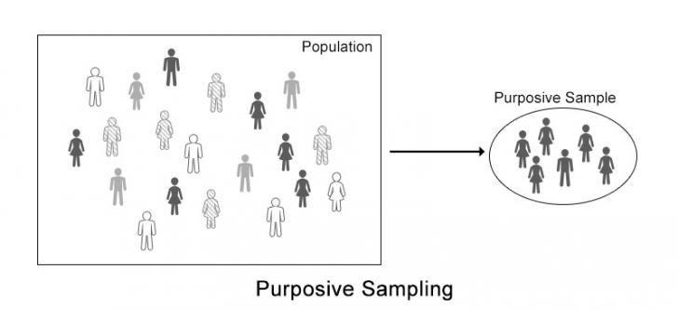
4. Purposive sampling:
Purposive sampling refers to a group of non-probability sampling techniques in which units are selected because they have characteristics that you need in your sample.

