Slide 1
Economics of Power Generation

Slide 2
Economic of Power Generation
Economy is the main principle of design of a power plant. Power plant economics is important in controlling the total power costs to the consumer. Power should be supplied to the consumer at the lowest possible cost per kWh. The total cost of power generation is made up of fixed cost and operating cost. Fixed cost consists of interest on capital, taxes, insurance and management cost. Operating cost consists of cost of fuel labor, repairs, stores and supervision. The cost of power generation can he reduced by,

Slide 3
Economic of Power Generation
Selecting equipment of longer life and proper capacities.
Running the power station at high load factor.
Increasing the efficiency of the power plant.
Carrying out proper maintenance of power plant equipment to avoid plant breakdowns.
Keeping proper supervision as a good supervision is reflected in lesser breakdowns and extended plant life.
Using a plant of simple design that does not need highly skilled personnel.

Slide 4
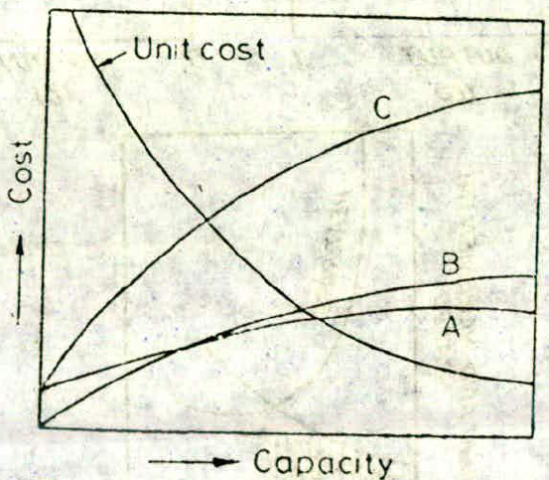
Various Cost Curve

Slide 5
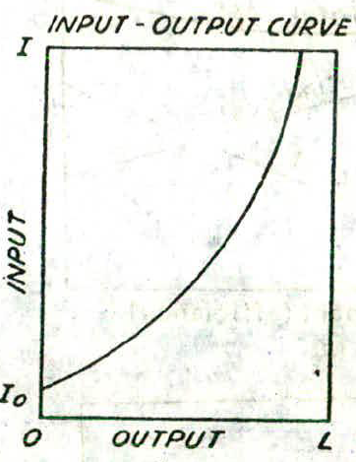
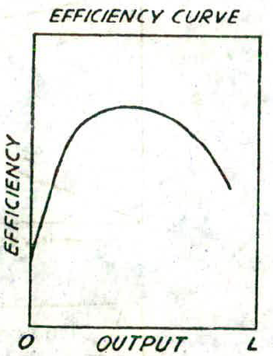
Plant Performance and Operation Characteristics
Input Output Curve:
Efficiency Curve:

Slide 6
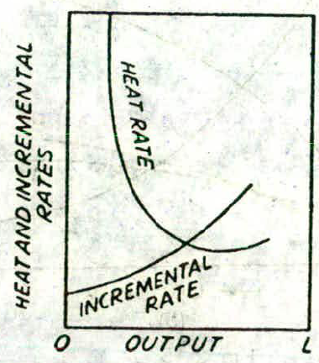
Plant Performance and Operation Characteristics
Heat rate & Incremental rate Curve:
HR= I/L & IR= dI/dL =$\frac{dI}{dL}$

Slide 7
Economic Load Sharing

Slide 8
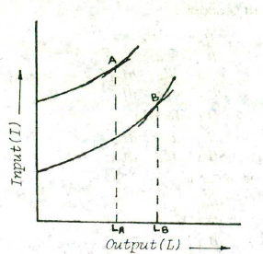
Economic Load Sharing

Slide 9
Condition for Maximum Efficiency

Slide 10
Depreciation Cost: the amount to be set aside per year from income to meet the depreciation caused by the age of service, wear and tear of machinery. Depreciation amount collected per year helps in replacing and repairing the equipment.
2.13 Cost of Electrical Energy

Slide 11
Straight Line Method
Straight Line Method
According to this method it is assumed that depreciation occurs uniformly according to a straight line law. The annual amount to be set aside is calculated by the following expression
Annual depreciation reserve = $\frac{P−S}{n}$
where P = Principal sum (capital cost of plant)
S = Salvage value or Residual value of power plant at the end of years.
n = Probable duration of useful life of power plant in years.
The amount collected every year as depreciation fund does not depend on the interest it may draw. Any interest if earned by the depreciation amount is considered as income.

Slide 12
Sinking Fund Method
(b) Sinking Fund Method
In this method the annual amount to be set aside per year consist of annual instalments plus the interest on all the instalments.
Annual depreciation reserve =
where r = rate of interest.
P = Principal sum (capital cost of the plant)
S = Salvage value
n = Useful life in years

Slide 13
Example 2.15. Determine the annual cost of a feed water softener
from the following data
Cost = Rs. 80,000
Salvage value = 5% Salvage value, S=(800000*5/100)=
Life = 10 years.
Annual repair and maintenance cost = Rs. 2500
Annual cost of chemicals = Rs. 5,000
Labour cost per month = Rs. 300
Interest on sinking fund = 5%.
Annual depreciation cost=

Slide 14
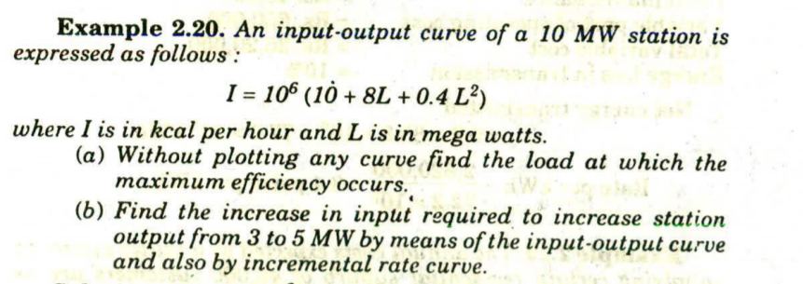
For maximum efficiency, $\frac{I}{L}= \frac{dI}{dL}$
or,(10+8L+0.4L^2)/L= (0+8+0.4*2L)
or, 10/L+ 8+ 0.4L= 8+0.8L
or, 10/L=0.4L
or, L^2=10/0.4

Slide 15
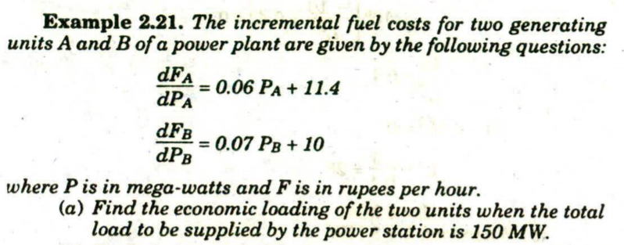
$P_{A}+P_{B}=150$
For economical load sharing,
$\frac{dFa}{dPa}=\frac{dFb}{dPb}$
or, 0.06 $P_{A}+11.4=0.07P_{B}+10$
or, 0.06(150-$P_{B})+11.4=0.07 PB+10$

Slide 16
, I/L=dI/dL
or, (10+8L+0.4L^2)/L=0+8+0.4*2L
or, 10/L+8+0.4 L=8+0.8L
or,10/L=0.8L-0.4L
or, 10/L=o.4L
0r, L^2=10/0.4
or,

