Slide 1
Daffodil International University Dept. of CSE Information Security
Lecture 11
System Hacking Concepts

Slide 2
System Hacking
System hacking is defined as the compromise between computer systems and software to access the target computer and steal or misuse their sensitive information. The malware and the attacker identify and exploit the vulnerability of the computer system to gain unauthorized access.
Phases of System Hacking
Reconnaissance/Footprinting
Scanning
Gaining access
Maintaining access
Covering tracks

Slide 3
Reconnaissance/Footprinting

Slide 4
Footprinting types
Footprinting can be categorized into passive footprinting and active footprinting.
Passive footprinting
Finding information through search engines
Finding the Top-Level Domains (TLDs) and sub domains of a target through web services
Gathering information using groups, forums, blogs
Extracting information about the target using Internet archives
Performing people search using social networking sites and people search services
Collecting location information on the target through web services
Determining the operating systems in use by the target organization

Slide 5
Footprinting types
Active footprinting
Querying published name servers of the target
Searching for digital files
Extracting website links and gathering wordlists from the target website
Extracting metadata of published documents and files
Gathering website information using web spidering
Gathering information through email tracking

Slide 6
Scanning

Slide 7
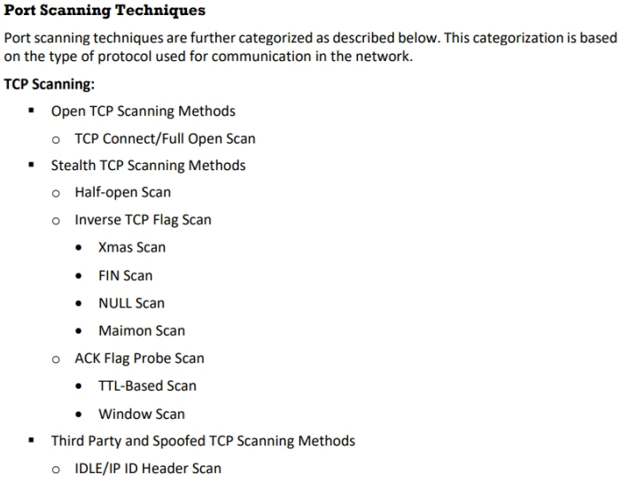
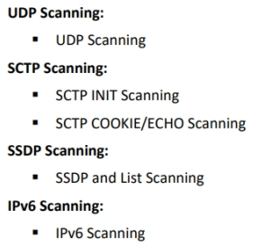
Port Scanner

Slide 8
Gaining Access
Maintaining Access

Slide 9
Clearing Logs

Slide 10
Thank You

