Slide 1
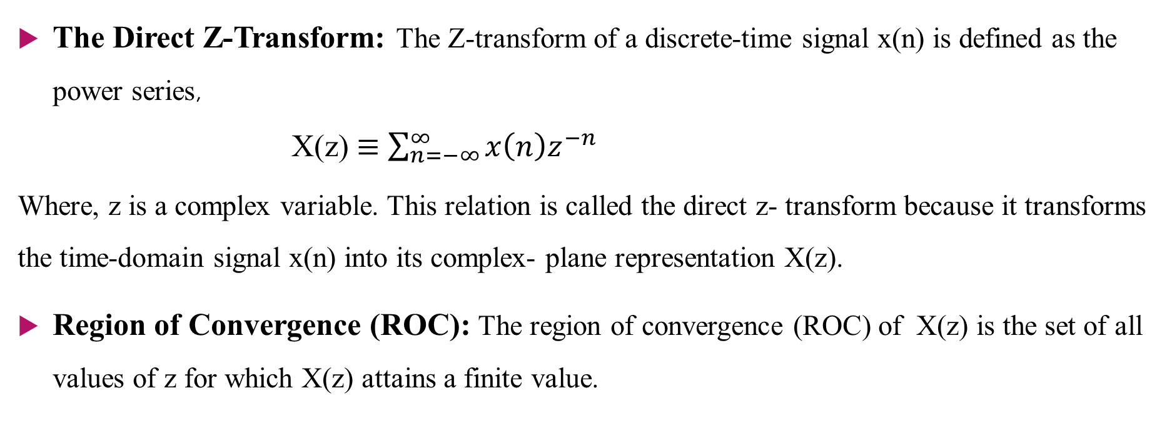
Lecture-7: The Z-Transform
The Direct Z-Transform: The Z-transform of a discrete-time signal x(n) is defined as the power series,
X(z) $≡$ $\sum_{n=−∞}^{∞}{x\left(n\right)z^{−n}}$
Where, z is a complex variable. This relation is called the direct z- transform because it transforms the time-domain signal x(n) into its complex- plane representation X(z).
Region of Convergence (ROC): The region of convergence (ROC) of X(z) is the set of all values of z for which X(z) attains a finite value.

Slide 2

Problems
Example-3.1.1: Determine the z-transform of the following finite-duration signal,
(a) x₁(n)= {1, 2, 5, 7, 0, 1}
(b) x₂(n)= {1, 2, 5, 7, 0, 1}
(c) x₃(n)= {0, 0, 1, 2, 5, 7, 0, 1}
(d) x₄(n)= {2, 4, 5, 7, 0, 1}
(e) x₅(n)= $δ(n)$
(f) x₆(n)= $δ\left(n−k\right), k>0$
(g) x₇(n)= $δ\left(n+k\right), k>0$

Slide 3

Problems
Example: Determine the z-transform of the signal,
(3.1.2) $x\left(n\right)={\left(\frac{1}{2}\right)}^{n }u(n)$
(3.1.3) $x\left(n\right)= a^{n}u(n)$
(3.1.4) x(n)= -$a^{n}$u(-n-1)= 0, $n≥0$
-$a^{n}$, $n≤−1$
(3.1.5) x(n)= $a^{n}u\left(n\right)+ b^{n}u(−n−1)$

Slide 4
Example-3.2.1: Determine the z-transform and ROC of the signal
Example-3.2.2: Determine the z-transform of the signal
(a)
(b)
Example- 3.2.5
Example- 3.2.6
Example- 3.2.7
Example- 3.2.8

