Slide 1
Power Plant Performance Analysis

Slide 2
Load Curves
The curve showing the variation of load on the power station with respect to (w.r.t) time is known as a load curve.
The load on a power station is never constant; it varies from time to time. These load variations during the whole day (i.e., 24 hours) are recorded half-hourly or hourly and are plotted against time on the graph. The curve thus obtained is known as daily load curve.
The monthly load curve can be obtained from the daily load curves of that month. For this purpose, average* values of power over a month at different times of the day are calculated and then plotted on the graph.
The yearly load curve is obtained by considering the monthly load curves of that particular year. The yearly load curve is generally used to determine the annual load factor.

Slide 3
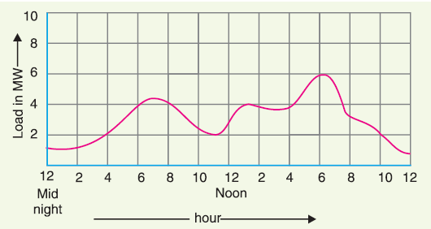
Continue….

Slide 4
Importance of Load Curves
The daily load curves have attained a great importance in generation as they supply the following information readily :
The daily load curve shows the variations of load on the power station during different hours of the day.
The area under the daily load curve gives the number of units generated in the day. Units generated/day = Area (in kWh) under daily load curve.
The highest point on the daily load curve represents the maximum demand on the station on that day.
The area under the daily load curve divided by the total number of hours gives the average load on the station in the day.
The ratio of the area under the load curve to the total area of rectangle in which it is contained gives the load factor.

Slide 5
The load curve helps in selecting the size and number of generating units.
The load curve helps in preparing the operation schedule of the station.

Slide 6
Load Duration Curve
When the load elements of a load curve are arranged in the order of descending magnitudes, the curve thus obtained is called a load duration curve.
The following points may be noted about load duration curve :
The load duration curve gives the data in a more presentable form. In other words, it readily shows the number of hours during which the given load has prevailed.
The area under the load duration curve is equal to that of the corresponding load curve. Obviously, area under daily load duration curve (in kWh) will give the units generated on that day.
The load duration curve can be extended to include any period of time. By laying out the abscissa from 0 hour to 8760 hours, the variation and distribution of demand for an entire year can be summarized in one curve. The curve thus obtained is called the annual load duration curve.

Slide 7
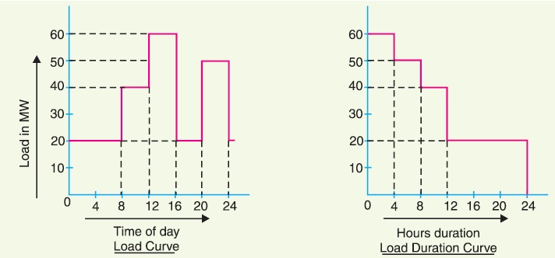
Load Curve vs Load Duration Curve

Slide 8
Important Terms and Factors
Connected load. It is the sum of continuous ratings of all the equipments connected to supply system.
Maximum demand : It is the greatest demand of load on the power station during a given period.
Maximum demand is generally less than the connected load.
The knowledge of maximum demand is very important as it helps in determining the installed capacity of the station.
Demand factor. It is the ratio of maximum demand on the power station to its connected load i.e.,
The value of demand factor is usually less than 1.

Slide 9
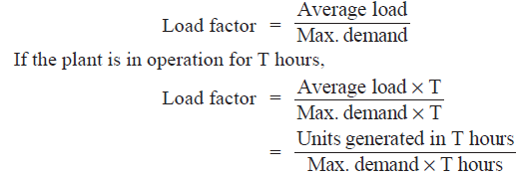
Average load. The average of loads occurring on the power station in a given period (day or month or year) is known as average load or average demand.
Load factor. The ratio of average load to the maximum demand during a given period is known as load factor i.e.,
Load factor is always less than 1 because average load is smaller than the maximum demand.

Slide 10
Diversity factor. The ratio of the sum of individual maximum demands to the maximum demand on power station is known as diversity factor i.e.,
diversity† factor will always be greater than 1.
Plant capacity factor. It is the ratio of actual energy produced to the maximum possible energy that could have been produced during a given period i.e.,

Slide 11
Reserve Capacity:
Reserve capacity = Plant capacity −Max. demand
If the maximum demand on the plant is equal to the plant capacity, then load factor and plant capacity factor will have the same value. In such a case, the plant will have no reserve capacity.
Plant use factor. It is ratio of kWh generated to the product of plant capacity and the number of hours for which the plant was in operation i.e.

Slide 12
Units Generated per Annum
It is often required to find the kWh generated per annum from maximum demand and load factor. The procedure is as follows :
Utilization factor: It is ratio between Max. Demand and Plant Capacity.
Utilization Factor= Max. demand/ Plant Capacity

Slide 13
Example 3.1. The maximum demand on a power station is 100 MW. If the annual load factor is 40% , calculate the total energy generated in a year.

Slide 14
Example 3.2. A generating station has a connected load of 43MW and a maximum demand of 20 MW; the units generated being 61·5 × 106 per annum. Calculate (i) the demand factor and (ii) load factor.

Slide 15
Example 3.3. A 100 MW power station delivers 100 MW for 2 hours, 50 MW for 6 hours and is shut down for the rest of each day. It is also shut down for maintenance for 45 days each year. Calculate its annual load factor.

Slide 16
Example 3.4. A generating station has a maximum demand of 25MW, a load factor of 60%, a plant capacity factor of 50% and a plant use factor of 72%. Find (i) the reserve capacity of the plant (ii) the daily energy produced and (iii) maximum energy that could be produced daily if the plant while running as per schedule, were fully loaded.

Slide 17
Example 3.6. A power station has a maximum demand of 15000 kW. The annual load factor is 50% and plant capacity factor is 40%. Determine the reserve capacity of the plant.

Slide 18
Example 3.14. A power station has a daily load cycle as under : 260 MW for 6 hours ; 200 MW for 8 hours : 160 MW for 4 hours, 100 MW for 6 hours. If the power station is equipped with 4 sets of 75 MW each, calculate (i) daily load factor (ii) plant capacity factor and (iii) daily requirement if the calorific value of oil used were 10,000 kcal/kg and the average heat rate of station were 2860 kcal/kWh.

