Slide 1
Hydro Power Plant

Slide 2
Hydro-electric Power Station
A generating station which utilizes the potential energy of water at a high level for the generation of electrical energy is known as a hydro-electric power station
Hydro-electric power stations are generally located in hilly areas where dams can be built conveniently and large water reservoirs can be obtained.

Slide 3
Hydro-electric Power Station
In a hydro-electric power station, water head is created by constructing a dam across a river or lake.
From the dam, water is led to a water turbine.
The water turbine captures the energy in the falling water and changes the hydraulic energy into mechanical energy at the turbine shaft.
The turbine drives the alternator which converts mechanical energy into electrical energy.

Slide 4
Hydro-electric Power Station
Advantages
It requires no fuel as water is used
It is quite neat and clean as no smoke or ash is produced.
It requires very small running charges.
It is comparatively simple in construction and requires less maintenance.
It does not require a long starting time like a steam power station.
It is robust and has a longer life.
In addition to the generation of electrical energy, they also help in irrigation and controlling floods.
Although such plants require the attention of highly skilled persons at the time of construction, yet for operation, a few experienced persons may do the job well.

Slide 5
Hydro-electric Power Station
Disadvantages
It involves high capital cost due to construction of dam.
There is uncertainty about the availability of huge amount of water due to dependence on weather conditions.
Skilled and experienced hands are required to build the plant.
It requires high cost of transmission lines as the plant is located in hilly areas which are quit away from the consumers.

Slide 6
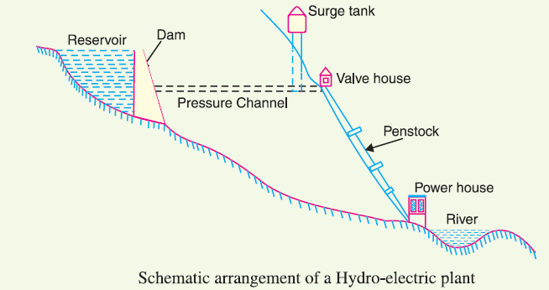
Schematic Arrangement of Hydro Power Station
Dam is constructed across a river/lake and water from the catchment area collects at the back of the dam to form a reservoir.
A pressure tunnel is taken off from the reservoir and water brought to the valve house at the start of the penstock.

Slide 7
Schematic Arrangement of Hydro Power Station (Contd.)
Explanation of Hydro Power Plant block diagram

Slide 8
Schematic Arrangement of Hydro Power Station (Contd.)
The valve house contains main sluice valves and automatic isolating valves. The former controls the water flow to the power house and the latter cuts off supply of water when the penstock bursts.
From the valve house, water is taken to water turbine through a huge steel pipe known as penstock.
The water turbine converts hydraulic energy into mechanical energy.
The turbine drives the alternator which converts mechanical energy into electrical energy.

Slide 9
Schematic Arrangement of Hydro Power Station (Contd.)
A surge tank is built just before the valve house and protects penstock. When the gates close, there is a sudden stopping of water at the lower end of the penstock and consequently the penstock can burst like a paper log.
The surge tank absorbs this pressure swing by increase in its level of water.

Slide 10
Choice of Site for Hydro Power Station
Availability of water
Since the primary requirement of a hydro-electric power station is the availability of huge quantity of water, such plants should be built at a place where adequate water is available at a good head.
Storage of water
There are wide variations in water supply from a river or canal during the year. This makes it necessary to store water by constructing a dam in order to ensure the generation of power throughout the year.

Slide 11
Choice of Site for Hydro Power Station
Cost and type of land
The land for construction of the plant should be available at a reasonable price.
Transportation facilities:
The site selected for a hydro-electric plant should be accessible by rail and road so that necessary equipment and machinery could be easily transported.

Slide 12
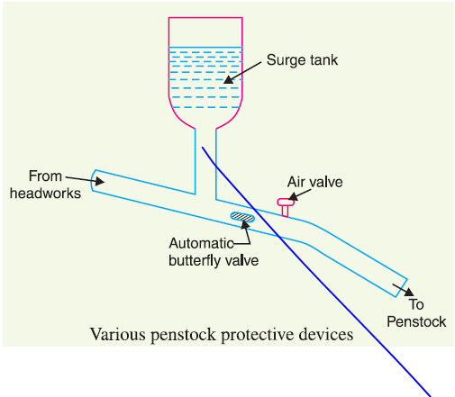
Components of Hydro-electric Power Station
The constituents of a hydro-electric plant are:
hydraulic structures
water turbines and
(3) electrical equipment.
Hydraulic structures in a hydro-electric power station include dam,
spillways, headworks, surge tank, penstock and accessory works.

Slide 13
Components of Hydro-electric Power Station
Dam. A dam is a barrier which stores water and creates water head.
Spillways. There are times when the river flow exceeds the storage capacity of the reservoir. Such a situation arises during heavy rainfall in the catchment area. In order to discharge the surplus water from the storage reservoir into the river on the down-stream side of the dam,
spillways are used.

Slide 14
Components of Hydro-electric Power Station
Headworks: The headworks consists of the diversion structures at the head of an intake. The flow of water into and through headworks should be as smooth as possible to avoid head loss and cavitation.
Surge tank: A surge tank is a small reservoir or tank (open at the top) in which water level rises or falls to reduce the pressure swings in the conduit.

Slide 15
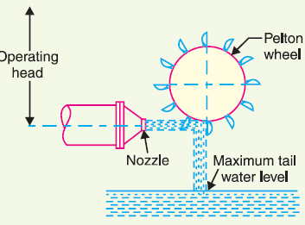
Components of Hydro-electric Power Station
Water turbines: Water turbines are used to convert the energy of falling water into mechanical energy.
The principal types of water turbines are:
(i) Impulse turbines (ii) Reaction turbines
(i) Impulse turbines: Such turbines are used for high heads. In an impulse turbine, the entire pressure of water is converted into kinetic energy in a nozzle and the velocity of the
jet drives the wheel. The example of
this type of turbine is the wheel. It
consists of a wheel fitted with
elliptical buckets along its periphery.
The force of water jet striking the buckets
on the wheel drives the turbine.

Slide 16
Components of Hydro-electric Power Station
(ii) Reaction turbines: Reaction turbines are used for low and medium heads. The important types of reaction turbines are:
Francis turbines (b) Kaplan turbines
A Francis turbine is used for low to medium heads. It consists of an outer ring of stationary guide blades fixed to the turbine casing and an inner ring of rotating blades forming the runner.
A Kaplan turbine is used for low heads and large quantities of water.
Electrical equipment: The electrical equipment of a hydro-electric power station includes alternators, transformers, circuit breakers and other switching and protective devices

Slide 17
Examples: Hydro-electric Power Station

Slide 18
Examples: Hydro-electric Power Station

Slide 19
Examples: Hydro-electric Power Station

Slide 20
Examples: Hydro-electric Power Station

Slide 21
Thank You
Contact: dralam.eee@diu.edu.bd

