Slide 1
ETHICS & ADVERTISEMENT

Slide 2
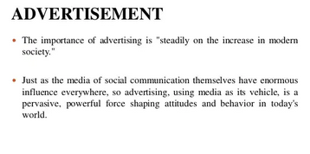

Slide 3
