Slide 1
KNITTING BY FAHMIDA SIDDIQA
Fabric Manufacturing

Slide 2
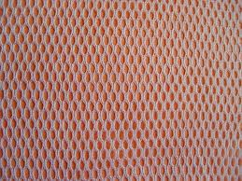
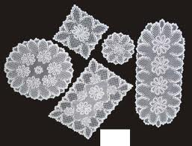
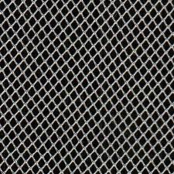
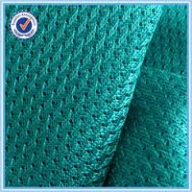
DIFFERENT WARP KNITTED STRUCTURE:

Slide 3
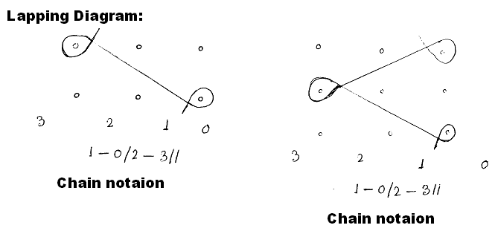
LAPPING DIAGRAM:
Lapping diagram are drawn around horizontal rows of points that represent needles in plain view, usually assuming the pattern mechanism to be on the right. As the guides position themselves in the spaces between the needles the positions between vertical columns of points can be given chain link numbers commencing with the ‘O’ position which is to the right of the right hand column of points. Provided the direction and extent of the overlaps are correctly indicated in the lapping diagram and chain notation, the under laps will always be corrected position as each extends from the end of one overlap to the start of the next.
Here,
0…3 → Chain link
‘-’ → Overlap
‘/’ → Under lap

Slide 4
SOME SINGLE GUIDE BAR STRUCTURE

Slide 5
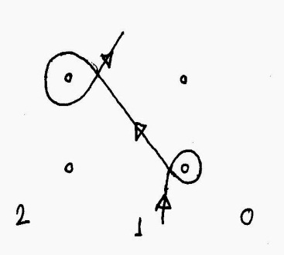
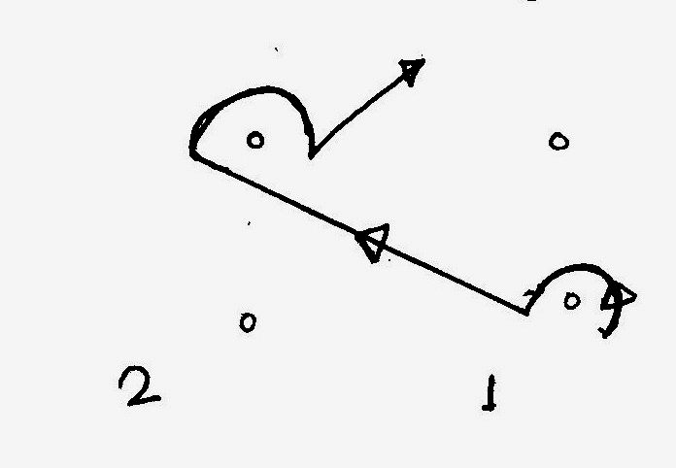
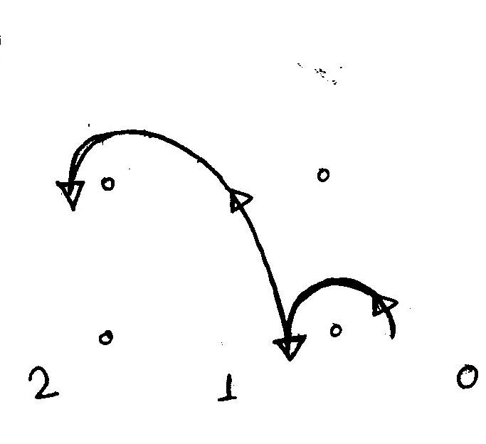
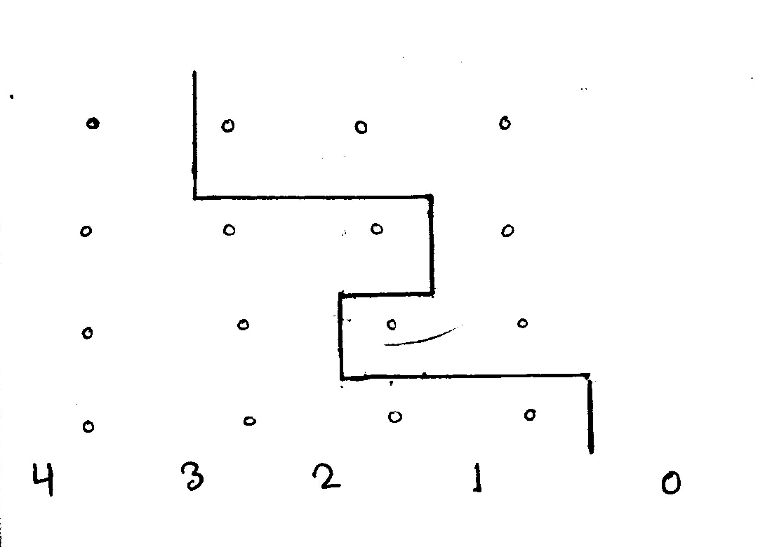
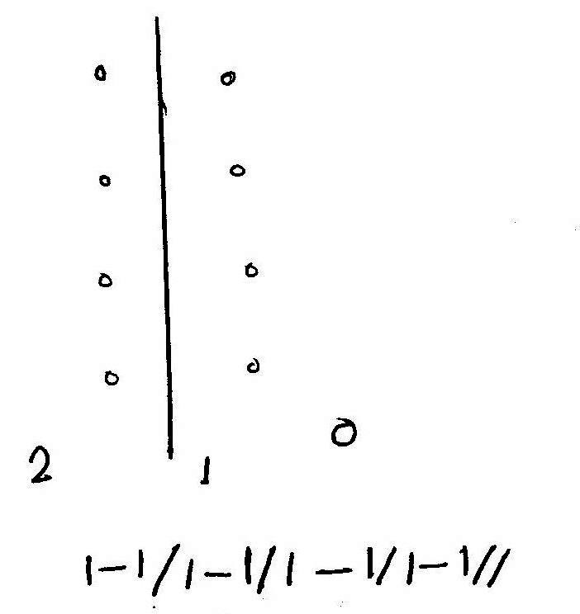
BASIC OVERLAP/UNDER LAP VARIATIONS:
All guide bar lapping movements are composed of one or more of the following lapping variation
1. An overlap followed by an underlap in the opposite direction (closed lap)
2. An over lap followed by an underlap in the same direction (open lap)
3. Only overlaps and no underlaps (open laps)
4. Only underlaps and no overlaps (Laying-in)
5. Neitheir overlaps nor underlaps (Miss lapping)
(1-0/1-2//) (0-1/2-1//) (0-1/1-2//) 0-0/2-2/1-1/3-3//
Close lap Open lap Open laps laying-in Miss laps

Slide 6
A) OPEN LAP B) CLOSE LAP

Slide 7
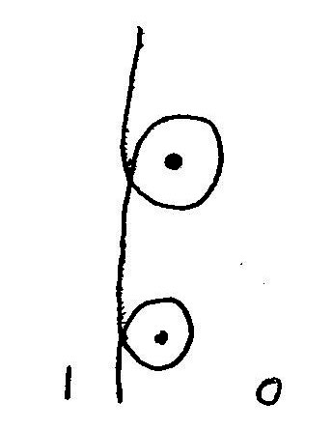
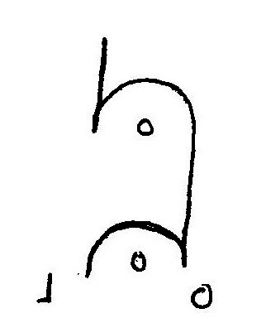
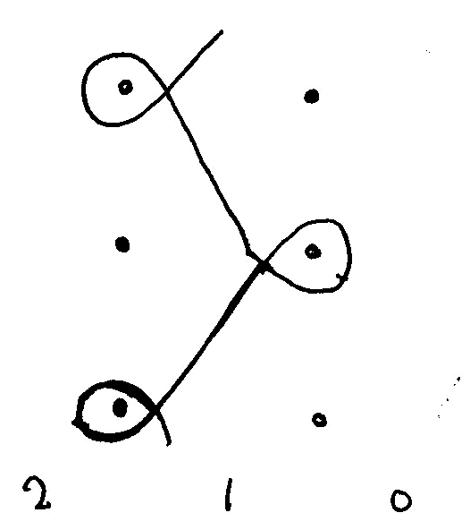
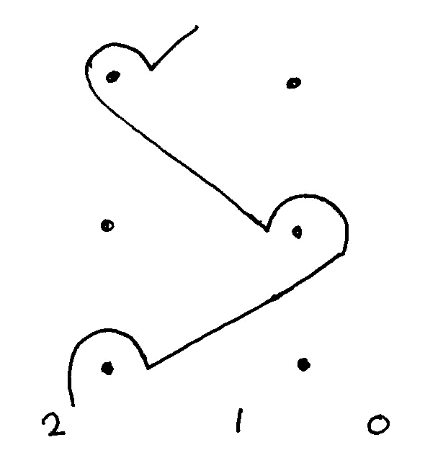
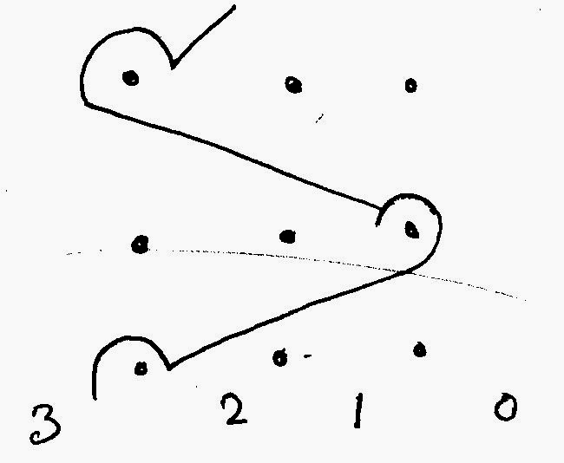
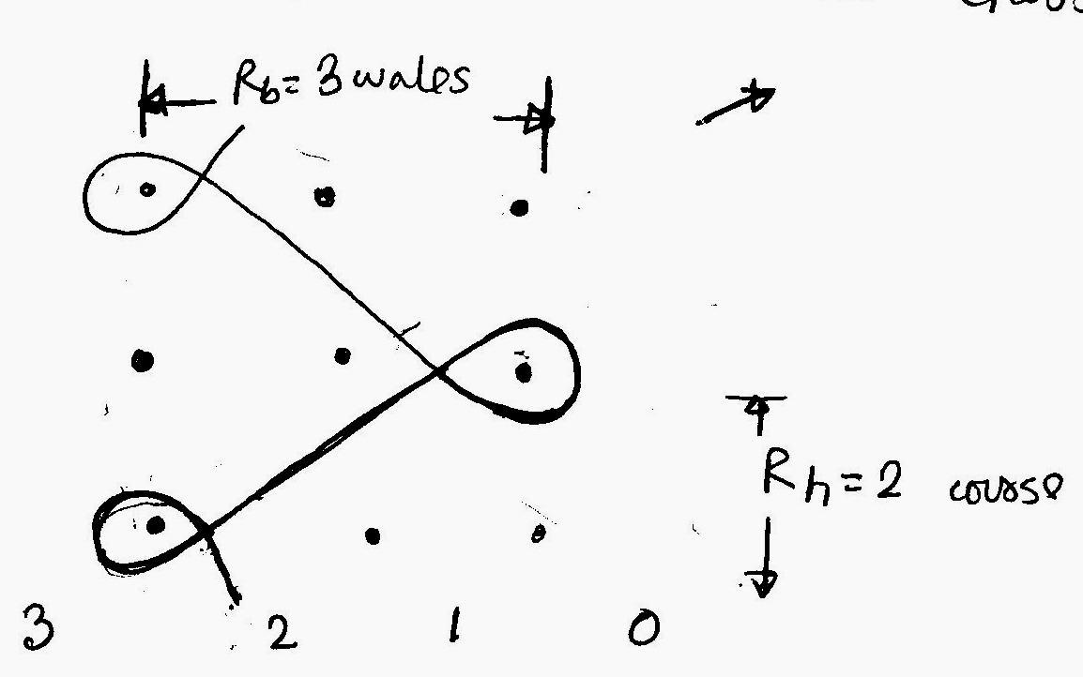
BASIC LAPPING MOVEMENTS:
1.Pillar/Chain stitch
1-0/1-0 closed lap 1-0/0-1 Open lap
2.Tricot stitch or 1 and 1
lapping movement
2-1/0-1 Closed 1-2/1-0 open
3.Cord stitch or 2 and 1
lapping movement
Open 3-2/0-1// Closed 2-3/1-0//

Slide 8
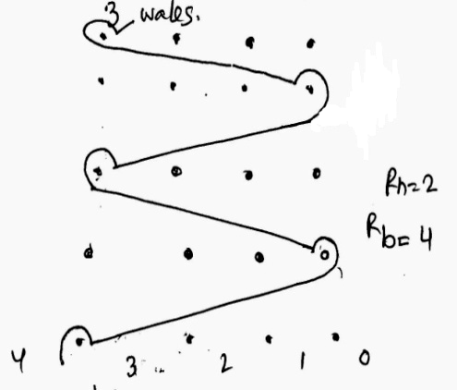
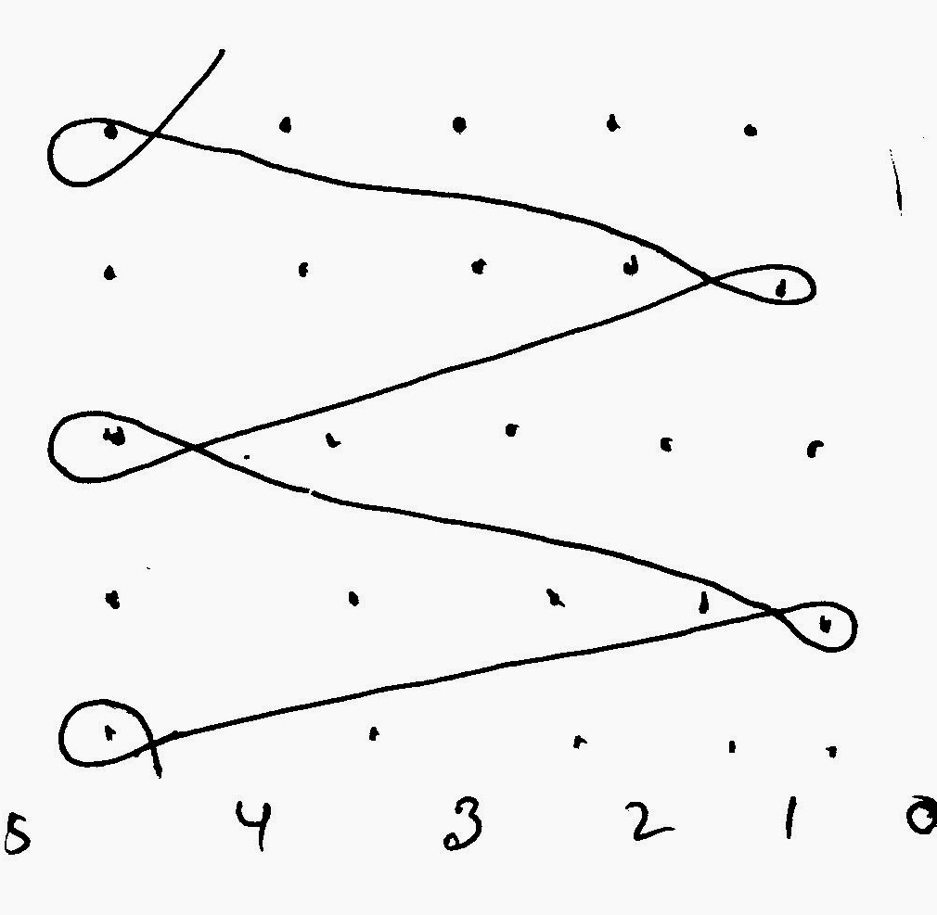
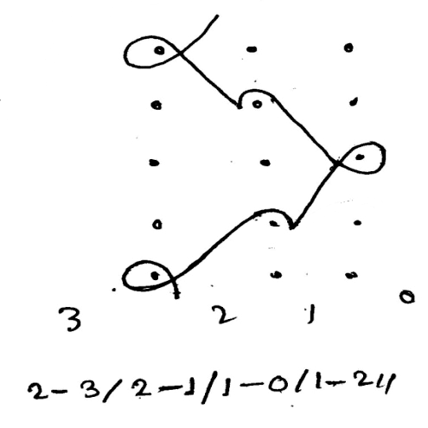
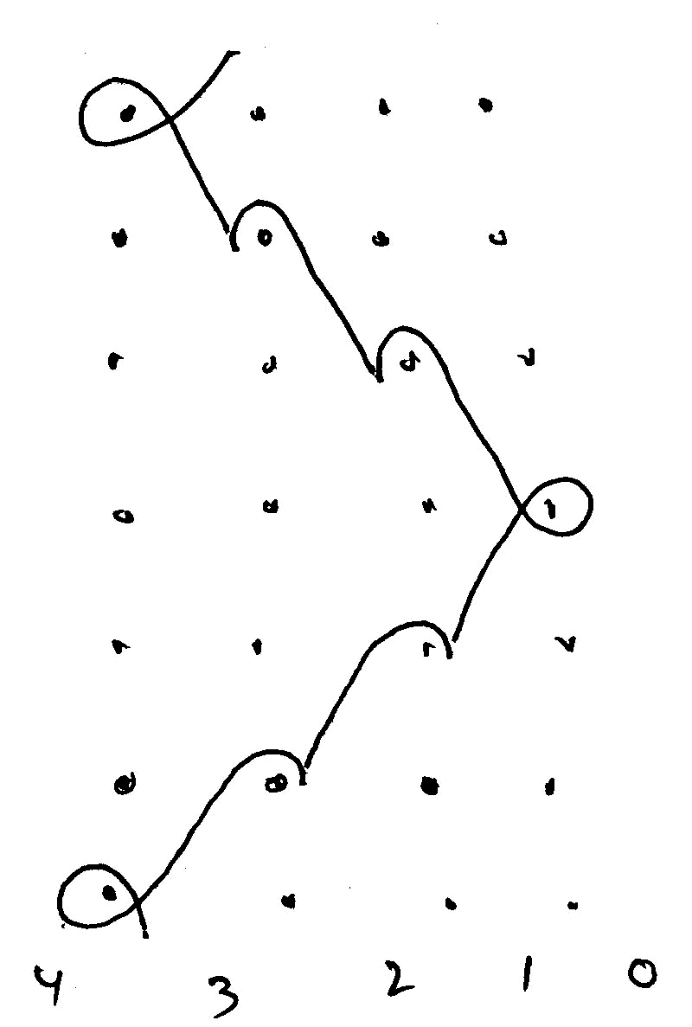
BASIC LAPPING MOVEMENTS:
4.Longer reciprocating
lapping movements
5. Atlas stitch

Slide 10
WEFT KNITTING
Types of weft knitting m/c:
According to the end product, the weft knitting m/c
may be broadly classified as either:
Fabric length m/c
Garment length m/c
According to their frame design and needle
bed arrangement, the weft knitting m/c may be
broadly classified as either:
Straight bar frame m/c
Flat knitting m/c
Circular knitting m/c

Slide 11
FEATURES OF FABRIC M/CS:
Large diameter, circular, latch needle m/c (also known as yarn goods or piece goods) knit fabric, at high speed.
The fabric is manually cut away from the m/c usually in roll form after a convenient length has been knitted.
Most fabric is knitted on circular m/c either single-cylinder (single jersey) or cylinder and dial (double jersey) of the revolving needle cylinder type, because of their high speed and productive efficiency
Sinker wheel and loop wheel frames could knit high quality specialty fabrics with bearded needles although circular m/cs employing bearded needles are now absolute, the production rates of these m/c were uncompetitive

Slide 12
Unless used in tubular body-width, the fabric tube requires splitting into open-width
The fabric is finished on continuous finishing equipment and is cut-and-sewn into garments or it is used for household and technical fabrics
The productivity and patterning facilities of fabric m/cs vary considerably.
Generally; cam settings and needle set-outs are not altered during the knitting of the fabric

Slide 13
FLAT KNITTING M/C: FEATURE:
2 stationary needle bed in flat knitting m/c arranged in an inverted V formation
Latch needle is used
Angular cam of a bi-directional cam system used
There is a separate cam system for each needle bed
The two cam systems linked together by a bridge, which passes across from one needle bed to the other
Carriage width determined yarn carrier is used
Cam system is attached to bottom side of carriage
The flat m/c is the most versatile of the weft knitting m/c
Fabric produce with finer to coarser yarn
The operation and supervision of the m/c is simple
The stitch length range is wide and possibly of changing the m/c gauge
Trimmings, edging, collars, to shaped panels and integrally knitted complex garments and other articles

Slide 14
DIFFERENCE BETWEEN WARP & WEFT KNITTING. WARP KNITTING WEFT KNITTING
The loops are produced to the length of fabric
The threads runs in the vertical direction
Each loop in the horizontal direction is made from a different thread
It is elastic to the length
It’s elasticity is less
Yarns are supplied from beam
At least one yarn is needed for each needle
Less shrinkage
The loops are produced to the width of the fabric
The threads runs in the horizontal direction
A horizontal row of loops can be made by using one thread
It is elastic to the width
Higher elasticity
From cone/small package
Any number of needle are required for one yarn
More/Higher shrinkage

