Slide 1
Lecture-1: Signals, System and Signal Processing
Signal: A signal is the variation of physical quantity with respect to one or more independent variable.
It varies with time, space, or any other independent variables.
It is a function which carries some information.

Slide 2
Examples
S (t) = 5t,
The function varies linearly with the independent variable, t (time)
S (x, y) = 3x + 2xy + 10y²,
Two independent variables, x, y.

Slide 3
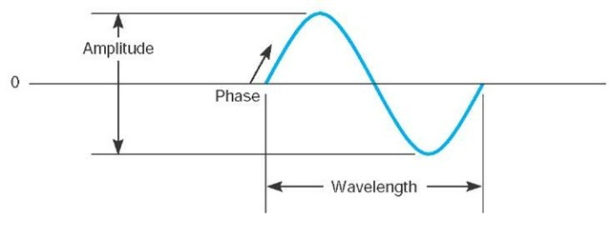

Characteristics of Signals
A sign wave has three characteristics:
Amplitude
Frequency or period
Phase
Where,
A_{i} (t)= Amplitude, F_{i} (t)=Frequency,$θ$_{i}(t)=Phase

Slide 4
System
A physical device that performs an operation on signal.
Example: Filters.
A filter used to reduce the noise and interference corrupting a desired information-bearing signal is called a system.

Slide 5
Signal Processing
When we pass a signal through a system, as in filtering, we say that we have processed the signal. In this case the processing of the signal involves filtering the noise and interference from the desired signal.
In general, the system is characterized by the type of operation that it performs on the signal. Such operations are usually referred to as signal processing.

Slide 6
Block Diagram of a digital signal processing
Analog Input signal
A/D Converter
Digital Signal Processor
D/A Converter
Analog output signal
Digital Input signal
Digital Output signal
Fig: Block Diagram of a digital signal processing

Slide 7
Advantages of digital over analog signal processing
Digital signal processing operations can be changed by changing the program in digital programmable
Better control of accuracy in digital systems compared to analog systems.
Digital signals are easily stored on magnetic media such as magnetic tape without loss of quality of reproduction of signal.
Digital signals can be processed off line, i.e., these are easily transported.
Sophisticated signal processing algorithms can be implemented by DSP method.
Digital circuits are less sensitive to tolerances of component values.
Digital systems are independent of temperature, ageing and other external parameters.
Digital circuits can be reproduced easily in large quantities at comparatively lower cost..
Processor characteristics during processing, as in adaptive filters can be easily adjusted in digital implementation.

