Slide 1
Social and Cultural Aspect of Health

Slide 2
Objectives to learn:
Difficulties in changing behavior
Factors Affecting Health
Key factors/Determinants of Health
Impact of culture on health

Slide 3
Why Social & behavioral is important in PH
To prevent disease is the key role of PH programs. In developing and implementing prevention programs the environmental & social factors are increasingly recognized as important components, depending on many reasons

Slide 4
Difficulties in changing behavior
To prevent disease we increasingly ask people to begin things that they have not done previously, to stop doing things that they have been doing for years and to do more of some things and less of others .
Pattern of disease rates: In some groups, individuals often come and go over time. If groups have different rates over time, there may be something promotes or discourages disease among individuals in those groups

Slide 5
Important factors affecting diseases (NCD)
There are three important factors, through which the environment affects the incidence, severity & persistence of non-infectious diseases :
Socio-economic status
Marital status
Gender

Slide 6
Socioeconomic status (SES)
A dependable finding from the early century, is that people in the lowest socioeconomic groups have the highest rates of morbidity and mortality, whether the socioeconomic status was studied in relation to education, income, or occupation: the lower the level the higher the death and morbidity rate
Example: Many studies have documented that the Blacks' low SES as a partial causes for poor health outcomes in comparison to Whites in USA.
Notes:
There are two explanations for that importance of socioeconomic status. One is that it is a so powerful risk factor that we always statistically control for its influence, So it is rarely studied as a phenomenon in its own right. The second is that socioeconomic status is not amenable to intervention as other factors do, smoking, diet.

Slide 7
Marital status
It has been known for many years that people who are not married-whether single, separated , widowed or divorced-have higher mortality rates than married people.
In general, married people are more likely to engage in positive and less likely to engage in negative health behaviors than widowed, divorced, or single people.
Marital status is also causes some diseases. Example: A recent study of Japanese aged 40–69 found a risk of all-cause mortality among single men and women was twice higher than their married counterparts.

Slide 8
Gender
Gender issues is the most important factors for health and disease. It is almost in every society where men have higher mortality rates than women. Behavior-related fatalities are still most common causes of death for men and are still much higher in men than in women. For example: Men are more than four times to die as likely as women in car accidents.
But women suffer many more times than men from diseases
This excess of male deaths occurs at every age and for every major cause for which comparison is possible.
Notes:
Two proposed explanations for this gender difference ; biological explanation , stating that women are biologically more fit than men and social or life style explanation purporting that men behave in ways more damaging to health i.e. employment, hard driving behavior, cigarette smoking and physical activity.

Slide 9
Another social factors affecting disease incidence
Life events:
life events like stress can lead increase the rate of illness. The relationship between stress and illness is complex.
The susceptibility to stress varies from person to person. The factors that influence to the stress are genetic vulnerability, coping style, type of personality and social support.
Behavior factors affecting Health:
Smoking
Alcohol

Slide 10
Definition
Society: A group of people involved in persistent interpersonal relationships, or a large social grouping sharing the same geographical or social territory, typically subject to the same political authority and dominant cultural expectations ( Wikipedia)
Culture is the patterns of ideas, customs and behaviours shared by a particular people or society. These patterns identify members as part of a group and distinguish members from other groups. Culture may include all or a subset of the following characteristics: (ethnicity, language, religion and spiritual beliefs, sexual orientation, geographic origin, group history, education, life experience etc)
Health: Health is a state of complete physical, mental and social well-being and not merely the absence of disease or infirmity (WHO)

Slide 11
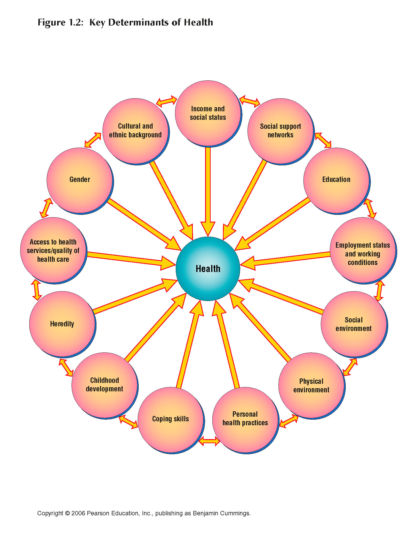
Key factors/Determinants of Health

Slide 12
Social factors influence human life and health
The following factors create major differences between groups of people healthy live in a society
Social factors | Influence | Health address
Education | Knowledge level | Healthy or unhealthy behavior
Income & occupation | Life style | Food nutrition and treatment
Ethnicity & race | Influence by culture | Traditional treatment
Religion | Believe | healing by religious leader
Political affiliation | Empowered for access | Avail health facilities
Geographic region
Common diseases have roots in lifestyle, social factors and environment, and successful health promotion depends upon population-based strategy of prevention

Slide 13
Importance of Social & Cultural Factors in Healthcare
The ways people think about health and illness
Individual behaviors and habits that influence health
How you and your actions are perceived by the community where you work
How culture interacts with environment, economy, and politics to affect health

Slide 14
Social determinants of health
The social determinants of health are the form in which people are born, grow, live, work and age. These circumstances are shaped by the distribution of money, power and resources at global, national and local levels
This are economic and social conditions –their distribution among the population – that influence individual and group differences in health status
They are risk factors found in one's living and working conditions (distribution of income, wealth, influence, and power), rather than individual factors (behavioral risk factors or genetics) that influence risk of disease, or vulnerability to disease or injury.

Slide 15
Social determinants of health
According to some viewpoints, these distributions of social determinants are shaped by public policies that reflect the influence of prevailing political ideologies of those governing a jurisdiction
The WHO says that “This unequal distribution of health-damaging experiences is not in any sense a ‘natural’ phenomenon but is the result of a toxic combination of poor social policies, unfair economic arrangements and bad politics.”

Slide 16
Culture
The attitudes and behavior characteristic of a particular social group
Culture refers to the cumulative deposit of knowledge, experience, beliefs, values, attitudes, meanings, hierarchies, religion, notions of time, roles, spatial relations, concepts of the universe, material objects and possessions acquired by a group of people in the course of generations through individual and group striving
How culture influences health beliefs- read the papers
Some example from your experiences

Slide 17
How social & cultural factors relate to health & illness
Social scientists choose a difference between disease & illness:
Illness is the personal, social, & cultural influences on experience of impairment, pathology, & disease
Disease is the physiological process of pathology
Example:
Cultural factors such as early marriage contribute to the health problem of women, particularly in rural area
Social factors such as education and literacy also influence health outcomes

Slide 18
How social & cultural factors relate to health & illness
The role of a healthcare provider is to alleviate suffering. Yet, it is difficult to address suffering if you don’t understand the many factors contributing to it .
Suffering is a distressing psychological condition that may causes by physical symptoms such as pain, shortness of breath, or hunger.
It may also be caused by nonphysical sources such as how people define quality of life, the meanings they attach to relationships, the anxiety that uncertainty can cause in an individual or family’s life.

Slide 19
How social & cultural factors relate to health & illness
Suffering may be mitigated by someone’s religious explanation for why they are experiencing an illness or their hope for the future during and after treatment
How suffering is expressed also differs greatly from culture to culture. Some peoples place a high value on suppressing expressions of pain, for example, while others actually encourage such expressions. Norms for men and women may also differ

Slide 20
How social & cultural factors relate to health & illness
In order to change people’s behavior to benefit health, one must understand the way that people think about health. For example: What are people’s attitudes and practices?
How would a change impact their lives? In order to fully address suffering, it is important to attend to the social, psychological, and cultural components of people’s health in addition to their bodies. (Henderson 1997)

Slide 21
Anthropological perspectives: Understanding health
“Anthropology is the study of the whole human species in all its diversity” (Kiefer, Doing Health Anthropology)
There are 3 key anthropological perspectives on health:
Health Beliefs and Practices
Critical Medical Anthropology
Discourse Analysis
Medical Anthropology is a field social science devoted to investigating & understanding health, illness and healing from the perspective of the Socio-cultural perspective

Slide 22
How culture influences health beliefs-
literature- How culture influences health beliefs.doc

Slide 23
Sociological perspectives on health
From a sociological/ social point of view, factors contribute to the evaluation of a person as ‘healthy’ or ‘sick’. (Schaefer & Smith, 2004).
Because health is relative, we can view it in a social context and consider how it varies in different situations or cultures.
Functionalist Approach | Inter actionist Approach
Conflict Approach | Feminist Approaches

Slide 24
Functionalist approach
Sickness requires at least a temporary disruption in a person’s social interactions.
The sick are expected to try to get well (e.g., seek medical care) and return to their normal activities.
Being sick must be controlled so that not too many people are released from their societal responsibilities at any one time.
An overly broad definition of illness would disrupt the workings of a society.

Slide 25
Morbidity rates and populations
Social scientist find morbidity rates useful because they reveal that a specific disease occurs more frequently among one segment of a population then another.
Social Class
Clearly associated with differences in morbidity and mortality rates. Why is class linked to health ? Crowded living conditions, substandard housing, poor diet, stress, limited education, workplace, etc

Slide 26
Importance of social & cultural factors in healthcare
The ways people think about health and illness
How and when they will report / tell about the problems
Individual behaviors and habits that influence health
How you and your actions are perceived by the community where you work
How culture interacts with environment, economy, and politics to affect health

Slide 27
The social view of health
What is the major health problem of a society
How does society handle sickness?
Who decides when someone is ill & when they are well?
How does health vary over different social groups?
Sociologists do not believe that a purely objective view of illness can be achieved because illness is social as well as biological

Slide 28
How to maintain good health: Social & cultural point of view
Please mention the way that how can we address those challenges or maintain good health (public health point of view)

Slide 29
Culturally sensitivity to ask a health problem
Please name some diseases or health problems that culturally difficult to ask and tell about

Slide 30
Study materials
Book: Health behavior and health education-Theory, Research and Practice: 4th Edition, Karen Glanz, Barbara K. Rimer, K. Viswanath, Editors-Foreword by C. Tracy Orleans
Article: The Effect of Handwashing at Recommended Times with Water Alone and With Soap on Child Diarrhea in Rural Bangladesh: An Observational Study. - Stephen P. Luby etl. PLoS Medicine, www.plosmedicine.org 1 June 2011 | Volume 8 | Issue 6
The relationship between socioeconomic status and health – Jonathan S Feinstein, Yale University , National bureau of Economic Research
How culture influences health beliefs- Feature writing
Book chapter: Social condition as Fundamental causes of Disease- BG Link and J Phelan, Journal of Health and Social Behavior, Vol-35, 2010

Slide 31
Thanks!
Discussion !
Questions?

