Slide 1
Macroeconomics

Slide 2
GDP
GROSS DOMESTIC PRODUCT
Gross domestic product (GDP) is a measure of the income and expenditures of an economy.
It is the total market value of all final goods and services produced within a country in a given period of time.

Slide 3
GNI (Gross National Income)
GNI (Gross National Income) similar to GNP includes the value of all goods and services produced by nationals – whether in the country or not.
The number includes the nation's gross domestic product plus the income it receives from overseas sources.
Formula:
GNI = GDP + Net property income from abroad

Slide 4
(GNP)
Gross National Product
Gross national product (GNP) is an estimate of total value of all the final products and services turned out in a given period by the means of production owned by a country's residents.

Slide 5
NOMINAL GDP
Nominal GDP measures the value of all finished goods and services produced by a country at their current market prices.
FORMULA OF NOMINAL GDP:
NOMINAL GDP= Q X P (Current prices)

Slide 6
REAL GDP
Real GDP is a measurement of economic output that accounts for the effect of constant prices.
FORMULA OF REAL GDP
REAL GDP= Q X P (Constant prices)

Slide 7
Per capita income
Per capita income is a measure of the amount of money earned per person in a nation or geographic region.
Per capita income for a nation is calculated by dividing the country's national income by its population.

Slide 8
Domestic Income:
National Income:
It is the sum total of factor incomes generated by all the production units located within domestic territory of a country during an accounting year.
It is the sum total of factor incomes earned (generated) by normal residents of a country during an accounting year.
Symbolically:
National Income = Domestic Income + Net factor income from abroad

Slide 9
GDP deflator
In economics, the GDP deflator (implicit price deflator) is a measure of the level of prices of all new, domestically produced, final goods and services in an economy in a year.
Formula:

Slide 11
Consumer Price Index (CPI)
The Consumer Price Index (CPI) is a measure that examines the weighted average of prices of a basket of consumer goods and services, such as transportation, food, and medical care.
It is calculated by taking price changes for each item in the predetermined basket of goods and averaging them.
The CPI is one of the most frequently used statistics for identifying periods of inflation or deflation.

Slide 12
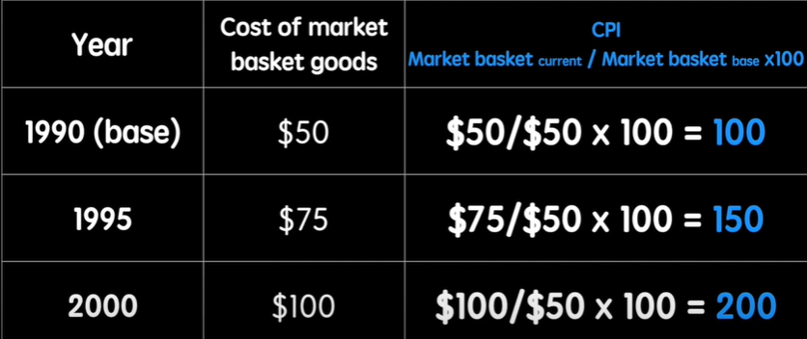

Slide 13
Disposable income
Disposable income, also known as disposable personal income (DPI), is the amount of money that households have available for spending and saving after income taxes have been accounted for.
Formula:
​DPI = Personal Income−Personal Income Taxes​

Slide 14
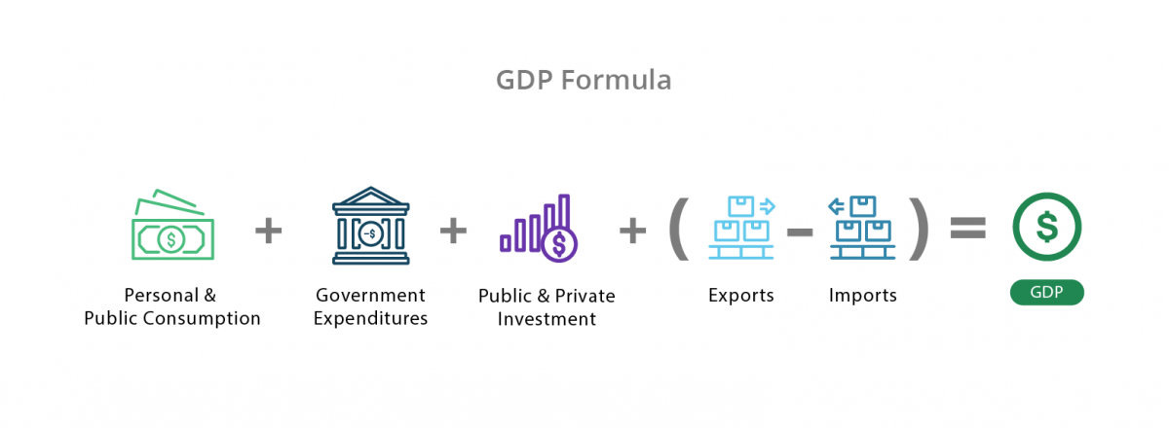
How to calculate GDP !!

Slide 16
Thank You !!

