Slide 1
Sales responsibilities and preparation
Chapter 7

Slide 2
Complaint handling
The term complaint handling describes the handling of customer complaints within a company. Criticism is supposed to be evaluated in a way that is systematic and orderly, and used to create a positive impact. It is also supposed to resolve the issue that prompted the customer’s criticism. The goal of complaint management is to strengthen customer loyalty as well as quality assurance.

Slide 3
Diversion
An effective method of gaining an account in the face of entrenched competition is the diversion. The aim is to distract a rival into concentrating its efforts on defending one account (and therefore neglecting another).

Slide 4
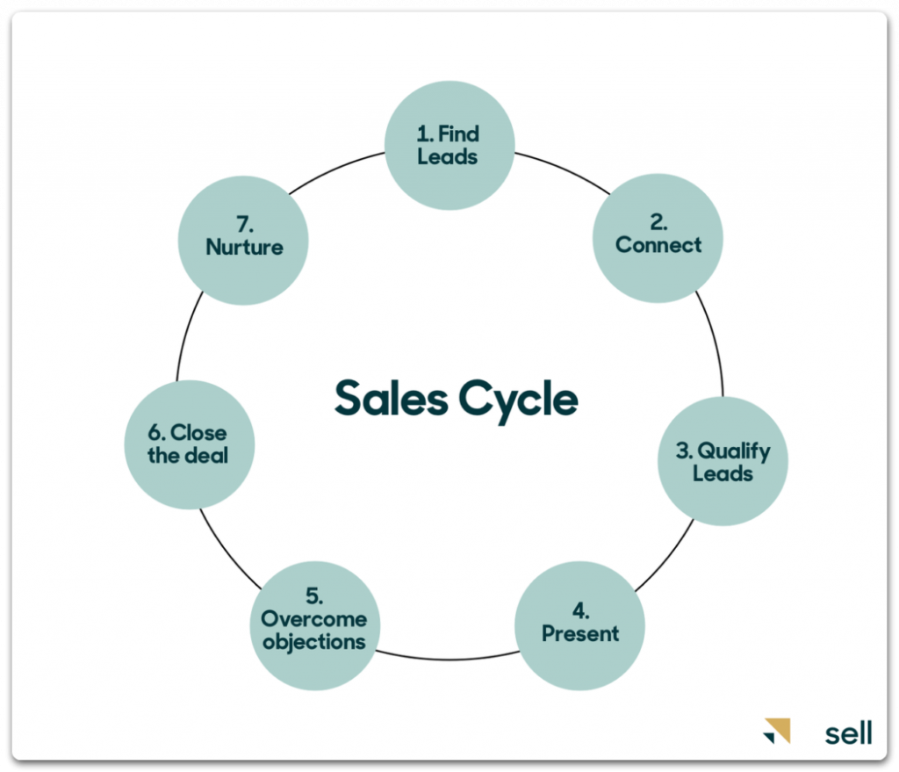
Sales Cycle
The term “sales cycle” describes all the sales process steps, starting from the first customer contact to closing the deal and follow-ups. Simply put, it’s a potential client’s journey from recognizing they need a product to making a purchase. And since the sales process is a journey for a prospect, it’s a roadmap for a salesperson.

Slide 5
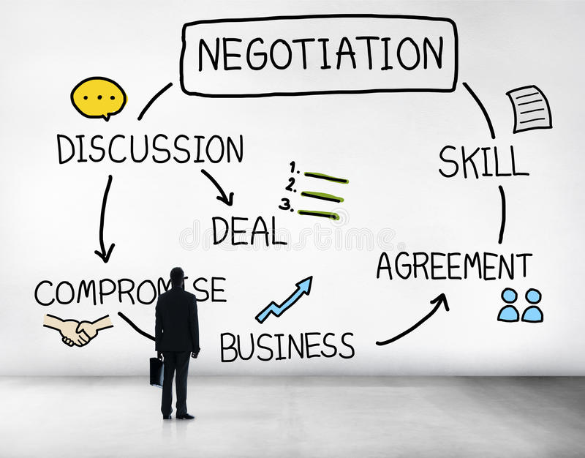
Sales negotiation
A sales negotiation is a discussion between a buyer and a seller to make a sales deal. These negotiations allow sellers to address a buyer's concerns about a purchase by reestablishing the value of the product or service and making compromises

Slide 6
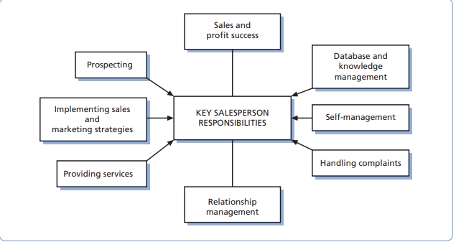
Sales responsibilities
The primary responsibility of a salesperson is to conclude a sale successfully. This task will involve the identification of customer needs, presentation and demonstration, negotiation, handling objections and closing the sale
Key responsibilities of salespeople

Slide 7
Prospecting
Prospecting is the searching for and calling upon customers who, hitherto, have not purchased from the company. This activity is not of uniform importance across all branches of selling. It is obviously far more important in industrial selling than retail selling
For example, a salesperson of office equipment may call upon many new potential customers,

Slide 8
Existing customers
Trade directories
Enquiries.
The press and the internet
Cold canvassing/cold calling
Sources of prospects

Slide 9
Database and knowledge management
Name and address of company
Name and position of contact(s)
Nature of business;
Date and time of interview;
Assessment of potential;
Buyer needs, problems and buying habits;
Past sales with dates;
Problems/opportunities encountered;
Future actions on the part of salesperson (and buyer).
Databases and customer knowledge are not just essential for prospecting. A systematic approach to customer record-keeping is also to be recommended to all repeat-call salespeople

Slide 10
Self-management
A salesperson may have to organize their own call plan, which involves dividing territory into sections to be covered day by day and deciding the best route to follow between calls. Often it makes sense to divide a territory into segments radiating outwards, with the salesperson’s home at the center.

Slide 11
Providing service
Salespeople are in an excellent position to provide a ‘consultancy’ service to their customers. Since they meet many customers each year, they become familiar with solutions to common problems. Thus an industrial salesperson may be able to advise customers on improving productivity or cutting costs
computer salespeople may offer to conduct an analysis of customer requirements and produce a written report in order to complete a sale

Slide 12
Another key responsibility for salespeople is relationship management. There is, however, another set of relationships that a salesperson must master in today’s complex selling environment: that between the salesperson and other people in their company who are vital to ensure a smooth sales process and efficient delivery and service of the product
Relationship management
Implementing sales and marketing strategies
The Salesforce is also charged with the responsibility of implementing sales and marketing strategies designed by management. Misunderstandings regarding strategy can have grave implications. For example, the credibility of a premium price and high-quality position in the marketplace can be seriously undermined by a Salesforce too eager to give large price discounts. The solution might be to decide discount structure at managerial level based on the price sensitivity of various market segments. The salesforce would then be told the degree to which price could be discounted for each class of customer.

Slide 13
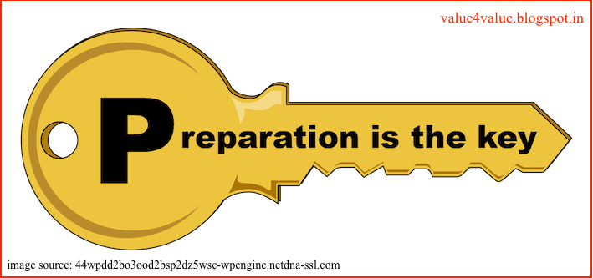
Preparation
The ability to think on one’s feet is of great benefit to salespeople, since they will be required to modify their sales presentation to suit the particular needs and problems of their various customers and to respond quickly to unusual objections and awkward questions. However, there is much to be gained by careful preparation of the selling task. Some customers will have similar problems; some questions and objections will be raised repeatedly.

Slide 14
Preparation for pure selling and sales negotiations
Product knowledge and benefits
Knowledge of competitors’ products and their benefits
Sales presentation planning
Setting sales objectives
Understanding buyer behavior

Slide 15
Preparation for sales negotiations
The number of options available to each party
The quantity and quality of information held by each party
Need recognition and satisfaction.
The pressures on the parties.
Assessment of the balance of power

Slide 16
Determination of negotiating objectives
‘Must have’ objectives. The ‘must have’ objectives define a bargainer’s minimum requirements; for example, the minimum price at which a seller is willing to trade. This determines the negotiating breakpoint
‘Would like’ objectives. These are the maximum a negotiator can reasonably expect to get; for example, the highest price a seller feels they can realistically obtain. This determines the opening positions of buyers and sellers.

Slide 17
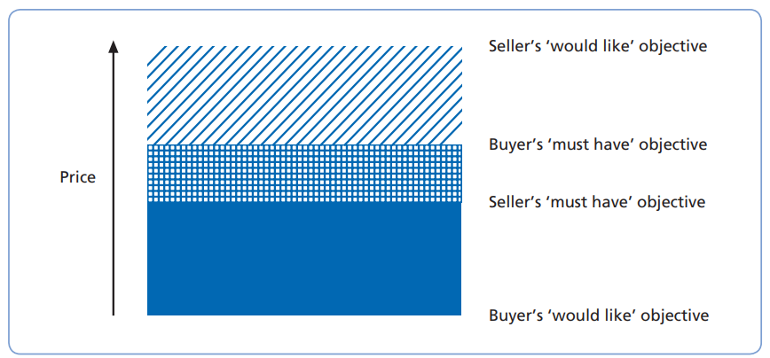
A negotiating scenario

Slide 18
Price;
Timing of delivery;
The product – its specification, optional extras;
The price – e.g. Works price, price at the buyer’s factory gate, installation price, in-service price;
Payment – on dispatch, on receipt, in working order, credit terms;
Trade-in terms, e.g. Cars.
Concession analysis
Since negotiation implies movement in order to achieve agreement, it is likely that concessions will be made by at least one party during the bargaining process. Preparation can aid negotiators by analyzing the kinds of concession that might be offered to the other side. The key to this concession analysis is to value concessions the seller might be prepared to make through the eyes of the buyer

Slide 19
Proposal analysis
A further sensible activity during the preparation stage is to estimate the proposals and demands the buyer is likely to make during the course of negotiation, and the seller’s reaction to them. This is analogous to the anticipation of objections in pure selling – it helps when quick decisions have to be made in the heat of the negotiation.

