Slide 1
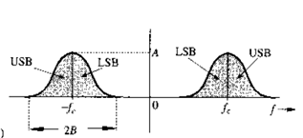
Fourier Transform , Frequency Shifting and DSB(Double Side Band) Modulation

Slide 3
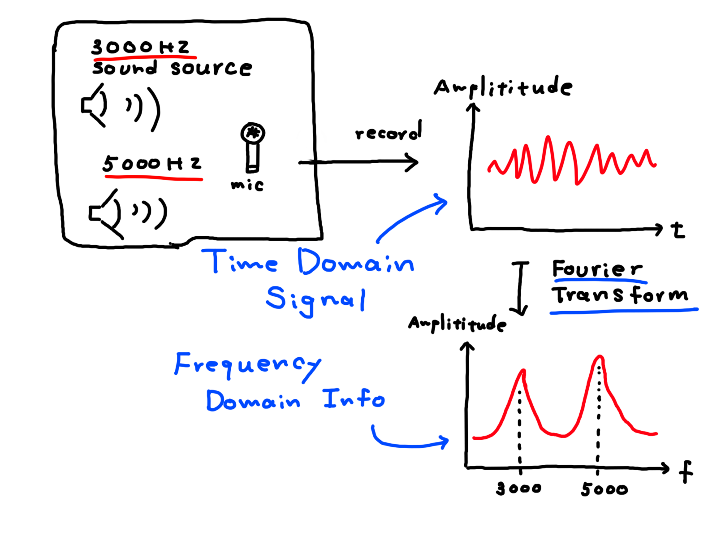

Slide 4
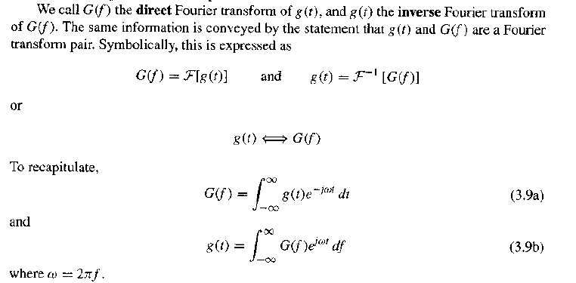

Slide 5
Fourier Transform of some important signal

Slide 8
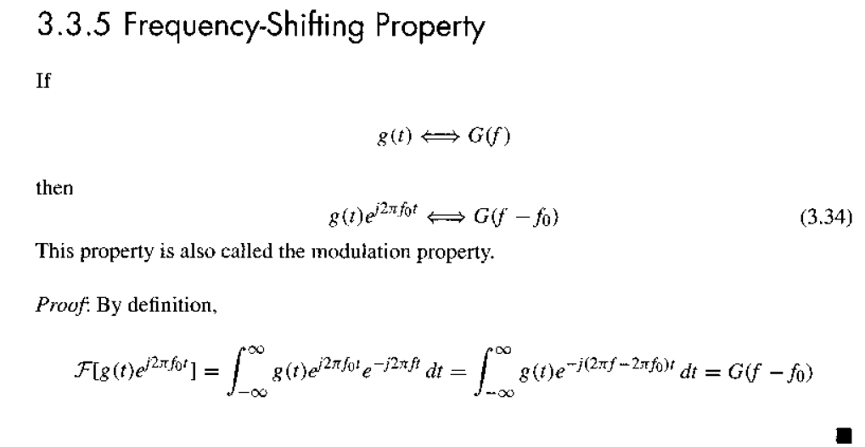

Slide 9
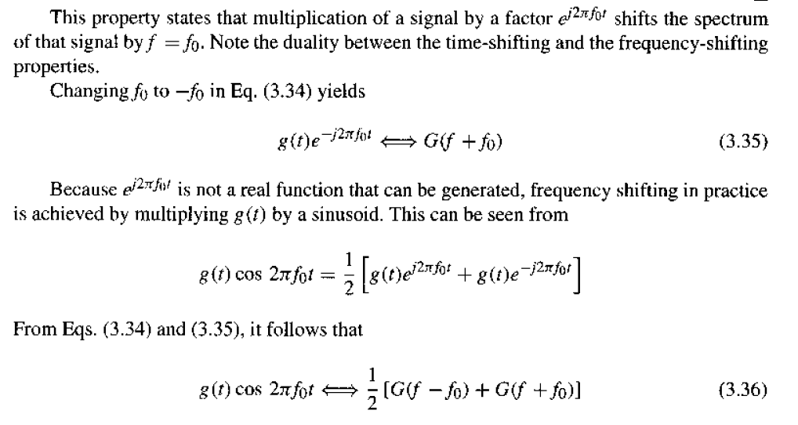

Slide 10
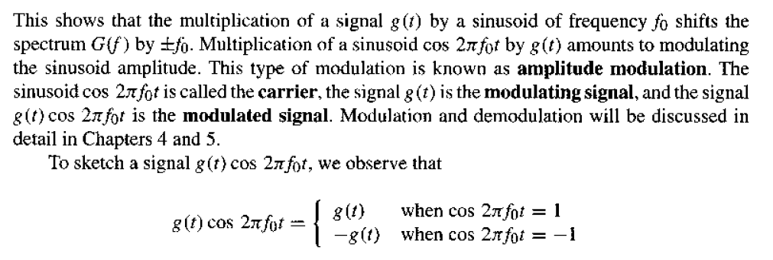

Slide 11
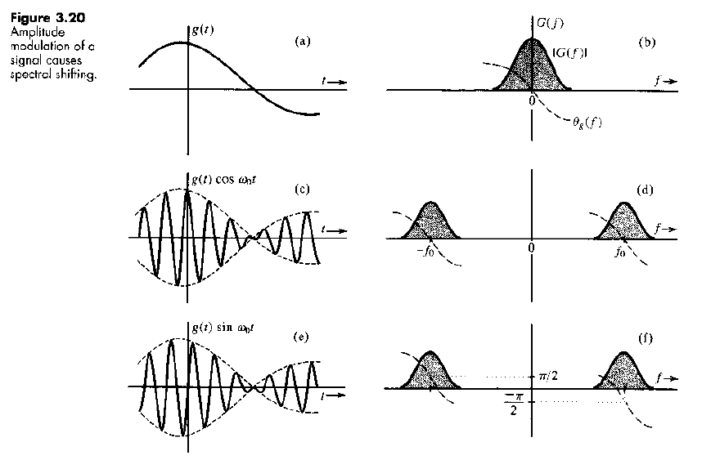

Slide 12
Write the answer of the below Questions and Submit in BLC:
1.What is Base Band Signal?
2.What is Modulation?
3.Why Need Modulation?
4.What is Guard Band?
5.What is Fourier Transform.
6.Why Low Frequency signal can cover long distance but high frequency signal can not? Discuss with proper figures.
7.Draw the F.T of a DC Signal.

Slide 14
Write down the answer of the below questions
What is Communication Engineering?
Draw the basic block diagram of a communication system.
What is input transducer? Write the name of some input transducer.
What is output transducer? Write the name of some output transducer.
What is Base Band Signal?
What is Modulation?
Why Need Modulation in communication system?
What is Guard Band? Why we need Guard Band?
What is Carrier Communication?
What is Baseband Communication?
What is Fourier Transform?
What is Bandwidth of a signal?

Slide 15
Baseband and Carrier Communication
Modulation is a process that causes a shift in the range of frequencies in a signal.
Baseband Communications are communication systems that do not use modulation.
Carrier Communication are communication systems that use modulation.

Slide 17
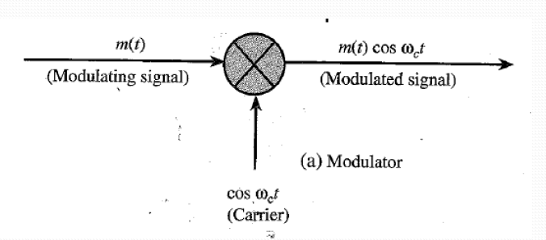
The original signal that generated from input transducer which actually we want to sent through transmitter is called Message Signal or modulating Signal or Baseband Signal.
The High Frequency Sinusoidal Signal Which is used to shift the frequency of message signal is called carrier signal.

Slide 18
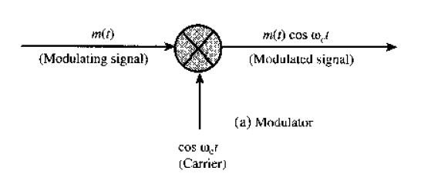

Slide 19
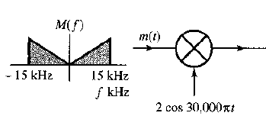

Slide 21
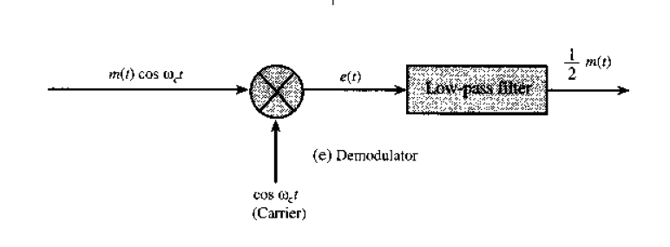
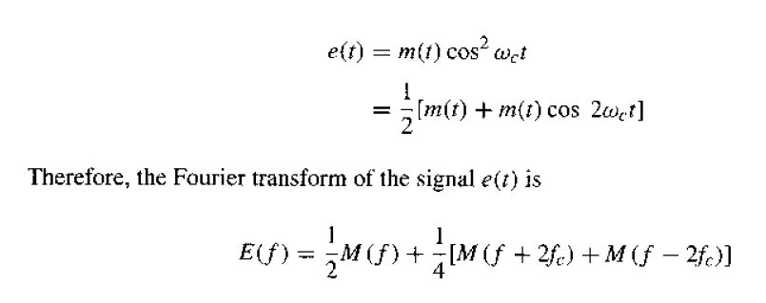

Slide 22
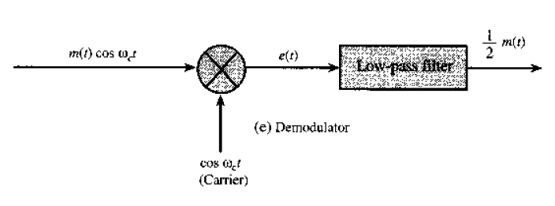

Slide 23
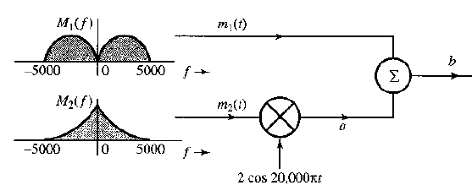

Slide 26
DSB Modulator & Demodulator
Transmitter
Receiver

Slide 27
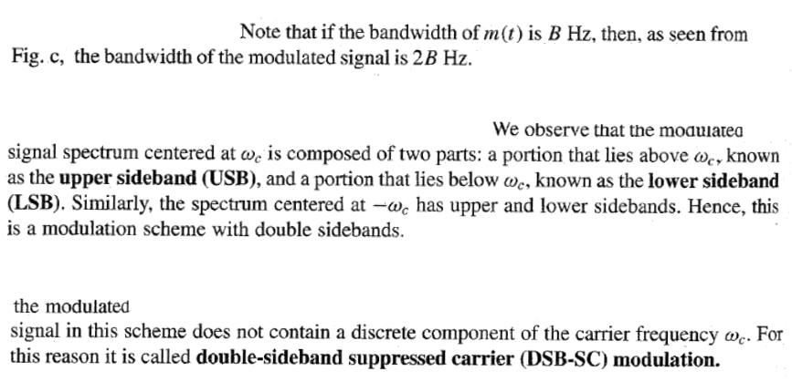

Slide 29
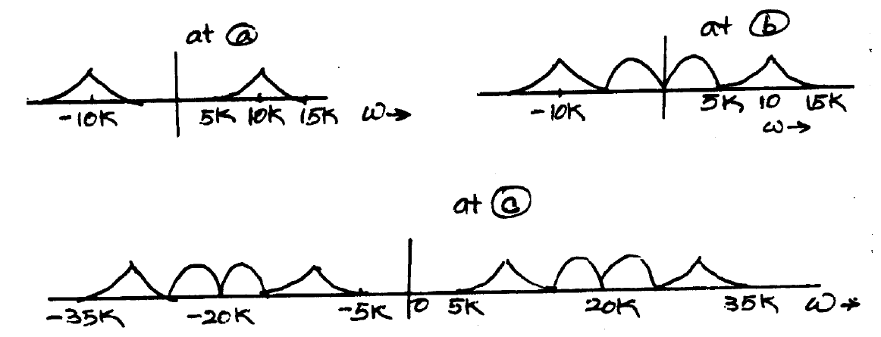

Slide 30
