Slide 1
Psychosocial support

Slide 5
Psychosocial support is an approach to victims of
disaster, catastrophe or violence
to foster resilience of communities and individuals.

Slide 8
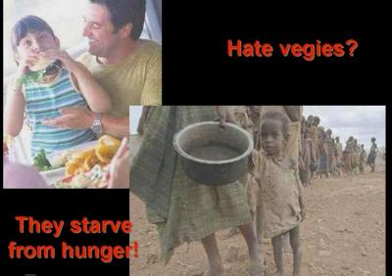

Slide 9
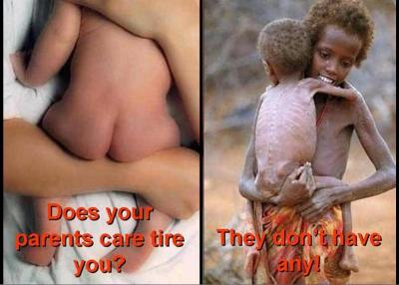

Slide 10
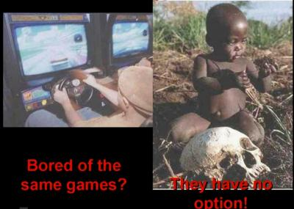

Slide 12
