Slide 1
Chapter-1 Introduction Part-1

Slide 2
Concept of Management
MANAGEMENT-1598
MANAGEMENT
Tactics
Technology
Handle, Motivate
People, human, labor

Slide 3
Definition-1
Manipulation of Resources to achieve goals or objectives
Human Resources
Physical resources
Financial Resources
Material or Informational Resources
To manage
To handle effectively
To influence
4 Ms
Man
Machine
Money
Material
Land
Labor
Capital
Material

Slide 4
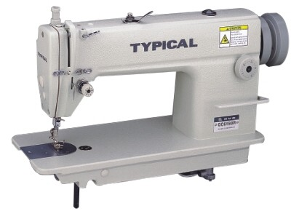
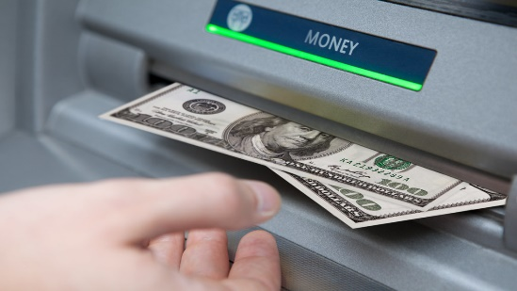
Organizational Resources
Human resource
Physical resource
Financial resource
Material resource

Slide 5
Definition-2
Series of steps
Complete task
The process of getting activities completed efficiently and effectively with and through other people.
Use resources in a low cost and produce high quality product
Making right decision at the right time and successfully implementing that decision

Slide 6
Definition-3
The attainment of organizational goals in an effective and efficient manner through planning, organizing, leading and controlling organizational resources.

Slide 7
Thank you

