Slide 1
Contract Act,1872

Slide 2
Objectives
1. The objectives of this lesson is to make the students aware of the legal consequences of everyday business/economic activities.
2. To achieve this objective, this lesson will discuss basic principles of the Contract Law of Bangladesh. It will focus on the concept of a valid contract and how to create it. This will include
the basic elements and characteristics of a contract,
various types and forms of contract,
termination of contract and
remedies for breach of contract.
After the end of each topic, a case study will be presented to better understand the topic.

Slide 3
Concept of “Contract”
CONTRACT: DEFINITION
A contract is an agreement which is enforceable by law. Therefore, in acontract, there must be
an agreement and
(ii) the agreement must been forceable by law.
An agreement comes into existence whenever one or more person promise to one or others to do or not to do something. It is a promise or a set of reciprocal promises. Note that the manner in which contracts are, if necessary, enforced belongs to civil procedures.

Slide 4
DIFFERENCE BETWEEN AN AGREEMENT AND CONTRACT
A contract is an agreement to create an obligation or obligations, but there are other transactions which are based on agreements and which also obligations but are not called contracts.
All contacts are agreements but all agreements are not contracts.
Agreements which are enforceable by law are contracts. An agreements which is “enforceable by law” – constitutes a legal binding on parties involved.
If an agreement is not enforceable by law, then it is not a contract. An agreement becomes a contract only when all necessary legal requirements are satisfied.

Slide 5
Legal Requirements/ Elements

Slide 6
1. Offer - One of the parties made a promise to do or refrain from doing some specified action in the future.
2.. Acceptance - The offer was accepted unambiguously. Acceptance may be expressed through words, deeds or performance as called for in the contract. Generally, the acceptance must mirror the terms of the offer. If not, the acceptance is viewed as a rejection and counteroffer.
If the contract involves a sale of goods (i.e. items that are movable) between merchants, then the acceptance does not have to mirror the terms of the offer for a valid contract to exist, unless:
(a) the terms of the acceptance significantly alter the original contract; or
(b) the offeror objects within a reasonable time.

Slide 7
3. Consideration - Something of value was promised in exchange for the specified action or nonaction. This can take the form of a significant expenditure of money or effort, a promise to perform some service, an agreement not to do something, or reliance on the promise. Consideration is the value that induces the parties to enter into the contract.
The existence of consideration distinguishes a contract from a gift. A gift is a voluntary and gratuitous transfer of property from one person to another, without something of value promised in return. Failure to follow through on a promise to make a gift is not enforceable as a breach of contract because there is no consideration for the promise.

Slide 8
4. Legality: What makes contracts valid?
There’s more to contracts than the basic structure, though. It’s perfectly possible to create a contract that meets the definition but is not legally binding. A contract is valid if it both follows the appropriate structure and meets the following requirements:
Doesn’t violate public policy
All parties understand and agree on the terms.

Slide 9
5. Capacity: All parties are able to consent
A fundamental part of the contracting process is confirming that all parties involved are eligible to consent. This is known as having the “capacity” to enter the contract. Certain groups are never assumed to have the capacity, including minors or adults with mental limitations.
Other parties may only have the capacity in certain circumstances. A company can enter a contract if it can prove that it’s a genuine legal entity and the person who will sign the contract is the company’s authorized signatory. Without these elements, an agreement may be considered void or voidable.
6. Mutuality - The contracting parties had “a meeting of the minds” regarding the agreement. This means the parties understood and agreed to the basic substance and terms of the contract.

Slide 10
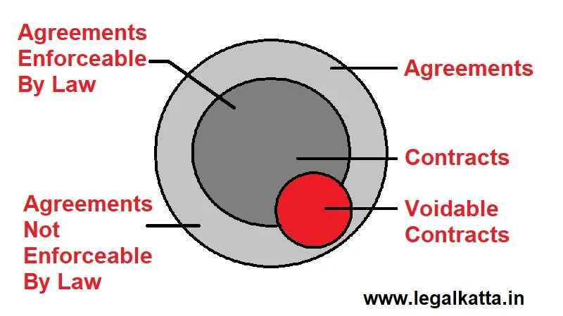
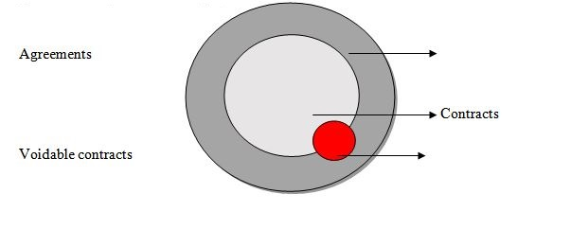
Are all Agreements Contracts?
A contract is a lawful agreement which means an agreement that gives rise to legal enforceability.

Slide 11
When the agreement is enforceable by law then it becomes a valid contract. The red circle talks about the voidable contract which means when some contracts are enforceable on the part of one party and not on the part of another contracting party then the contracts are said to be voidable.
For example, X has invited a person Y for a dinner at his house. Y accepts the invitation but he could not reach me due to an emergency. This cannot be said of a contract as it does not create a legal obligation. It is just a social agreement that creates acceptance that agreements are not legally binding.

Slide 12
How does an Agreement become a Contract?
According to section 10 of the Contract Act, of 1872,
“All agreements are contracts if they are made by the free consent of parties competent to contract, for a lawful consideration and with a lawful object, and are not hereby expressly declared to be void.”

Slide 14
What are the conditions when Agreements become Contracts?
The following conditions must be fulfilled to make an agreement, a contract:
Competent Parties
This condition is one of the essential elements, which states that the parties making or entering a contract must be competent to each other.
According to Section 11 of the Contract Act, of 1872, a person entering a contract is competent to contract when he
Has attained the age of majority i.e., 18 years of age.
A minor person who has not attained the age of 18 years entering into an agreement to make a contract then it is void-ab-initio which means void from the beginning and hence cannot be enforced.
For example –A boy who is 15 years of age entered into an agreement to sell a car to another party then this agreement is void-ab-initio. This agreement was not enforced by law.

Slide 15
Is of sound mind
If a person is not in his/her state of mind or of an unsound mind while entering an agreement, then the agreement is void.
For example – A person who signed an agreement regarding the property of that person but was not in his state of mind as he was drunk and in a state of intoxication, then the agreement is void.
Is not expressly disqualified from contracting by the law.
The agreement is void when a person at the time of entering into an agreement is disqualified by law.
For example – X who was declared insolvent by the court and thus disqualified from contracting, ordered by the court but still buys a house from the property dealer by making an agreement the agreement is considered to be void.

Slide 16
3. Free consent of Parties
The second main essential is that all the parties should enter into a contract with free consent. The consent can be either expressly by words – oral or written or impliedly by gestures or surrounding circumstances. Section 14 of the Contract Act, of 1872, has given the definition of the term ‘Free Consent’.
4. Lawful consideration and object
If any consideration or object is unlawful or violates any provision of law then such agreement is unenforceable and is known as void. So it is very important to note that the consideration and objectification to the contract should be lawful and not violate any provisions of law.

Slide 17
Under Section 23 of the Contract Act, of 1872, the consideration and object of an agreement are unlawful if it is:
Forbidden by law
Fraudulent
Of such a nature that if permitted, would defeat the provisions of any law
Involves and implies injury to person or property
Regarded as immoral or opposed to public policy by the law
If any above-mentioned consideration or object is contained in an agreement, then such agreement becomes void. For any purpose, the object or consideration should not be unlawful.
Section 24 of the Act says that if the consideration or object is wholly or partly unlawful to the agreement then the agreement is unenforceable and becomes a void agreement.

Slide 18
4. The agreement should not expressly be declared to be void
Some contracts are there which are expressly declared null and void by the law and these agreements are known as an unenforceable and void agreement in the eyes of law.
There are some sections under the Contract Act, of 1872 deal with the agreements that are expressly declared null and void:
Agreements in restraint in marriage (Section 26)
Agreements in restraint in trade (Section 27)
Agreements in restraint of legal proceedings (Section 28)
Uncertain agreements are void (Section 29)
Agreements for a wager are void (Section 30)
Agreements contingent on an impossible event (Section 36)
Agreements to do impossible acts (Section 56)
If the above-mentioned subjects are contained in an agreement, then such agreement becomes unlawful and void.

Slide 19
Conclusion
“All contracts are agreements but all agreements are not contracts” this statement is absolutely true and valid. The agreement has a wider concept than a contract and so the agreement is the basis of the contract. The agreement first starts with an offer and ends with the consideration and the contract needs to have lawful enforceability to run between both parties. In case of any breach of the agreement by one party, then the aggrieved party has the right to go to court against the guilty party and compel them to pay the compensation decided by the court.

