Slide 1
Introduction to intellectual property right
Juwel Rana Lecturer Dept. of Nutrition and Food Engineering, DIU

Slide 2
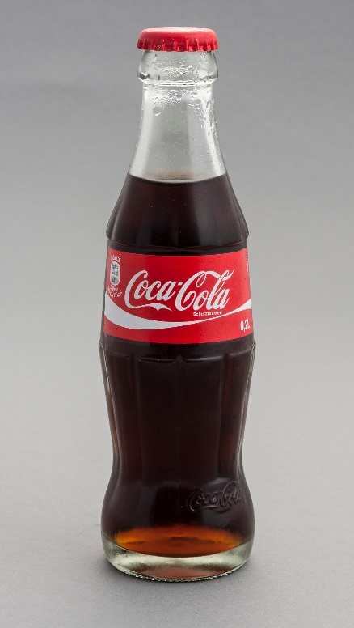

Slide 3
How do you make a new biscuits?

Slide 4
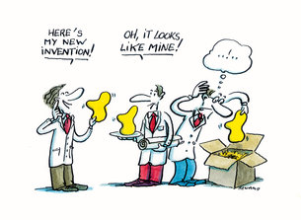
What is IP?
Intellectual property (IP) refers to creations of the mind, such as inventions; literary and artistic works; designs; and symbols, names and images used in commerce.
Property which comes from the Human Brain and for which Government gives protection is called Intellectual Property.
The different types of intellectual property rights are copyrights, patents and trademark.

Slide 5
Intellectual property rights
Intellectual property rights are the rights given to persons over the creations of their minds. They usually give the creator an exclusive right over the use of his/her creation for a certain period of time.
Intellectual property rights (IPR) have been defined as ideas, inventions, and creative expressions based on which there is a public willingness to bestow the status of property.

Slide 6
Types Of IPR
The types of intellectual property include:
Trade Secret
Trademarks
Copyright
Patent
Industrial
Design
Graphical Indication

Slide 7
Types Of IPR
Trade secrets
A trade secret is a formula, practice, process, design, instrument, pattern, or compilation of information which is not generally known or reasonably ascertainable, by which a business can obtain an economic advantage over competitors and customers.
Trade secrets are IP rights on confidential information which may be sold or licensed.
The unauthorized acquisition use or disclosure of such secret information by others is regarded as an unfair practice & a violation of the trade secret protection.
Example: Formula of its soft drinks is a trade secret for Coca-Cola.

Slide 8
Types Of IPR
Trademark
A trademark is a recognizable sign, design or expression which is capable of distinguishing the products or services of a particular trader from the similar products or services of other traders.
Under the Trade Marks Act, 2009, protection is granted for seven (7) years and it can be renewed after every expiry for further ten (10) years on payment of renewal fees.
For details and updated information on Trademarks, visit www.dpdt.gov.bd

Slide 9
Types Of IPR
Patents
A patent is an exclusive right granted for an invention, which is a product or a process that provides, in general, a new way of doing something, or offers a new technical solution to a problem.
Under The Patents and Designs Act, 1911, the Department of Patents, Design and Trademark (DPDT) provides patent protection (registration) to the patent holders for 16 years on payment of prescribed fees.
Duration of protection may be renewed for a further period. A patent confers on the patentee the exclusive privilege of making, selling and using the invention throughout Bangladesh and of authorizing others to do so.
For details and updated information on protection of patents and design, visit www.dpdt.gov.bd

Slide 10
Types Of IPR
Copyright:
A copyright gives the creator of an original work exclusive rights to it, usually for a limited time.
Copyright may apply to a wide range of creative, intellectual, or artistic forms, or "works".
Copyright does not cover ideas and information themselves, only the form or manner in which they are expressed.
The Copyrights Act, 2000 (amended in 2005) provides protection to authors, artists or dramatists.
Copyright law protects only the form of expression of ideas, not the ideas themselves.
In order to get a copyright, the owner has to show that the work is original.
For details on Copyright protection in Bangladesh, visit www.copyrightoffice.gov.bd

Slide 11
Types Of IPR
Industrial design right
An industrial design right is an intellectual property right that protects the visual design of objects that are not purely utilitarian.
An industrial design consists of the creation of a shape, configuration or composition of pattern or color, or combination of pattern and color in three-dimensional form containing aesthetic value.
Example: Design of Apple mobile
Under the Patents and Designs Act, 1911, any person claiming to be the proprietor of any new or original design not previously published in Bangladesh may register the design.
The registered proprietor of the design shall have copyright in the design for five (5) years from the date of registration.
For details and updated information on Patents and Designs, visit www.dpdt.gov.bd

Slide 12
Types Of IPR
Geographical Indication:
A geographical indication is a sign used on products that’s have a specific geographical origin and possess quality or a reputation that are due to that origin.
Example: Muslin is the fourth GI certified products.
Bangladesh has enacted ‘The Geographical Indication of Goods (Registration and Protection) Act, 2013’.
In order to implement the Act, the Geographical Indication of Goods (Registration and Protection) Rules, 2015 has been enacted Registration of GI goods shall remain valid for indefinite period unless it is rescinded or otherwise declared void.
The duration of registration of authorized users of GI goods will be five (5) years and is renewable for a further period of 3 (three) years.
For details and updated information on Geographical Indications of Goods, visit www.dpdt.gov.bd.

Slide 13
Find out the list of GI products?
How many products have been geographical indications registered?

Slide 14
Laws Under IP
Constitution / Basic Law
Constitution of Bangladesh (as amended up to May 17, 2004) (2004)
Main IP Laws: enacted by the Legislature
Trademarks Act, 2009 (Act No. XIX of 2009) (2009)
Copyright Act, 2000 (Act No. 28 of 2000, as amended up to 2005) (2005)
The Patents and Designs Act (Act No. II of 1911) (2003)
IP-related Laws: enacted by the Legislature
Right to Information Ordinance, 2008 (2008)
Penal Code, 1860 (Act No. XLV of 1860) (2004)
Civil Procedure Act, 1908 (Act No. V of 1908) (1908)
The Custom Act (Act No. IV of 1969) (196)
IP Laws: issued by the Executive
SRO No. 312-Law/2000 (2000)
The National Curriculum and Text-Book Board Ordinance, 1983 (Ordinance No. LVII of 1983) (1983)

Slide 17
Impacts of IPR
1.Encourage individual to innovation
2.Secure individuals IP
3.Maintaining quality
4.Ensure original product
5.Helping to identify the desire source
1.Copyright ownership doesn’t own up
2.Missing the mark with trademark
3.Problems with patent
Positive Impacts
Negative impacts

Slide 18
Why is it important to protect intellectual property rights?
IP rights are important because they can:
set a business apart from competitors
be sold or licensed, providing an important revenue stream
offer customers something new and different
form an essential part of a marketing or branding
be used as security for loans

Slide 19
Picture with Caption Layout
Caption

Slide 20
Reference
http://www.bangladeshcustoms.gov.bd/trade_info/intellectual_property_rights

