Slide 1
ER model to Schema/Entity Relationship Model
Prepared By
Fatema Tuj Johora
Lecturer, CSE,DIU

Slide 2
ER to Schema/Relational Model
Step 1: Find strong entity and attributes
Create table or schema that includes all the attributes
Include only the simple components not the composite attributes
Create table for the multivalued attributes.
Assign primary key
Step 2: Find Weak Entity and Attributes
Create table or schema that includes all the attributes
Include the primary key from the owner table and this will become the foreign key
Step 3:Find the Relations
Assign foreign key for the Table contains “many” relation

Slide 3
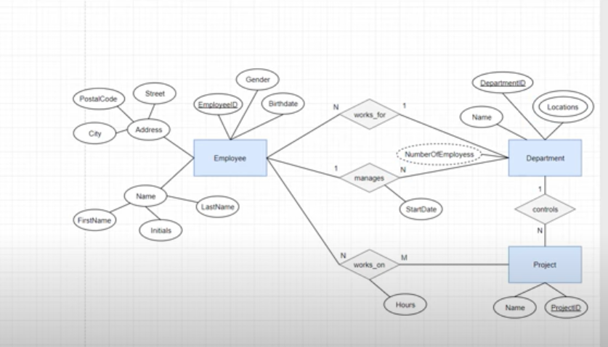
ER to Schema

Slide 4
Continue………
Three Entity named
Employee (Strong)
Project (Strong)
Department (Strong) and
no weak entity here
4 Relations
Works_on (N-M)
Works_for (N-1)
Manages (1-N)
Controls (1-N)

Slide 5
Schema for Entities (Step 1)
Employee(EmployeeID,Gender,BirthDate,Street,Postcode,City,FirstName,Initials,LastName)
Project (ProjectID,Name)
Department( DeptId,Name,Locations)
But Here Department Entity contains a multivalued attribute so we have to create separate table/schema taking reference from department table for “Locations” Entity. This entity will have a PK and own attribute and Department Table will take the PK from Locations Table and make it FK
So the Locations Table or schema will be: Locations (LocationID, Name)
And Department Schema will be :
Department( DeptId,Name,LocationID(FK) )

Slide 6
Schema for Entities (Step 3) as there is no weak entity
First Works with (N-M) Relations:
“Works_on”
This Works_on makes relation between Employee and Project entity
So Works_on will contain Primary Key from both entity and its own entity named “Hours”
So the Schema will be: Works-on (EmployeeID(FK),ProjectID,Hours)
Then works with (1-N/n-1) Relations:
works_for (N-1)
Manages (1-N)
Controls (1-N)

Slide 7
Schema for Relations
“Works_for” makes relation between “employee” and “department”.
N
1
Employee
Works_for
department

Slide 8
Schema for Relations (Works_for)
“Works_for” entity will take the PK from Employee as FK and department and its own attribute
Works-for (EmployeeID(FK),DeptID(FK))
Entity contains “Many” type relation that is “employee” will take the primary key from the “department” entity and make it FK.
Employee(EmployeeID,Gender,BirthDate,Street,Postcode,City,FirstName,Initials,LastName,DeptID (FK))

Slide 9
Schema for Relations (manages)
“Manages” makes relation between “employee” and “department”entity

Slide 10
Schema for Relations (manages)
“manages” entity will take the PK from Employee as FK and department and its own attribute
manages (EmployeeID(FK),DeptID(FK), startdate)
Entity contains “Many” type relation that is “department” will take the primary key from the “employee” entity and make it FK.
Department( DeptId,Name,LocationID(FK),EmployeeID )

Slide 11
Schema for Relations (controls)
“Controls” Make relation between “department” and “project entity”

Slide 12
Schema for Relations (controls)
“controls” entity will take the PK from “Department” as FK and “project” and its own attribute
controls (projectID(FK),DeptID(FK))
Entity contains “Many” type relation that is “project” will take the primary key from the “department” entity and make it FK.
Project (ProjectID,Name,DeptID(FK))

