Slide 1
Lecture 01
Software Project III

Slide 2
What is Web?
World Wide Web [Old]
A collection of interlinked multimedia documents (web pages stored on internet connected devices and accessed using a common protocol (HTTP))
World Wide Web [New]
An infrastructure that allows to easily develop, deploy, and use distributed systems
Distributed systems
A system in which components located on networked computers communicate and coordinate their actions by passing messages in order to achieve a common goal

Slide 3
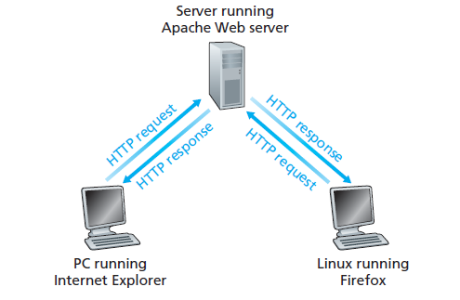
How does www work?
The web uses the Hypertext Transfer Protocol to communicate (Communication) protocol
A defined system that allows two or more entities to transmit information via any kind of variation of a physical quantity
It defines the rules, syntax, semantics and synchronization of communication

Slide 4
History of HTTP
1991 – HTTP 0.9
1996 – HTTP/1.0
1997 – HTTP/1.1
1997-2014
Minor improvements and clarifications of HTTP/1.1 are developed
2015 – HTTP/2
Major revision of HTTP with focus on efficiency and privacy improvements
HTTP/2 allows a server to push resources to client even before they are requested
HTTP/2 puts more emphasis on encrypted connections

Slide 5
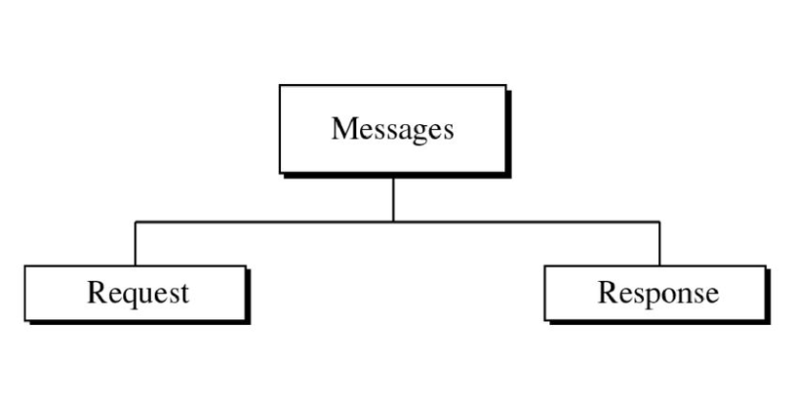
HTTP

Slide 6
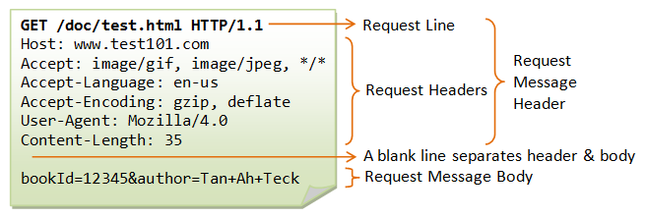
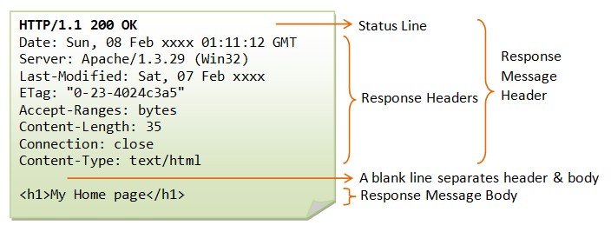
HTTP

Slide 7
Web Server
There is an always-on host, called the server, which services requests from many other hosts, called clients. A classic example is the Web application for which an always-on Web server services requests from browsers running on client hosts. When a Web server receives a request for an object from a client host, it responds by sending the requested object to the client host. Note that with the client-server architecture, clients do not directly communicate with each other; for example, in the Web application, two browsers do not directly communicate. Another characteristic of the client-server architecture is that the server has a fixed, well-known address, called an IP address (which we’ll discuss soon). Because the server has a fixed, well-known address, and because the server is always on, a client can always contact the server by sending a packet to the server’s IP address.

Slide 8
Communication Protocol
TCP service
reliable transport between sending and receiving process
flow control: sender won’t overwhelm receiver
congestion control: throttle sender when network overloaded
does not provide: timing, minimum throughput guarantee, security
connection-oriented: setup required between client and server processes
UDP service
unreliable data transfer between sending and receiving process
does not provide: reliability, flow control, congestion control, timing, throughput guarantee, security, orconnection setup,

Slide 9
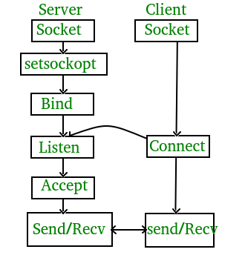
Socket Programming
process sends/receives messages to/from its socket
socket analogous to door
sending process shoves message out door
sending process relies on transport infrastructure on other side of door to deliver message to socket at receiving process

Slide 10
Algorithm for TCP client
Find the IP address and port number of server
Create a TCP socket
Connect the socket to server (Server must be up and listening for new requests)
Send/ receive data with server using the socket Close the connection
Algorithm for TCP server
Find the IP address and port number of server Create a TCP server socket
Bind the server socket to server IP and Port number (this is the port to which clients will connect)
Accept a new connection from client returns a client socket that represents the client which is connected Send/ receive data with client using the client socket
Close the connection with client

Slide 11
Algorithm for UDP client
Find the IP address and port number of server
Create a UDP socket
Send/ receive data with server using the socket
Close the connection
Algorithm for UDP server
Find the IP address and port number of server Create a UDP server socket
Bind the server socket to server IP and Port number (this is the port to which clients will send)
Send/ receive data with client using the client socket
Close the connection with client

Slide 12
What is an API?
An API is a set of programming code that enables data transmission between one software product and another. It also contains the terms of this data exchange.
Application programming interfaces consist of two components:
Technical specification describing the data exchange options between solutions with the specification done in the form of a request for processing and data delivery protocols
Software interface written to the specification that represents it

