Slide 1
Impression Management

Slide 3
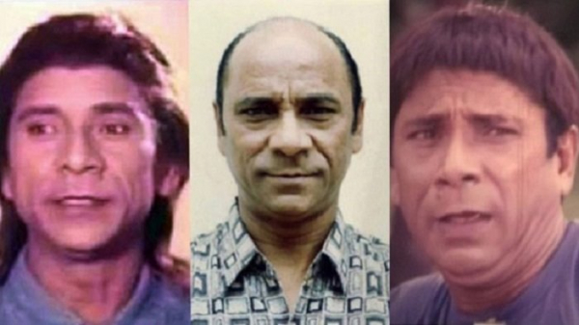

Slide 4
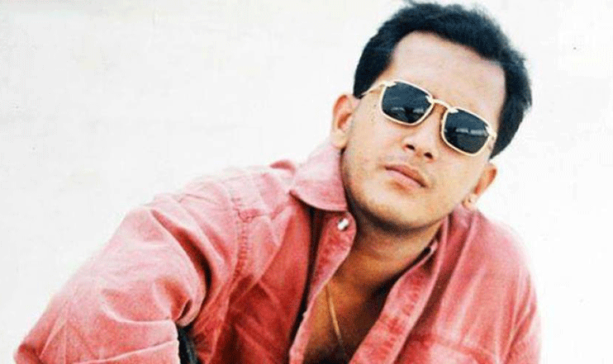

Slide 5
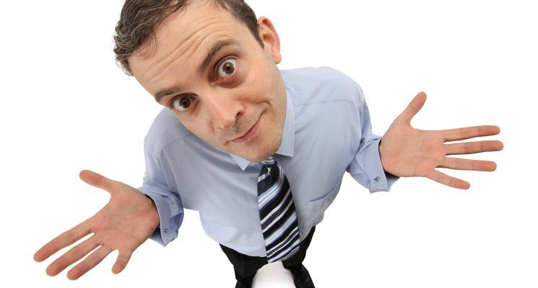
What is Impression Management?

Slide 6
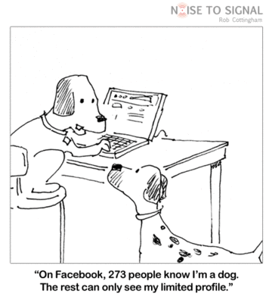
Impression Management
The process of portraying yourself to others in a manner that creates a desired impression.

Slide 7
Need of Impression Management

Slide 8
You will not get second chance to make your first impression

Slide 9
Within seconds of seeing a person for the first time we decide their:

Slide 10
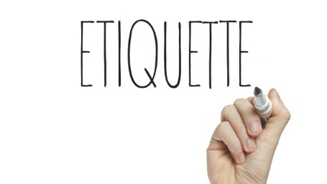
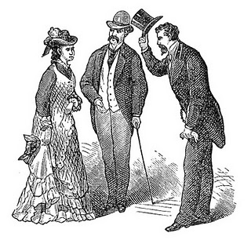

Slide 14
We evaluate others on the basis of

Slide 15
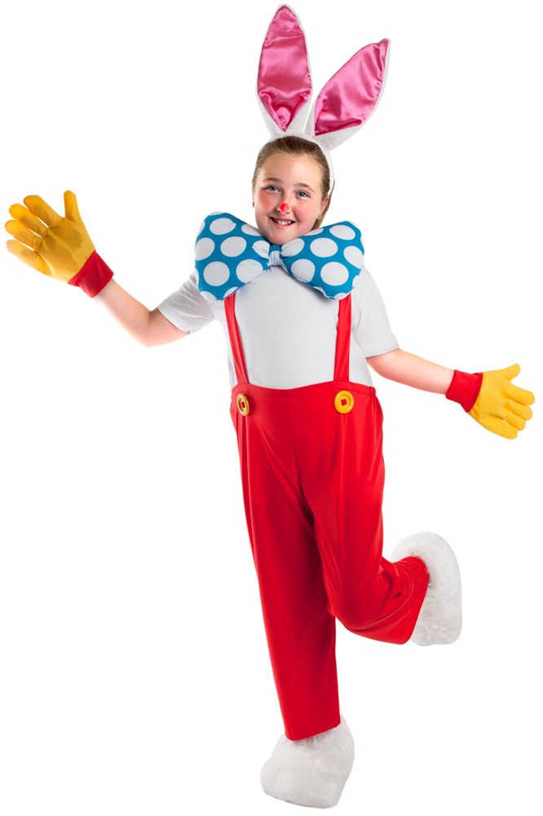
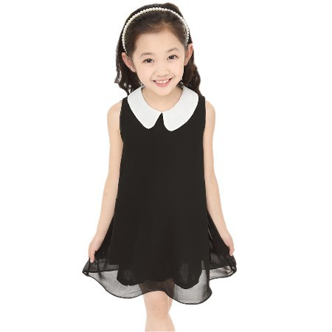
Dress

Slide 16
Hair Style

Slide 17
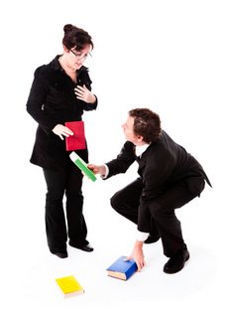
Manner and general behavior

Slide 18
Body language

Slide 19
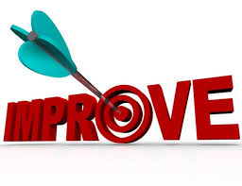
How To Improve Impression Management :-
Dress appropriately
Learn to shake hands
Keep your body language open
Keep smiling and feel confident

Slide 21
