Slide 1
Chapter 02
Solution of Algebraic and Transcendental Equations

Slide 2
False Position Method

Slide 3
Method of False Position
This is another method to find the roots of f (x) = 0. This method is also known as Regular False Method.
In this method, we choose two points a and b such that f (a) and f (b) are of opposite signs. Hence a root lies in between these points. The equation of the chord joining the two points, (a, f (a)) and (b, f (b)) is given by
$$\frac{y−f(a)}{x−a}=\frac{f\left(b\right)−f(a)}{b−a}$$

Slide 4
We replace the part of the curve between the points [a, f (a)] and [b, f (b)] by means of the chord joining these points and we take the point of intersection of the chord with the x axis as an approximation to the root (see Fig.3). The point of intersection is obtained by putting x= c and y = 0 in (5), as
$$x=x_{1}=c=\frac{af\left(b\right)−bf(a)}{f(b)−f(a)}$$
C is the first approximation to the root of f (x) = 0.

Slide 5
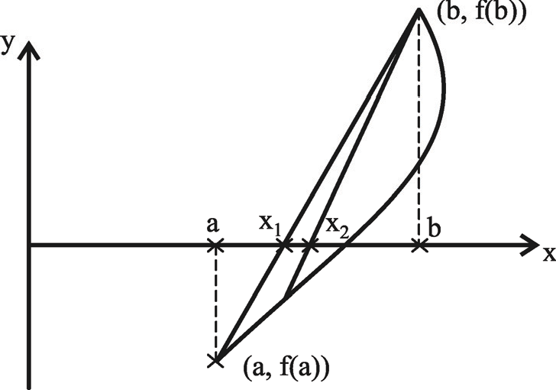
Fig. 3 Method of False Position

Slide 6
If f (c) and f (a) are of opposite signs, then the root lies between a and c and we replace b by c in (6) and obtain the next approximation . Otherwise, we replace a by c and generate the next approximation. The procedure is repeated till the root is obtained to the desired accuracy. This method is also called linear interpolation method or chord method.

Slide 7
Procedure of False Position Method :
Step 1 : To find the Given function, $f (x)$
Let , $x^{3}+ x^{2} =1$
Find $f (x)$ in the step 1
$$∴$$
$$∴$$

Slide 8
Step 2 : Choose , two real numbers a and b
such that ,
$$f(a)×f(b)<0$$
For $a=0,$
Find the Interval between ( a , b ) in the step 2
For $b=1,$

Slide 9
Find the Interval between ( a , b ) in the step 2
$$∴f(a)×f(b)=f(0)×f(1)=(−1)×1=−1<0$$
Since , $f(a)=f(0)$ is negative and $f(b) =f (1)$ is positive
So at least one real root lies between 0 and 1.

Slide 10
Step 3:
Find out value give it name c.
$$Find the value c, using$$ $∴c=$ $\frac{af\left(b\right)−bf(a)}{f(b)−f(a)}$
$$a=0,b=1 \\ root,c=\frac{af\left(b\right)−bf(a)}{f(b)−f(a)}=0.5$$
c is the root of the given function if $f (c) = 0$; else follow the next step.

Slide 11
Step 4 : Case I : If $f(c)$ is negative , then $a=c$
Case II : If $f(c)$ is positive , then $b=c$
$f(c)$ is negative
Case I : If $f(c)$ is negative, then $a=c$
Case II : If $f(c)$ is positive, then $b=c$
Step 5:
No of Iterations | Value of a | Value of b | F(a) | F(b) |  | $f(c)$ | Sign of $f (c)$ | Change
$$c=\frac{af\left(b\right)−bf(a)}{f(b)−f(a)}$$
Repeat steps 2,3 , 4 until the last two iterations are equal.
01
1
1
0.5
- 0.625
<0
0
-1
- .62
a = c
02
0.5
0.6923
-0.5
1
-0.625
1
0.75
-0.1889
<0
a = c
03
0.6923
-0.1889
0.875
0.555
<0
a= c
1
1
0.7412
-0.0434
04
0.7412
1
1
0.7520
0.8125
-0.0093
a= c
-0.0434
0.653
<0
05
0.7520
1
-0.0093
1
0.78125
0.07
a= c
0.7543
-0.002
<0

Slide 12
Step 5 :
Repeat steps 2, 3 , 4 until the last two iterations are equal or the difference between the last two iterations are near to zero.

Slide 13
No of Iterations | Value of a | Value of b | F(a) | F(b) |  | $$f(c)$$ | Sign of $f (c)$ | Change
$$c=\frac{af\left(b\right)−bf(a)}{f(b)−f(a)}$$
6
0.7543
1
-0.002
1
-0.7547
-0.0004
<0
a = c
It is evident that from the above table, the difference between last two successive iterative values of x is
$$\left|0.7547−0.7543\right|≈0.0004 or near to zero$$
Step 5:
Repeat steps 2,3 , 4 until the last two iterations are equal.

Slide 14
which the accuracy condition for the solution exact. So, the required root of the given equation up to the three decimal places is 0.754

Slide 15
Algorithm of Bisection Method:

